Slide 1

Call Center
Designed & Presented By
Jnanaranjan Pradhan (Data Analyst)

Slide 2
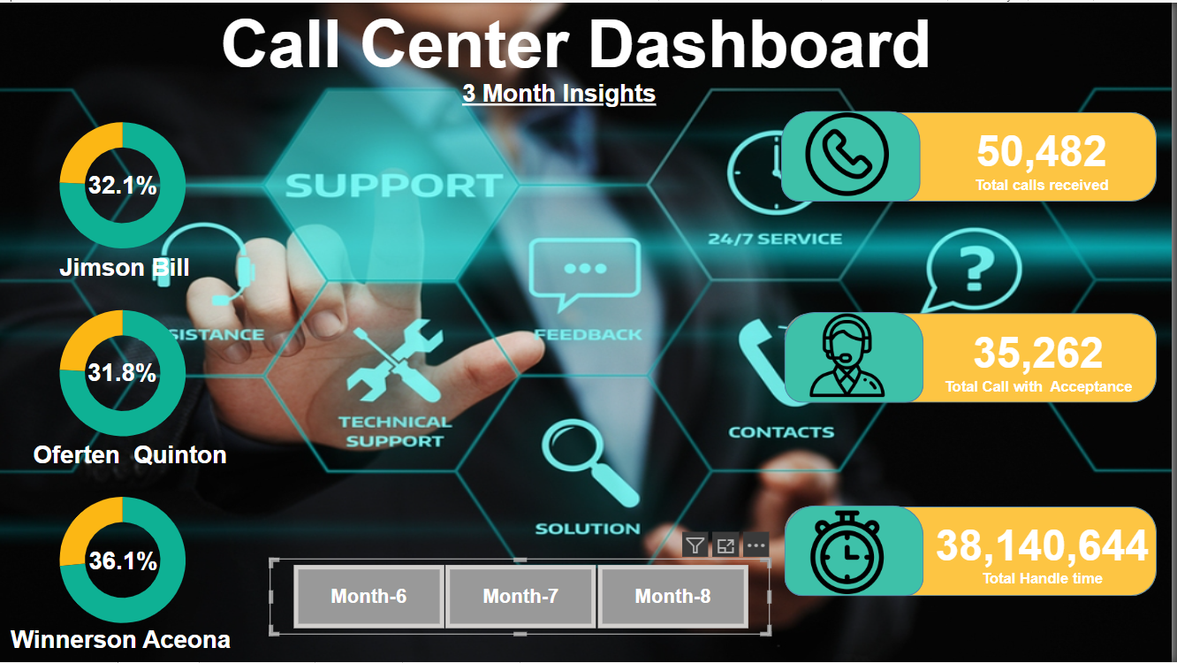

Slide 3
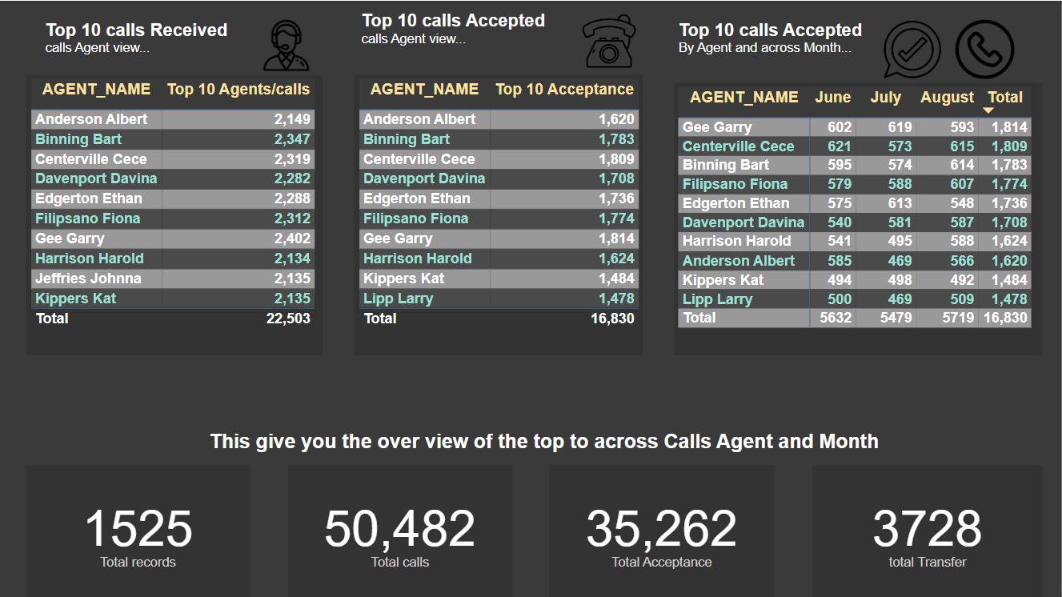

Slide 4
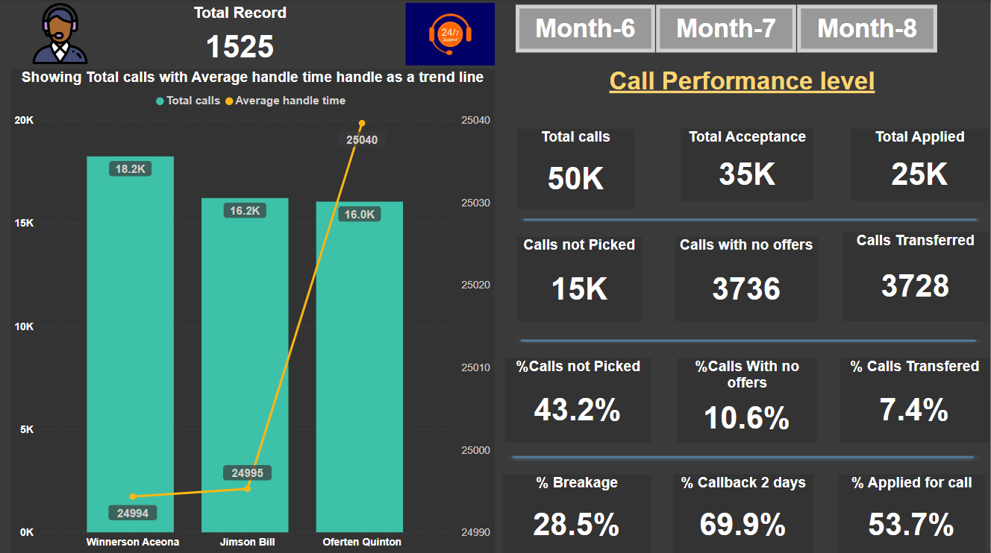

Slide 5
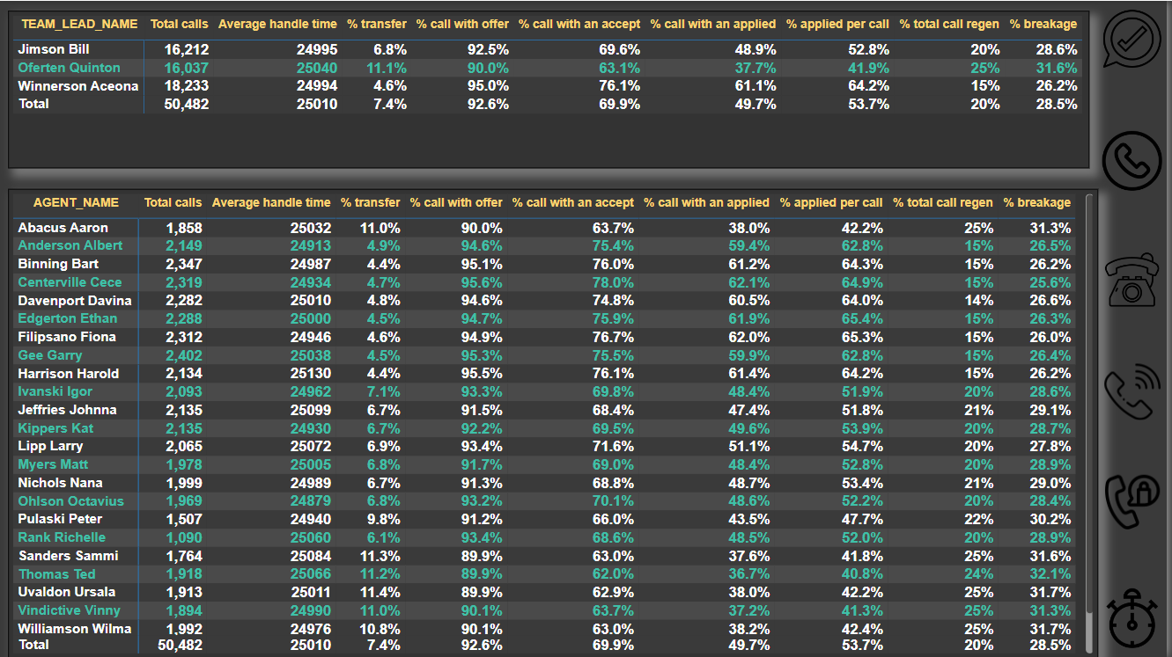

Slide 6
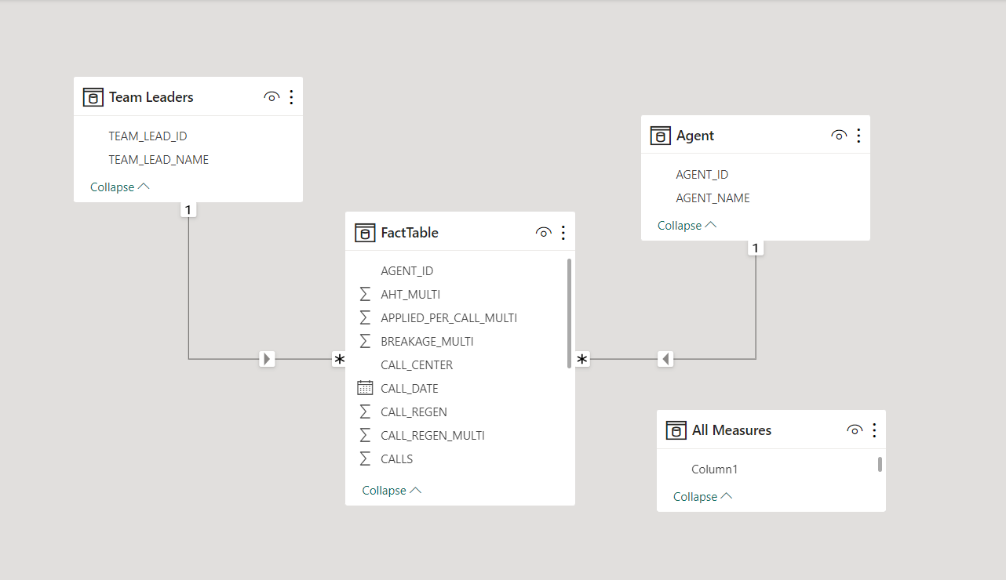

Slide 7
Total calls Received:
50,482
Launch Power BI Desktop.
In the Home tab, click on "Get Data" to open the "Get Data" dialog.
In the "Get Data" dialog, choose the appropriate data source. If your data is stored in a database, select the corresponding database source (e.g., SQL Server, Excel, CSV, etc.). After selecting the source, connect to your data.
In the "Navigator" dialog that appears, select the three tables you want to import: Fact Table, Team Leader, and Agent Table. Configure the connection details, such as the server name and credentials, if required by your data source.
After selecting the tables, a preview of the data will be displayed. Verify that the data appears correctly, and click "Load" to import the data into Power BI Desktop.
The Fact Table contains the following columns: Agent ID, AHT Multi, Applied per Call Multi, Breakage Multi, Call Center, Call Date, Call Regen, Call Regen Multi, Calls, Calls Offer Applied, Calls with Accept, Calls with Offer, Handle Time, Month Name, Team Lead ID, Transfers, Transfer Multi, Year Number, etc.
The Team Leader table contains the following columns: Team Lead ID, Team Lead Name.
The Agent table contains the following columns: Agent ID, Agent Name.
Total calls with Acceptance:
35,262
Total Handle time:
38,140,644
Total Transfer:
3728
Total Applied:
25K

Slide 8
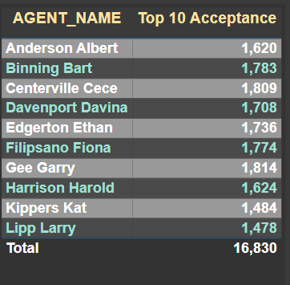
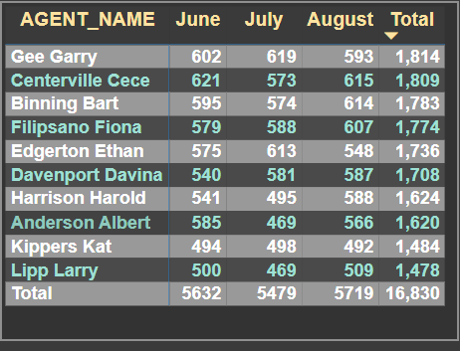
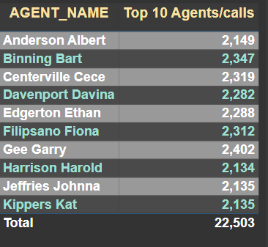
The chart displays the top 10 agents by the total number of calls. The total number of calls is 50,482, and the top 10 agents accounted for 22,503 of these calls. The agent with the highest number of calls from the client is Gee Garry, with a total of 2,402 calls. In the second position is Binning Bart, who received 2,347 calls from the client. Third on the list is Centerville CeCe, with 2,319 calls from the client.
The chart displays the top 10 agents by the total number of acceptances. The total number of acceptances is 35,262, and the top 10 agents accounted for 16,830 of these acceptances. The agent with the highest number of acceptances from clients is Gee Garry, who received 1,814 acceptances. In the second position is Centerville CeCe, with a total of 1,809 acceptances from clients. Third on the list is Binning Bart, with 1,783 accepted calls from clients.
In this chart, we have the total acceptances by agent name for the months of June, July, and August. The overall total of acceptances is 16,830. In June, the total acceptances amount to 5,632, in July, the total is 5,479, and in August, it reaches 5,719.
In the month of August, the agent accepted more calls compared to June and July.

Slide 9
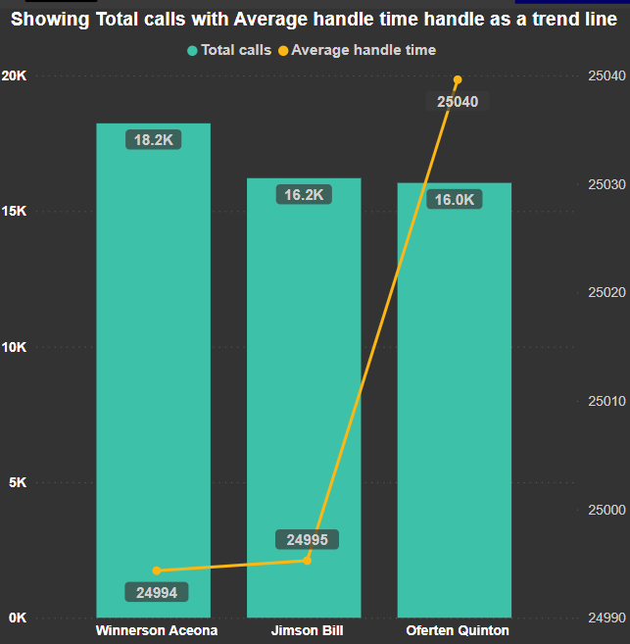
In this chart, we are displaying the total number of calls and the average handle time by agent. The agent with the highest number of calls from clients is Winnerson Aceona , with a total of 18.2K calls. However, their average handle time is lower compared to other agents, with a value of 24,994. The second agent, Jimson Bill, received 16.2K total calls, with an average handle time of 2,995. The last agent, Oferten Quinton, received fewer calls from clients, with a total of 16K, but their average handle time is higher compared to other agents, with a value of 25,040.

Slide 10
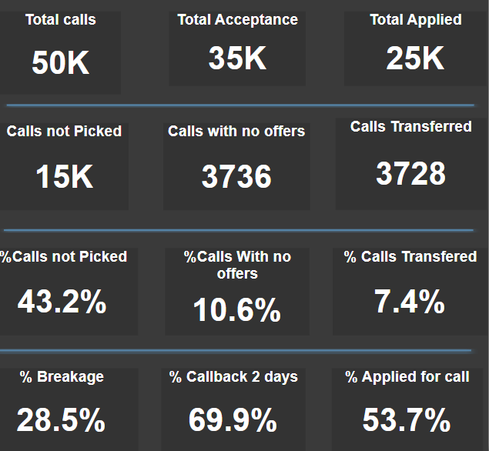
In the card visual, we are displaying the following key metrics: total calls, total acceptances, total applied, calls not picked, calls with no offer, calls transferred, percentage of calls not picked, percentage of calls with no offers, percentage of calls transferred, percentage of breakage, percentage of callbacks within 2 days, and percentage applied for calls.

Slide 11
Recommendations for improving call center operations include:
Quality Assurance and Training:
Implement a robust quality assurance program to monitor and evaluate calls.
Provide ongoing training and coaching to agents to improve their skills.
Offer regular feedback and recognition for good performance.
Efficient Call Routing:
Optimize call routing to ensure calls are directed to the most appropriate agents.
Implement Interactive Voice Response (IVR) systems to handle routine inquiries and direct calls effectively.
Customer Feedback:
Gather and analyze customer feedback to understand pain points and areas for improvement.
Use feedback to refine processes and procedures.
Performance Metrics:
Define and track key performance indicators (KPIs) to assess call center performance.
Metrics may include Average Handling Time (AHT), First Call Resolution (FCR), and Customer Satisfaction (CSAT).
Workforce Management:
Efficiently schedule and allocate staff based on call volume patterns.
Balance staffing to ensure agents are available during peak call times.
Technology and Tools:
Invest in modern call center software and tools for call recording, analytics, and CRM integration.
Implement chatbots and virtual assistants to handle routine queries.
Empower Agents:
Equip agents with knowledge bases and scripts for consistent and accurate responses.
Provide agents with the authority to resolve customer issues without excessive escalations.

Slide 12
8.Multi-Channel Support:
Offer support through various channels, including phone, email, chat, and social media.
Ensure consistency in service quality across all channels.
9.Data Analysis:
Use data analytics to identify trends and patterns in customer inquiries.
Make data-driven decisions to enhance service.
10.Employee Well-Being:
Prioritize employee well-being and work-life balance to reduce agent turnover.
Create a positive work environment and offer growth opportunities.
11.Disaster Recovery and Redundancy:
Develop a disaster recovery plan to ensure business continuity in case of system failures or emergencies.
12.Compliance and Security:
Ensure compliance with data protection regulations and maintain stringent security measures to protect customer data.
13.Continuous Improvement:
Foster a culture of continuous improvement. Regularly review processes and make necessary adjustments.
14.Predictive Analytics:
Use predictive analytics to forecast call volumes and allocate resources effectively.
15.Customer Self-Service:
Promote customer self-service options like FAQs and online resources to reduce call volume.

Slide 13

Thanks You
If you want to view my live dashboard, please click on the 'Live Dashboard' link below:
Live Dashboard

