Slide 1
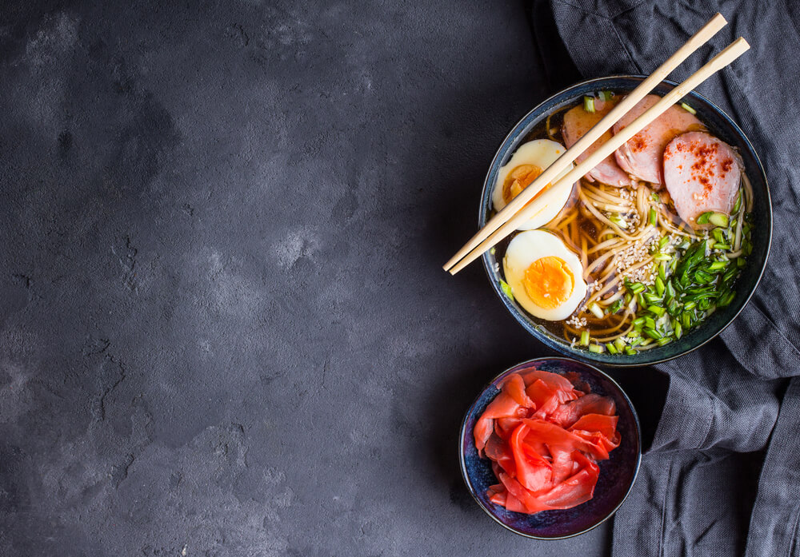
DANNY’S DINER
THE TASTE OF SUCCESS
Jnanaranjan Pradhan

Slide 2

Contents:
1.About us
2.Problem statement
3.Datasets
4.Insights and Questions
5.Conclusion

Slide 3
About Us:
Danny seriously loves Japanese food so in the beginning of 2021, he decides to embark upon a risky venture and opens up a cute little restaurant that sells his 3 favorite foods: sushi, curry and ramen.
Danny’s Diner is in need of your assistance to help the restaurant stay afloat - the restaurant has captured some very basic data from their few months of operation but have no idea how to use their data to help them run the business.

Slide 4
Problem statement
Danny wants to use the data to answer a few simple questions about his customers, especially about their visiting patterns, how much money they’ve spent and also which menu items are their favorite. Having this deeper connection with his customers will help him deliver a better and more personalized experience for his loyal customers.
He plans on using these insights to help him decide whether he should expand the existing customer loyalty program - additionally he needs help to generate some basic datasets so his team can easily inspect the data without needing to use SQL.
Danny has provided you with a sample of his overall customer data due to privacy issues - but he hopes that these examples are enough for you to write fully functioning SQL queries to help him answer his questions.

Slide 5
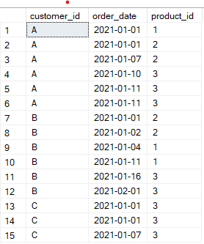
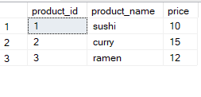
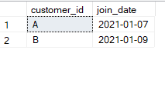
Datasets
Danny has shared with you 3 key datasets for this case study:
.Sales
.Menu
.Members
CREATE TABLE sales ( "customer_id" VARCHAR(1), "order_date" DATE, "product_id" INTEGER );

Slide 6
CREATE TABLE menu ( "product_id" INTEGER, "product_name" VARCHAR(5), "price" INTEGER );
CREATE TABLE members ( "customer_id" VARCHAR(1), "join_date" DATE );
Select * from sales
Select * from Menu
Select * from Members

Slide 7
Insights and Questions
What is the total amount each customer spent at the restaurant?
How many days has each customer visited the restaurant?
What was the first item from the menu purchased by each customer?
What is the most purchased item on the menu and how many times was it purchased by all customers?
Which item was the most popular for each customer?
Which item was purchased first by the customer after they became a member?
Which item was purchased just before the customer became a member?
What is the total items and amount spent for each member before they became a member?
If each $1 spent equates to 10 points and sushi has a 2x points multiplier - how many points would each customer have?
In the first week after a customer joins the program (including their join date) they earn 2x points on all items, not just sushi - how many points do customer A and B have at the end of January?

Slide 8
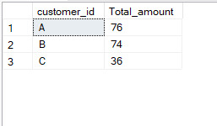
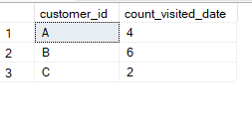
1.What is the total amount each customer spent at the restaurant ?
select
s.customer_id,sum(m.price) as Total_amount
from sales as s inner join menu as m on
s.product_id=m.product_id
group by s.customer_id;
2. How many days has each customer visited the restaurant?
select
customer_id,
count( distinct order_date) as count_visited_date
from sales group by customer_id

Slide 9
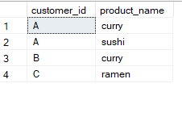
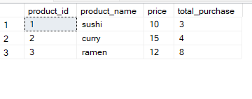
3. What was the first item from the menu purchased by each customer?
with c as
(select
customer_id,order_date,m.product_id,m.product_name,
min(order_date) over(partition by customer_id) as
min_date
from sales as s inner join menu as m on s.product_id=m.product_id)
select customer_id,product_name from c where
order_date= min_date
group by customer_id,product_name
4. What is the most purchased item on the menu and how many times was it purchased by all customers?
select
s.product_id,product_name,price,
count(s.product_id) total_purchase
from sales s inner join menu m
on s.product_id=m.product_id
group by s.product_id,product_name,price

Slide 10
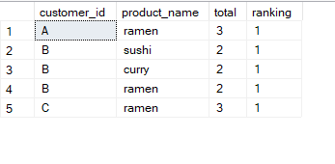

5. Which item was the most popular for each customer?
with cte as
(select s.customer_id,m.product_name,count(*) total
from sales as s inner join menu as m on s.product_id=m.product_id
group by customer_id,product_name)
,final as
(select customer_id,product_name,total,
rank() over(partition by customer_id order by total desc )as ranking from cte)
select * from final where ranking=1;
6.Which item was purchased first by the customer after they became a member
with final as
(selects.* ,m.customer_id as custid,m.join_date,
rank() over(partition by s.customer_id order by order_date) as ranking,e.product_name
from sales as s left join members as m on s.customer_id=m.customer_id
join menu as e on s.product_id=e.product_id
where s.order_date>=m.join_date)
select customer_id,product_name,ranking from final where ranking=1

Slide 11
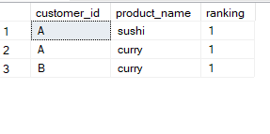
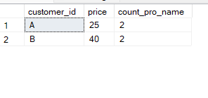
7.Which item was purchased just before the customer became a member
with cte as
(select
s.* ,m.customer_id as custid,m.join_date,
rank() over(partition by s.customer_id order by order_date) as ranking,
e.product_name
from sales as s left join members as m on s.customer_id=m.customer_id
join menu as e on s.product_id=e.product_id
where s.order_date<m.join_date)
select customer_id,product_name,ranking from cte where ranking=1
8. What is the total items and amount spent for each member before they became a member
with cte as
(select s.customer_id,s.order_date,m.join_date,e.price ,e.product_name
from sales as s left join members as m on s.customer_id=m.customer_id
join menu as e on s.product_id=e.product_id
where s.order_date<m.join_date)
select customer_id,sum(price) as price,count(distinct product_name)as count_pro_name from cte group by customer_id

Slide 12
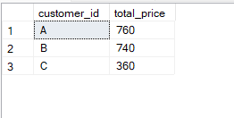
9. f each $1 spent equates to 10 points and sushi has a 2x points multiplier - how many points would each customer have?
with cte as
(select s.customer_id,s.order_date,e.product_name,e.price,
case when product_name='suchi' then 2*e.price else e.price end as newprice
from sales as s
inner join menu as e on s.product_id=e.product_id)
select customer_id,sum(newprice)*10 as total_price from cte group by customer_id

Slide 13
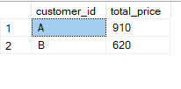
10.In the first week after a customer joins the program (including their join date) they earn 2x points on all items, not just sushi - how many points do customer A and B have at the end of January?
with cte as
(select s.customer_id,s.order_date,e.product_name,e.price,
case when product_name='suchi' then 2*e.price
when s.order_date between m.join_date and m.join_date then 2*e.price
else e.price end as newprice
from sales as s
inner join menu as e on s.product_id=e.product_id
join members as m on s.customer_id=m.customer_id
where s.order_date<='2021-01-31')
select customer_id,sum(newprice)*10 as total_price from cte group by customer_id

Slide 14
Conclusion:
1. Customer A spent more (76) followed by B(74) and C (36). This makes Customer A the most valuable customer at the moment. 2. B had the most visits (6) while C had the least visits (2). 3.Customer A first orders are curry and sushi, Customer B’s first order is curry, and Customer C’s first order is ramen. 4. With 8 purchases, ramen is the most purchased item. 5. Customer’s favorite item is ramen. 6. After becoming members, Customer A ordered curry and Customer B ordered sushi. 7. Just before becoming a member, Customer A bought sushi and curry while Customer B bought sushi. 8. Before becoming member, Customer A had spent 25 on 2 items and Customer B, 40 on 2 items. 9. A got 760 points, B got 740 points and C got 360 points. 10. A got 910 points and B got 620 points.

