Slide 1

Employee Management
Dashboard
Employee Management
Dashboard
Domain : Employee management system
Designed & Presented By
Jnanaranjan Pradhan (Data Analyst)

Slide 2
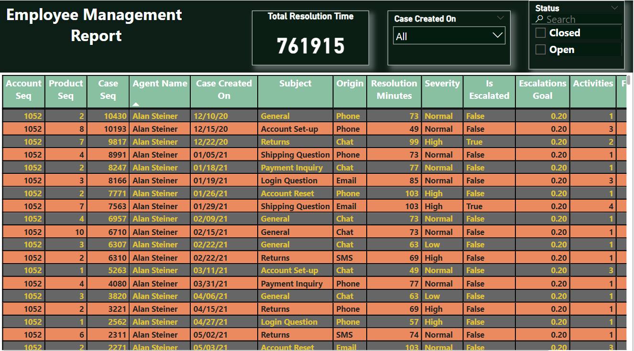

Slide 3
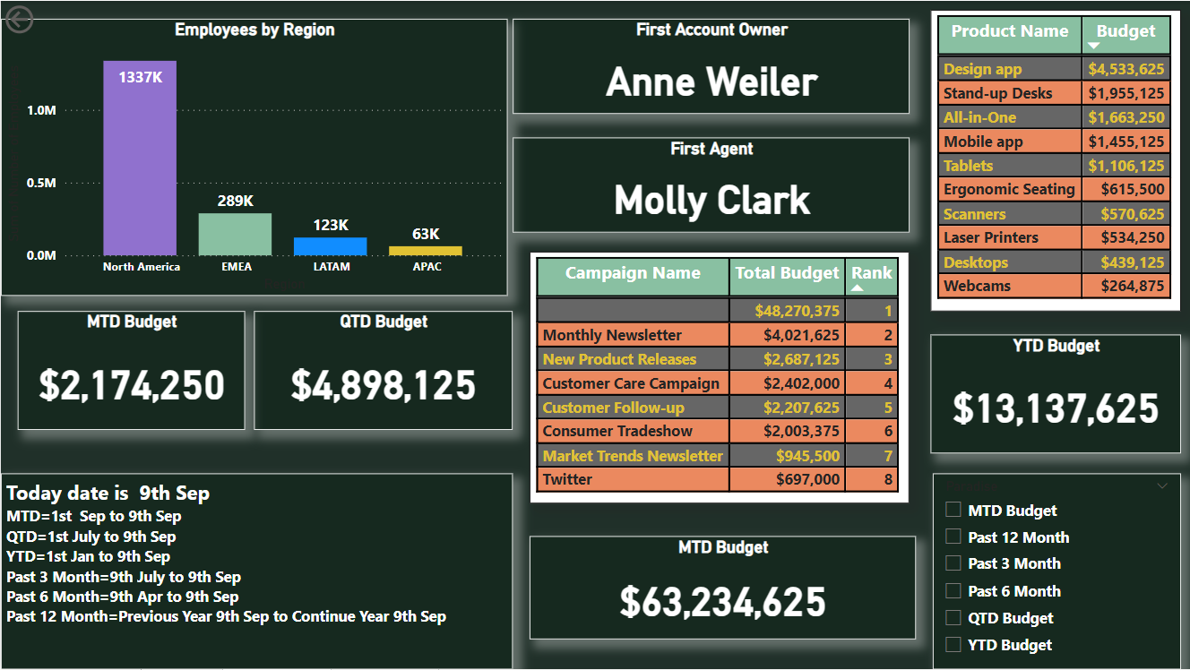

Slide 4
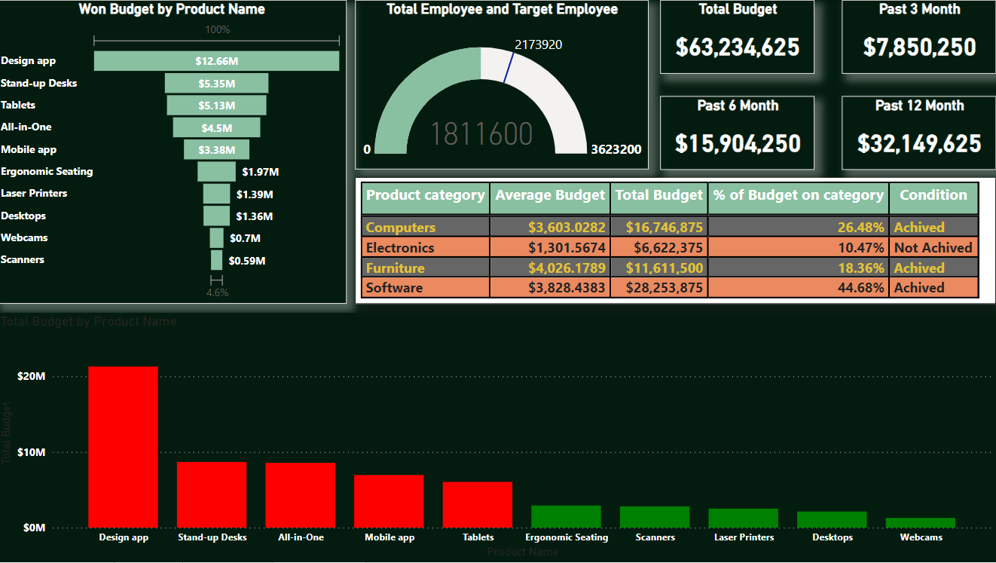

Slide 5
Total Budget:
$ 63,234,625
Total Budget Past 3 Month:
$ 7,850,250
Total Budget Past 6 Month:
$15,904,250
Total Budget Past 12 Month:
$32,149,625

Slide 6
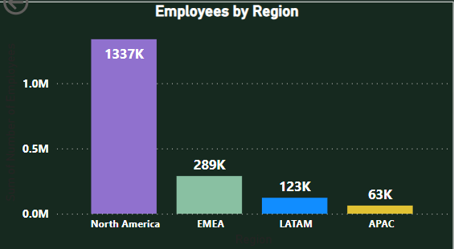
1.In North America, there are more employees compared to other regions. The total number of employees in that region is 1,337,000.
2. In the EMEA region, there are 289,000 employees. In the LATAM region, there are 123,000 employees. In the APAC region, there are 63,000 employees.
3. In the APAC region, there are fewer employees.

Slide 7
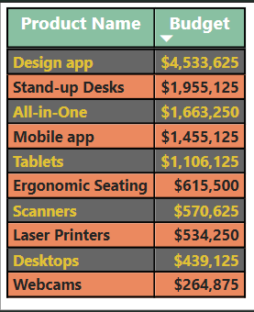
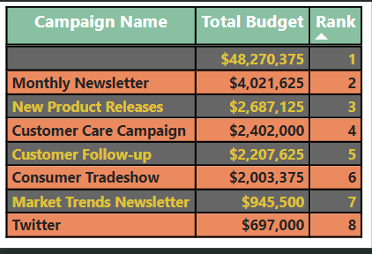
1.Based on the campaign name, we have determined the total budget and ranked them according to the total budget.
2.Another campaign has earned a higher budget compared to the others; its budget is $48,270,375.
3.On the Twitter campaign side, the budget is lower compared to the other campaign; its budget is $697,000.
1.We have determined the total budget based on the product name.
2.The "Design" product earns a higher budget compared to the other product names, while the "Webcams" product earns a lower budget compared to the others.

Slide 8
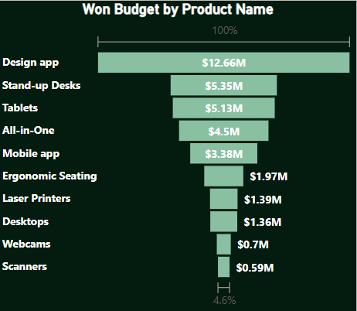
1.We have determined the total budget based on the product name, and its status is "Won".
2.In this case, the "Design" app earns a higher budget compared to the other product names, while "Webcams" and "Scanner" earn less budget compared to the others.

Slide 9
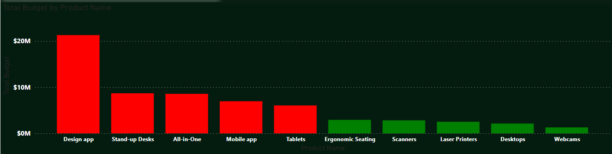
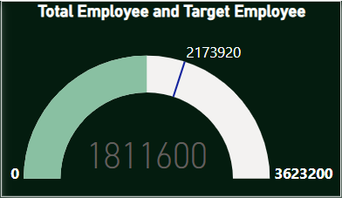
1.We have determined the total budget based on the product name.
2.The "Design" product earns a higher budget compared to the other product names, while the "Webcams" product earns a lower budget compared to the others.
In this diagram, we are displaying whether the total number of employees has reached their target budget or not. We can observe that the total number of employees has not reached its target value.

Slide 10
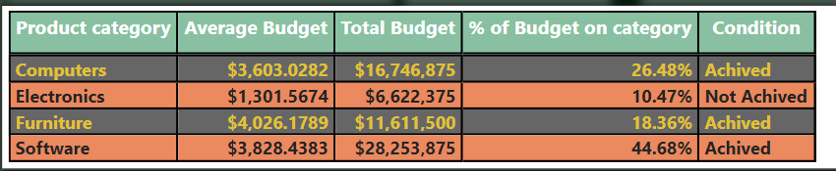
1.We have calculated the average budget, total budget, and the percentage of the budget based on product category and condition
2.The "Furniture" product has earned a higher average budget, while the "Electronics" product has a lower average budget compared to other products.
3.The "Software" product has earned a higher budget, while the "Electronics" product has a lower budget compared to other products. When calculating the percentage based on the budget within the product category, "Software" has 44.68%, which is higher, whereas "Electronics" has 10.36%, which is lower.

Slide 11
Recommendation to improve Budget:
To provide recommendations for improving the budget for an Employee Management System (EMS), you may consider the following points:
Cost-Benefit Analysis: Conduct a thorough cost-benefit analysis to identify areas where investments in the EMS can yield the highest returns. Assess the potential savings in terms of time, resources, and efficiency improvements.
Customization: Ensure that the EMS is tailored to meet the specific needs of your organization. Customization can eliminate unnecessary features and optimize the system's performance.
Training and User Adoption: Invest in comprehensive training for employees who will use the EMS. Improved user adoption can lead to better utilization of the system's capabilities, thereby maximizing its value.
Data Analytics: Leverage data analytics within the EMS to gain insights into workforce trends, productivity, and areas for improvement. Informed decision-making can lead to cost savings and increased efficiency.
Integration: Integrate the EMS with other relevant systems (e.g., payroll, time tracking, performance management) to eliminate duplicate data entry and streamline processes.
Vendor Negotiations: If you're working with a third-party EMS vendor, negotiate pricing and licensing terms. Explore options for volume discounts, long-term contracts, or flexible payment structures.
Cloud-Based Solutions: Consider transitioning to a cloud-based EMS if you haven't already. Cloud solutions often offer cost savings through reduced infrastructure and maintenance

Slide 12
8.Regular Audits: Conduct periodic audits of your EMS usage to identify unused or underutilized features. Eliminate or optimize such features to reduce costs.
9.Scalability: Ensure that the EMS can scale with your organization's growth. Investing in a scalable solution can prevent the need for costly upgrades or replacements in the future.
10.Feedback and Continuous Improvement: Encourage feedback from users and stakeholders to identify pain points and areas where the EMS can be improved. Implement continuous improvement processes to refine the system over time.
12.Security Measures: Invest in robust cybersecurity measures to protect employee data within the EMS. Security breaches can result in significant financial losses and reputation damage.
13.Compliance: Ensure that your EMS complies with relevant data privacy and labor regulations. Non-compliance can lead to fines and legal expenses.
14.Vendor Comparison: If you're considering a new EMS or switching vendors, compare options carefully. Look at not only the initial cost but also long-term maintenance and support fees.
15.Total Cost of Ownership (TCO): Calculate the TCO of the EMS, including initial implementation, ongoing maintenance, and support costs. This will give you a clearer picture of the budget required.
16.ROI Tracking: Continuously monitor and measure the return on investment (ROI) of your EMS. This helps in assessing the actual value the system provides and justifies the budget allocation.

Slide 13
Thanks You
If you want to view my live dashboard, please click on the 'Live Dashboard' link below:
Live Dashboard

