Slide 1
Fleet Management
Dashboard
Domain : Transportation and Logistics
Designed & Presented By
Jnanaranjan Pradhan (Data Analyst)

Slide 2
Business Model:
A fleet management system (FMS) is a comprehensive software and hardware solution used by businesses and organizations to efficiently manage and monitor their fleet of vehicles, assets, or equipment. It encompasses a range of functions and features aimed at improving fleet operations, reducing costs, enhancing safety, and ensuring compliance with regulatory requirements. Here are some key components and capabilities of a typical fleet management system:
Vehicle Tracking: FMS uses GPS technology to provide real-time tracking of vehicles' locations. This enables fleet managers to monitor the movement of vehicles, improve route planning, and respond quickly to emergencies.
Telematics Data: The system collects data from onboard sensors and devices, such as vehicle speed, fuel consumption, engine diagnostics, and driver behavior (e.g., speeding, harsh braking). This data helps in optimizing fleet performance and maintenance
Route Optimization: FMS offers tools for optimizing routes, which can reduce fuel consumption, minimize driving time, and improve delivery efficiency.
Maintenance Management: The system schedules and tracks vehicle maintenance based on usage or time intervals. It provides alerts for routine servicing, helping prevent breakdowns and prolonging the lifespan of vehicles.
Driver Behavior Monitoring: FMS tracks and reports on driver behavior, promoting safer driving practices and reducing the risk of accidents. This can include monitoring for speeding, harsh braking, and excessive idling.

Slide 3
6.Fuel Management: FMS helps control fuel costs by monitoring fuel consumption and identifying instances of fuel theft or inefficiency
7.Inventory and Asset Management: For businesses that transport goods or manage assets, FMS can track cargo or asset status, temperature (for perishable goods), and inventory levels.
8.Reporting and Analytics: Fleet managers can generate reports and analyze historical data to identify trends, make informed decisions, and optimize operations. Common reports include cost analysis, driver performance, and vehicle utilization.
9.Compliance and Regulatory Reporting: FMS helps ensure compliance with various regulations and standards, such as hours of service (HOS) logging for drivers, emissions reporting, and safety standards.
10.Geofencing: Create virtual geographic boundaries (geofences) and receive alerts when vehicles enter or exit predefined areas.
11.Driver Behavior Monitoring: FMS tracks and reports on driver behavior, promoting safer driving practices and reducing the risk of accidents. This can include monitoring for speeding, harsh braking, and excessive idling.
12.Security: FMS includes security features to protect sensitive data, prevent unauthorized access, and secure communication between vehicles and the system.
13.Alerts and Notifications: Real-time alerts and notifications are sent to fleet managers for critical events, such as accidents, breakdowns, or unauthorized vehicle use.
Integration: Many FMS platforms can integrate with other business systems, such as accounting, payroll, or customer relationship management (CRM) software.
Fleet management systems are used in various industries and sectors, including logistics, transportation, delivery services, construction, agriculture, and public transportation

Slide 4
Tools used:
Power BI Desktop
SQL
Excel
Dax Studio(For Report Optimization)
CHATGPT & Google
PowerPoint
"Adobe.color.com " for choosing color
"flaticon.com" for choosing the icon.
Transportation and Logistics contain all the meta information or tables those are
1.Dim_customers
2.Dim_Drivers
3.Dim_Vehicles
4.FactTable_freight
5.FactTable_KMTravelled
6.States
7.DateTable

Slide 5
Column Description for Dim_customers :
Dim_Customers contains the following columns: Customer ID, City, Latitude, Longitude, and State ID..
Column Description for Dim_Drivers :
Dim_Drivers contains the following columns : Driver id and Driver .
Column Description for Dim_Vehicles :
Dim_Vehicles contains the following columns : Truck id , plate , Brand ,Truck Type , Trailer Type , year .
Column Description for FactTable_freight :
FactTable_freight contains the following columns : Date , Customer id, Truck id , invoice number , Freight id ,city , Net Revenue ,Weight(Kg) ,Weight(cubic), Good value .
Column Description for FactTable_KMTravelled :
FactTable_KMTravelled contains the following columns : Date ,Truck id, Drive id , KM travelled ,Liters , Fuel ,Maintenance , Fixed cost .
Column Description for States :
States contains the following columns : fullname ,Abbreviation , state id .
Column Description for DateTable :
DateTable contains the following columns : Date, Month,Month Number, Year, Quarter , Day name ,Days.
:

Slide 6
Data Loading and Power Query Documentation :
here are the general steps to follow when working with data loading and Power Query:
1. Determine Your Data Source : Identify the source(s) of your data. This could be a database, Excel file, CSV file, web service, or other data repositories.
2. Open Power Query:
Depending on your software, open Power Query. In Microsoft Excel, you can find it under the "Data" tab. In Power BI Desktop, it's typically in the "Home" tab.
3. Connect to Data Source :
Use Power Query to connect to your data source(s). This may involve providing connection details, credentials, or selecting files.
4. Data Import :
After connecting to your data source, you'll typically see a preview of the data. Select the tables or data you want to import into your Power Query environment.
5. Data Transformation:
Apply transformations to your data as needed. This can include:
Cleaning and formatting data.
Renaming columns.
Filtering rows.
Calculating new columns using formulas.
Joining or merging multiple tables.
Pivoting or unpivoting data.
Handling missing values.
Applying custom transformations using M or Power Query formula language.

Slide 7
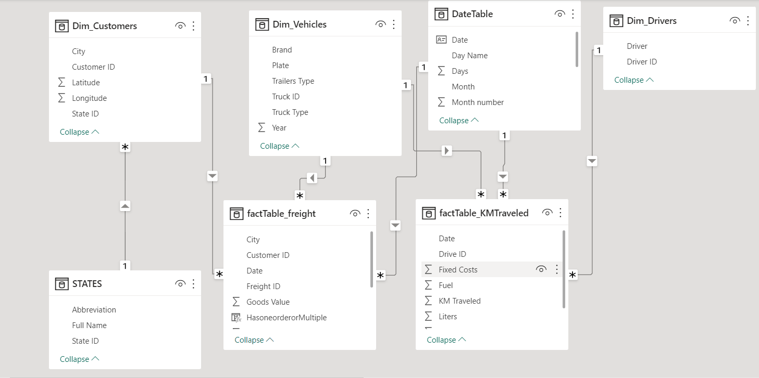
Model View:

Slide 8
Company important KPI:
1.All Liters consumed
Total liters:
Total liters consumed = SUM(factTable_KMTraveled[Liters])2.Total Drivers
Total Driver:
Total Driver = COUNT(Dim_Drivers[Driver ID])
3.Total Kilometer Traveled
total kilometer travelled by truck
Total KM Travelled = SUM(factTable_KMTraveled[KM Traveled])
4.Total fix cost
Total Fixed costs:
Total fix cost = SUM(factTable_KMTraveled[Fixed Costs])
5.Total Fuel consumed
Total Fuel:
Total Fuel consumed = SUM(factTable_KMTraveled[Fuel])
6.Maintenance Cost
Total Maintenace:
Total Maintenace cost = SUM(factTable_KMTraveled[Maintenance])

Slide 9
To create Date table:
DateTable=
ADDCOLUMNS(
CALENDARAUTO(),
"Month",FORMAT([Date],"MMM"),
"Month number",MONTH([Date]),
"Year",YEAR([Date]),
"Quarter","Q" & FORMAT([Date],"Q"),
"Day Name",FORMAT([Date],"ddd"),
"Days",1)
Drivers KPI:
1.Average Speed
Driver avg. speed =
DIVIDE([Total KM Travelled],[Total Driver],0)
2.Average Fuel Efficiency
Avg. fuel Efficiency =
DIVIDE([Total KM Travelled],[Total liters consumed],0)
3.Fuel consumption per Kilometer
Total Fuel consumption per KM =
DIVIDE([Total liters consumed],[Total KM Travelled],0)

Slide 10
4.Fuel Cost per Kilometer :
Fuel cost per KM =
DIVIDE([Total Fuel consumed],[Total KM Travelled],0)
This Dax expression calculate the sum of the values in the "weight(kg)" column of the factTable_freight table.It adds all the individual weight of different shipment or greight items and divides the sum of the weight by 1000.since 1 metrics ton is equal to 1000 kilograms,dividing the sum by 1000 converts the total weight from kilograms to metrics tons.
1.Total Weight(Tons) = SUM(factTable_freight[Weight (Kg)])/1000
2.Total Weight(cubic) = SUM(factTable_freight[Weight (Cubic)])
3.Total Revenue = SUM(factTable_freight[Net Revenue])
4.Total Goods Value = SUM(factTable_freight[Goods Value])
5.Total Deliver Orders = DISTINCTCOUNT(factTable_freight[Invoice Number])
This DAX expression calculates the previous year's revenue and current year's revenue, then finds the growth compared to the previous year.
1.(%) YoY Growth Revenue =
var currentyearRevenue=[Total Revenue]
var PreviousyearRevenue=CALCULATE([Total Revenue],SAMEPERIODLASTYEAR(DateTable[Date]))
return
DIVIDE(currentyearRevenue-PreviousyearRevenue,PreviousyearRevenue,0)

Slide 11
2.(%) YoY Growth Goods Value =
var currentyearGV=[Total Goods Value]
var PreviousyearGV=CALCULATE([Total Goods Value],SAMEPERIODLASTYEAR(DateTable[Date]))
return
DIVIDE(currentyearGV-PreviousyearGV,PreviousyearGV,0)
3.(%) YoY Growth Weight Tons =
var currentyearWT=[Total Weight(Tons)]
var PreviousyearWT=CALCULATE([Total Weight(Tons)],SAMEPERIODLASTYEAR(DateTable[Date]))
return
DIVIDE(currentyearWT-PreviousyearWT,PreviousyearWT,0)
4.(%) YoY Growth Weight cubic =
var currentyearWC=[Total Weight(cubic)]
var PreviousyearWC=CALCULATE([Total Weight(cubic)],SAMEPERIODLASTYEAR(DateTable[Date]))
return
DIVIDE(currentyearWC-PreviousyearWC,PreviousyearWC,0)

Slide 12
5.(%) YoY Growth Deliver order =
var currentyearDO=[Total Deliver Orders]
var PreviousyearDO=CALCULATE([Total Deliver Orders],SAMEPERIODLASTYEAR(DateTable[Date]))
return
DIVIDE(currentyearDO-PreviousyearDO,PreviousyearDO,0)
The Dax expression "HasMultipleTransction" is a calculated column that evaluates wheather a customer in the 'factTable_freight' table has multiple transction or not.
1.HasoneorderorMultiple =
IF(
CALCULATE(COUNTROWS(factTable_freight),ALLEXCEPT(factTable_freight,factTable_freight[Customer ID]))>1,
"Yes",
"No")
2.Customer with Multiple orders =
CALCULATE(COUNT(factTable_freight[HasoneorderorMultiple]),
factTable_freight[HasoneorderorMultiple]="Yes")
3.Customer with One orders =
CALCULATE(COUNT(factTable_freight[HasoneorderorMultiple]),
factTable_freight[HasoneorderorMultiple]="No")

Slide 13
4.% of Repeat Customers=
DIVIDE([Customer with Multiple orders],[Customer with Multiple orders]+[Customer with One orders],0)
5.% of OneTime Customers =
DIVIDE([Customer with One orders],[Customer with Multiple orders]+[Customer with One orders],0)
6.Full state1 =
LOOKUPVALUE(STATES[Full Name],STATES[State ID],Dim_Customers[State ID])

Slide 14
Key Insights
If customers with multiple orders are higher than customers with single orders in the dataset, it includes that there is significant portion of repeat customers or loyal customers who are placing
multiple orders . This can be a positive sign for the business, as it suggests that the company is able to retain customers and generate repeat business . Here are some recommendations based on this observation.
1.Customer Retention Strategies :Since there is a notable number of customers placing multiple orders ,focus on Customer Retention Strategies .Implement loyalty programs,personalized communication and excellent customer service to encourage repeat purchases maintain customer loyalty.
2.Upselling and Cross-selling Opportunities : Leverage the fact that customer are placeing multiple orders to identify Upselling and Cross-selling Opportunities. Analyse the purchases patterns of the customer and recommend relevant product and service to increase their average order value.
3.Customer Engagement: Engage with customers regularly through email campaigns, newsletters, or social media. Keeping customers informed about new products, promotions, and updates can increase the likelihood of repeat purchases.
4.Feedback and Reviews: Encourage customers to leave feedback and reviews after each purchase. Positive reviews and feedback can attract new customers and boost customer loyalty.
5.Targeted Marketing: Segment customers based on their purchase history and behavior. Use targeted marketing campaigns to offer personalized promotions and incentives to encourage repeat purchases.

Slide 15
6.Customer Journey Analysis: Analyze the customer journey from the first purchase to subsequent orders. Identify any potential roadblocks or pain points in the process and work on improving the overall customer experience.
7.Customer Support: Provide excellent customer support to address any issues or concerns promptly. Satisfied customers are more likely to come back for future purchases. Check grammar.
8.Referral Programs: Encourage satisfied customers to refer friends and family to your business. Offer incentives for successful referrals to expand your customer base.
9.Competitor Analysis: Keep an eye on the competition and understand why customers are choosing your business over competitors. Use this knowledge to further enhance your offerings.
By focusing on customer retention, encouragement, and satisfaction, the business can capitalize on the higher number of customers with multiple orders and build a strong and loyal customer base, leading to long-term growth and success.

Slide 16

Thanks You
If you want to view my live dashboard, please click on the 'Live Dashboard' link below:
Live Dashboard

