Slide 1

Domain : Human Resources
Designed & Presented By
Jnanaranjan Pradhan (Data Analyst)

Slide 2

Business Model:
Human Resources (HR) is a crucial function within organizations that deals with managing the human capital of the company. HR professionals are responsible for various aspects of employee management, recruitment, training, and ensuring that the organization complies with labor laws and regulations. Here are some key aspects of HR:
>Recruitment and Selection: HR is responsible for finding, attracting, and hiring the right talent for the organization. This includes creating job descriptions, posting job ads, conducting interviews, and making job offers.
>Onboarding: Once employees are hired, HR assists in the onboarding process, which involves introducing new employees to the company culture, policies, procedures, and their job responsibilities.
Employee Relations: HR plays a critical role in managing employee relations. This includes addressing workplace conflicts, mediating disputes, and ensuring a positive work environment.
Training and Development: HR is responsible for identifying training needs, creating training programs, and facilitating professional development opportunities for employees to enhance their skills and knowledge.
Compensation and Benefits: HR manages the compensation and benefits packages for employees. This includes determining salaries, administering benefits like health insurance and retirement plans, and ensuring compliance with wage and hour laws.

Slide 3
Performance Management: HR oversees performance appraisal processes, sets performance goals, and provides feedback to employees. They also play a role in performance improvement plans and employee recognition programs.
Compliance: HR ensures that the organization complies with labor laws, regulations, and employment standards. This involves staying up-to-date with changing laws and advising the organization on compliance matters
Employee Engagement: HR works to create a positive workplace culture that fosters employee engagement, motivation, and satisfaction. This may involve organizing events, surveys, and programs to boost morale and teamwork.
Talent Management: HR professionals develop strategies for talent retention, succession planning, and career progression within the organization. This helps in identifying and nurturing future leaders.
HR Technology: In the modern era, HR often relies on technology for various functions, including applicant tracking systems, payroll software, and employee self-service portals.
Health and Safety: HR is involved in creating and implementing workplace safety programs and policies to protect the health and well-being of employees.

Slide 4
Tools used:
Power BI Desktop
SQL
Excel
Dax Studio(For Report Optimization)
CHATGPT & Google
PowerPoint
"Adobe.color.com " for choosing color
"flaticon.com" for choosing the icon.

Slide 5
HR Dashboard contain the following tables:
HR Analytics csv File:
We first import the HR Analytics CSV file into Power Query. We use the 'Split Column' function, set the first row as the header, and utilize the 'Detect Data Type' option to clean the table.
This table contain the following columns:Age,Attrition,BusinessTravel,DailyRate,Department,DistancefromHome,
Education,EducationField,EmployeeCount,EmployeeNumber,EmployeeSatisfaction,Gender,Hourlyrate,Jobinvolvment,Joblevel,Jobrole,Jobsatisfaction,Maritalstatus,Monthlyincome,Monthlyrate,Numcompaniesworked,Over18 ,Overtime,Percentsalaryhike,Performancerating,relationshipsatisfaction,Standardhours,Stockoptionlevel,Totalworkingyears,Trainingtimelastyear,Worklifebalance,Yearatcompany,YearsincurrentRole,YearsincelastPromotion,YearsWithcurrentManager.
HR Employee Data:
We import HR Employee Data in power Query use detect datatype option to detect the proper datatype.
This table contain the following columns :EmployeeNumber ,EmployeeName.

Slide 6
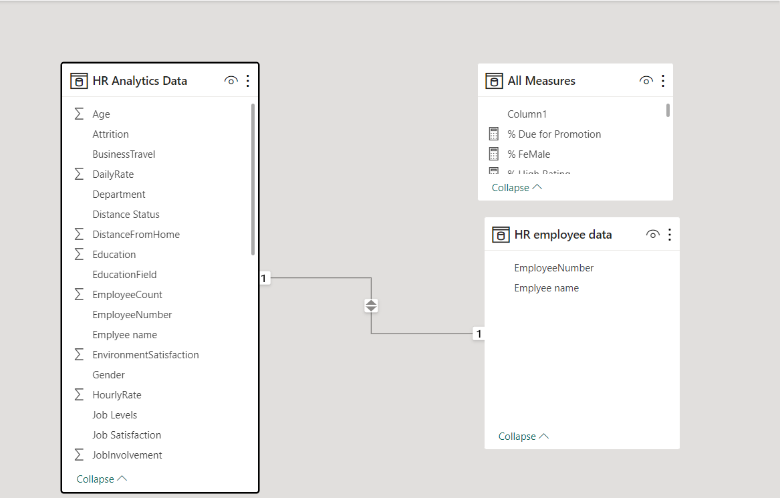
Model View :

Slide 7
KPI:
1.Total Emp = COUNTROWS('HR Analytics Data')
2.Male = CALCULATE([Total Emp],'HR Analytics Data'[Gender]="male")
3.FeMale = CALCULATE([Total Emp],'HR Analytics Data'[Gender]="female")
4.% Male = DIVIDE([Male],[Total Emp],0)
5.% FeMale = DIVIDE([FeMale],[Total Emp],0)
6.Due for Promotion = CALCULATE([Total Emp],'HR Analytics Data'[Promotion Status]="Due for Promotion")
7.Not Due = CALCULATE([Total Emp],'HR Analytics Data'[Promotion Status]="Not Due")
8.% Due for Promotion = DIVIDE([Due for Promotion],[Total Emp],0)
9.% Not Due = DIVIDE([Not Due],[Total Emp],0)
10.On Services = CALCULATE([Total Emp],'HR Analytics Data'[Retreanchment status]="On Services")

Slide 8
11.Will be retreanched = CALCULATE([Total Emp],'HR Analytics Data'[Retreanchment status]="Will be retreanched")
12.% Will be Retreanched = DIVIDE([Will be retreanched],[Total Emp],0)
13.% On Services = DIVIDE([On Services],[Total Emp],0)
14.High Rating = CALCULATE([Total Emp],'HR Analytics Data'[Performance Rating]="High Rating")
15.Low Rating = CALCULATE([Total Emp],'HR Analytics Data'[Performance Rating]="Low Rating")
16.% High Rating = DIVIDE([High Rating],[Total Emp],0)
17.% Low Rating = DIVIDE([Low Rating],[Total Emp],0)

Slide 9
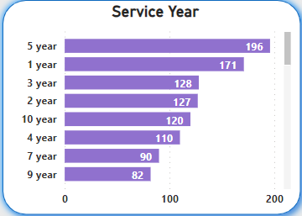
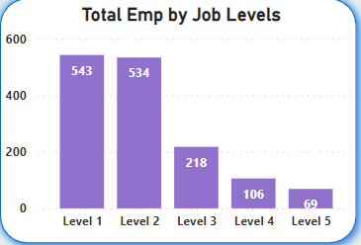
The stacked bar chart shows the number of service years worked by employees in that company. Most employees have a service
year of 5.
The stacked column chart shows that most employees work at Level 1 and Level 2 compared to the other levels.

Slide 10
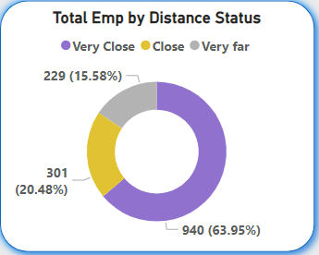
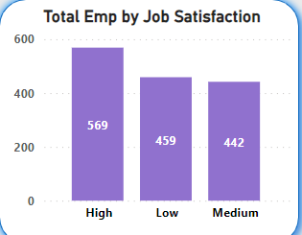
The Donut chart shows the distance of employees from their homes to the office. Most employees live closest to the office.
The stacked column chart shows how many people are satisfied with working in that company. Satisfaction depends on factors such as salary, the distance from home to the office, traffic, workload, etc.

Slide 11
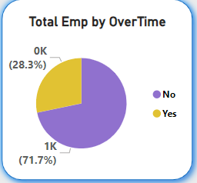
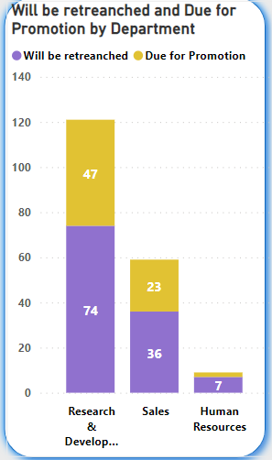
This pie chart shows how many people are doing overtime. Fewer people are performing overtime duties.
Overtime refers to the additional hours that an employee works beyond their regular or standard working hours. These extra hours typically come with a higher pay rate, often at a rate of one and a half times (1.5x) or even double (2x) the employee's regular hourly wage, as mandated by labor laws or company policies.
The stacked column chart shows, department-wise, how many employees have been promoted in their jobs and how many people have left the company in each department.

Slide 12
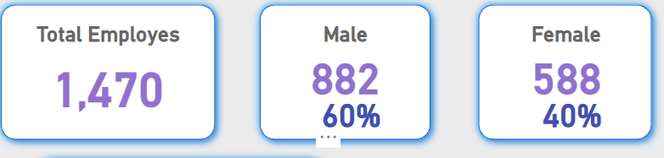
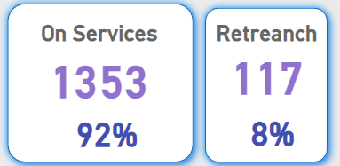
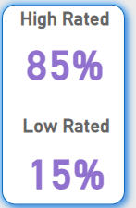
The card displays the total number of employees in the company and breaks down the count by gender, showing how many are male and how many are female.
The card shows how many people are currently working in the company and how many people have retired from the company.
This card displays the company's hiring rate for job vacancies.

Slide 13
Key Insights:
HR dashboards are essential tools for Human Resources professionals and organizational leaders to monitor and analyze key HR metrics and data in a visually accessible format. Here are some key insights that HR dashboards can provide:
Workforce Demographics: HR dashboards can provide a breakdown of the workforce by age, gender, ethnicity, and other demographics. This information helps organizations understand the diversity and composition of their workforce, which is crucial for diversity and inclusion initiatives.
2.Headcount and Turnover: HR dashboards can display real-time data on headcount and turnover rates. This information helps HR teams identify trends and take action to reduce turnover, which can be costly for organizations.
3.Recruitment Metrics: Dashboards can show data related to the recruitment process, including time-to-fill positions, cost per hire, and the source of hires. This helps HR teams assess the efficiency and effectiveness of their recruitment efforts.
4.Employee Engagement: Metrics related to employee engagement, such as survey results and feedback scores, can be visualized on the dashboard. This data helps HR teams identify areas where engagement can be improved.
5.Employee Engagement: Metrics related to employee engagement, such as survey results and feedback scores, can be visualized on the dashboard. This data helps HR teams identify areas where engagement can be improved.

Slide 14
6.Performance Management: HR dashboards can track key performance indicators (KPIs) related to employee performance, such as performance appraisal completion rates, performance ratings, and the distribution of performance scores.
7.Training and Development: Data on training completion rates, skill development, and employee participation in learning programs can be displayed. This helps HR assess the impact of training initiatives on employee growth.
8.Compensation and Benefits: Dashboards can show information on salary structures, compensation ratios, and benefit utilization. This data helps ensure that compensation and benefits align with organizational goals.
9.Absenteeism and Attendance: HR dashboards can provide insights into employee attendance patterns, including absenteeism rates and trends. This information can be used to address attendance issues and promote a healthy work-life balance.
10.HR Compliance: Metrics related to HR compliance, such as the status of required trainings and certifications, can be displayed on the dashboard. This helps HR ensure that the organization meets legal and regulatory requirements.
11.Cost Analysis: HR dashboards can show the cost of HR-related activities, such as recruitment costs, training expenses, and compensation. This data is valuable for budgeting and cost optimization.
12.Succession Planning: HR dashboards can include data on potential successors for key roles within the organization. This helps with succession planning and talent development.

Slide 15
13.Time and Attendance: Metrics related to employee time and attendance, including overtime hours and attendance trends, can be visualized. This information is essential for managing labor costs and workforce scheduling.
14.Turnover Reasons: Dashboards can provide insights into the reasons employees leave the organization, such as career growth opportunities, compensation issues, or work-life balance. This information informs retention strategies.
15.Employee Satisfaction and Feedback: Data from employee surveys, feedback forms, and performance reviews can be displayed on the dashboard. This helps HR understand employee sentiment and make data-driven decisions to improve workplace satisfaction.
16.HR Metrics Trends: HR dashboards can track historical trends in various HR metrics, allowing organizations to identify patterns and make informed decisions for the future.

Slide 16
Thanks You
If you want to view my live dashboard, please click on the 'Live Dashboard' link below:
Live Dashboard

