Slide 1

Designed & Presented By
Jnanaranjan Pradhan (Data Analyst)

Slide 2

Business Model:
Hotel booking refers to the process of reserving and securing accommodation at a hotel or other types of lodging for a specific period, typically for travelers or guests. This process can be done through various means, including online booking platforms, travel agencies, or directly through the hotel. Here are some key aspects of hotel booking:
Types of Accommodation: Hotel booking can encompass a wide range of accommodation options, including hotels, motels, resorts, hostels, bed and breakfasts (B&Bs), vacation rentals, and more. The choice of accommodation depends on the traveler's preferences, budget, and needs.
Booking Methods:
Online Booking: Most travelers use the internet to book hotels through hotel booking websites or apps. These platforms provide a vast selection of options, reviews, photos, and pricing information.
Travel Agencies: Travel agencies can assist travelers in finding and booking hotels as part of a broader travel package.
Direct Booking: Some travelers prefer to contact hotels directly via phone or the hotel's website to make reservations.
Reservation Information:
Check-in and Check-out Dates: Guests specify the dates they intend to stay at the hotel.
Number of Guests: The reservation should include the number of adults and children to ensure the appropriate room is booked.
Room Type: Guests can choose the type of room they want (e.g., single, double, suite).
Special Requests: Guests may make special requests such as bed preferences, smoking or non-smoking rooms, and amenities.

Slide 3
4.Pricing and Payment:
Room Rates: The cost of the room per night or for the entire stay.
Taxes and Fees: Additional charges, such as local taxes and service fees, may apply.
Payment Method: Guests provide payment information, which can include credit card details.
Cancellation Policies: Hotels typically have cancellation policies that outline the terms and fees for canceling or modifying a reservation.
5.Confirmation: After booking, guests receive a confirmation email or booking receipt, which includes details of the reservation, such as the booking reference number.
6.Check-in and Stay: On the day of arrival, guests check in at the hotel, where they may be required to provide identification and payment information. They receive room keys or key cards and are typically given information about hotel amenities and services.
During the Stay: Guests enjoy their stay, utilize hotel facilities, and may request services like room cleaning or room service.
Check-out: On the departure date, guests check out of the hotel, settle any outstanding charges, and return room keys.
Review and Feedback: After their stay, guests may be invited to leave reviews or feedback on their experience at the hotel, which can help other travelers make informed decisions.

Slide 4
Online Booking Platforms: Popular online hotel booking platforms include Booking.com, Expedia, Airbnb, Agoda, and many others. These platforms facilitate hotel discovery, comparison, and reservation processes.
Hotel booking plays a crucial role in travel planning, allowing travelers to secure comfortable and convenient accommodation for their trips. It's essential for both travelers and hotels to ensure a smooth and satisfactory booking experience.

Slide 5
Tools used:
Power BI Desktop
SQL
Excel
Dax Studio(For Report Optimization)
CHATGPT & Google
PowerPoint
"Adobe.color.com " for choosing color
"flaticon.com" for choosing the icon.

Slide 6
We have a hotel dataset containing Resort and city hotel data from 2015-2017,our central interest is to get insight from the year 2016 under resort hotel during the summer period(July and Augest).Althrough we will need to see insight in other month too.
Our other focues are cancellation level,average daily rate and revenue made compaired to revenue lost on a monthly basics.
First, we import the "Hotel Data" and rename it to "FactTable." The "FactTable" should contain the following columns: BookingId, Hotel, BookingDate, ArrivalDate, Lead Time, Nights, Guests, Distribution Channel, Country, CustomerType, Deposit Type, Avg Daily Rate, Status, Status Update, Cancelled, Revenue, and Revenue Loss.
Next, we duplicate the "FactTable," remove all columns except "Hotel," remove duplicate rows, and then assign an index.
The duplicated "FactTable" will be named "Lookup table Hotel" and should contain the following columns: Hotel and HotelId.

Slide 7
>Calender Table:
To create a calendar table in Power BI Desktop using a DAX function
Calender =
ADDCOLUMNS(
CALENDARAUTO(),
"Year",YEAR([Date]),
"Month",FORMAT([Date],"mmm"),
"MonthNum",MONTH([Date]),
"Weekday",FORMAT([Date],"ddd"),
"Weeknum",WEEKDAY([Date]),
"Qtr",FORMAT([Date],"\QQ")
)
what is lead time in hotel booking ?
The Booking Lead Time is the number of days between the time a guest books their room and the time they are scheduled to arrive at the hotel

Slide 8
KPI:
1.Total Revenue = SUM(FactTable[Revenue])
2.Revenue Lost = SUM(FactTable[Revenue Loss])
3.# Transction = COUNTROWS(FactTable)
4.Total Cancellation = CALCULATE([# Transction],FactTable[Cancelled (0/1)]=0)
5.% Cancellation = DIVIDE([Total Cancellation],[# Transction],0)
6.Avg Daily Rate = AVERAGE(FactTable[Avg Daily Rate])

Slide 9
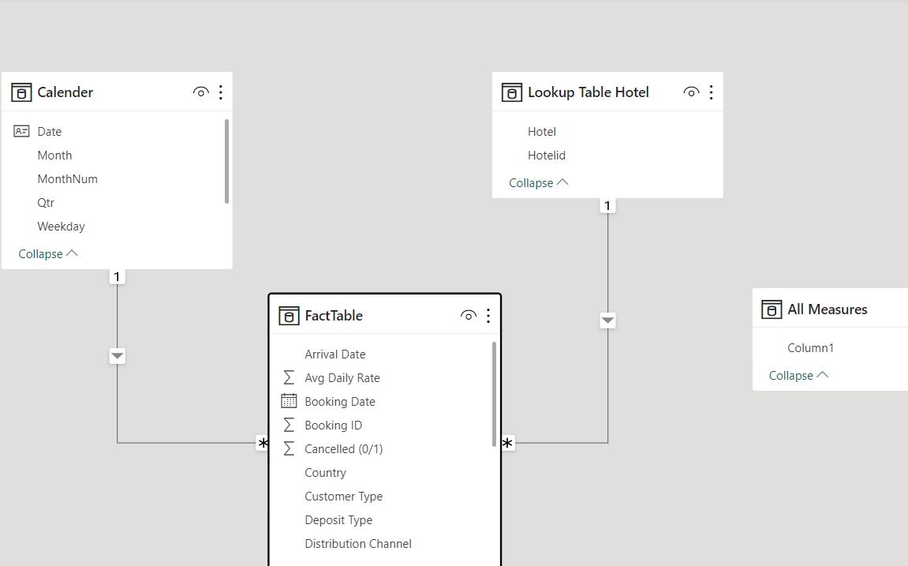
Model View:

Slide 10
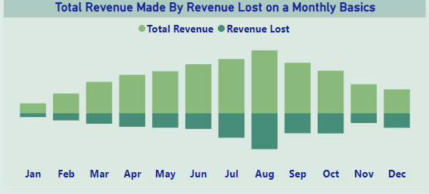
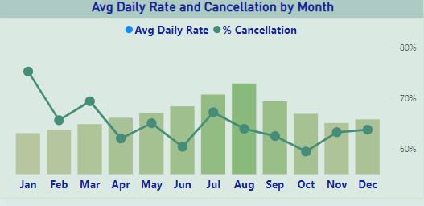
There is an increase in revenue in July & August but also lost to
Cancellation
($1,770K) were lost to cancellation in July & August
Good News the Avg Daily Rate is Higher in August with low cancellation. We have high cancellation in Jan, Mar, Jul , Nov & Dec.

Slide 11
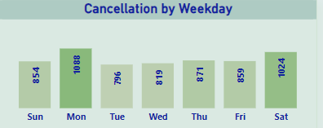
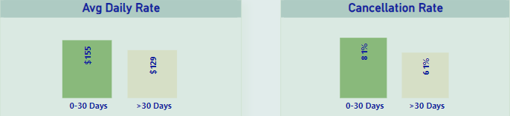
Higher Cancelation falls between Monday & Saturday
Summer Booking within 30 days have higher Cancellation,
it might be affected by the high Average daily rate.

Slide 12
Key Insights:
Hotel booking is a complex industry with many factors influencing traveler decisions and hotel operations. Here are some key insights and trends in the hotel booking industry:
Online Booking Dominance: The majority of hotel bookings are now made online, with travelers using websites and mobile apps to search for, compare, and reserve accommodations. Online travel agencies (OTAs) and hotel websites play a significant role in this process.
Mobile Booking: Mobile devices are increasingly being used for hotel bookings. Travelers rely on smartphones and tablets to make reservations, check availability, and access booking confirmations.
Review Influence: Guest reviews and ratings on platforms like TripAdvisor, Yelp, and Google Reviews have a substantial impact on booking decisions. Travelers often consider peer feedback when choosing a hotel.
Personalization: Hotels are investing in data analytics and customer relationship management (CRM) to offer personalized experiences. This includes tailoring room recommendations, amenities, and offers based on individual preferences and past behavior.
Dynamic Pricing: Many hotels use dynamic pricing strategies, adjusting room rates based on factors such as demand, time of booking, and local events. Travelers may find different prices for the same room depending on when they book.
Metasearch Engines: Metasearch engines like Google Hotel Search, Trivago, and Kayak aggregate hotel listings and prices from various sources, simplifying the booking process by providing comprehensive comparisons.
Direct Booking Campaigns: Hotels often encourage guests to book directly through their websites by offering perks such as lower rates, loyalty program benefits, and room upgrades.
OTA Presence: Online travel agencies remain influential, as they offer a wide range of accommodations and often provide competitive pricing. Hotels partner with OTAs to reach a broader audience.
Alternative Accommodations: The rise of platforms like Airbnb has introduced alternative lodging options, such as vacation rentals and home sharing, which offer unique experiences outside of traditional hotels.

Slide 13
10.Sustainability: An increasing number of travelers are considering eco-friendly and sustainable practices when choosing hotels. Sustainable certifications and practices can attract environmentally conscious guests.
11.Technology Integration: Hotels are adopting technology to enhance the guest experience, including mobile check-in and check-out, keyless entry, in-room tablets, and chatbots for guest inquiries.
12.Flexible Cancellation Policies: The COVID-19 pandemic accelerated the adoption of flexible cancellation policies, allowing travelers to change or cancel bookings more easily in uncertain times.
13.Safety and Hygiene: In response to the pandemic, hotels have implemented enhanced cleaning and safety protocols. Travelers are more attentive to health and safety measures when making booking decisions.
14.Business Travel: The return of business travel is a significant factor for many hotels. The evolving nature of remote work and hybrid work models may impact the demand for corporate accommodations.
15.Global Travel Trends: Travel trends are influenced by factors such as economic conditions, geopolitical events, and health crises. Shifts in international travel patterns can impact hotel bookings significantly.

Slide 14
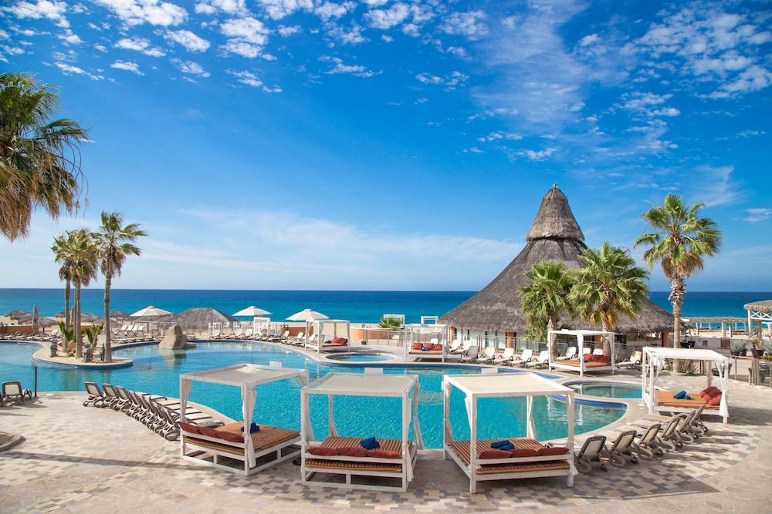
Thanks you
If you want to view my live dashboard, please click on the 'Live Dashboard' link below:
Live Dashboard

