Slide 1


Business Insights 360
Project Overview
Atliq Business Model:
Atliq is a consumer goods electronics company , they sales the hardware like PC , Mouse , Printer so on to different customers like 'Croma’, 'BEST BUY','STAPLES','FLIPKART' and then from there, these stores sales the hardware to End Consumer like you and me person.
In Atliq Hardware , the customer is the stores like 'Croma’, 'BEST BUY','STAPLES','FLIPKART' etc. The consumer is who consume the product. Here there are two types of customers/Platform one is 'Brick & Mortar' like 'Croma’, 'BEST BUY' and second is E-commerce like 'FLIPKART’, 'Amazon' etc.
Atliq have three channels Retailer, Direct , Distributor.
Retailer channels means they sales his product to customer like 'Croma’, 'BEST BUY’, 'STAPLES’, 'FLIPKART’, 'Amazon' etc.
Direct channels means they sales his product to his own customer/stores like 'Atliq Hardware E-store’, 'Atliq Hardware exclusive'
Distributor channels means they sales his product to a Big customer, the customer sales that product to small stores, the store sales product to the end consumer.
AtliQ Hardware's , a growing electronic goods company having operations in various countries. Their business is growing rapidly and they still rely on excel files for data analytics. Excel files are hard to consume and not effective in generating insights. Also due to the lack of effective analytics the company faced a major loss in Latin America So that They needed quick and smart decisions based on data. So, I took on the task of creating an automated Power BI dashboard for the Finance, Sales, Marketing, and Supply Chain teams. The goal was to help them analyze data and make better decisions.

Slide 2
Tools used:
SQL
Power BI Desktop
Excel
Dax studio(For report optimization)
CHATGPT and Google(For clearing some droughts)
Project Walkthrough
1.Project Planning:
The Project connected with an email from the Product owner outlining the requirement for five different dashboards in power BI.
Finance View : Show Profit and loss statement to understand financial performance across markets , products , customers etc.
sales view : show top/ bottom customers along with key metrics . A metrics would be preferable to understand their performance.
Marketing view : same as sales view but for products.
Supply chain : Reliability , Forecast Accuracy in a view to understand SC Performance.
Executive View : Integrated View Of Key Insights for executives(More details TBD)

Slide 3
2.Data collection & Exploration(Using SQL)
Data was imported into MYSQL.
Basic SQL query provided invaluable for quick data exploration
3.Data Load:
Data was loaded into Power BI through MYSQL server
4.Initial data validation:
Data was validated against Benchmark numbers.
Primary data validation in power bi was crucial before developing compressive dashboard
This validation process can sometimes reveal data quality issues, requiring close collaboration between data analyst and engineers to address them
5.Data Transformation in Power Query:
Checked and corrected data using the ‘Clean and Trim’ function to address leading spaces.
Created Calculated column.
Merge tables using merge queries to produce a single ,more useful table.

Slide 4
Best Practices in Power Query:
Assign meaningful query step names.
Group tables into logical categories.
Disable the load of tables that aren't used externally to boost performance.
Use consistent naming conventions for tables and measures.
Profit and Loss(P & L):
Example:
Atliq hardware sales a Mouse to his customer(Croma) 30 $ means Gross price or base price of Mouse is 30$.
*pre-invoice Deduction :Yearly discount agreements made at the beginning of each financial year.
Gross price :30 $
-pre-invoice Deduction:2
------------------------------- ----
=Net Invoice sales:28
*post-invoice Deduction is Promotional offers +Placement Fees + Performance Rebate
Gross price :30 $
-pre-invoice Deduction:2
------------------------------- ----
=Net Invoice sales:28
-post-invoice Deduction:3
------------------------------------
=Net sales:25

Slide 5
*Net sales is basically the Revenue of Atliq.
*cost of oods sold(COGS) is the Manufacturing cost + Freight(Transportation)+other cost
Gross price :30 $
-pre-invoice Deduction:2
------------------------------- ----
=Net Invoice sales:28
-post-invoice Deduction:3
------------------------------------
=Net sales:25
-cost of oods sold(COGS):20
---------------------------------------
=Gross Margin(Profit):5
Gross Margin % of Net sales(GM/NS):20 %

Slide 6
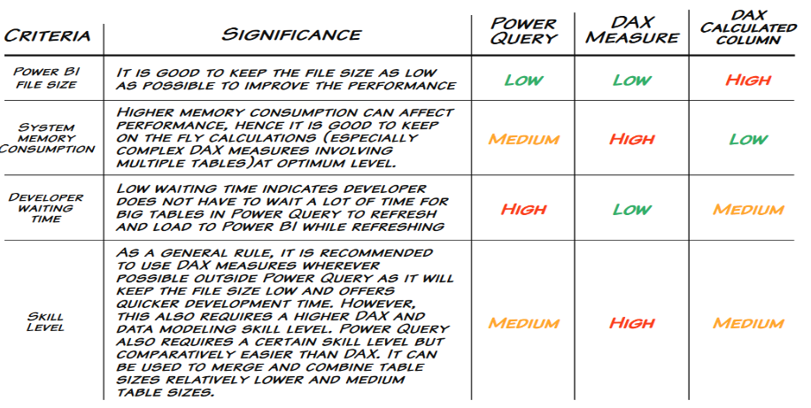
Decision Matrix for Choosing Between Power Query or DAX for Generating Calculated Columns:
Calculated columns can be created either in Power Query or in DAX. Both options come with their advantages and drawbacks. It's essential to use judgment based on the specific situation.

Slide 7
6.Data Modelling:
>Utilized the Snow Flake Schema for data modeling.
>Data modeling is a pivotal aspect of the data analytics pipeline. Considerable effort should be expended to construct the
appropriate data model.
7. Verify Your Data Model:
>After data modeling, basic visuals and calculations were executed to ascertain the accuracy of the data model.
8. Review Mockups & Start Finance View Visualization:
>Reviewed preliminary sketches of the dashboards as provided by the product owner.
>Established measures and preliminary visuals as needed.
Learnings:
Grasping the filter context is fundamental to Power BI tool design. The filter context informs the slicing and dicing operations.
While the gross margin is a useful metric, senior management often places higher importance on visualizing net profit to comprehend actual profit. Net Profit is calculated as Gross Margin minus Operational Expenses.
Constructing BI dashboards is iterative. Sometimes, mid-project, there might be a need to import new datasets and reconsider the entire design. Maintaining an agile and open mindset benefits both the data analyst and the organization

Slide 8
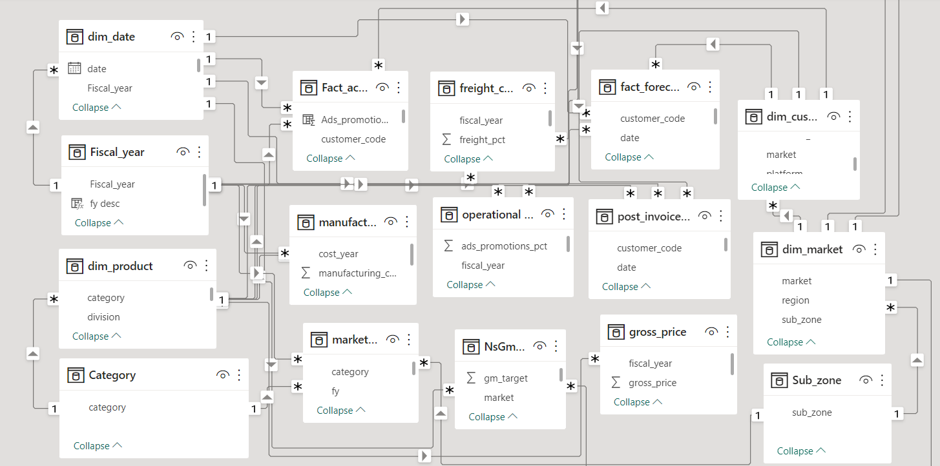

Slide 9
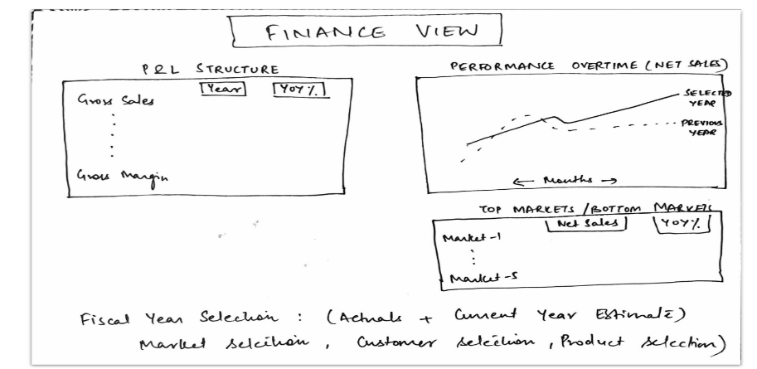
Finance View:

Slide 10
9. Review Sales & Marketing View Mockups: >Constructed visuals for Top Customers & Products and Unit Economic Visuals.
>For the sales team, metrics like Gross Margin and Net Sales (Revenue) are prioritized over Net Profit as they typically lack
control over operating expenses.
>For the marketing team, understanding the variation in marketing expenditure over time and the subsequent change in
Revenue/Gross Margin is crucial.
10. Review and Building Supply Chain View: >Focused on metrics like Net Error, Net Error%, ABS Error, ABS Error%, and Forecast Accuracy.
>For the supply chain team, key metrics include Forecast Accuracy & Risk (either out of stock or excess inventory situations).
how to create date table in power query:
1.Open a blank query in Power Query of Power BI
2.type ={Number.From(#date(2017,9,1))..Number.From(#date(2022,12,31))}
3.That will generate a series of numbers as a list
4.Convert it to a table (upper left menu button.
5.Convert the ABC123 type to date
6.Rename to Date.
7.Now you have a date table. Add columns as necessary (year, month, month name, etc) to make your date table suit your needs.
8.Close and load.
9.Right-click on it and mark it as a date table.

Slide 11
How to add fiscal_year in my dim_date table:
=Date.Year(Date.AddMonths([Month],4))
How to create current month from fact_sales_monthly:
Right click on 'fact_sales_monthly' table then click Reference then use that formula
= List.Max(#"gdb041 fact_sales_monthly"[date])
How to get remaining Forcast:
First select date column from date column select any row then that show
= Table.SelectRows(Source, each ([date] = #datetime(2018, 7, 1, 0, 0, 0)))
then we replace
= Table.SelectRows(Source, each ([date] > LastSalesMonth))
*Gross price=qty*price of a product in a specific fiscal year
*How to create unique Fiscal_year table from dim_date table of Fiscal_year column ?
Go to Power BI Desktop---->Modeling---->click New Table---->then write Fiscal_year=ALLNOBLANKROW(dim_date[Fiscal_year])

Slide 12
*How to extract 'discounts_pct' column from 'post_invoice_deductions' table to 'fact_actuals_estimates'?
post_invoice_deductions_amount =
var res=CALCULATE(MAX(post_invoice_deductions[discounts_pct]),
RELATEDTABLE(post_invoice_deductions))
return res*fact_actuals_estimates[net_invoice_sales_amount]
*How to extract 'other_deductions_pct' column from 'post_invoice_deductions' table to 'fact_actuals_estimates'?
post_invoice_other_deductions_amount =
var res=CALCULATE(MAX(post_invoice_deductions[other_deductions_pct]),
RELATEDTABLE(post_invoice_deductions))
return res*fact_actuals_estimates[net_invoice_sales_amount]
*How to get net_sales_amount ?
net_sales_amount = fact_actuals_estimates[net_invoice_sales_amount]-fact_actuals_estimates[post_invoice_deductions_amount]-fact_actuals_estimates[post_invoice_other_deductions_amount]
How to extract 'manufacturing_cost' column from 'manufacturing_cost' table to 'fact_actuals_estimates'?
manufacturing_cost =
var res=CALCULATE(MAX(manufacturing_cost[manufacturing_cost]),
RELATEDTABLE(manufacturing_cost))
return res*fact_actuals_estimates[qty]

Slide 13
*How to extract 'freight_pct' column from 'freight_cost' table to 'fact_actuals_estimates'?
freight_cost =
var res=CALCULATE(MAX(freight_cost[freight_pct]),
RELATEDTABLE(freight_cost))
return res*fact_actuals_estimates[net_sales_amount]
*How to extract 'other_cost_pct' column from 'freight_cost' table to 'fact_actuals_estimates'?
other_cost =
var res=CALCULATE(MAX(freight_cost[other_cost_pct]),
RELATEDTABLE(freight_cost))
return res*fact_actuals_estimates[net_sales_amount]
*How to get 'total_cogs_amount'?
total_cogs_amount = fact_actuals_estimates[manufacturing_cost]+fact_actuals_estimates[freight_cost]+fact_actuals_estimates[other_cost]
*How to get 'gross_margin_amount'?
gross_margin_amount = fact_actuals_estimates[net_sales_amount]-fact_actuals_estimates[total_cogs_amount]

Slide 14
Gross sales $:
GS $ = SUM(fact_actuals_estimates[gross_sales_amount])
Net_invoice_sales $:
NIS $ = SUM(fact_actuals_estimates[net_invoice_sales_amount])
Net_invoice_sales for India $:
NIS IND $ = CALCULATE([NIS $],dim_market[market]="India")
Benchmark Varience:
Benchmark var = [NIS $]-[NIS IND $]
Net_invoice_sales for last year:
NIS LY $ = CALCULATE([NIS $],SAMEPERIODLASTYEAR(dim_date[Date]))

Slide 15
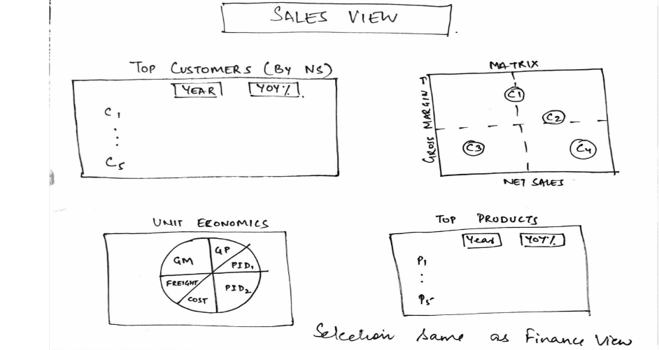
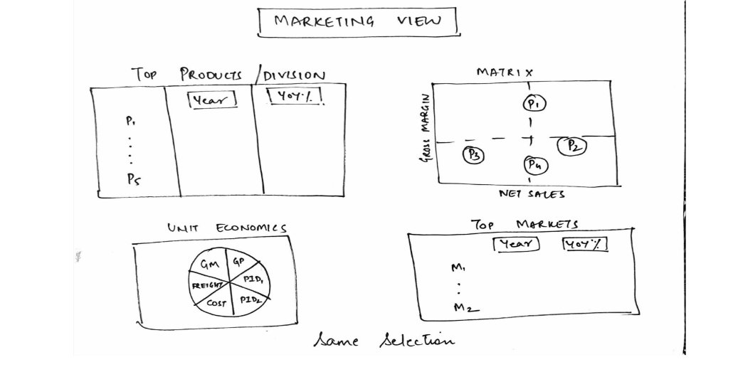
Sales View:
Marketing View:

Slide 16
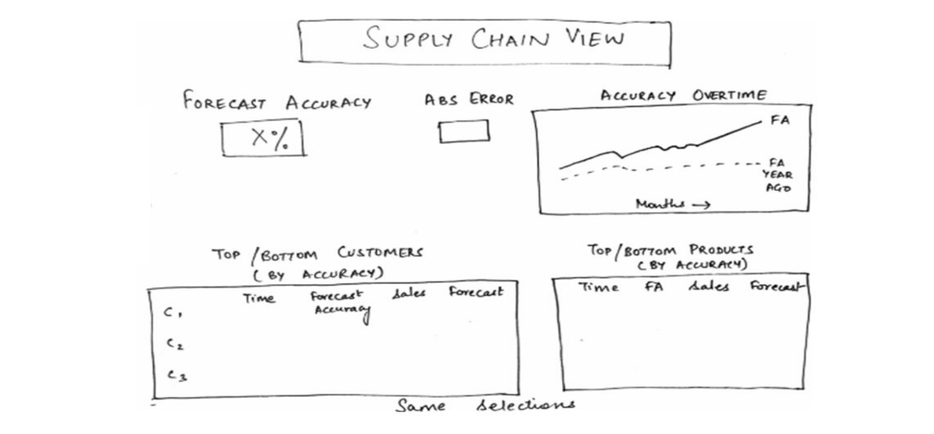
Supply chain View:

Slide 17
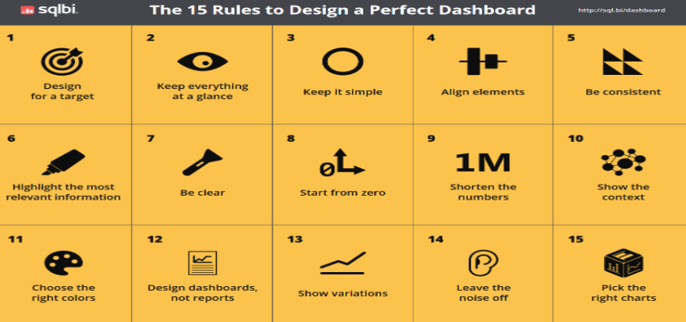
11. Designing an Effective Dashboard:
>Employed 15 design principles for crafting a visually appealing and effective dashboard
>Reusability expedites the process. It's beneficial to copy a visual from one page to another and modify it as per new
requirements.

Slide 18
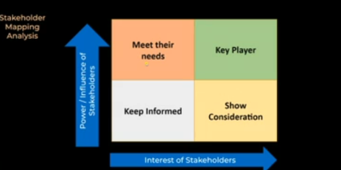
12. Setting Data Validation (Creating a User Acceptance Test Report):
>After constructing the dashboard, the next phase involves User Acceptance Testing (UAT). The data analytics team
dispatched a UAT excel file detailing expectations for user acceptance testing prior to engaging with stakeholders. 13. Implementing Stakeholder Feedbacks:
>Incorporated any suggested modifications. >Stakeholder mapping is very important to get good understanding of stakeholder’s personalities and their expectations
14.Performance Optimization >Used Dax studio to and Performance analyzer in power bi to enhance performance.
15.Deployment >Uploading to power bi service >Configured the Gateway for refresh.

