Slide 1

Restaurant database project
Designed & Presented By
Jnanaranjan Pradhan (Data Analyst)

Slide 2
Our primary goal in undertaking this project is to design and implement a robust restaurant database system that will revolutionize the way restaurants operate. Through this project, we aim to achieve the following objectives:
Efficient Menu Management: The project will provide a seamless platform for restaurants to manage their menus, enabling them to add, edit, and remove items with ease. Additionally, it will allow for detailed item categorization, pricing, and descriptions.
Order and Reservation Management: We will develop a sophisticated system that enables customers to place orders and make reservations conveniently. The system will also facilitate order tracking, payment processing, and real-time reservation management.
Inventory Control: Our project will empower restaurants to maintain precise control over their inventory, ensuring that ingredients, supplies, and beverages are always adequately stocked. Automated alerts will notify staff when stock levels are low.
Customer Engagement: The database will store customer information and preferences, enabling personalized service and marketing efforts. We aim to enhance customer engagement and loyalty through data-driven insights.
Operational Efficiency: By centralizing and automating various restaurant operations, our project will contribute to increased efficiency and reduced overhead costs.
Reporting and Analytics: We will implement robust reporting and analytics features to help restaurant owners and managers make informed decisions based on sales data, customer trends, and performance metrics.

Slide 3
The Restaurant database contain the following table:
1.Restrutant table contain the following column: r_id,r_name,cuisine
2.Food table contain the following column : f_id,f_name,type
3.delivery_partner table contain the following column :partner_id,partner_name
4.Menu table contain the following column :menu_id,r_idf_id,price
5.order_details table contain the following column :id,order_id,f_id
6.orders table contain the following column:order_id,user_id,r_id,amount,date,partner_id,delivary_time,delivary_rating,restrutant_rating
7.user table contain the following column :user_id,name,email,password.

Slide 4
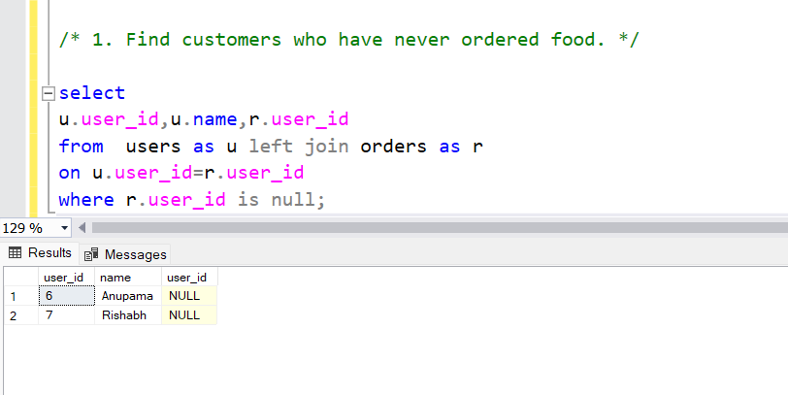

Slide 5
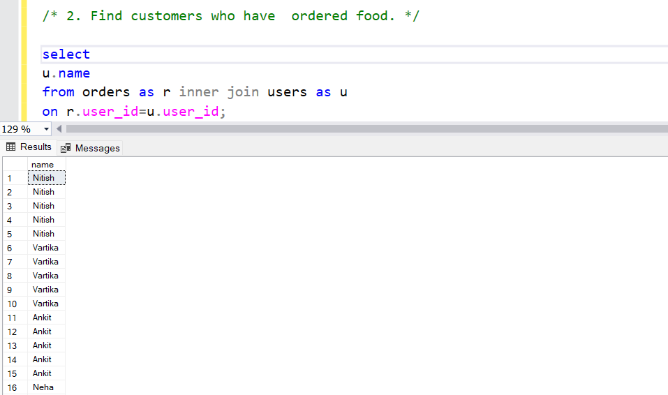
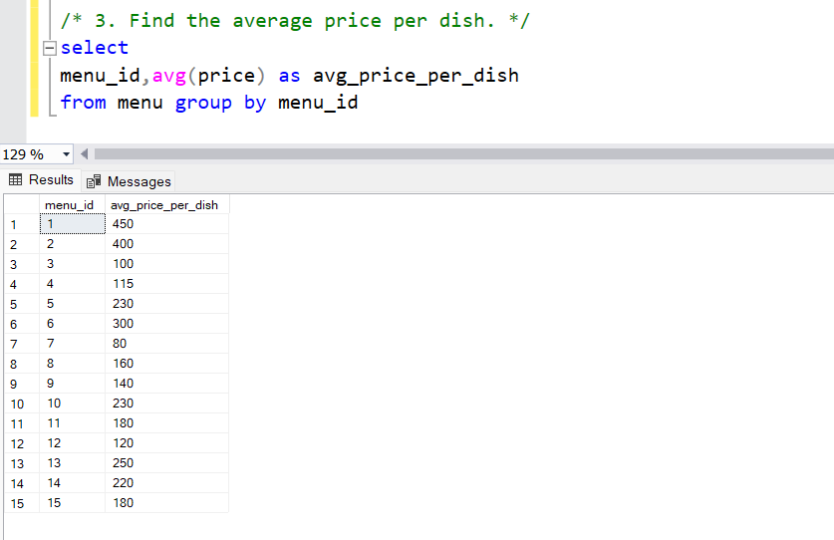

Slide 6
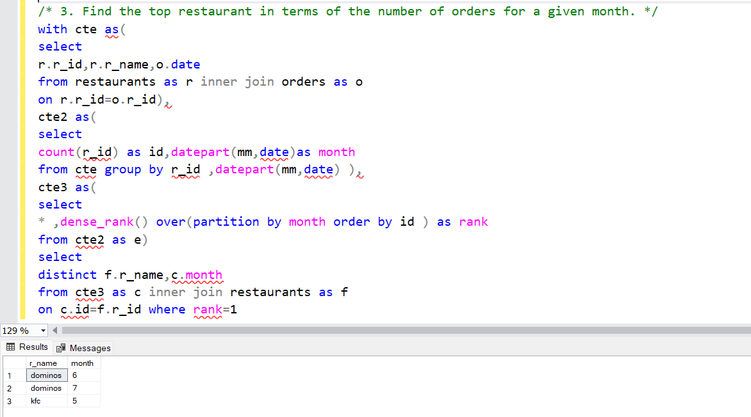

Slide 7
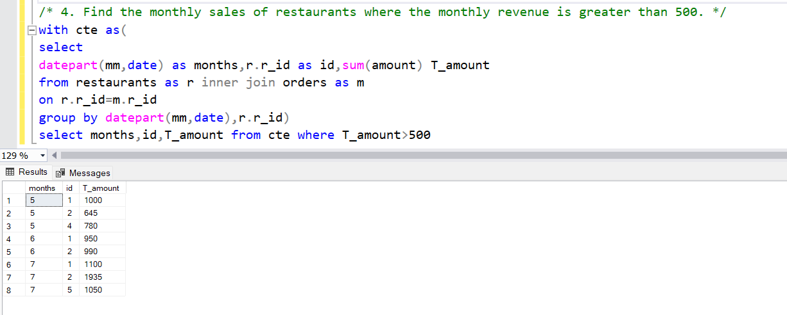

Slide 8
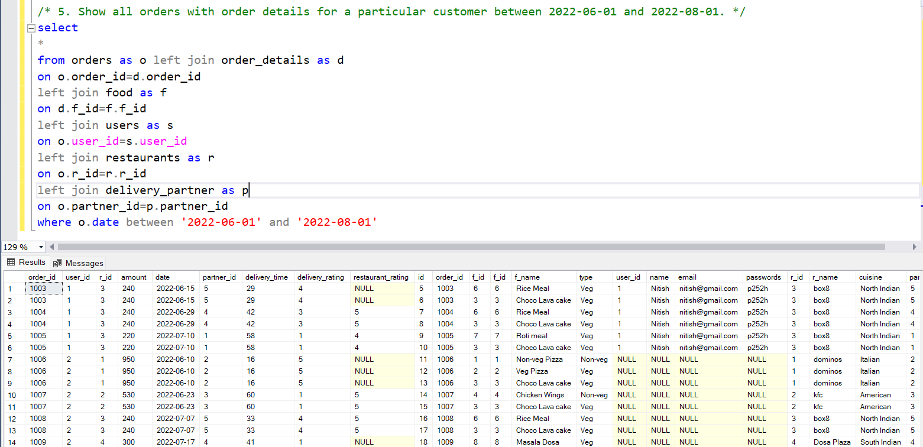

Slide 9
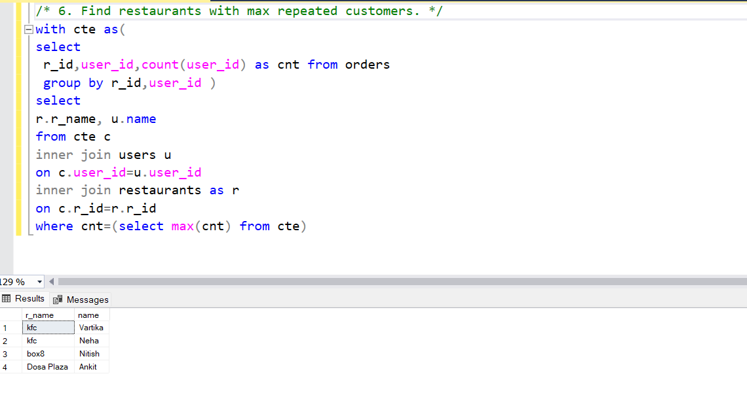

Slide 10
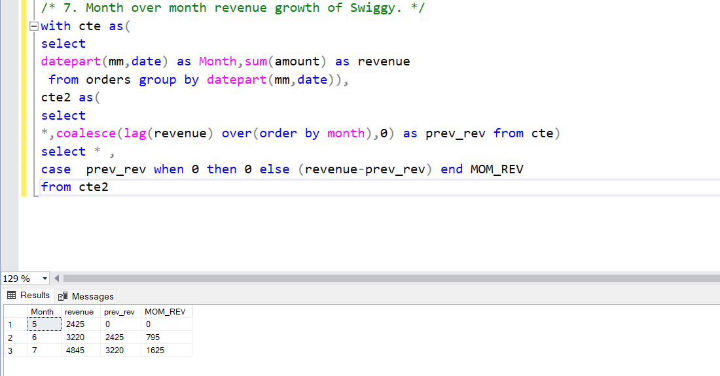

Slide 11
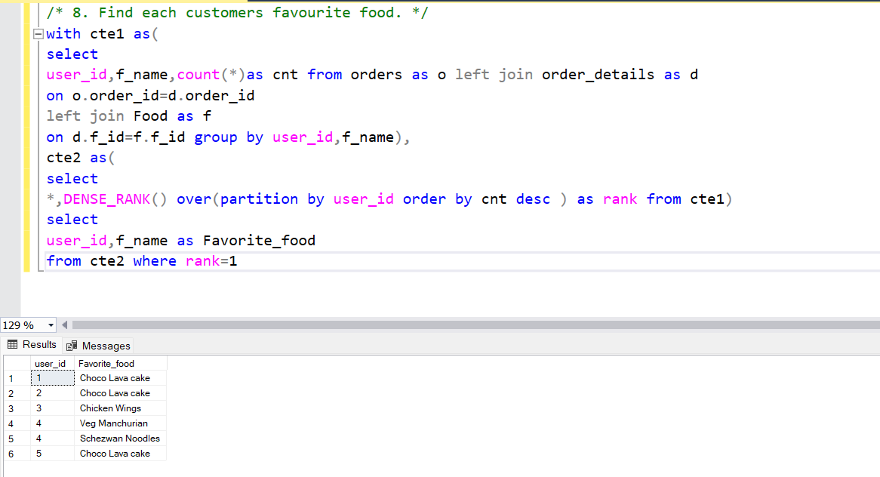

Slide 12
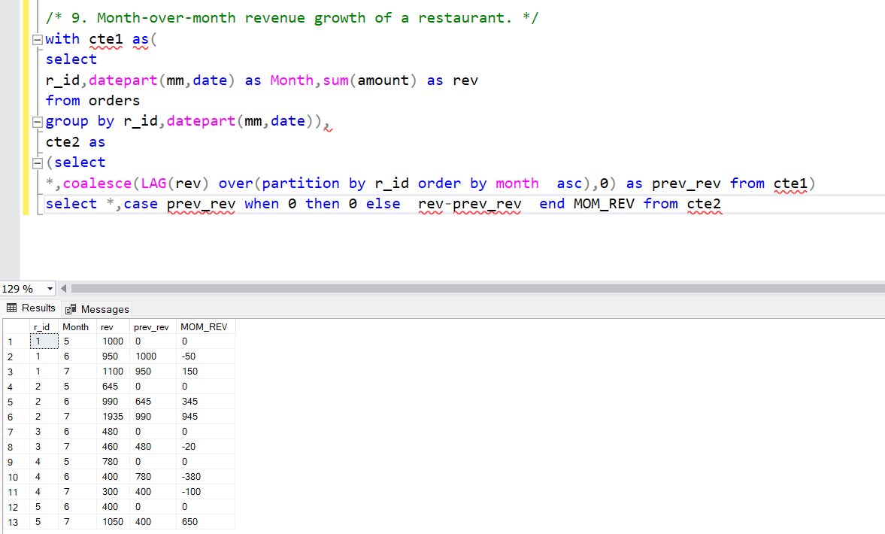

Slide 13
Significance of the Project:
The "Restaurant Database Project" is significant in the context of the restaurant industry because it addresses the growing demand for digital solutions that optimize restaurant operations and enhance the dining experience. It offers a competitive advantage to restaurants by improving customer service, resource management, and data-driven decision-making.

Slide 14
Thanks You
To download the data, please click the 'Database' link below.
Database

