Slide 1
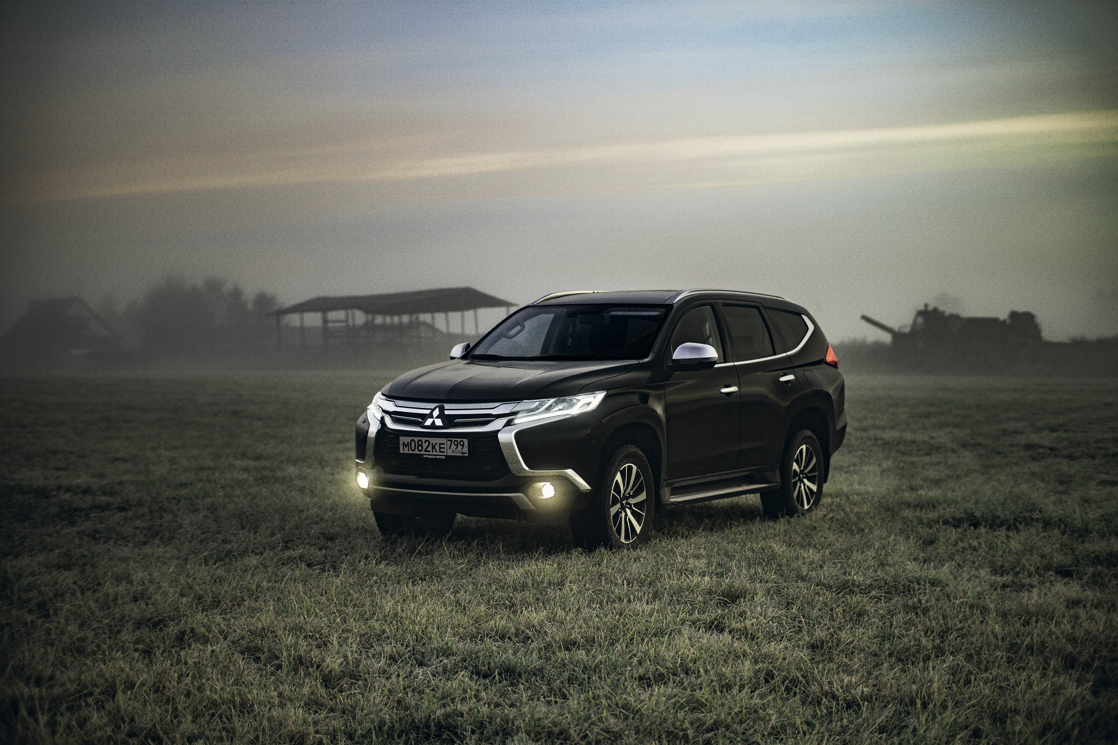
STEVE’S CAR
SHOWROOM
Hosted by Steel Data
STEVE’S CAR
SHOWROOM
Presented By Data Analyst
Jnanaranjan Pradhan

Slide 2

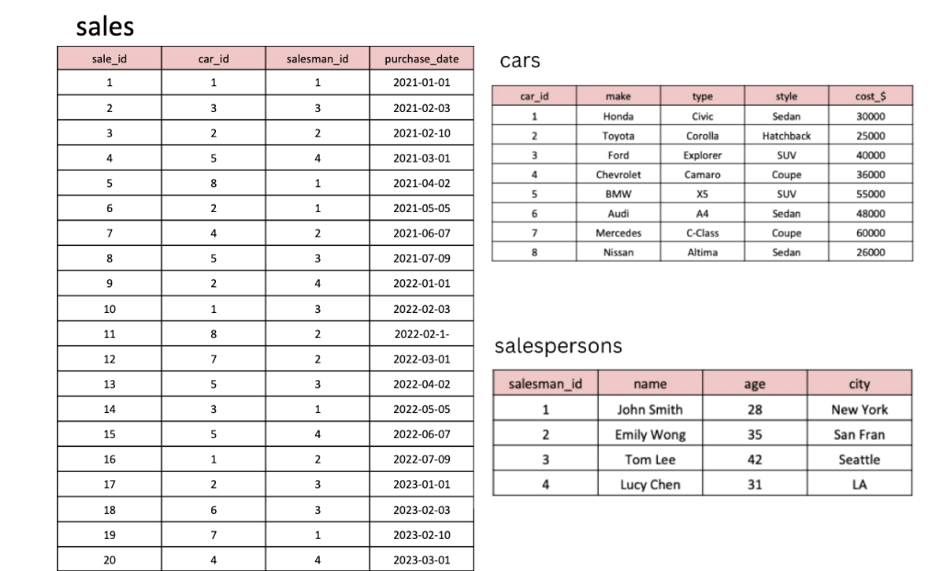
Introduction :
Steve runs a top-end car showroom but his data analyst has just quit and left him without his crucial insights
Tables
Here are the tables you will be
using

Slide 3
CREATE TABLE cars (car_id INT PRIMARY KEY,make VARCHAR(50),type VARCHAR(50),style VARCHAR(50), cost_$ INT ); INSERT INTO cars (car_id, make, type, style, cost_$) VALUES (1, 'Honda', 'Civic', 'Sedan', 30000), (2, 'Toyota', 'Corolla', 'Hatchback', 25000),(3, 'Ford', 'Explorer', 'SUV', 40000),(4, 'Chevrolet', 'Camaro', 'Coupe', 36000),(5, 'BMW', 'X5', 'SUV', 55000),(6, 'Audi', 'A4', 'Sedan', 48000),(7, 'Mercedes', 'C-Class', 'Coupe', 60000), (8, 'Nissan', 'Altima', 'Sedan', 26000);
--------------------
CREATE TABLE salespersons (salesman_id INT PRIMARY KEY,name VARCHAR(50),age INT,city VARCHAR(50)); INSERT INTO salespersons (salesman_id, name, age, city) VALUES (1, 'John Smith', 28, 'New York'), (2, 'Emily Wong', 35, 'San Fran'),(3, 'Tom Lee', 42, 'Seattle'),(4, 'Lucy Chen', 31, 'LA’);
--------------------
CREATE TABLE sales (sale_id INT PRIMARY KEY,car_id INT,salesman_id INT,purchase_date DATE, FOREIGN KEY (car_id) REFERENCES cars(car_id),FOREIGN KEY (salesman_id) REFERENCES salespersons(salesman_id));

Slide 4
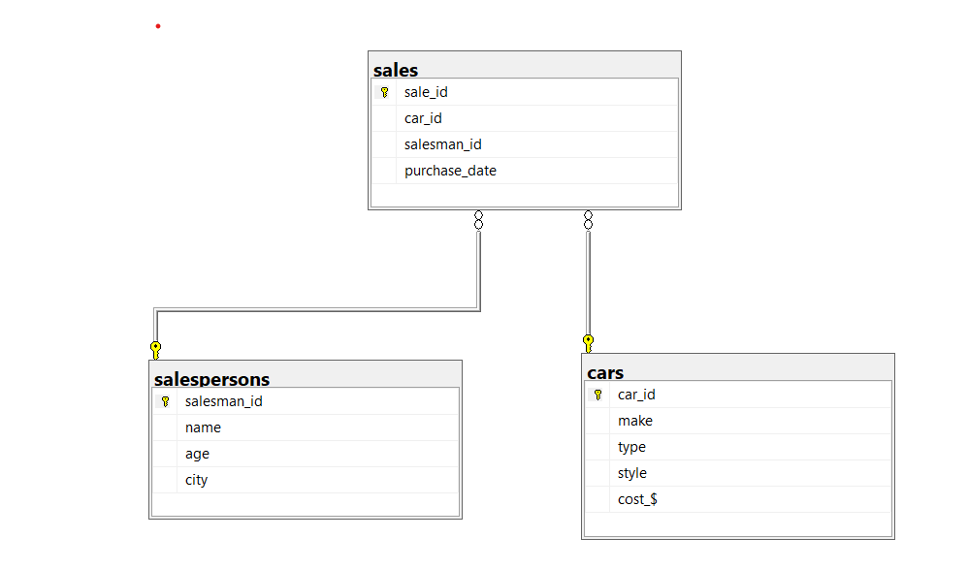
INSERT INTO sales (sale_id, car_id, salesman_id, purchase_date) VALUES (1, 1, 1, '2021-01-01'),(2, 3, 3, '2021-02-03'),(3, 2, 2, '2021-02-10'),(4, 5, 4, '2021-03-01'),(5, 8, 1, '2021-04-02'),(6, 2, 1, '2021-05-05'),(7, 4, 2, '2021-06-07'),(8, 5, 3, '2021-07-09'),(9, 2, 4, '2022-01-01'),(10, 1, 3, '2022-02-03'),(11, 8, 2, '2022-02-10'),(12, 7, 2, '2022-03-01'),(13, 5, 3, '2022-04-02'),(14, 3, 1, '2022-05-05'),(15, 5, 4, '2022-06-07'),(16, 1, 2, '2022-07-09'),(17, 2, 3, '2023-01-01'),(18, 6, 3, '2023-02-03'),(19, 7, 1, '2023-02-10'),(20, 4, 4, '2023-03-01');
ER Diagram :

Slide 5
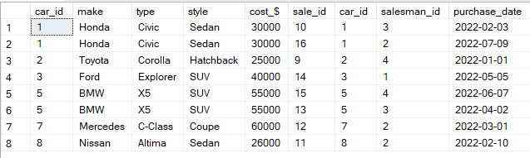
Objective:
Steve's Car Showroom wants insights from the given data. My primary responsibility is to identify key insights based on specific questions, analyze the business, and provide recommendations for improvement. This includes determining which cars generate the highest and lowest revenue.
What are the details of all cars purchased in the year 2022?
select * from cars as c
Inner join sales as s on
c.car_id=s.car_id where
DATEPART(yy,purchase_date)=2022
order by c.car_id
(or)
select * from cars as c
inner join sales as s on
c.car_id=s.car_id where
purchase_date
between '2022-01-01' and '2022-12-31'
order by c.car_id

Slide 6
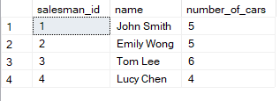
/*2. What is the total number of cars sold by each salesperson?*/
select
s.salesman_id,s.name,count(*) as number_of_cars
from salespersons as s
inner join sales as sa on
s.salesman_id=sa.salesman_id
group by s.salesman_id,s.name
(or)
select *,
count(sa.car_id) over(partition by s.salesman_id)
as total_cars_sold
from salespersons as s
inner join sales as sa on
s.salesman_id=sa.salesman_id

Slide 7
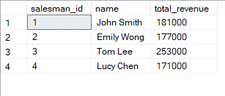
3. What is the total revenue generated by each salesperson?
select sa.salesman_id,
sa.name,sum(c.cost_$) as total_revenue
from salespersons as sa
inner join sales as s on
sa.salesman_id=s.salesman_id
inner join cars as c on s.car_id=c.car_id
group by sa.salesman_id,sa.name
select sa.salesman_id,sa.name,
sum(c.cost_$) over (partition by sa.salesman_id,sa.name ) as total_revenue
from salespersons as sa
inner join sales as s on
sa.salesman_id=s.salesman_id
inner join cars as c on s.car_id=c.car_id

Slide 8
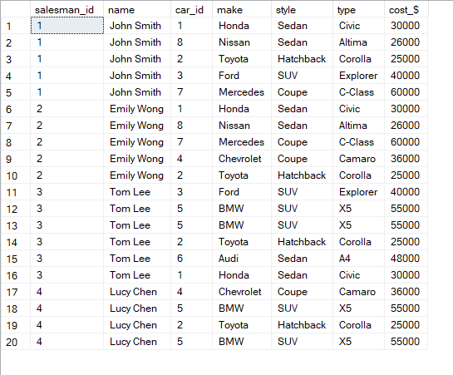
4. What are the details of the cars sold by each salesperson?
select sa.salesman_id,sa.name,
s.car_id,c.make,c.style,c.type,c.cost_$
from salespersons as sa inner join sales as s
on sa.salesman_id=s.salesman_id inner join cars as c on s.car_id=c.car_id
order by sa.salesman_id

Slide 9
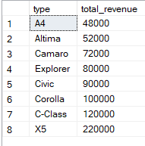
5. What is the total revenue generated by each car type?
select c.type,sum(c.cost_$) as total_revenue
from sales as s inner join cars as c
on s.car_id=c.car_id
group by c.type
order by total_revenue
6. What are the details of the cars sold in the year 2021 by salesperson 'Emily Wong’ ?
select *
from sales as s inner join cars as c
on s.car_id=c.car_id
inner join salespersons as sa
on sa.salesman_id=s.salesman_id
where datepart(yy,s.purchase_date)=2021
and sa.name='Emily wong'

Slide 10


/*7. What is the total revenue generated by the sales of hatchback cars?*/
select
style,sum(cost_$) total_revenue
from cars as c inner join sales as s
on c.car_id=s.car_id
where style='hatchback’
group by style
/*8. What is the total revenue generated by the sales of SUV cars in the year 2022?*/
select
c.style,sum(c.cost_$) as total_revenue
from sales as s inner join cars as c
on s.car_id=c.car_id
inner join salespersons as sa
on sa.salesman_id=s.salesman_id
where datepart(yy,s.purchase_date)=2022
and c.style='suv'
group by c.style

Slide 11


9. What is the name and city of the salesperson who sold the most number of cars in the year 2023?
select top 1 s.name,s.city,count(*) as sold
from salespersons as s
inner join sales as sa
on s.salesman_id=sa.salesman_id
inner join cars as c on sa.car_id=c.car_id
where DATEPART(yy,sa.purchase_date)=2023
group by s.name,s.city
order by sold desc
10. What is the name and age of the salesperson who generated the highest revenue in the year 2022?
select top 1 s.name,s.age,
sum(c.cost_$) as highest_revenue
from salespersons as s inner join sales as sa
on s.salesman_id=sa.salesman_id
inner join cars as c on sa.car_id=c.car_id
where DATEPART(yy,sa.purchase_date)=2022
group by s.name,s.age
order by highest_revenue desc

Slide 12
Insights :
Among all the salespeople ,Tom Lee has sold the highest number of cars.
The highest revenue $253,000 was generated by Tom Lee.
The X5 car type generate the highest revenue.
Hatchback cars have generated $1,000,000 in revenue.
SUV cars have generated $1,000,000in revenue.
In 2023,The most number of cars were sold from Seattle.
$116,000 was the highest revenue generated by Emily Wong in the year 2022

