Slide 1

Sales Dashboard
Domain :Retail
Designed & Presented By
Jnanaranjan Pradhan (Data Analyst)

Slide 2

Business Model:
A Sales Management System is a set of tools, processes, and technologies designed to help businesses streamline and optimize their sales operations. It encompasses a wide range of functions and features aimed at improving sales team productivity, managing customer relationships, tracking sales performance, and ultimately driving revenue growth.
Describe the essential features of a Sales Management System, including:
Customer Relationship Management (CRM): Managing and organizing customer information and interactions.
Lead Management: Capturing, qualifying, and nurturing leads.
Sales Pipeline Management: Tracking sales opportunities through various stages.
Contact Management: Managing contact information for leads and customers.
Sales Analytics: Providing insights into sales performance.
Inventory and Product Management: Managing product information and availability.
Reporting and Forecasting: Generating reports and sales forecasts.
Task and Appointment Management: Scheduling sales-related tasks and appointments.
Integration: Compatibility with other business systems (e.g., accounting, marketing).

Slide 3
Tools used:
Power BI Desktop
SQL
Excel
Dax Studio(For Report Optimization)
CHATGPT & Google
PowerPoint
"Adobe.color.com " for choosing color
"flaticon.com" for choosing the icon.
About Table:
Sales data Excel file :
First, we import the Sales data Excel file. This Excel file contains a single table named "Sheet1." We rename "Sheet1" to "Fact Table." Next, we clean the data by:
1.Removing unnecessary rows.
2.Using the "Use first row as header" option.
3.Detecting data types and changing them according to the data.
The "Fact Table" contain the following columns:orderid,orderNumber,productKey,SalesPersonKey,SelesPerson,SuperVisor,Manager,Channel,Quantity,
Unit Price.

Slide 4
Budget Excel file:
Next, we import the Budget Excel file, which contains three tables named "2019," "2020," and "2021 budget." We proceed to clean the data by:
1.Removing unnecessary columns.
2.Eliminating null values.
3.Using the first row as headers.
4.Unpivoting other columns and the total budget column.
5.Removing rows related to the order date, etc.
Dim Salesperson Table:
To create a table in Power Query using the Fact Table and name it "Dim Salesperson" with the specified columns (salesperson Key, salesperson, supervisor, Manager), you can follow these steps:
Load your Fact Table into Power Query.
Select the columns you need for the "Dim Salesperson" table: salesperson Key, salesperson, supervisor, Manager.
Use the "Duplicate" option to create a duplicate of the selected columns.

Slide 5
To remove duplicate values from the duplicated table and also remove null values, follow these steps:
a. Select the duplicated table.
b. Go to the "Transform" tab.
c. Click on the "Remove Duplicates" option.
d. In the "Remove Duplicates" dialog box, select the columns for which you want to remove duplicates (salesperson Key, salesperson, supervisor, Manager).
e. Click the "OK" button.
After removing duplicates and null values, you can rename the table to "Dim Salesperson" by right-clicking on the table in the Queries pane and selecting "Rename."
"Dim Salesperson" table in Power Query should now contain the specified columns without duplicate values or null values.

Slide 6
Calender Table:
To create a calendar table in Power BI Desktop using a DAX function
Calender =
ADDCOLUMNS(
CALENDARAUTO(),
"Year",YEAR([Date]),
"Month",FORMAT([Date],"mmm"),
"MonthNum",MONTH([Date]),
"Weekday",FORMAT([Date],"ddd"),
"Weeknum",WEEKDAY([Date]),
"Qtr",FORMAT([Date],"\QQ")
)
To add a new column in the calendar table to classify each date as either a "weekday" or "weekend," you can use a DAX formula.
Weekday/Weekend =
IF(Calender[Weeknum] in {1,7},"Weekend","Weekday")

Slide 7
Salesperson Table:
We import Salesperson Table, then we replace value, Whole number option.
Salesperson Table contain the following columns: SalesPersonID, URL
Group Table:
Group Table contain the following Columns: Group,URL

Slide 8
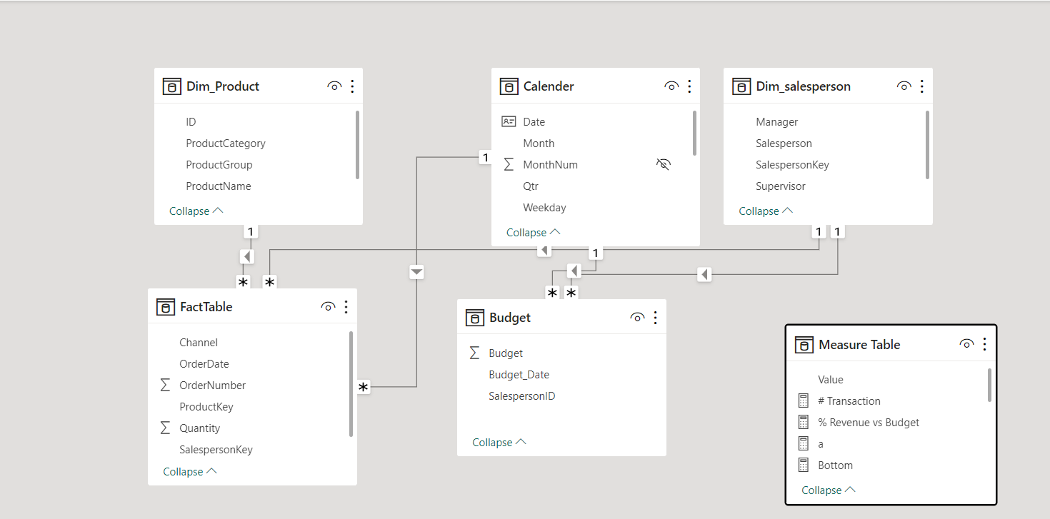
Model View

Slide 9
Company Important Key:
1.total revenue = SUMX(FactTable,FactTable[UnitPrice]*FactTable[Quantity])
2.Total Budget = SUM(Budget[Budget])
3.# Transaction = COUNTROWS(FactTable)
4.Total qty sold = SUM(FactTable[Quantity])
5.Pct of Revenue =
var a=CALCULATE([Total revenue],
REMOVEFILTERS(Dim_salesperson))
var b=[Total revenue]
return
DIVIDE(b,a)
6.Pct of Qty =
var a=CALCULATE([Total qty sold],
REMOVEFILTERS(Dim_salesperson[Supervisor]),
REMOVEFILTERS(Dim_salesperson[Salesperson]))
var b=[Total qty sold]
return
DIVIDE(b,a)

Slide 10
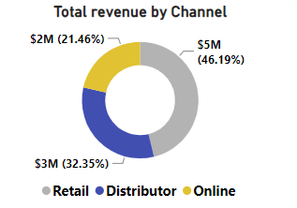
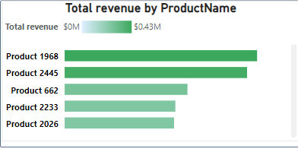
In the donut chart, we determined the total revenue based on channels. The retail channel contributed 46.19% of the total revenue, surpassing other channels. In contrast, the online channel generated a lower profit, accounting for only 21.46%.
In the stacked bar chart, we analyzed the total revenue based on product names. Products 1968 and 2445 contributed more revenue compared to other products, while products 2233 and 2026 generated less profit compared to the other products.

Slide 11
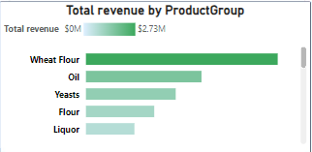
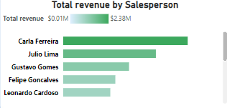
In the stacked bar chart, we calculated the total revenue based on product groups. Wheat flour generated the highest revenue, followed by oil, compared to other product groups. In contrast, liquor products yielded lower profits compared to other product groups
In the stacked bar chart, we analyzed the total revenue based on salespersons. Carla Ferreira sold more products and generated higher revenue for the company. In contrast, Leonardo Cardoso sold fewer products compared to other salespersons and contributed less profit to the company.

Slide 12
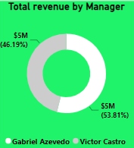
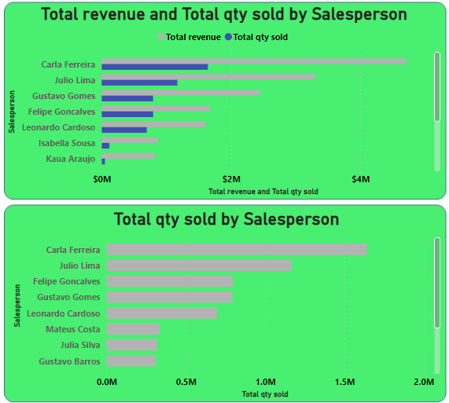
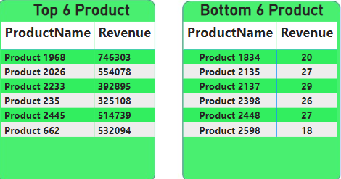
In the donut chart, we determined the total revenue based on managers. Manager Gabriel Azevedo generated more revenue compared to Victor Castro for the company.

Slide 13
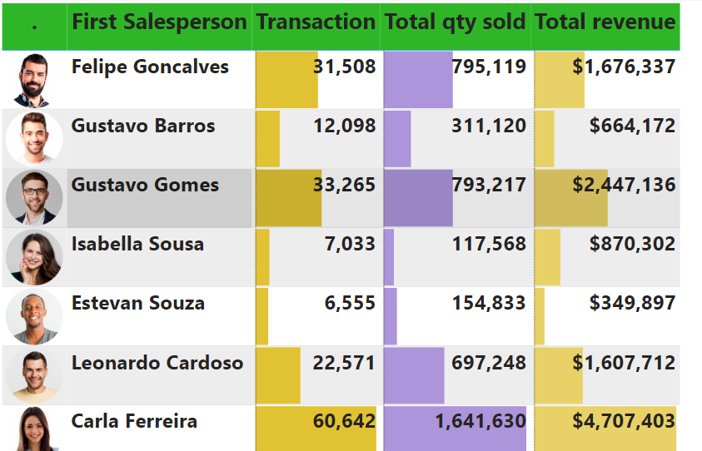

Slide 14
To improve the revenue from sales :
Understand Your Customers:
Take time to understand your customers' needs, preferences, and pain points.
Create buyer personas to tailor your products or services to specific customer segments.
Product/Service Enhancement:
Continuously improve your products or services based on customer feedback.
Innovate and stay ahead of market trends to offer unique value.
Pricing Strategies:
Analyze your pricing strategy. It may be beneficial to re-evaluate your pricing structure to maximize profitability.
Consider offering tiered pricing options to cater to different customer segments.
Sales and Marketing Alignment:
Ensure that your sales and marketing teams work together effectively.
Use marketing to generate high-quality leads that align with your ideal customer profiles.
Sales Training and Development:
Invest in sales training programs to enhance the skills of your sales team.
Equip your team with the knowledge and tools to address customer needs effectively.

Slide 15
Customer Relationship Management (CRM):
Implement a CRM system to track and manage customer interactions.
Use CRM data to personalize sales approaches and improve customer relationships.
Lead Generation:
Invest in lead generation strategies such as content marketing, social media marketing, and SEO.
Optimize your website to convert visitors into leads.
Customer Retention:
Focus on retaining existing customers, as it's often more cost-effective than acquiring new ones.
Develop loyalty programs and offer exceptional customer service.
Expand Your Market:
Consider expanding to new geographic regions or demographic segments.
Research and enter new markets strategically.
Networking and Partnerships:
Build strategic partnerships with other businesses to reach new audiences.
Attend industry events and network with potential clients and partners.

Slide 16
Continuous Improvement:
Regularly review and adjust your sales strategies based on performance metrics.
Foster a culture of continuous improvement within your sales team.
Customer Feedback:
Solicit and act on customer feedback to make necessary improvements.
Show customers that you value their opinions and are committed to meeting their needs.

Slide 17

Thanks You
If you want to view my live dashboard, please click on the 'Live Dashboard' link below:
Live Dashboard

