Slide 1

Sales & Finance (Profit & Loss) Dashboard
Domain : Sales & Finance
Designed & Presented By
Jnanaranjan Pradhan (Data Analyst)

Slide 2
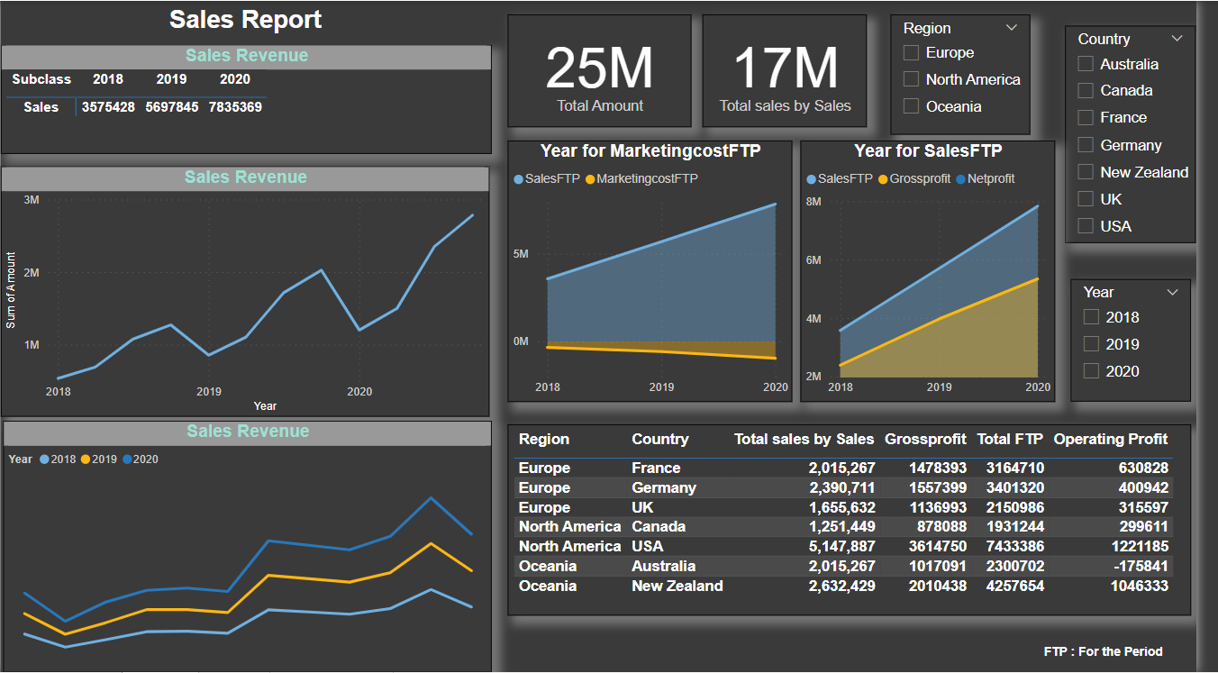

Slide 3
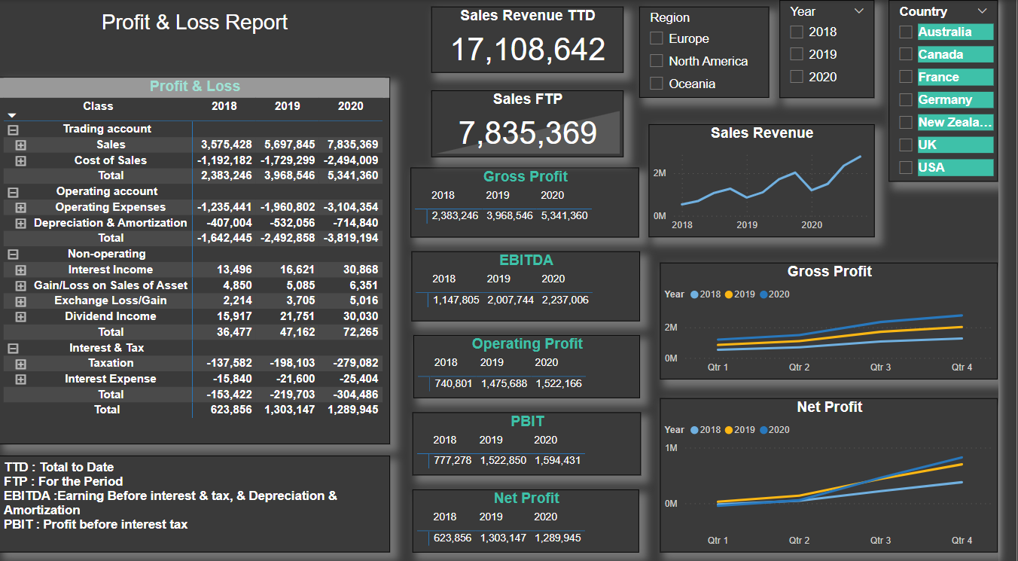

Slide 4
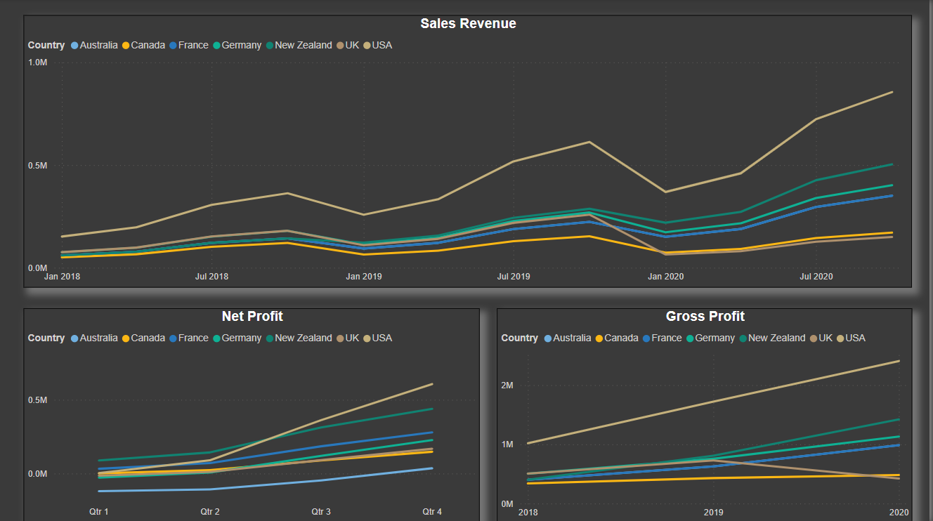

Slide 5
#Total Amount:
24,640,002
#Total Sales:
17,108,642
TTD : Total to Date
FTP : For the Period
EBITDA :Earning Before interest & tax, & Depreciation & Amortization
PBIT : Profit before interest tax
#Sales FTP:
7,835,369
#Sales Revenue TTD:
17,108,642

Slide 6
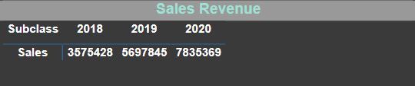
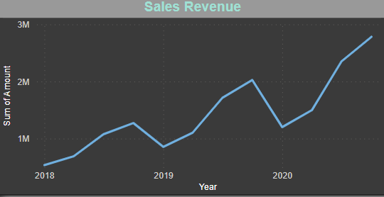
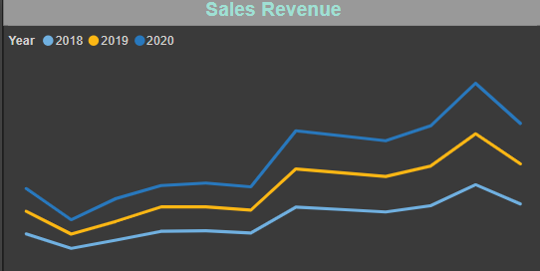
We observed sales based on subclass. In the year 2018, the total sales were 3,575,428. In the year 2019, total sales increased to 5,697,845. In the year 2020, total sales further increased to 7,835,369. The sales increased year by year as each subsequent year progressed.

Slide 7
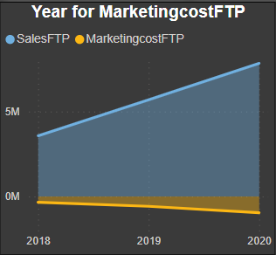
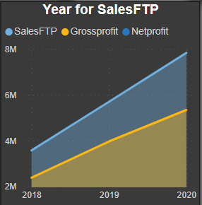
The sales decrease in the year 2018, but sales increase in the year 2020. Sales increase in the Marketing Cost FTP, Sales FTP, Gross Profit, and Net Profit year by year

Slide 8
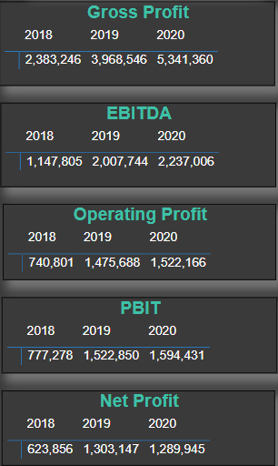
Gross Profit, EBITDA, Operating Profit, PBIT, and Net Profit increase year by year. In 2018, there was a lower Gross Profit, EBITDA, Operating Profit, PBIT, and Net Profit compared to the year 2020, where they showed an increase.

Slide 9
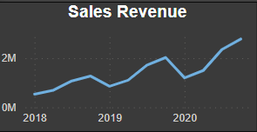
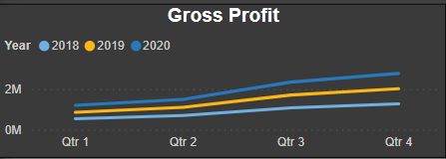
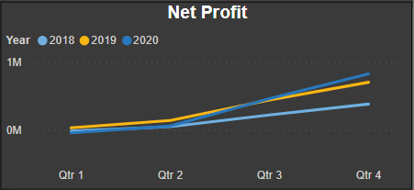
The revenue, Gross Profit, and Net Profit increase year by year. In 2018, there was lower revenue, Gross Profit, and Net Profit, but in the year 2020, these metrics showed an increase.

Slide 10
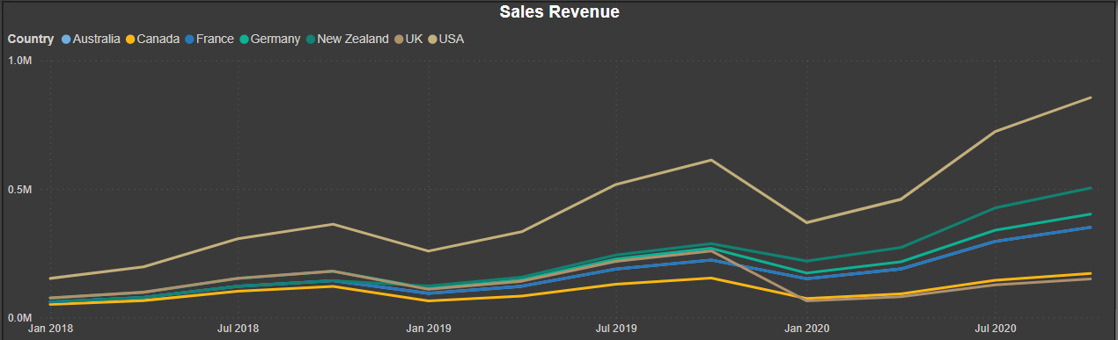
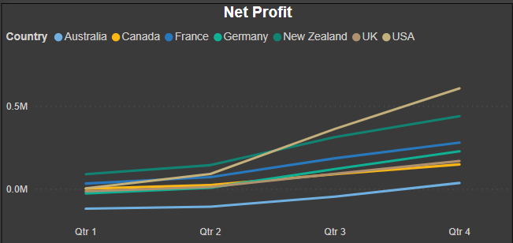
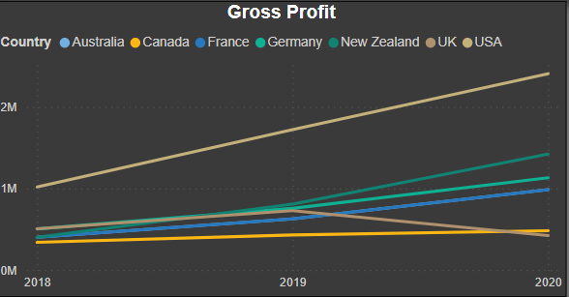
The revenue, Gross Profit, and Net Profit increase year by year. In 2018, there was lower revenue, Gross Profit, and Net Profit, but in the year 2020, these metrics showed an increase.

Slide 11
Recommendation:
Sales: Sales is the process of promoting and selling products or services to customers. It involves various activities such as prospecting, lead generation, pitching, negotiation, and closing deals. Effective sales strategies are essential for revenue generation and business growth.
Key elements of sales:
Customer Relationship: Building and maintaining strong relationships with customers is at the heart of sales. Satisfied customers often lead to repeat business and referrals.
Sales Funnel: The sales process typically follows a funnel model, starting with a broad pool of prospects and narrowing down to actual customers. Understanding this process is essential for sales success.
Sales Techniques: Sales professionals use various techniques such as consultative selling, solution selling, and relationship selling to address customer needs and close deals.
Sales Metrics: Measuring the effectiveness of sales efforts is crucial. Key performance indicators (KPIs) like conversion rate, average deal size, and sales cycle length help in assessing performance.

Slide 12
Finance: Finance is the management of money and resources within an organization. It encompasses activities related to budgeting, financial planning, investment, and accounting. Financial decisions are fundamental to the health and sustainability of a business.
Key elements of finance:
Financial Management: Efficiently managing financial resources is essential for the long-term success of a business. This involves budgeting, cost control, and strategic financial planning.
Financial Statements: Financial statements, including the balance sheet, income statement, and cash flow statement, provide a snapshot of a company's financial health and performance.
Financial Analysis: Evaluating financial data helps in making informed decisions. Tools like ratio analysis and financial modeling are used for assessing a company's financial stability.
Capital Management: Decisions related to sourcing and allocating capital are central to finance. This includes raising funds through loans or equity, as well as investing in projects with a positive return on investment.
The Intersection: The intersection of sales and finance is where a business's financial health and revenue generation meet. Effective coordination between the two functions is crucial. Sales revenue is the primary source of income for a company, and the finance department ensures that this revenue is managed wisely, supporting operations, growth, and profitability.

Slide 13

Thanks You
If you want to view my live dashboard, please click on the 'Live Dashboard' link below:
Live Dashboard

