Slide 1

Sales Performance Matrix Dashboard
Designed & Presented By
Jnanaranjan Pradhan (Data Analyst)

Slide 2
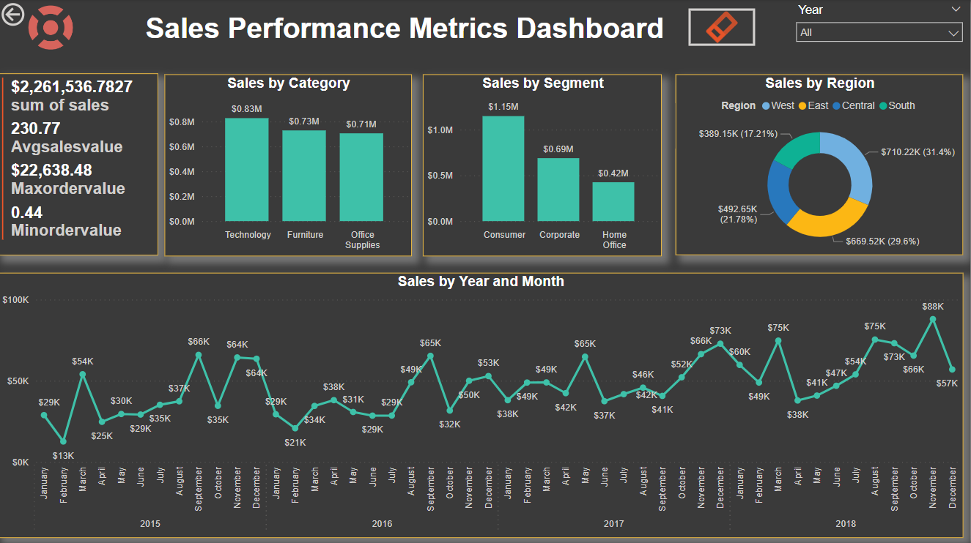

Slide 3
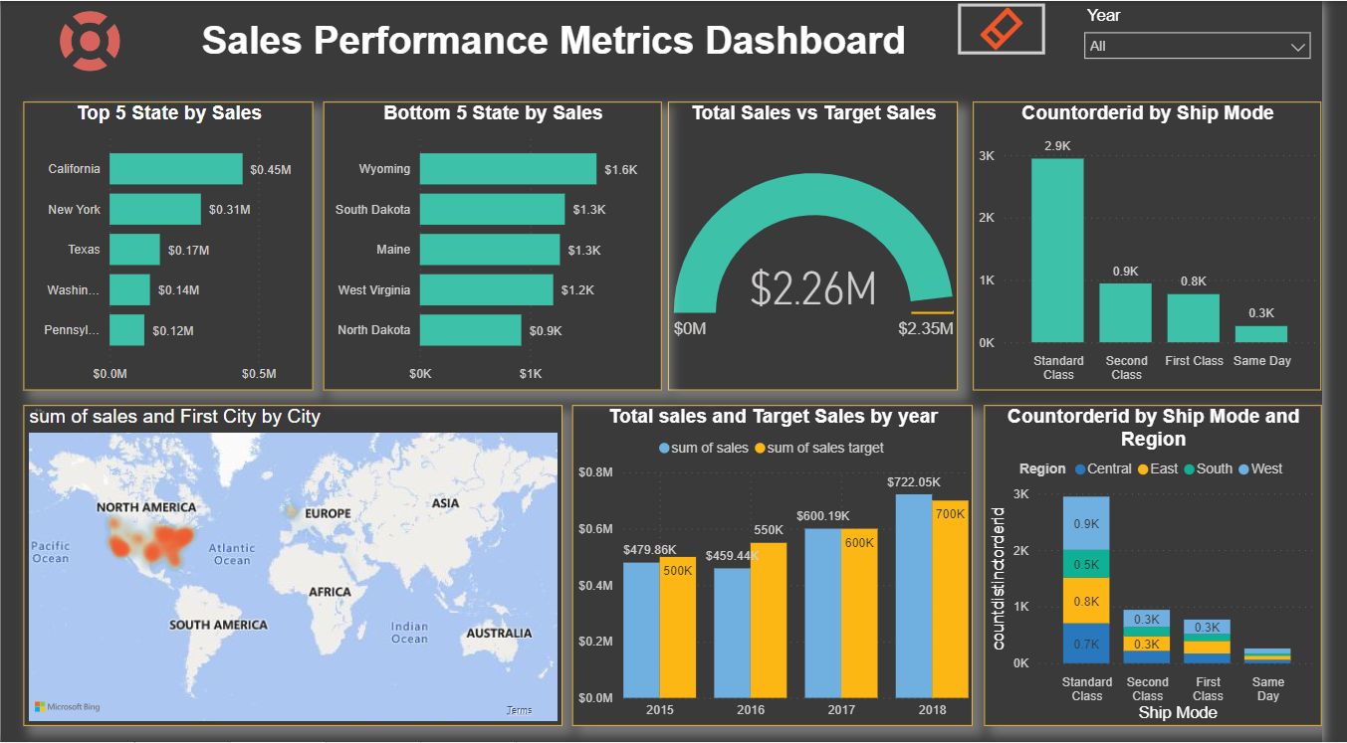

Slide 4
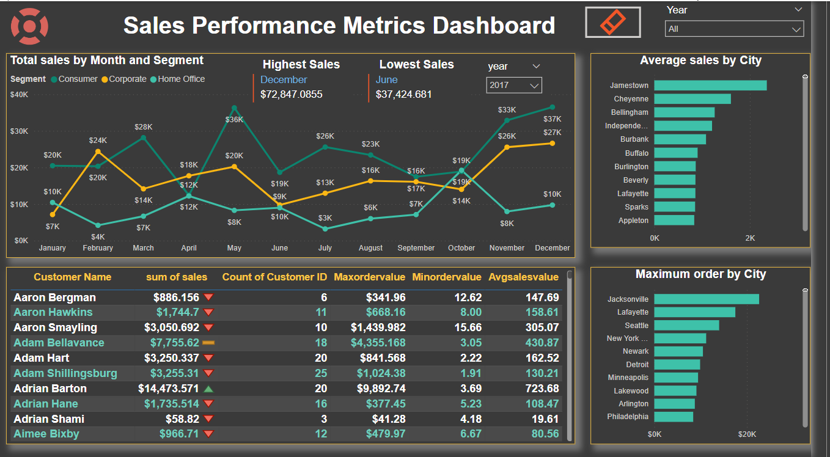

Slide 5
Total Sales:
$2,261,536,7827
The sales stote table contain the following columns :
Category , city , country , customer ID , Customer name ,order Date ,Order ID ,Postal Code , Product ID ,Product Name ,Region ,Row ID ,Sales ,Segment ,Ship Date ,Ship Mode ,State , Sub Category.
Start by importing the data into Power BI Desktop using the "Get Data" option.
Convert the "Order Date" column's data type from text to date.
Extract a new column named "Year" using the "New Column" option.
Create a table using the "Enter Data" option. Name the table "Sales Target." This table should contain two columns: "Year" and "Year-wise Target Value.
Total Average Sales:
230.77
Total Minimum order Value:
22,638.48
Total Maximum order Value:
0.44
Total target Value:
$2,350,000

Slide 6
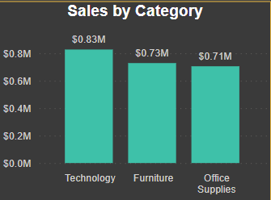
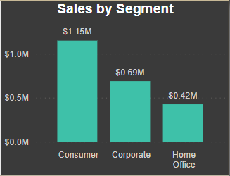
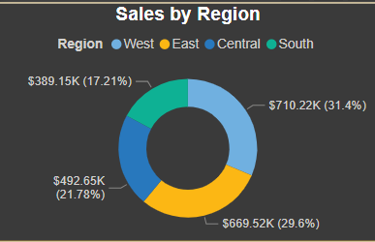
In the clustered column chart, when comparing sales based on categories, the "Technology" category products have higher sales with a value of $0.83 million, whereas the "Office Supplier" products have lower sales with a value of $0.71 million.
In this chart, we compare sales based on three segments: consumer, corporate, and home office. The consumer segment has the highest sales at $1.1 million, followed by the corporate segment at $0.69 million, and the home office segment with the lowest sales at $0.42 million.
In that chart, we compare sales based on regions. The West region generates the highest revenue, with a value of $710.22K, accounting for 31.4% of the total. The East region is the second highest, with a value of $669.52K (29.6%). The Central region follows with a value of $492.66K (21.78%). Finally, the South region generates the lowest revenue, with a total of $389.15K (17.21%).

Slide 7
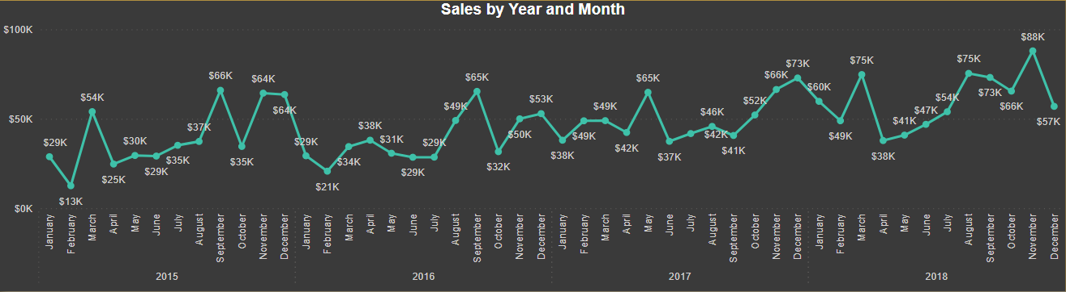
In this chart, we display the total sales on a year and month basis. In the year 2018, the month of November saw the highest revenue generated, totaling 88K, while in the year 2015, the month of February had the lowest revenue, amounting to 13K in comparison to other months and years. Additionally, it's noteworthy that during the winter season, particularly in November and December, sales are generally higher compared to other months. Conversely, during the New Year period, in January and February, revenue tends to be lower when compared to other months.

Slide 8
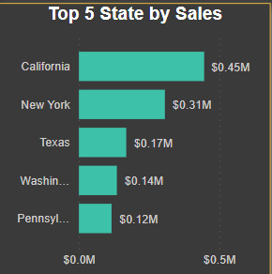
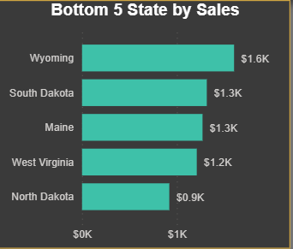
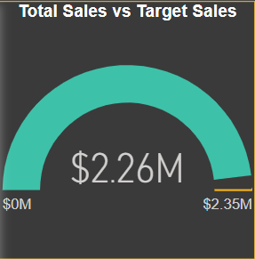
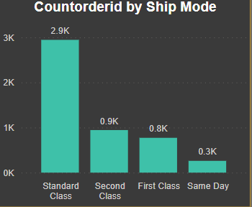
In the Gauge chart, we compare the Total Sales with the Target Sales. Our target sales are set at 2.35 million, but our actual Total Sales amount to 2.26 million. Unfortunately, we have not reached our target, as defined by our company.
In the chart, there are four ship modes: Standard, Second, First Class, and Same Day. We have counted the distinct order IDs in each ship mode. The Standard ship mode has the highest number of order IDs, while the Same Day ship mode has the lowest number of order IDs compared to the other ship modes.
We have identified the top 5 sales based on states. California generates the highest revenue, securing the 1st position, while Pennsylvania generates the lowest revenue, placing 5th.
We have identified the bottom 5 sales based on states. Wyoming generates the most revenue, placing 1st in the bottom-wise ranking, while North Dakota generates the least revenue, securing the 5th position among the bottom states.

Slide 9
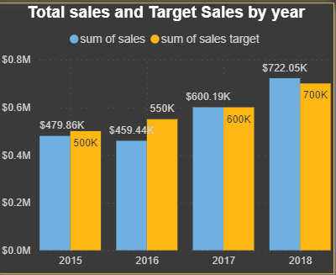
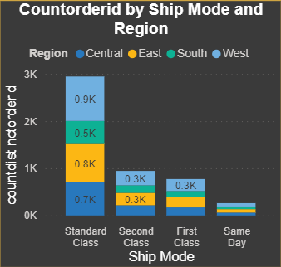
In this chart, we compare the total sales and target sales on a yearly basis. In most years, we successfully met or exceeded our target sales. However, in the year 2018, we fell short of our target. Our company set a higher target of 722.05K, but our actual sales were 700K. On the other hand, in the years 2015 and 2016, we achieved greater profits than the targets set by our company.
In this chart, we have counted the order IDs based on ship mode and region. We found that the "Standard Class" ship mode has the highest number of order IDs. Specifically, in the "Standard Class" ship mode, the West region has the most order IDs compared to other regions. On the other hand, the "Same Day" ship mode has the lowest number of order IDs, indicating fewer orders in this category.

Slide 10
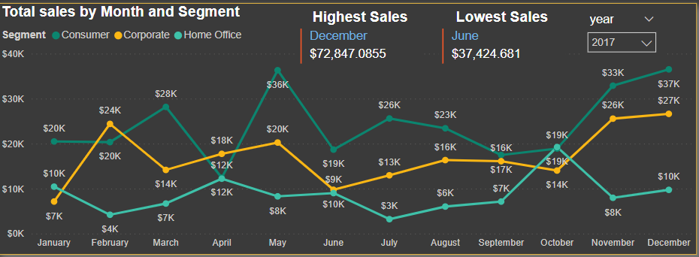
In this chart, we compare the total sales on a monthly and segment basis. During the month of December, the consumer segment generates the highest revenue compared to other months and segments. However, in the month of July, the Home Office segment generates less revenue compared to other months and segments.
The consumer segment generates more revenue, while the Home Office segment generates less revenue compared to the other segments.

Slide 11
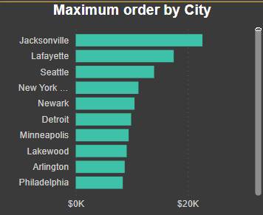
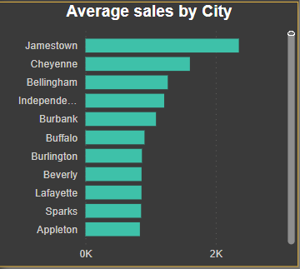
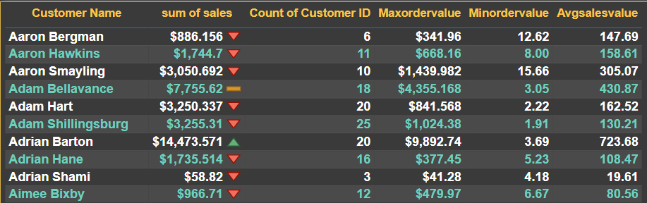
In this chart, we've determined the maximum sales in each city based on the order IDs. We can see which city generates the highest revenue with the maximum order IDs and which city generates the lowest revenue with the maximum order IDs.
In this chart, we've identified the average sales in each city. We can see which city generates the highest average revenue and which city generates the lowest average revenue.

Slide 12
Recommendation:
Improving sales performance metrics involves a combination of strategies, processes, and ongoing efforts. Here are some recommendations to enhance your sales performance metrics:
Set Clear and Realistic Goals: Establish specific, measurable, achievable, relevant, and time-bound (SMART) sales goals. Ensure that your sales team understands these goals and is motivated to achieve them.
Effective Sales Training: Provide comprehensive and ongoing sales training for your team. Ensure that they have the necessary skills and product knowledge to sell effectively.
Hire and Develop the Right Talent: Hire salespeople who have the skills, experience, and personality traits that align with your company's needs. Additionally, provide opportunities for ongoing professional development.
Sales Process Optimization: Streamline and refine your sales processes to reduce bottlenecks and improve efficiency. Ensure that sales stages are well-defined and that the sales team follows a consistent process.
Data-Driven Decision-Making: Leverage data and analytics to gain insights into your sales performance. Identify what works and what doesn't, and make data-driven adjustments.
CRM (Customer Relationship Management) Software: Implement a CRM system to track leads, manage customer data, and monitor sales activities. CRM tools can help automate tasks and improve organization.
Lead Qualification: Improve lead quality by implementing a lead scoring system. This ensures that your sales team is focusing their efforts on the most promising leads.

Slide 13
8.Sales and Marketing Alignment: Foster collaboration between your sales and marketing teams. Ensure they are aligned in terms of goals, messaging, and lead handoff procedures.
9.Incentives and Compensation: Design a competitive and motivating compensation plan for your sales team. Reward them for meeting and exceeding targets.
10.Performance Reviews and Feedback: Regularly review individual and team performance. Provide constructive feedback and coaching to help your salespeople improve.
11.Customer Relationship Management: Cultivate strong, long-lasting relationships with customers. Happy customers are more likely to make repeat purchases and refer others.
12.Technology Integration: Leverage technology to automate routine tasks and improve communication. This can free up your sales team to focus on selling.
13.Sales Enablement: Provide your sales team with the right tools and resources, such as sales collateral, presentations, and competitive intelligence, to help them succeed.
14.Continuous Learning: Encourage a culture of continuous learning within your sales team. Encourage them to stay up-to-date with industry trends and sales techniques.
15.Customer Feedback: Solicit feedback from customers to understand their needs and preferences better. Use this feedback to tailor your sales approach.
16.A/B Testing: Experiment with different sales and marketing strategies to determine which ones yield the best results. A/B testing can help refine your tactics.
17.Accountability: Hold your sales team accountable for their performance. Regularly review results and address underperformance promptly.
18.Sales Forecasting: Implement accurate sales forecasting to better plan for future sales and resource allocation.

Slide 14

Thanks You
If you want to view my live dashboard, please click on the 'Live Dashboard' link below:
Live Dashboard

