Slide 1

Presented by
Esha
Vinuthna
Gayathri

Slide 2
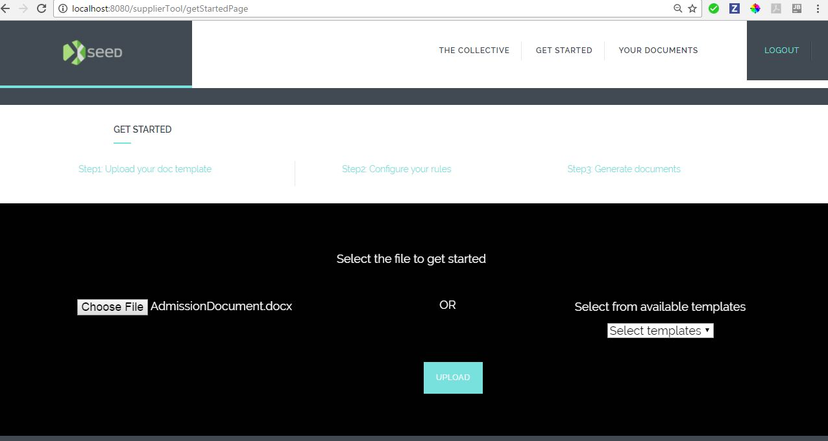

Slide 3
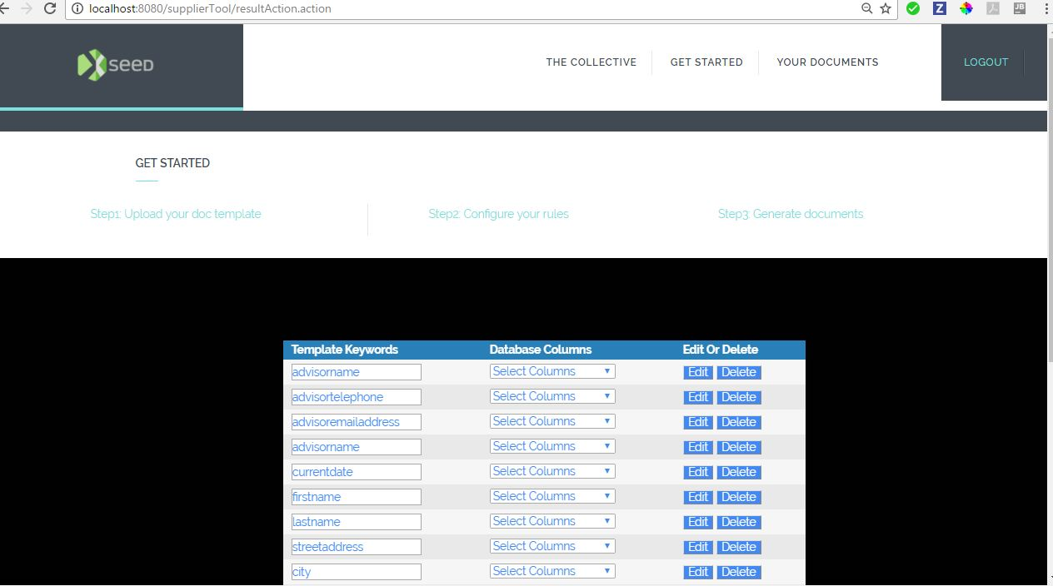

Slide 4
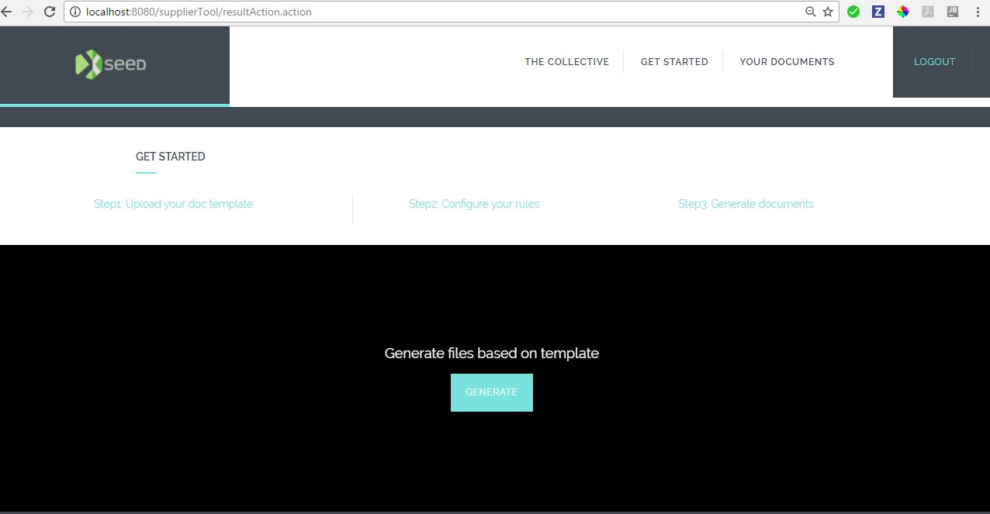

Slide 5
