Slide 1


Slide 2
Agenda
Problem Statement 03
Data Mining - 01 04
Data Mining - 02 05
Exploratory Data Analysis (EDA) 06
Data Visualization 07
Algorithms Used 08
Analysis of Results 09
Conclusion & Future Work 10

Slide 3
Problem Statement
Given a dataset containing information about various houses represented by the important features like
LotArea: The area of the lot in square feet.
Neighborhood: The location of the house in a specific neighborhood.
OverallQual: Overall material and finish quality of the house (1-10 scale).
YearBuilt: The original construction year of the house.
YearRemodAdd: The year of remodeling or addition to the house.
along with their corresponding sale prices (target variable).
The goal is to develop a predictive model that can accurately estimate the sale price of new houses based on their features.

Slide 4
Data Mining - 01
Firstly, after loading the dataset “test.csv” using ‘read_csv()’ from the pandas module.
Handling Missing Values: Carefully examined the dataset for any missing values.
For categorical variables, such as "Neighborhood" and "ExterQual", filled the missing values with the mode, which is the most frequent category in the respective feature.
For continuous variables like "LotFrontage" and "MasVnrArea“, used the K-Nearest Neighbors (KNN) imputer to estimate the missing values based on the values of their nearest neighbors.
Then, check for duplicates. Here,there are no duplicates.
Removing Outliers: Outliers can adversely impact model training. To address this, the Interquartile Range (IQR) method to detect and remove outliers from the dataset was used. This ensures the model is not influenced by extreme values.
Encoding Categorical Variables: Machine learning models require numerical input. For categorical variables like "Street" and “LotShape”,one-hot encoding is used.

Slide 5
Data Mining - 02
Removing Unnecessary Features: Some features, like "LowQualFinSF", "MiscVal", "BsmtFinSF2", "PoolArea", "3SsnPorch", and "ScreenPorch", showed very little correlation with the target variable, "SalePrice." To reduce complexity, Decided to drop these features from the dataset.
Seperate the Independent variables into one dataframe and the target variable into another.
Train-Test Split: For model evaluation, Split the preprocessed data into two subsets:
a training set (approximately 80-85% of the data)
a test set (remaining 15-20%).
Feature Scaling: To prevent features from having disproportionate effects on the model applied feature scaling. Specifically used standardization to scale numerical features, setting the mean to 0 and the standard deviation to 1. This ensures fair treatment of all features during model training.

Slide 6
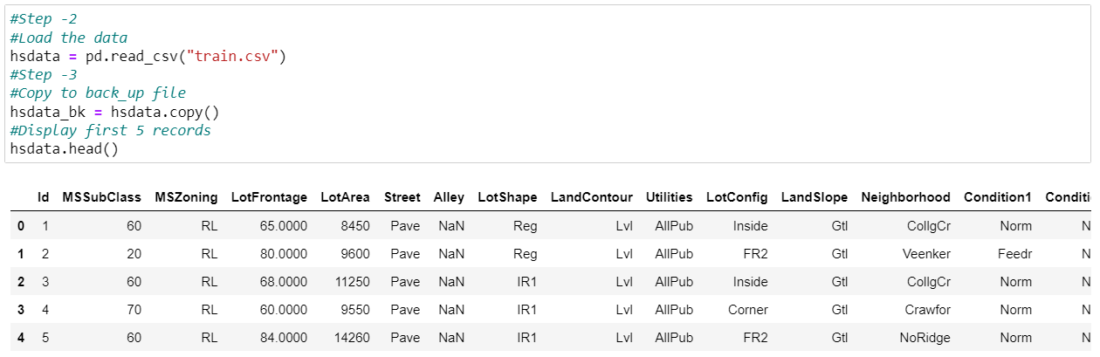
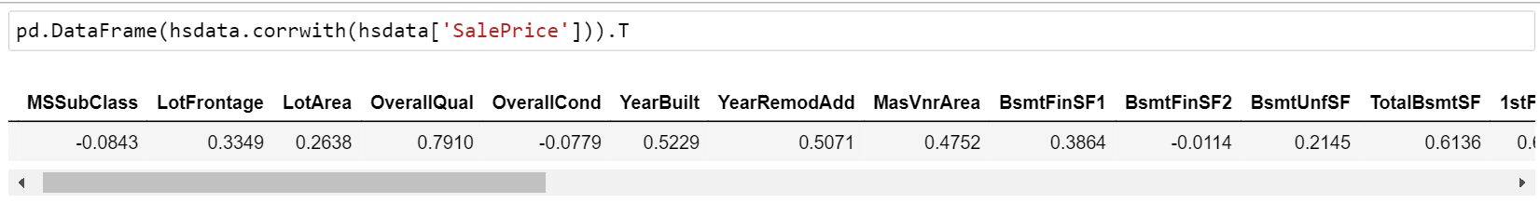
Exploratory Data Analysis (EDA)

Slide 7
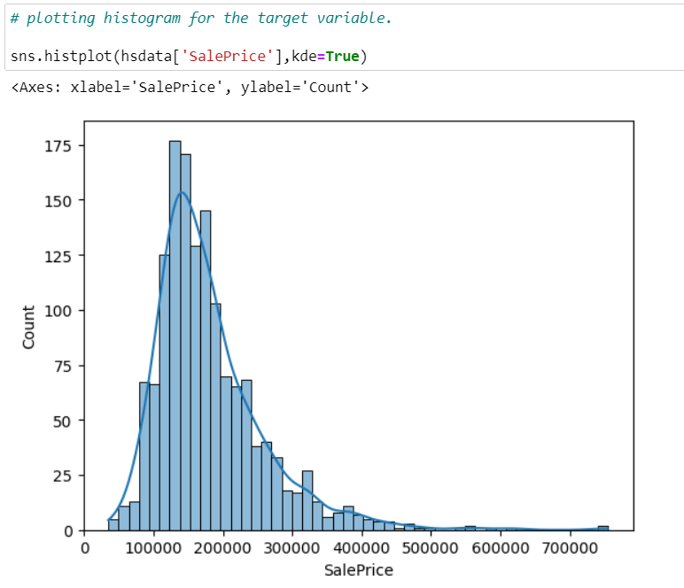
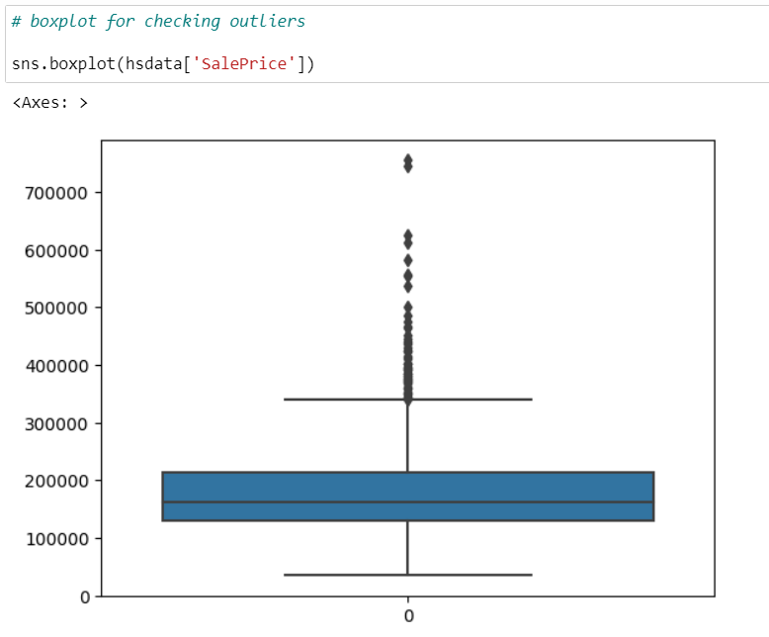
Data Visualization

Slide 8
Algorithms Used
For this dataset, following classification algorithms are used:
KNN Regressor
Linear Regression
Decision Tree Regressor
RandomForest Regressor
ExtraTrees Regressor
Bayesian Regressor
Support Vector Regressor

Slide 9
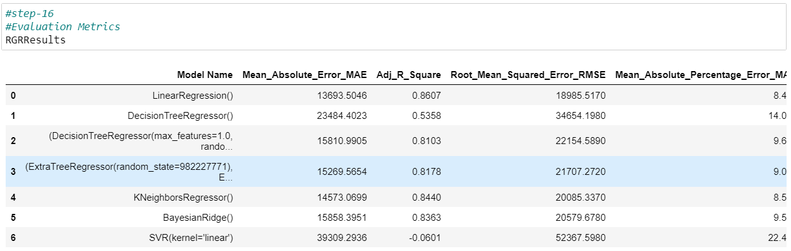
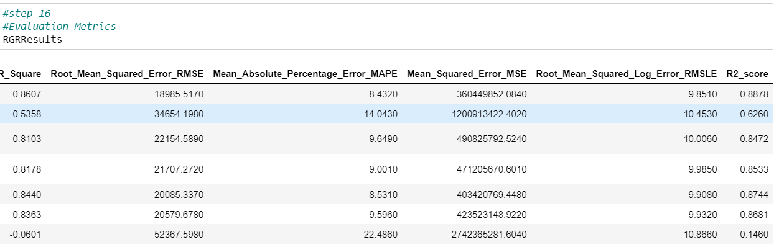
Analysis of Results

Slide 10
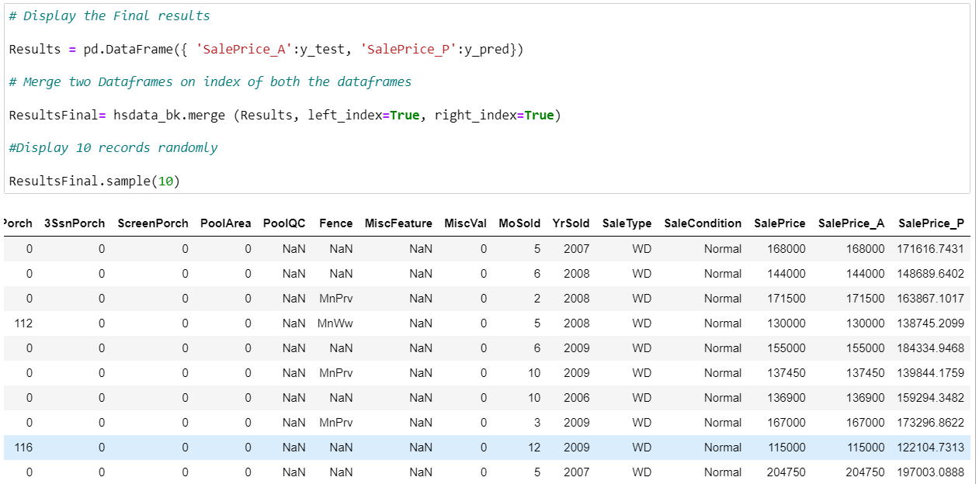
Conclusion and Future Work
Future Work:
Parameter tuning can be used to achieve better results.

Slide 11
Thank You
Q & A
Student Name: K J V Kumar
Roll Number: 21B91A05G2
SRKR Engineering College
Mobile: +91 6305128196
Email: 21b91a05g2@srkrec.ac.in
Bhimavaram - India

