Slide 1

Raysense
SMART INDIA HACKATHON 2026
PROBLEM STATEMENT TITLE
Adaptive Variable Resolution 2.5D Lidar Mapping
for Dynamic Environment Perception
PROBLEM STATEMENT ID
ORGANISATION
THEME
SIH26053
DRDO
Smart Automation
PS CATEGORY
TEAM ID
TEAM NAME
Software
ADD FROM PORTAL
Raysense
Notes:
PRANAVI — 55s. PS ID + DRDO. Then 93% / 11%. PAUSE 3s after "eleven percent".

Slide 2
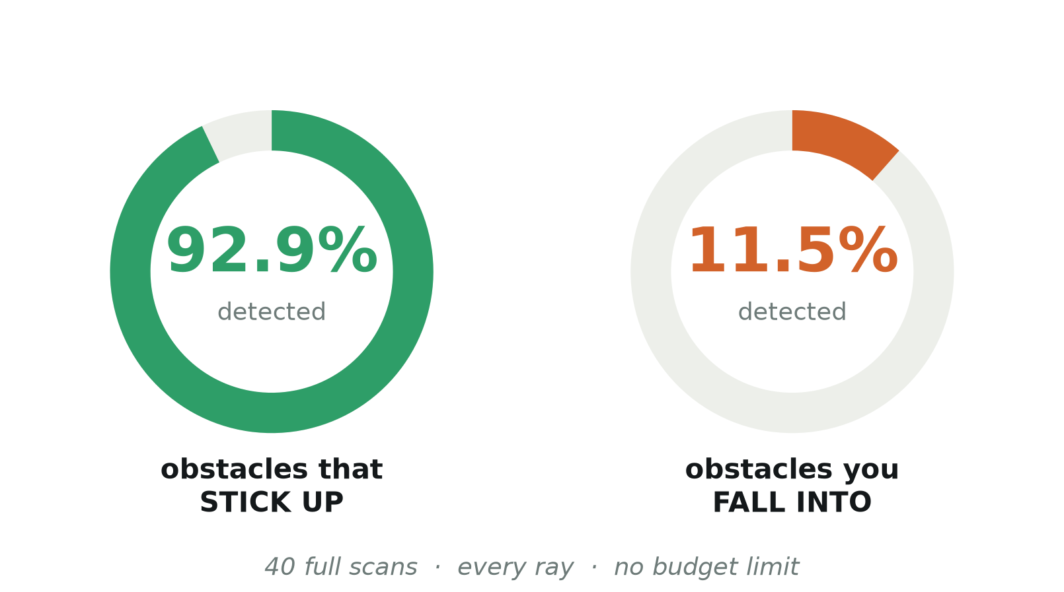
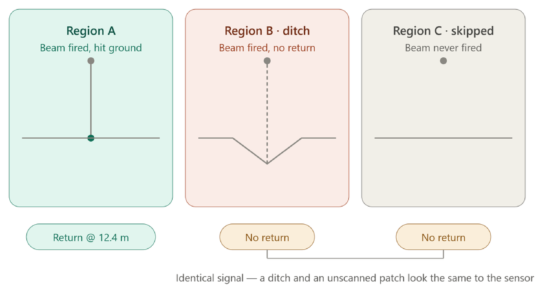
Raysense
Adaptive Point-Budget Lidar Perception for UGVs
A FULL SCAN ALREADY MISSES 9 IN 10 DITCHES
OUR ANSWER
A three-state map
OBSERVED
UNKNOWN
A DITCH AND A PATCH YOU NEVER LOOKED AT GIVE THE SAME SIGNAL
CANDIDATE_NEGATIVE
Unknown is never upgraded to “safe”.
@SIH Idea submission- Template
2
Notes:
JEEVIKA — 96s. Walk A / B / C. Land on "B and C are identical". Then the three states, then novelty.

Slide 3
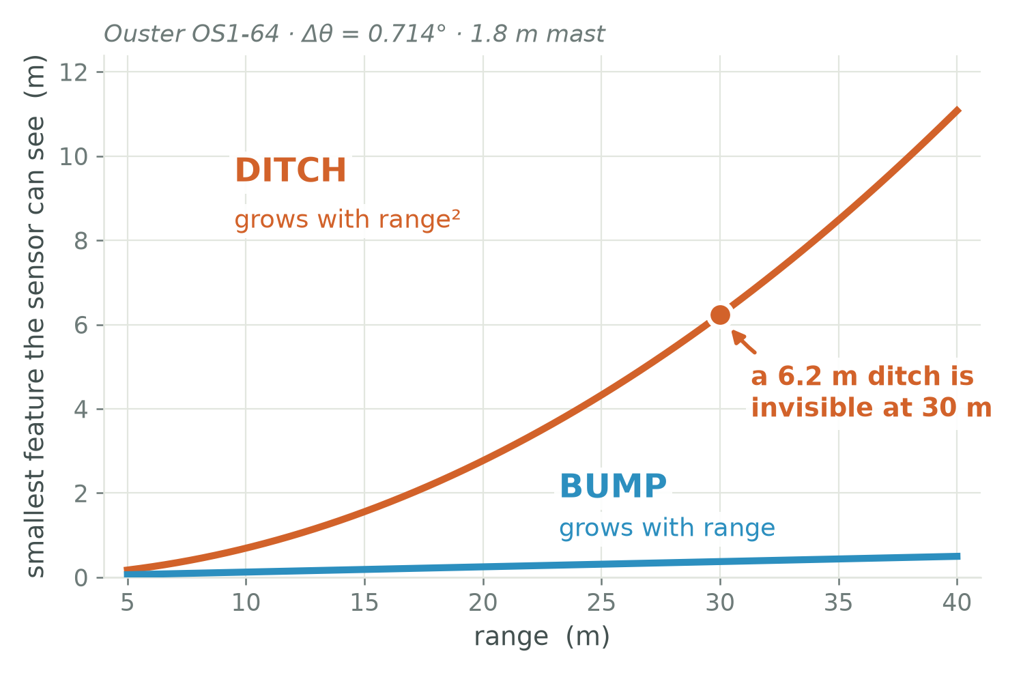
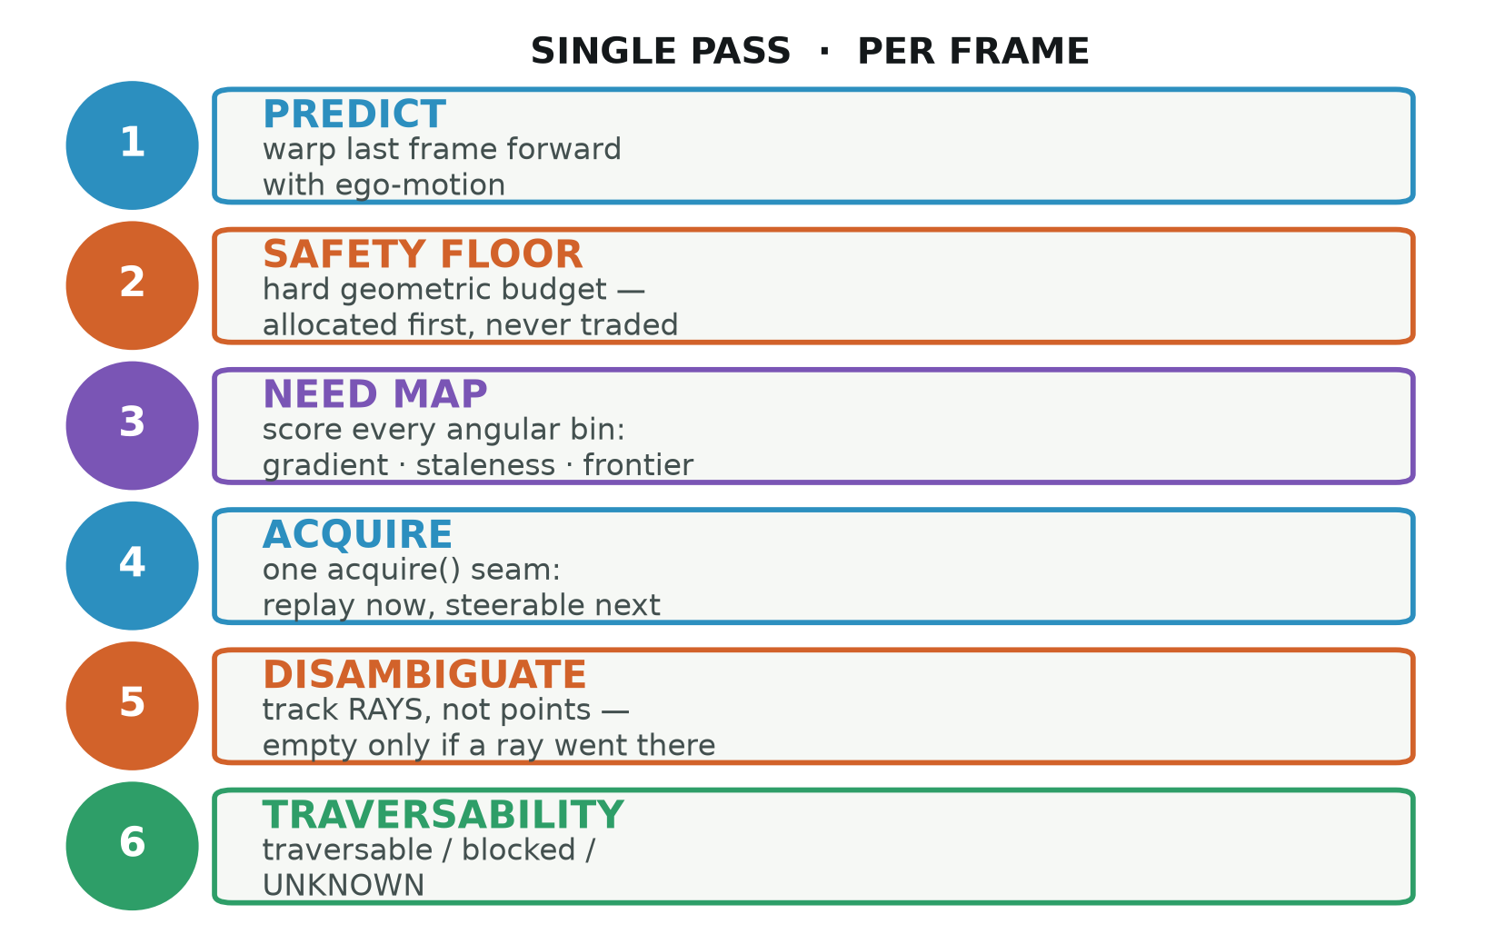
Raysense
TECHNICAL APPROACH
DITCHES DEGRADE QUADRATICALLY · BUMPS ONLY LINEARLY
Δθ ≤ w · h_{sensor} / r²
Python 3.11 · NumPy
Replay + live-sensor seam
Fixed-grid 2.5D map
43 ms / frame · CPU
@SIH Idea submission- Template
3
Notes:
NIKITA — 84s. 0.7 m spacing at 10 m, 9 m at 30 m. That is why a 6 m ditch at 30 m is invisible. Then the six steps.

Slide 4
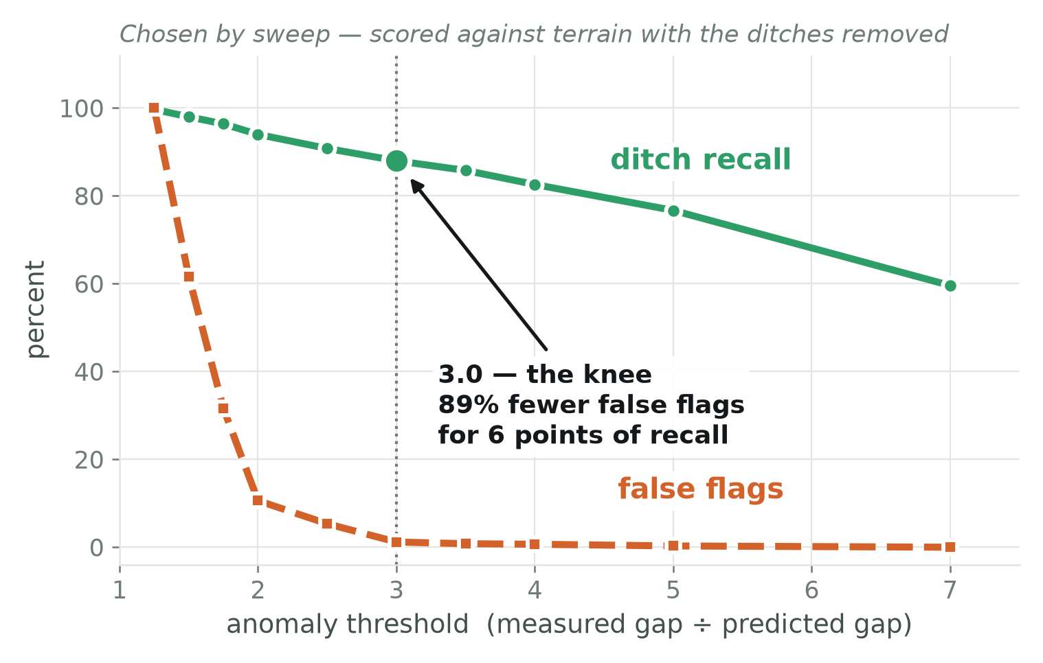
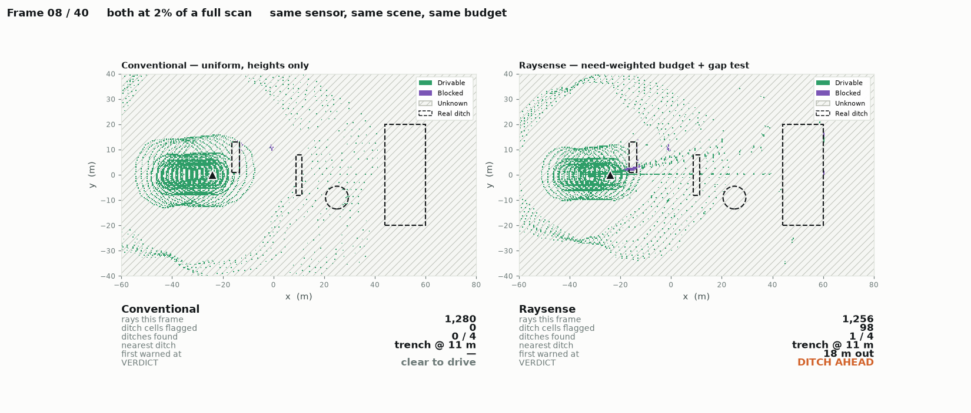
Raysense
FEASIBILITY AND VIABILITY
IT RUNS TODAY — 103 TESTS, REPRODUCIBLE BIT-FOR-BIT
NO NEW HARDWARE
GROUND TRUTH KNOWN
103 TESTS PASS
EVERY PARAMETER CHOSEN BY SWEEP, NOT BY EYE
HONEST RISKS
73%
precision, not 100% — crest occlusions
0
frames of RELLIS-3D run so far — next step
no
Jetson benchmark — we will not quote one
@SIH Idea submission- Template
4
Notes:
NIKITA — 48s. No new hardware, ground truth known. Volunteer all three risks — especially that RELLIS has NOT been run.

Slide 5
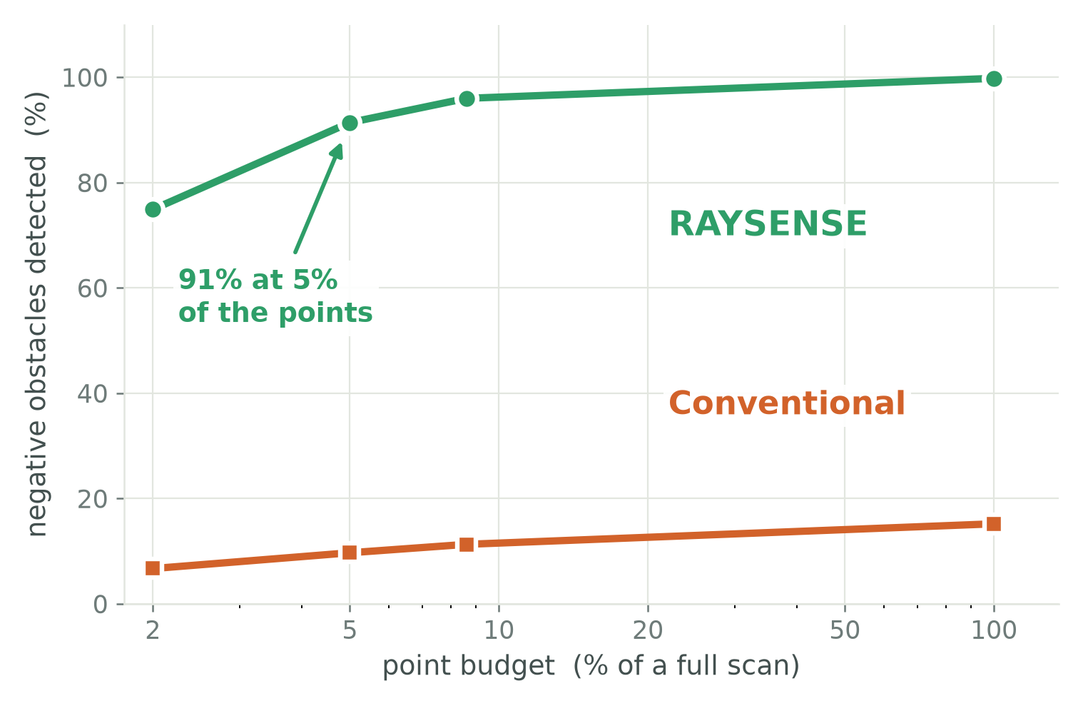
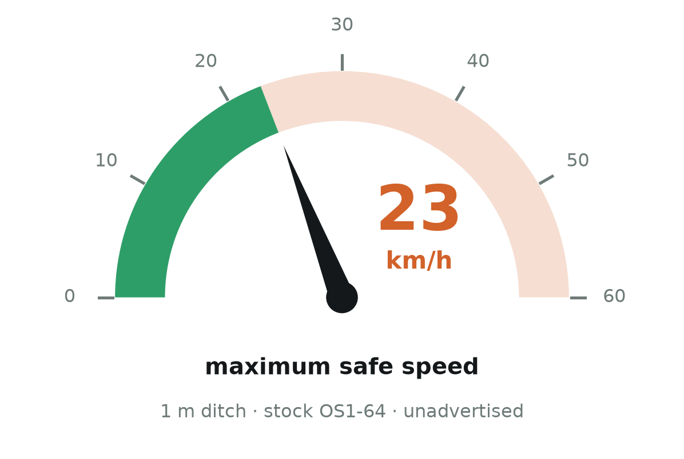
Raysense
IMPACT AND BENEFITS
THE SPEED LIMIT NOBODY PUBLISHED
91% OF DITCHES AT 5% OF THE POINTS · 20× FEWER
Defence UGVs
unmapped ground becomes navigable
Field operators
a ditch does not damage a vehicle — it ends it
Platform designers
a quantified speed ceiling, per sensor
@SIH Idea submission- Template
5
Notes:
ANUJ — 66s. Warmest delivery. Three audiences, then land on 23 km/h and PAUSE.

Slide 6
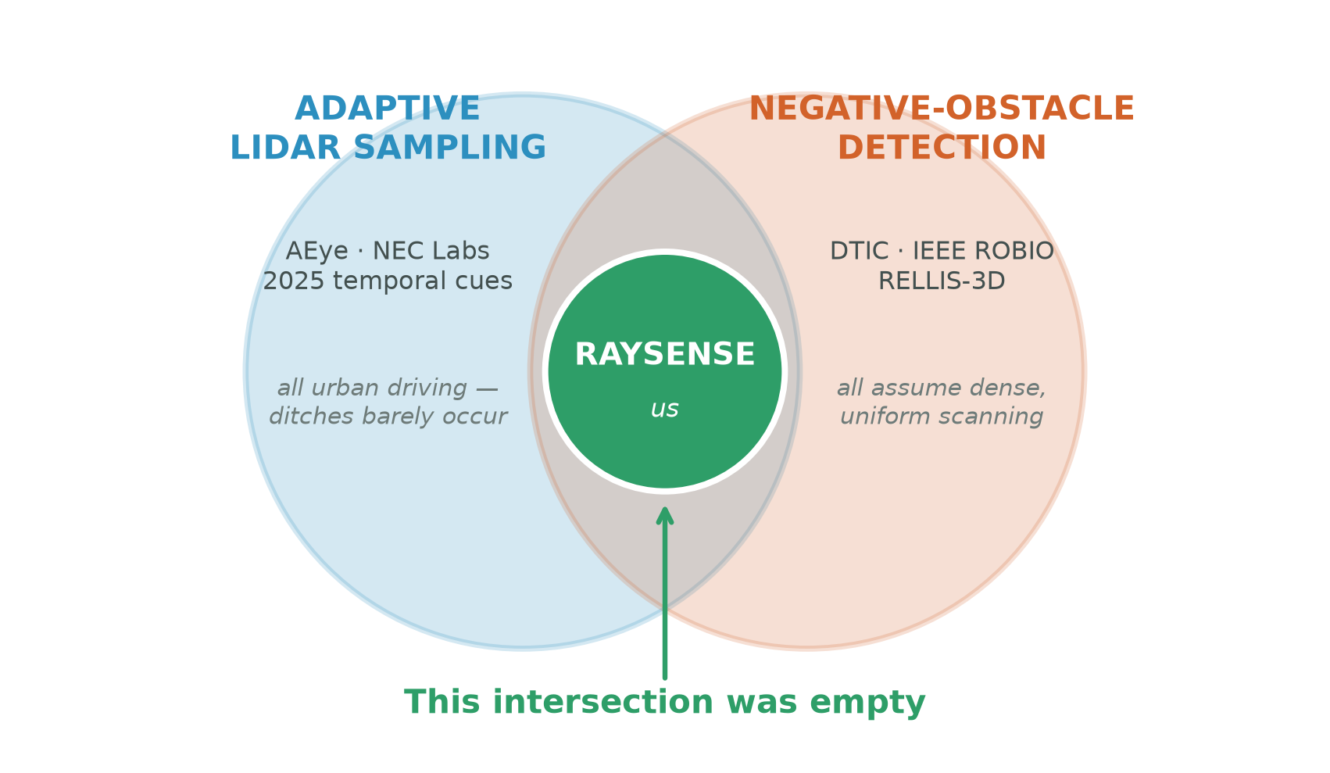
Raysense
RESEARCH AND REFERENCES
REFERENCES
RELLIS-3D
ICRA 2021 · off-road, Ouster OS1-64
NEC Labs
MEMS foveating lidar — Pittaluga et al.
Adaptive LiDAR Scanning
temporal cues, 2025
AEye iDAR / 4Sight
US 11675053 · 11782136 · 11860313
Larson & Trivedi
DTIC ADA561293 — negative obstacles
WE DID NOT INVENT ADAPTIVE LIDAR — WE FOUND WHERE IT BREAKS
IEEE ROBIO 2024
Ours: a three-state map · the corrected quadratic floor · a range-normalised gap test
sparse 3D lidar, off-road ditches
@SIH Idea submission- Template
6
Notes:
PRANAVI — 41s. We cite these BECAUSE the field exists. Close on the three numbers and stop.

