Slide 1



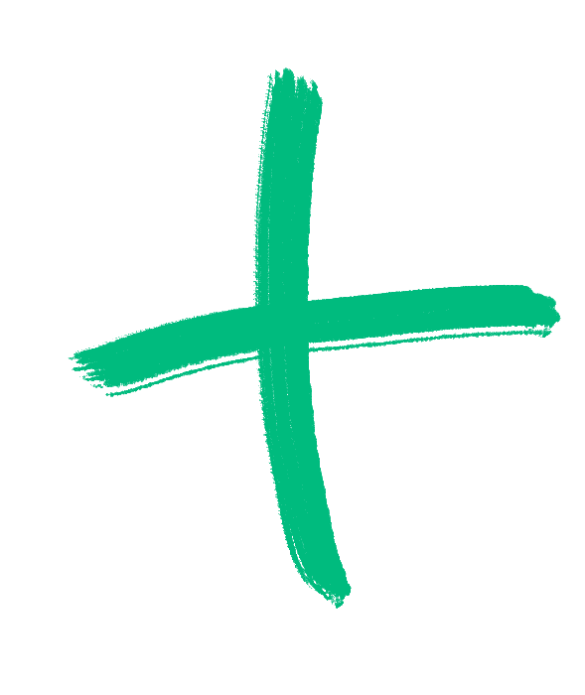

The Biggest Lever & Lowest Hanging Fruit:
Referrals

Slide 2

Table of Contents
Big Picture
Referral Form
Referral Tracker
Referral Compensation
Referral Contest

Slide 3
Big Picture
Referrals have historically had our highest close rate and largest AOV of all channels.
Close rate = 35%
Contract Value for On-Going = $185,900
Contract Value for Projects = $24,100

Slide 4
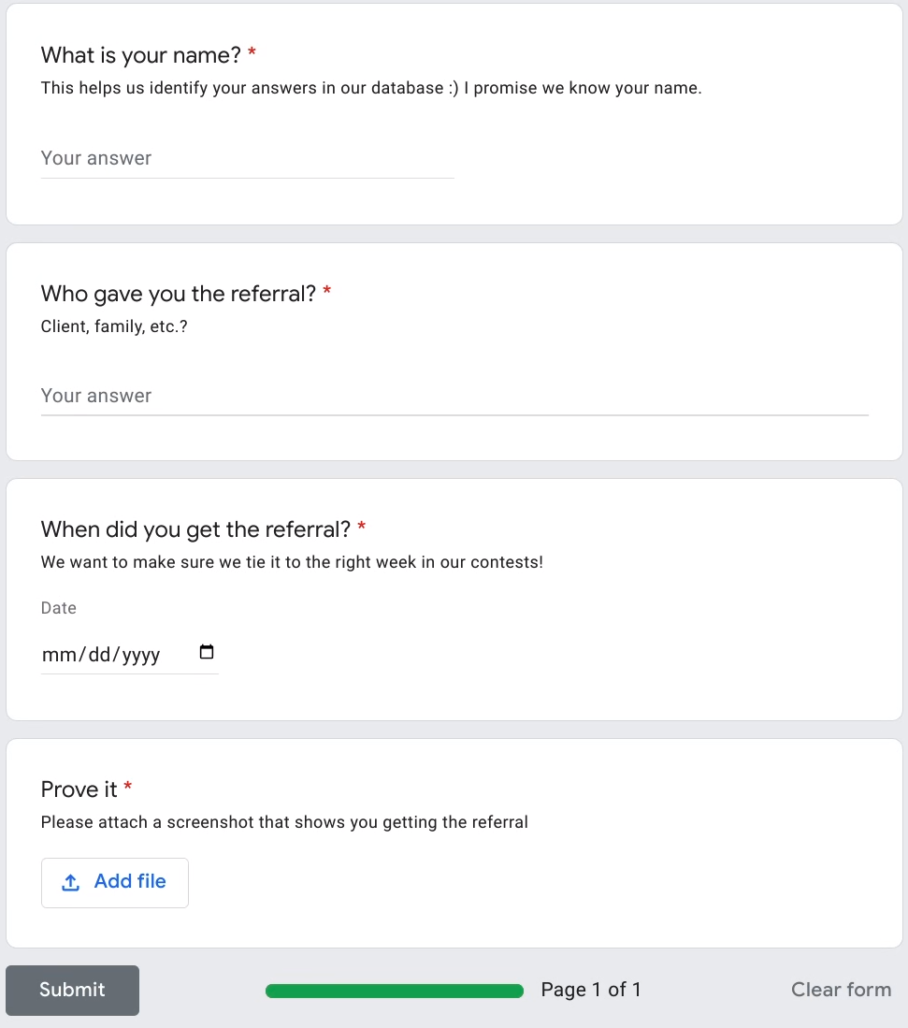

Referral Form
Link to Form

Slide 5
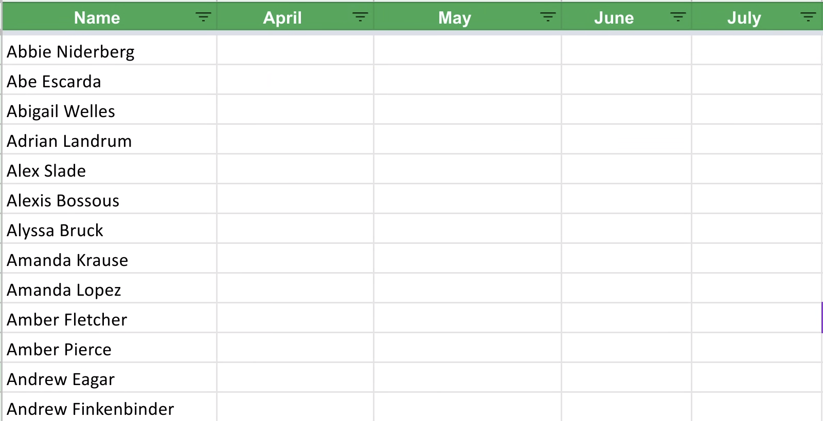
Referral Tracker
Link to Sheet

Slide 6
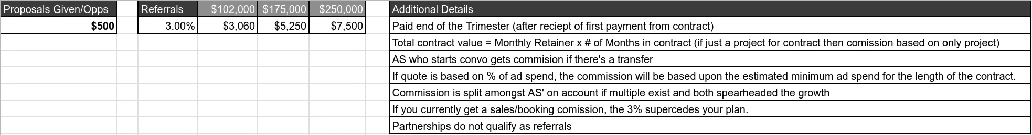
Referral Compensation
Link to Sheet

Slide 7
Referral Contest
The team member with the most referrals each week will win $500 and be announced at Office Hours
If there is a tie, the $500 pushes to the next week. So, if you win the next week it’s worth $1,000 and so on.
The person with the most referrals earned at the end of the month will win an additional $1,000. If there’s a tie, the $1,000 will be shared equally.
Fine print: All referrals must be a SaaS company that we are not currently working with or not currently an open opportunity, to count.

Slide 8
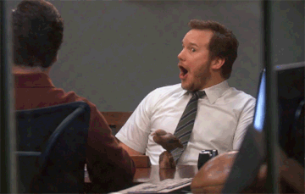
static

Slide 9
Thank You
Thank
You

