Slide 1



1:1s Template and Bi-Annual Performance Reviews
June 2022

Slide 2




Structured 1:1’s

Slide 3



Standards of 1:1s at Directive
All 1:1 notes are taken in Lattice
Managers and direct reports meet at a minimum 2x a month for 30 min each
Review the discussion points in the company wide template, if it doesn’t indicate how frequently, that means review every 1:1
Update all “Growth Areas” 1x a month
People Ops will track usage data in Lattice including the number of people participated
  Taking any action in the 1:1 will trigger it to show up as participated
    ex. checking off an agenda item, leaving a note, adding an action item, adding a talking point

Slide 4
Company Wide Bi-Weekly 1:1 Template
Status Updates (OKRs, Clients, Projects, etc.)
Roadblocks
Personal Check-In
What should I start, stop, and keep doing? (1x a month)
Career Development (2x a trimester)
Notes:
As our #1 value states, People First, we should first check in on how our people are doing. This impacts our work and checking in on where someone is can influence the rest of the conversation.
Checking in on OKR’s using Lattice Grow and connecting them to 1:1s to drive accountability, performance conversations ASAP, to get help to everyone so they can be set up for success to reach their OKRs
What is getting in the way of them accomplishing what they’ve set for themselves
We need to get the the habit of exchanging feedback and having a prompt will hopefully be a trigger to share in a specific way
Career Development conversations should happen 2x a trimester

Slide 5


Bi-Annual Performance Review

Slide 6
Bi-Annual Performance Review
Review cycles are based on the employees start date and happen bi-annually (every 6-months) including a self-review and a manager review
Reviews are a checkpoint, with the standard that an employee should never be surprised by anything brought up in the meeting
Revised questions by reducing the number of employee questions from 14 to 5 and matching them with the questions managers answer to create consistent topics both people are reviewing
Track metrics using Lattice usage data
Notes:
The structured 1:1 format with OKRs, roadblocks and feedback will prompt conversation to ensure course correction measures are put in place long before performance is a repetitive issue and a coaching conversation, PDR, or PIP are required
Instead of being focused solely on past performance, the bi-annual performance review is also a dedicated time to discuss career aspirations and how they can grow at Directive and as a professional

Slide 7
Bi-Annual Performance Review, Self Review
What went well in the previous 6 months?
  Description: Think of things you're proud of accomplishing, big or small, we want to hear it all!
    Comment
What could have gone better in the previous 6 months?
  Description: Think of things you're not as proud of or moments you learned from.
    Comment
To what extent are you meeting your assigned Objectives in Lattice?
  Description: Please explain the reason for your answer using the comment field below.
    Rating and Comment
    Developing, Performing, Exceeding with definitions
What skills, and/or behaviors would you like to improve in the next 6 months to move you closer to your career goals?
  Comment
I consistently embodied Directive values in the previous 6 months.
  Description: Values listed
    Rating (Likert Scale) and Comment

Slide 8
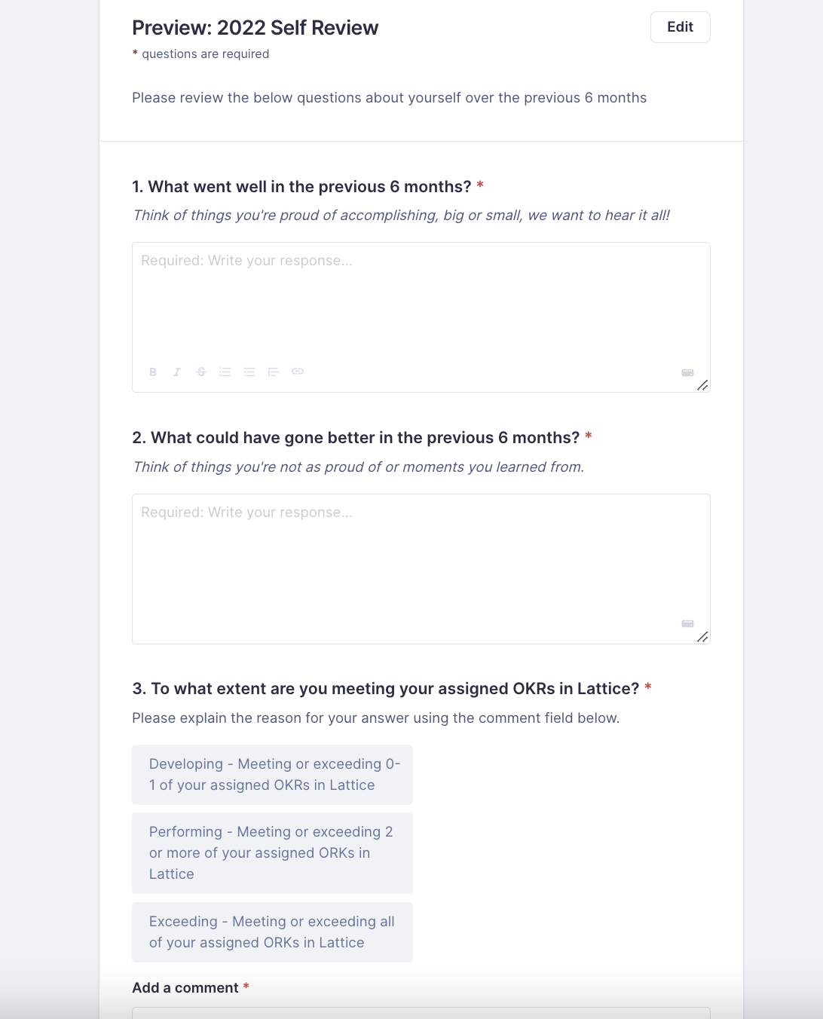
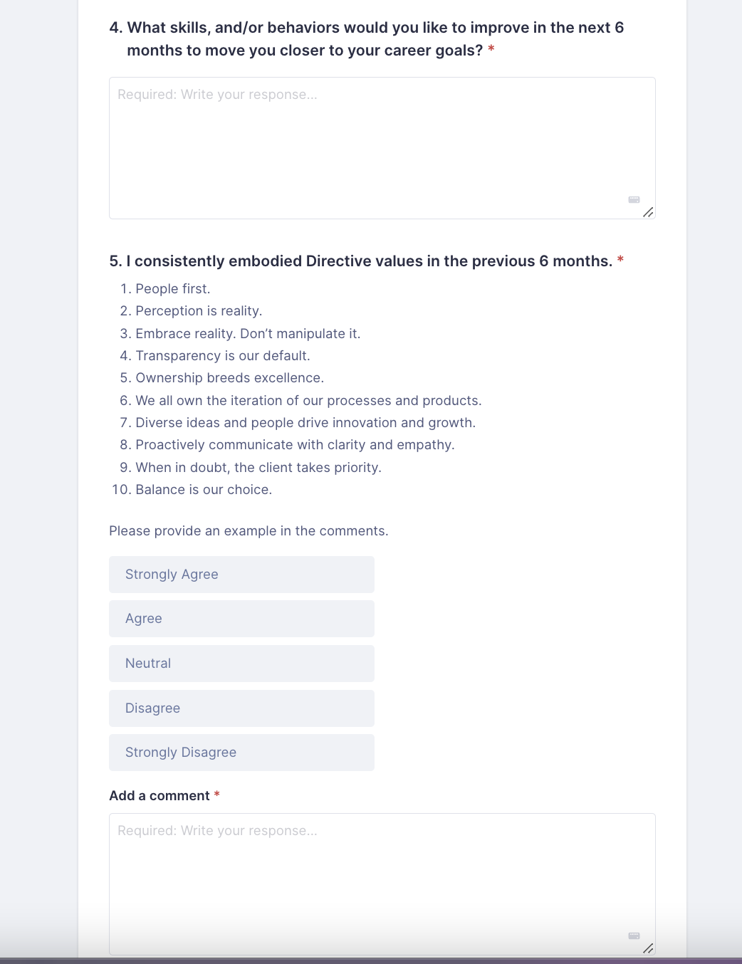
Preview of 2022 Self Review in Lattice

Slide 9
Bi-Annual Performance Review, Manager (*Downward) Review
What went well in the previous 6 months?
  Description: Think of things you're proud of accomplishing, big or small, we want to hear them all!
    Comment
What could have gone better in the previous 6 months?
  Description: Think of teachable moments and things you’d like to have seen be better.
    Comment
To what extent is this person meeting their assigned Objectives in Lattice?
  Description: Please explain the reason for your answer using the comment field below.
    Rating and Comment
    Developing, Performing, Exceeding with definitions
To what extent did this person accomplish the responsibilities and expectations of their role?
  Description: When answering this question, please think of the Roles & Responsibilities section of the relevant job description. Please explain the reason for your answer using the comment field below.
    Rating and Comment
    Developing: Below Expectations, Performing: Meets Expectations, Exceeding: Exceeds Expectations
*Downward means Manager reviewing a Direct Report
Notes:
UPDATED QUESTIONS 7/6/22
Summary of results and accomplishments
Summary of opportunities
Objective performance management rating (results output)
Manager coaching vision statement
Soft Skill /Job Requirement
Values alignment - are their behaviors demonstrating our values?
What Directive value did this person consistently demonstrate in the previous 6 months?
To what extent did this employee's behavior exemplify our companies values?
Comment
Promotion Question to report to Finance
Did this person’s behaviors consistently exemplify our company’s values?
Below Expectations = Developing
Met Expectations = Performing
Exceeded Expectations = Exceeding

Slide 10
Bi-Annual Performance Review, Manager (*Downward) Review
5. Did this person’s behaviors consistently exemplify our company values in the previous 6 months?
  Description: Values listed
    Rating and Comment
    Developing: Below Expectations, Performing: Meets Expectations, Exceeding: Exceeds Expectations
6. What would you like to see this person focus on or improve over the next 6 months?
Comment
7. (Hidden From Reviewee) Promotion Eligibility: Unless something changes, is this person currently on track to be considered for a promotion in the next 6 months?
Description: Your answer to this question will not be shown to the reviewee. The Finance & People Operations teams will use this information to help plan for any potential promotions that may occur in the next 6 months. Please explain the reason for your answer using the comment field below.
    Multiple Choice and Comment
    Yes. I believe this person is on track to be considered for a promotion within the next 6 months.
    No. I do not believe this person is on track to be considered for a promotion in the next 6 months.
*Downward means Manager reviewing a Direct Report
Notes:
UPDATED QUESTIONS 7/6/22:
Summary of results and accomplishments
Summary of opportunities
Objective performance management rating (results output)
Manager coaching vision statement
Soft Skill /Job Requirement
Values alignment - are their behaviors demonstrating our values?
What Directive value did this person consistently demonstrate in the previous 6 months?
To what extent did this employee's behavior exemplify our companies values?
Comment
Promotion Question to report to Finance
Did this person’s behaviors consistently exemplify our company’s values?
Below Expectations = Developing
Met Expectations = Performing
Exceeded Expectations = Exceeding

Slide 11
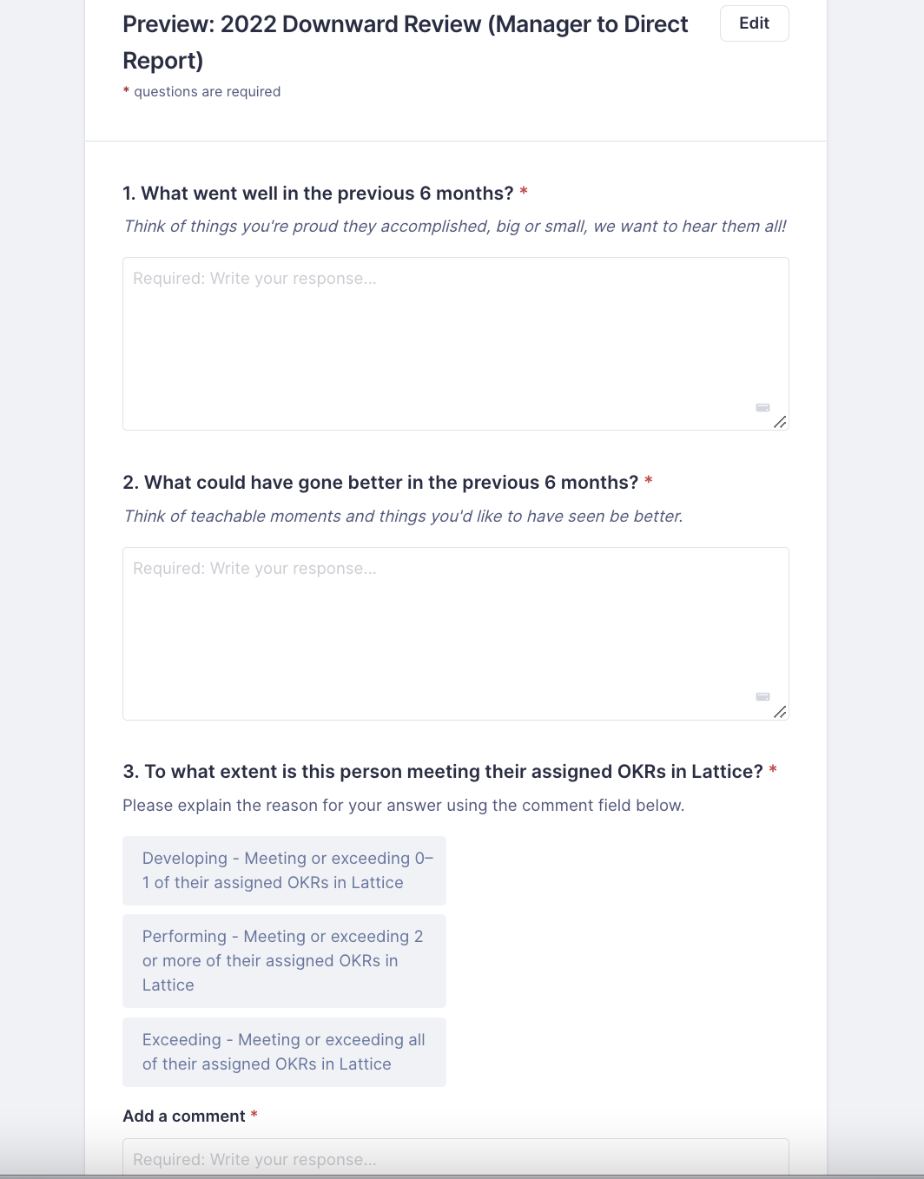
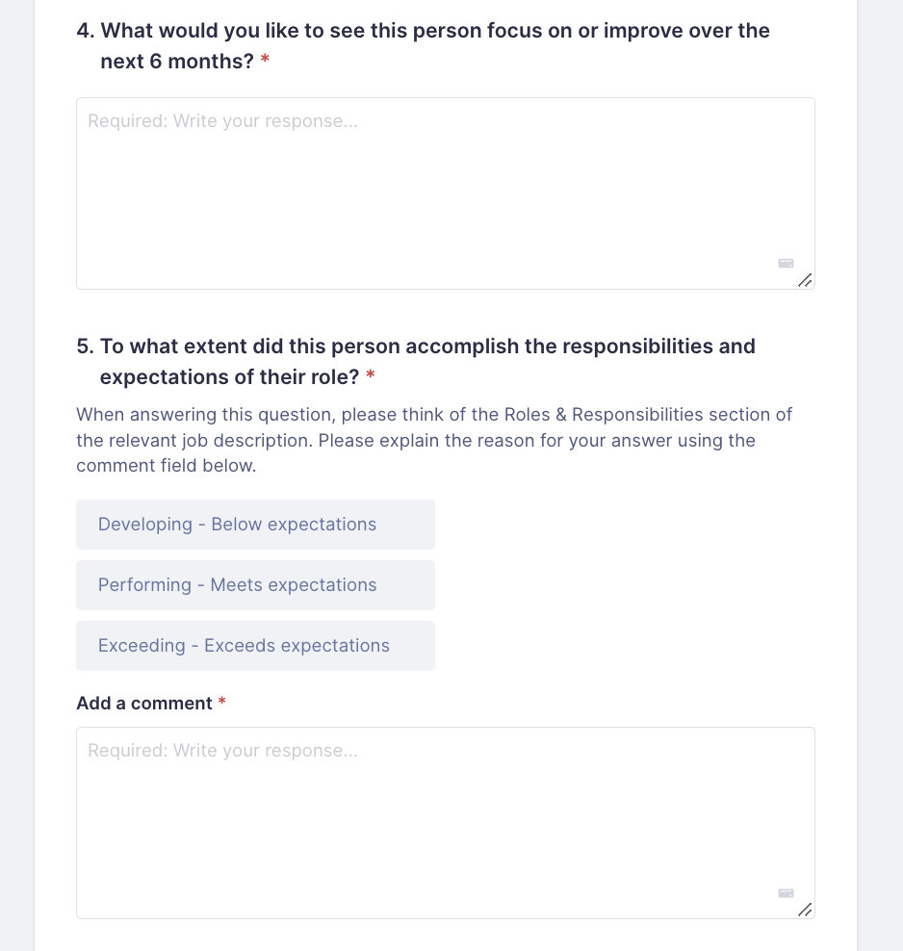
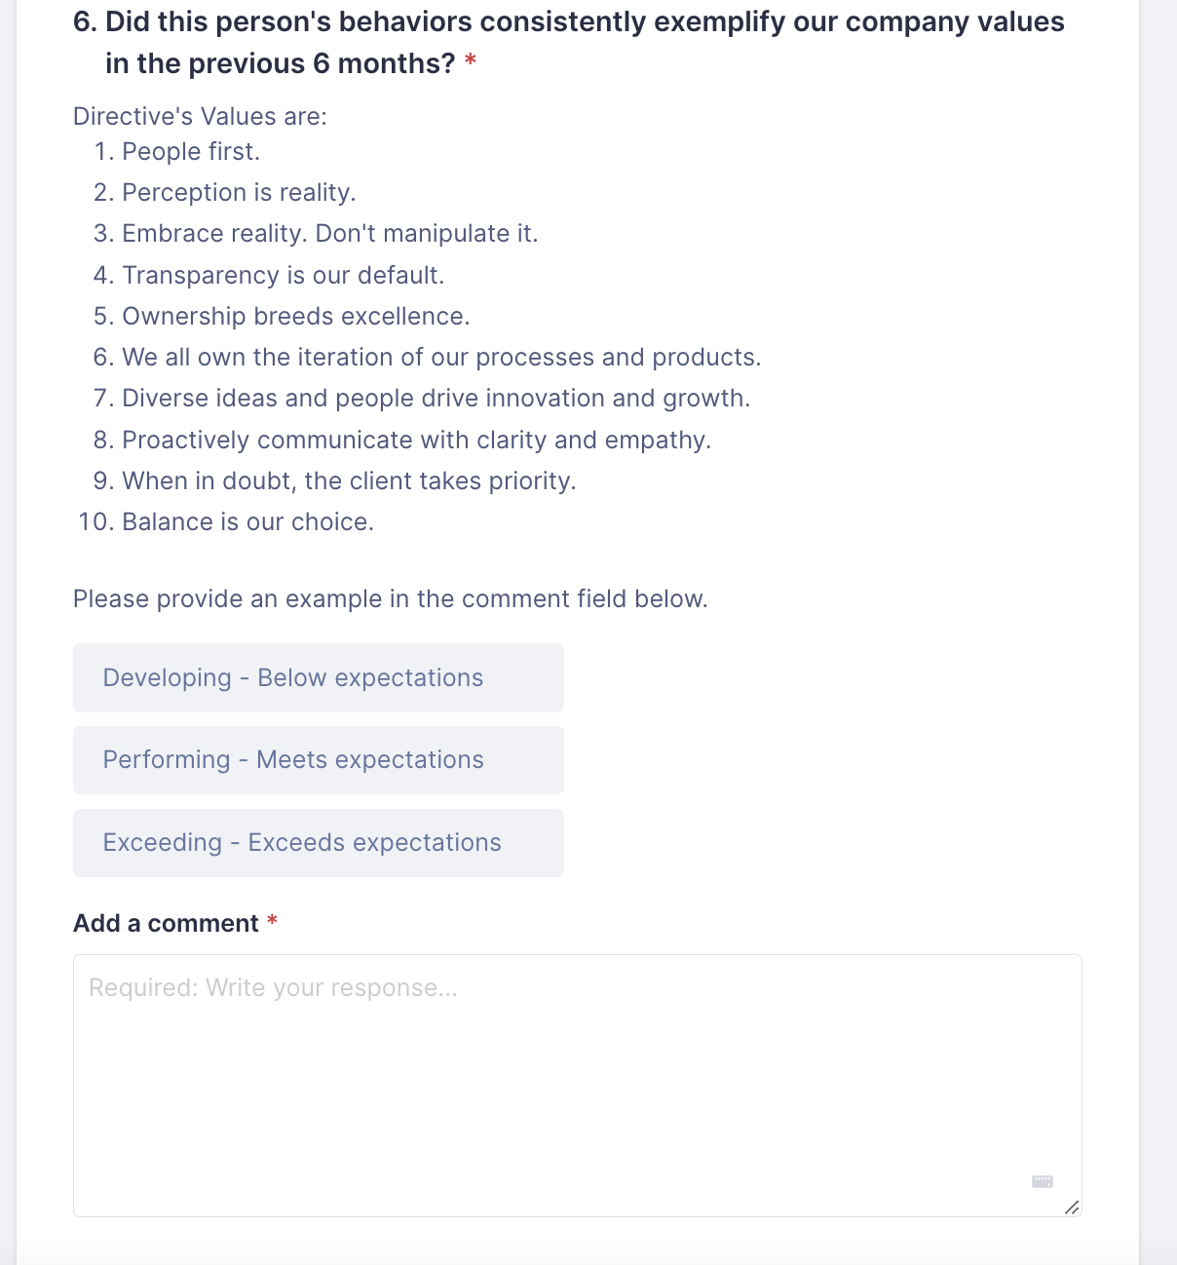
Preview of 2022 Downward Review in Lattice
Notes:
The previous questions weren’t action oriented to the manager and their management skills and need to be changed to directly provide the manager feedback on ways they can improve and ways the excel as a manager of people.

Slide 12
Bi-Annual Performance Review, Direct Report (*Upward) Review
Questions 1-4 are rating questions on a likert scale with optional comments
My manager supports my professional and personal growth
  Rating and comment optional
My manager is open to feedback
  Rating and comment optional
My manager provides me with clear feedback on my performance (including areas of opportunity & strengths)
  Rating and comment optional
My manager communicates in a clear, concise, and, empathetic way
  Rating and comment optional
What should your manager STOP doing?
  Comment Only
What should your manager START doing?
  Comment Only
What should your manager KEEP doing?
  Comment Only
*Upward means Direct Report reviewing Manager during the Managers Review Cycle
Notes:
The current questions aren’t action oriented to the manager and their management skills and need to be changed to directly provide the manager feedback on ways they can improve and ways the excel as a manager of people.
Likert Scale
Strongly Agree
Agree
Neutral
Disagree
Strongly Disagree

Slide 13
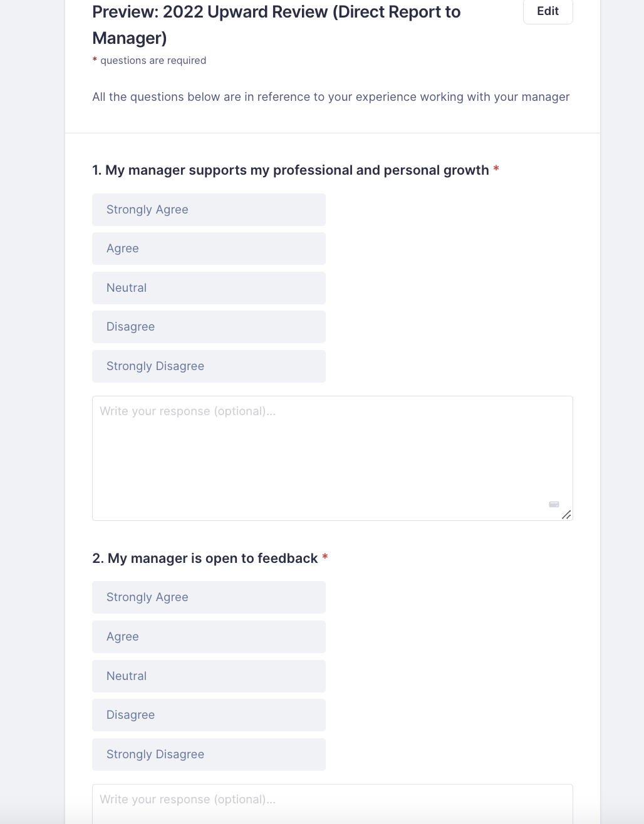
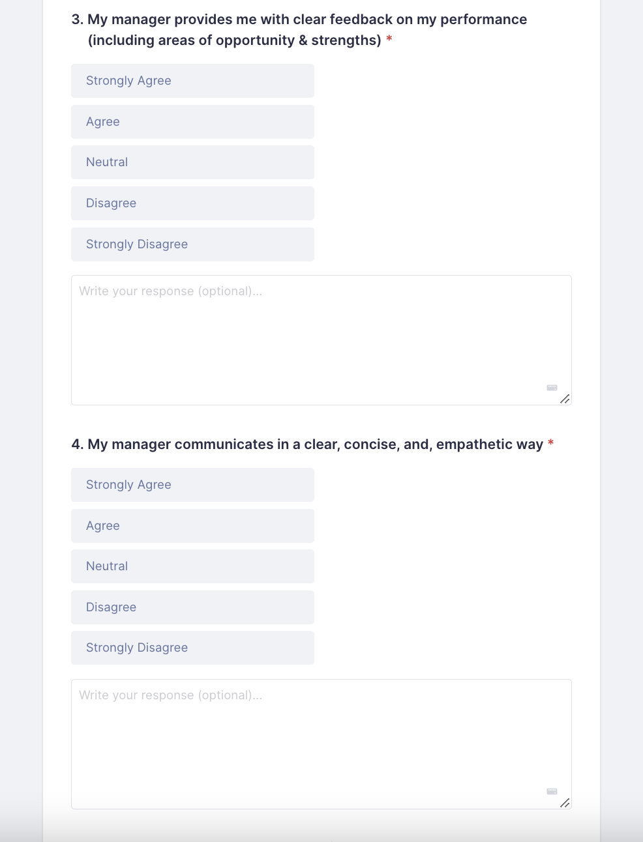
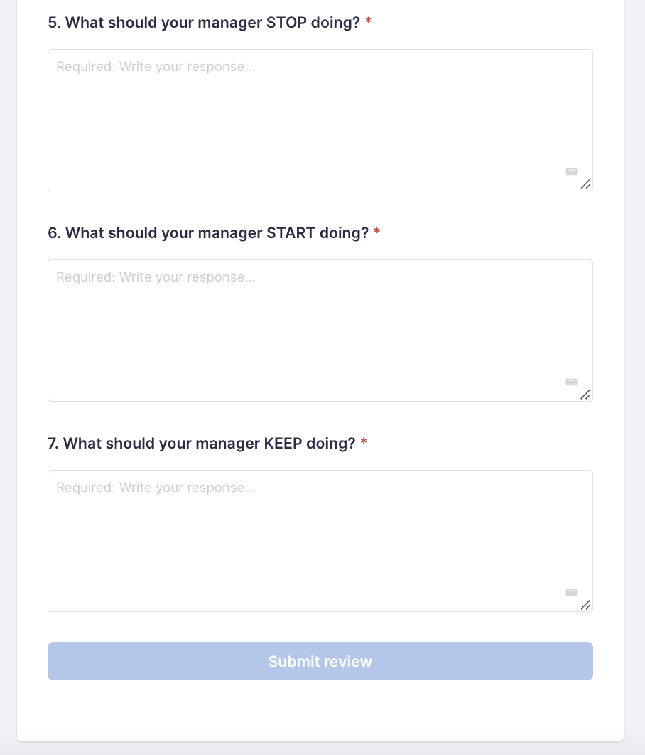
Preview of 2022 Upward Review in Lattice

Slide 14
Bi-Annual Performance Review, Direct Report (*Upward) Feedback
CURRENT Questions
What’s one thing the department/company should stop doing?
What’s one thing the department/company should start doing?
What’s one thing this department/company should continue doing?
If you were director, what’s the biggest thing you would focus the department/company on?
*Upward means Direct Reporting reviewing Manager at the Manager’s review
Notes:
The current questions aren’t action oriented to the manager and their management skills and need to be changed to directly provide the manager feedback on ways they can improve and ways the excel as a manager of people.

Slide 15
CURRENT
Bi-Annual Performance Review, Self Review
What accomplishments are you most proud of in the last 6 months?
To what extent did you meet your KPIs over the last 6 months?
How well do you listen to and communicate with others?
What skills, and/or behaviors would you like to improve in the next 6 months?
What value reasons with you most and why? Please provide an example of when you used the value or saw it used.
What went well for you this half of the year?
What could have gone better in the last 6 months?
What areas do you believe the company should focus on in the coming months?
What does company wide success look like to you by the end of the year?
Give an example of how you Embraced Reality this review period.
How do you show the value People > Clients?
Tell me about a time that Transparency was your Default?
Ownership Breeds Excellence is one of our values…what can you take ownership of in the coming months?
What does Proactively Communicate with Clarity and Empathy mean to you?

Slide 16
V1 PROPOSED Bi-Annual Performance Review, Self Review
What accomplishments are you most proud of from the previous 6 months?
What could have gone better in the previous 6 months?
To what extent did you meet your OKRs in the previous 6 months?
  Change to a rating question
  Define what meet OKRs means and list it out in the description
How did you progress towards your career goals in the previous 6 months?
What skills, and/or behaviors would you like to improve in the next 6 months to move you closer to your goals?
What Directive value resonates with you most and why? Provide an example.

Slide 17
Bi-Annual Performance Review, Manager (*Downward) Feedback
CURRENT Questions
To what degree did this person meet your expectations for their performance? Did they accomplish their goals?
In what areas do you see the most potential for this person? How do you hope to see this person grow over the next 3-6 months?
To what extent does this person embody our company values? Be as specific as you can.
V1 PROPOSED Questions
What were their wins and accomplishments from the previous 6 months?
What could have gone better in the previous 6 months?
To what extent did they meet their OKRs in the previous 6 months?
  Change to a rating question
  Define what meets means
What areas of progress have you observed over the previous 6 months?
What skills, and/or behaviors would you like to see them improve in the next 6 months to progress in their career?
What Directive value did this person exhibit most in the previous 6 months? Provide an example.
*Downward means Manager reviewing a Direct Report
Notes:
Why?
Remove expectations - keep it objective
Match up Manager questions with employee questions so they are reflecting on the same questions and have a common language to speak during the review
Level out the number of questions - currently the self review has 14 and the manager has 3!

