Slide 1

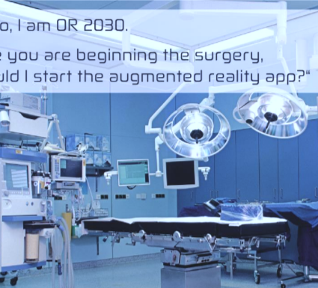
SURGICAL DATA SCIENCE
JERED ATAKY

Slide 2

What’s surgical data science?
Surgical Data Science is an emerging scientific field with the objective of improving the quality of interventional healthcare and its value through capturing, organization, analysis, and modeling of data.
It encompasses all clinical disciplines in which patient care requires intervention to manipulate anatomical structures with a diagnostic, prognostic, or therapeutic goal, such as surgery, interventional radiology, radiotherapy, and interventional gastroenterology.

Slide 3
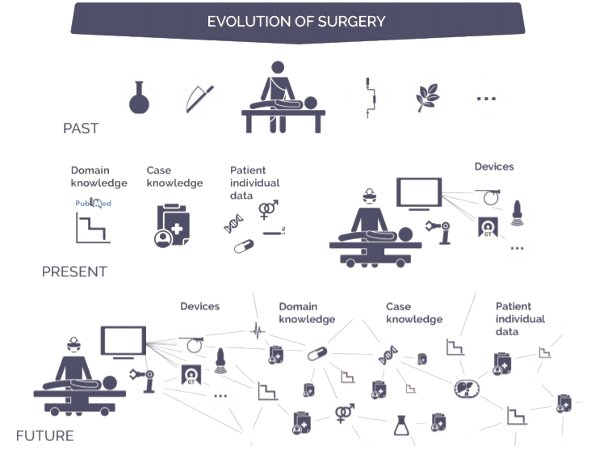
Evolution of surgical practice

Slide 4
Data sources
Medical records
Imaging
Medical devices
Sensors

Slide 5
Clinical applications
Decision support
The decision-making model has gradually evolved to be informed by predictive analytics based on systematic data capture.
Surgical decisions may be optimized by modeling individual patients within the context of population-level data and other multimodal data sources.
Surgical Data Science reinforces the importance of integration of such decision-support into patient care workflows via user-friendly data products.

Slide 6
challenges
Data availability:
Resourceful databases are lacking in documentation of surgery
Privacy and confidentiality of both patients and caregivers data
Data annotation is resource intensive.
2. Analysis of highly heterogeneous multi-modal data:
A substantial aspect of Surgical Data Science involves modeling the orchestrated manipulation by teams of individuals and patients’ response to such actions.
Anatomical manipulation during surgery is frequently irreversible, with errors resulting in serious complications or even death.

Slide 7
sources
http://workshop2016.surgical-data-science.org/
https://arxiv.org/ftp/arxiv/papers/
Provost, F., & Fawcett, T. (2013). Data science for business: What you need to know about data mining and data-analytic thinking. Sebastopol: O'Reilly.

