Slide 1
About me
Research
Publication
I am a cross-displinary scientist. My research bridges ecology, hydrology, biogeochemistry, and climate science, shaped by my unique path approaching science from multi-discriplinary trainings. The mission of my research is 1) to uncover principles and mechanisms regulating the organization and functioning of complex ecosystems; 2) to project biota and ecosystem re-organization under global change, and 3) to propose solutions that can facilitate organism and human adaptation to the changing environments.
My research is largely motivated by my curiousity to understand how complex adaptive systems–from the Earth system to tiny plankton community–work. I therefore value holistic systems approaches. By investigating adaptive capacity of organisms, interactions and feedbacks among living and non-living components in diverse ecosystems, grounded on observations, experiments and modelling, I aim to develop unifying theory and laws explaining and anticipating the evolving trajectories of natural and human-modified ecosystems under a changing planet.
Biodiversity and complex system science
The mission of my research
The motivation of my research
Check Jacky Liu’s website.
Notes:
Who are you Junna? , reflecting my unique path approaching science from an engineering training; I should come to this and revise this frequently.

Slide 2
What ChatGPT has told us?
I am a cross-disciplinary scientist whose research bridges ecology, hydrology, biogeochemistry, and climate science. My research perspective has been shaped by multidisciplinary training and by working across terrestrial and aquatic systems, from relatively natural ecosystems to those strongly modified by human activities. The overarching mission of my research is to: (1) uncover the principles and mechanisms governing the organization and functioning of complex ecosystems; (2) anticipate how biological communities and ecosystem processes reorganize under global environmental change; and (3) develop science-based solutions that enhance the capacity of both ecosystems and human societies to adapt to changing environments.
My research is driven by a fundamental curiosity about how complex adaptive systems operate across scales, from the Earth system to plankton communities. This motivates me to take a holistic, systems-oriented approach that integrates biological adaptation with interactions and feedbacks among organisms, climate, hydrology, and biogeochemical processes. By combining observations, experiments, data synthesis, and modeling across diverse ecosystems, I seek to identify general principles and develop predictive frameworks for explaining and anticipating the trajectories of natural and human-modified ecosystems on a rapidly changing planet.

Slide 3
I am a cross-disciplinary scientist curous about how complex adaptive systems–from the Earth System to tiny plankton communities–reorganize and alter their functioning under global change. My research bridges ecology, hydrology, biogeochemistry, and climate science, shaped by my unique path approaching science from multi-discriplinary trainings.
The mission of my research is to: (1) uncover the principles and mechanisms governing the organization and functioning of complex ecosystems; (2) predict how organisms adapt, communities reorganize, and ecosystem functions shift under global environmental change; and (3) develop solutions that facilitate biological and human adaptation to a changing planet.
To pursue these goals, I embrace systems thinking and holistic systems approaches. By integrating concepts and tools from multi-disciplines with observations, experiments, and mathematical models across diverse systems, my research seeks to quantify organisms’ adaptive capacity, disentangle interactions and feedbacks among biotic and abiotic components, reveal nonlinear dynamics and emergent patterns, and anticipate critical transitions across spatial and temporal scales.
I do not need this part on the website.
Notes:
How ecosystems and the biosphere reorganize in a changing world?

Slide 4
The first page should be the ecosystems I have studied:
Diverse plant communities. (go to Beijing botonic gardens)
Forest ecosystems with flux towers
The Yangtze River,
The lower Minosota River
The San Joaquin River
The San John Estuary
The YoloBypass
The Sycamore Creek

Slide 5
之前小彭做的图
Research
Biodiversity
Carbon-climate feedback
Ecohydrology
Biogeochemistry
A figure with many different plants
A river with a dam
With riparian vegetation.
Zooplankton
Atmospheric CO2
Phytoplankton
List three topics
Ecohydrology of Dammed rivers
Inorganic nutrients
Organic matter
Riparian vegetation-flow interactions
DIC
NH4
NO3
DIP
Org C
Org N
Org C
Ecological effects of dam construction
My water research, jem, Xiaoli’s PNAS
Environmental flow for river restoration

Slide 6
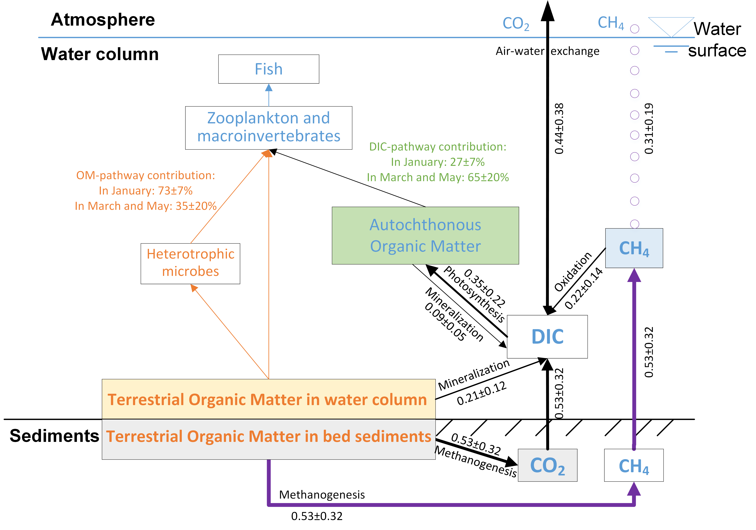
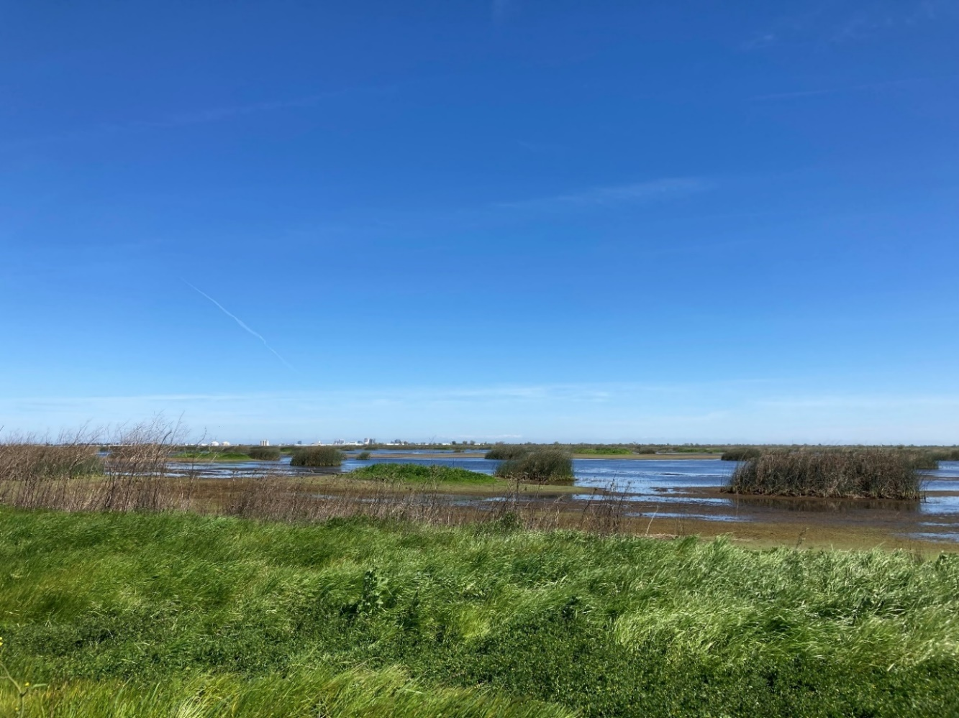
Terrestrial and aquatic ecosystems are interconnected. Terrestrial detritus (t-OM) supports aquatic food webs through consumers that forage on detritus. Our study evaluates the importance of a second terrestrial carbon pathway in which algae assimilate a substantial amount of dissolved inorganic carbon (DIC) released from the mineralization and methanogenesis of t-OM, supporting biodiverse wetlands.
Despite this, most CO₂ and CH₄ from t-OM decomposition are emitted to the atmosphere, suggesting the dual roles of t-OM in simultaneously supporting aquatic food webs and contributing to carbon emissions.
Biodiversity
Introduction of the study;
References
Biodiversity-stability relationships under climate change
Figure from science paper
Plant range shifts and diversity distribution
Terrestrial support of aquatic food webs
Seasonal wetlands in Yolo Bypass Wildlife Area (CA)
Notes:
Terrestrial detritus supports aquatic food webs through consumers that forage on detritus. Our study evaluates the importance of a second terrestrial carbon pathway in which algae assimilate a substantial amount of dissolved inorganic carbon (DIC) released from the mineralization and methanogenesis of t-OM. Despite this, most CO₂ and CH₄ from t-OM decomposition are emitted to the atmosphere, suggesting the dual roles of t-OM in simultaneously supporting aquatic food webs and contributing to carbon emissions.

Slide 7
Carbon-climate feedback

Slide 8
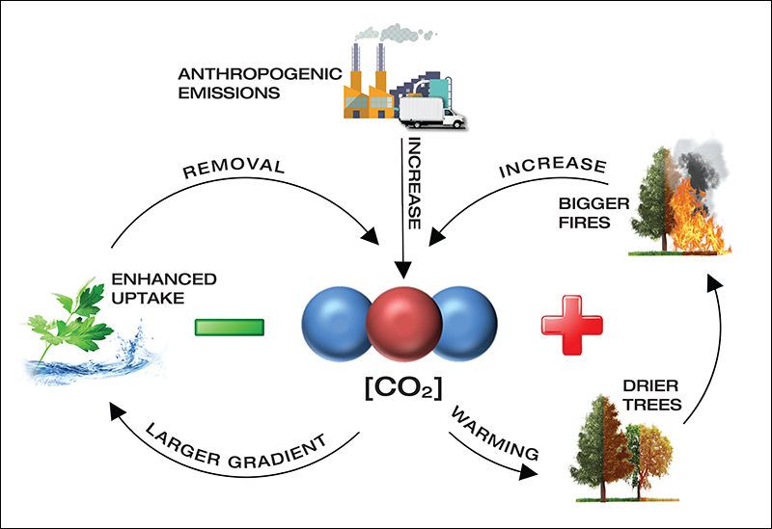
Terrestrial carbon–climate feedbacks can be either positive, amplifying climate change, or negative, dampening it, with their balance varying across ecosystems and over time.
Using global eddy-covariance observations over the past 2-3 decades, I ask:
Where and when are terrestrial carbon–climate feedbacks dominated by positive versus negative feedbacks across climates and biomes?
What mechanisms could shift the terrestrial biosphere from predominantly negative toward positive carbon–climate feedback in the future?
Carbon-climate feedback
How organisms adjust their respiration rate under warming?
The relative important of abotic factors such as warming-induced water limitation affect respirations?
https://eos.org/features/the-future-of-the-carbon-cycle-in-a-changing-climate
Manuscript is under review (☺)

Slide 9
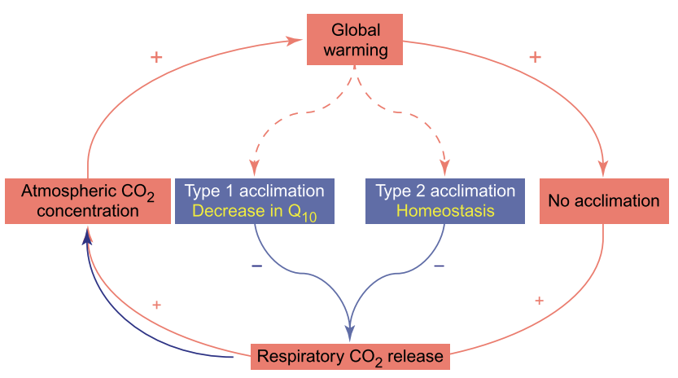
Building on my work to identify where and when terrestrial carbon–climate feedbacks are positive or negative, I investigate the mechanisms that determine whether positive feedbacks strengthen or weaken under continued climate change. In particular, I ask:
How will acclimation and adaptation of organisms, including plants and microbes, dampen or amplify positive carbon–climate feedback?
How do abiotic and indirect processes, such as warming-induced water limitation and changes in substrate availability, regulate the strength of this feedback?
Water limitation
Thermal acclimation of plant respiration
Thermal adaptation of microbial respiration
Substrate change
Notes:
Concept inspired by

Slide 10
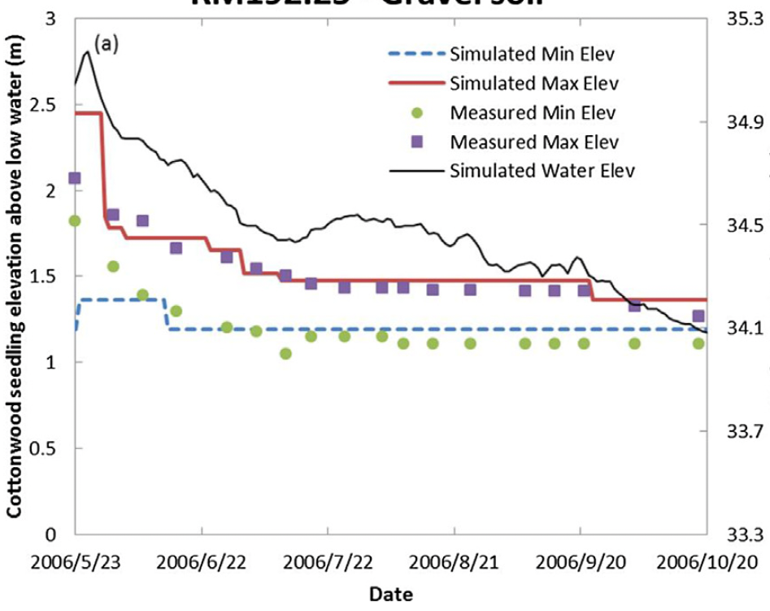
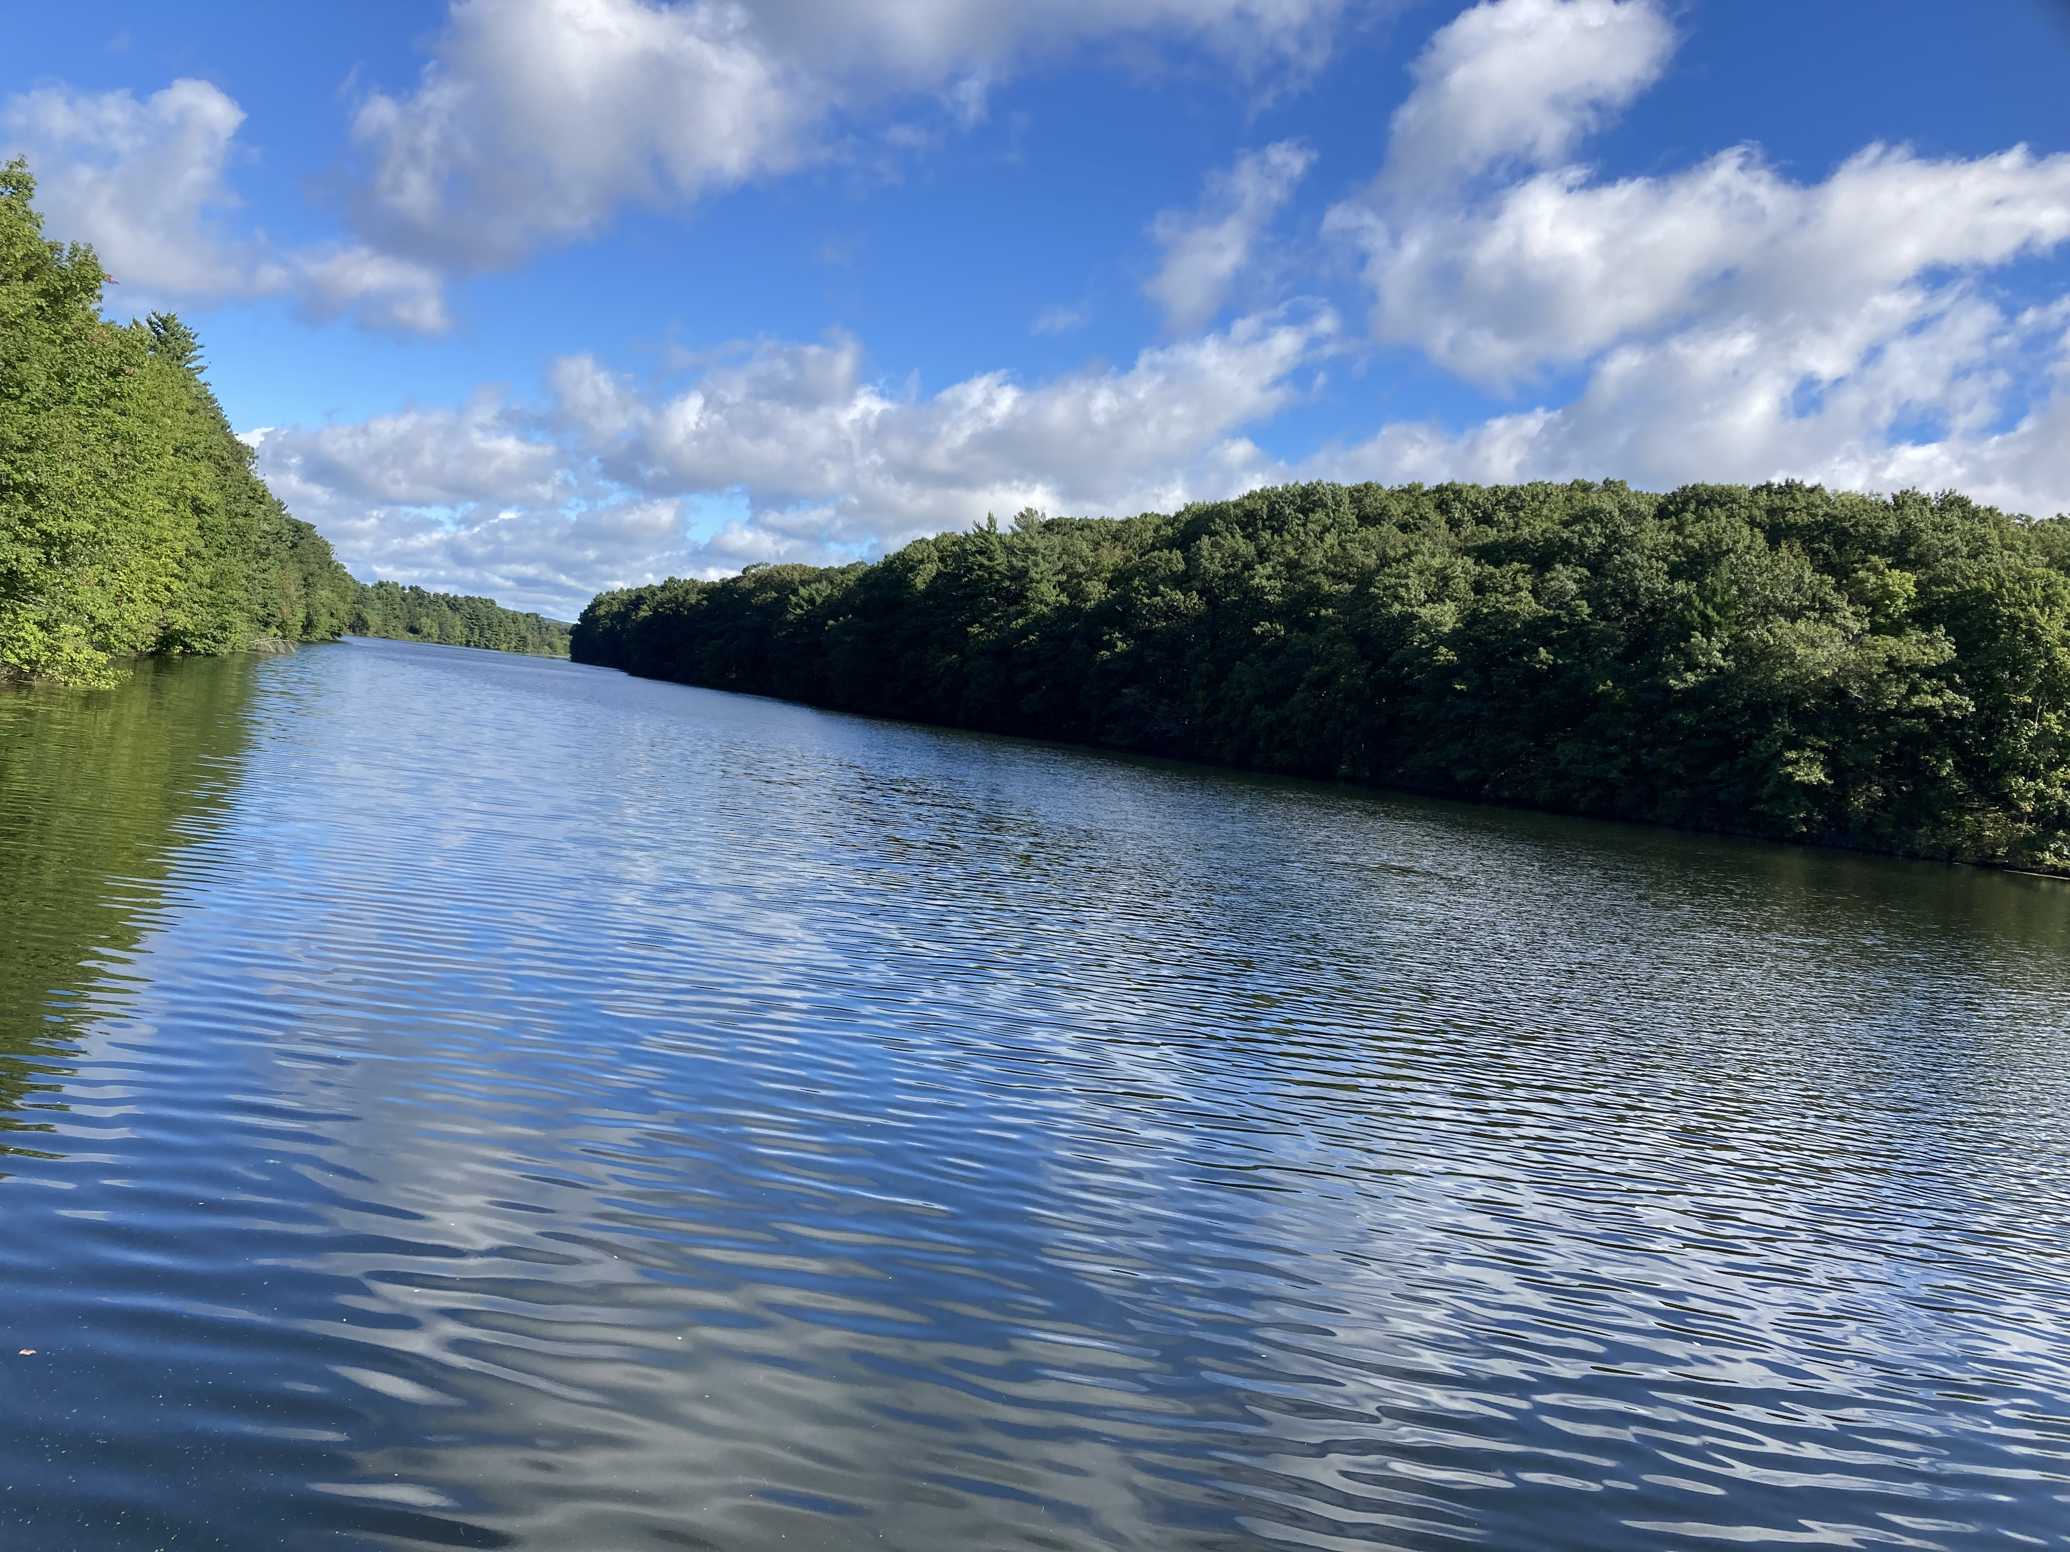
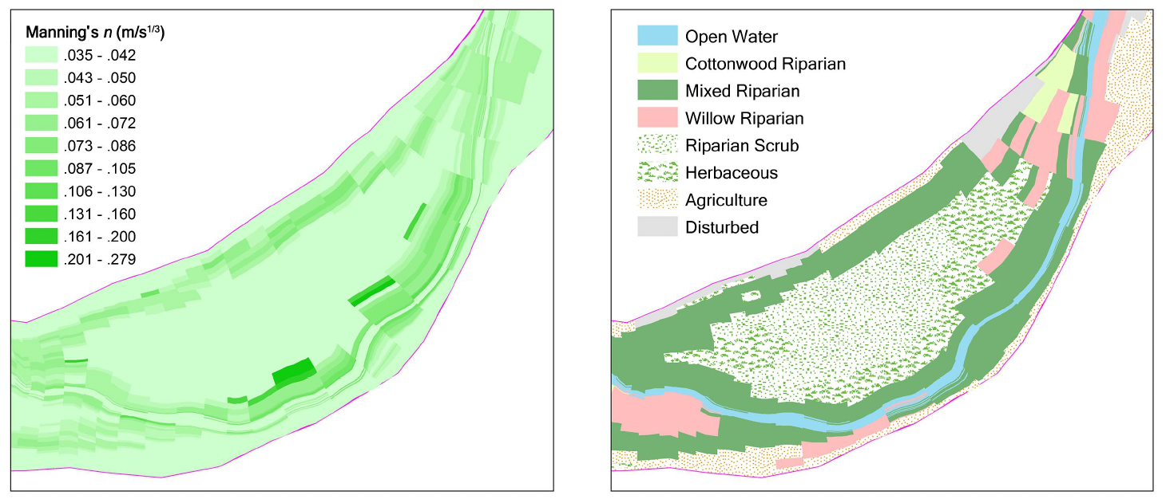
Flow – Riparian Vegetation Interactions
Riparian vegetation is a critical component of healthy river ecosystems. Its life cycle, from seed germination and seedling establishment to mature growth, is closely coupled with river flow regimes. At the same time, vegetation alters hydraulic resistance and can substantially influence water levels, particularly during floods.
In collaboration with the U.S. Army Engineer Research and Development Center and the U.S. Bureau of Reclamation, I coupled a riparian vegetation model with the widely used one-dimensional hydraulic model HEC-RAS to:
Evaluate the performance of 11 methods for estimating vegetation-induced hydraulic roughness; and
Simulate the two-way interactions between river flow regimes and riparian vegetation dynamics along the Sacramento River.
Notes:
Junna Wang, and Zhonglong Zhang. Journal of Hydraulic Engineering (ASCE), 2019.
Junna Wang, Zhonglong Zhang, Blair Greimann, Victor Huang. Ecological Modelling. 2018

Slide 11
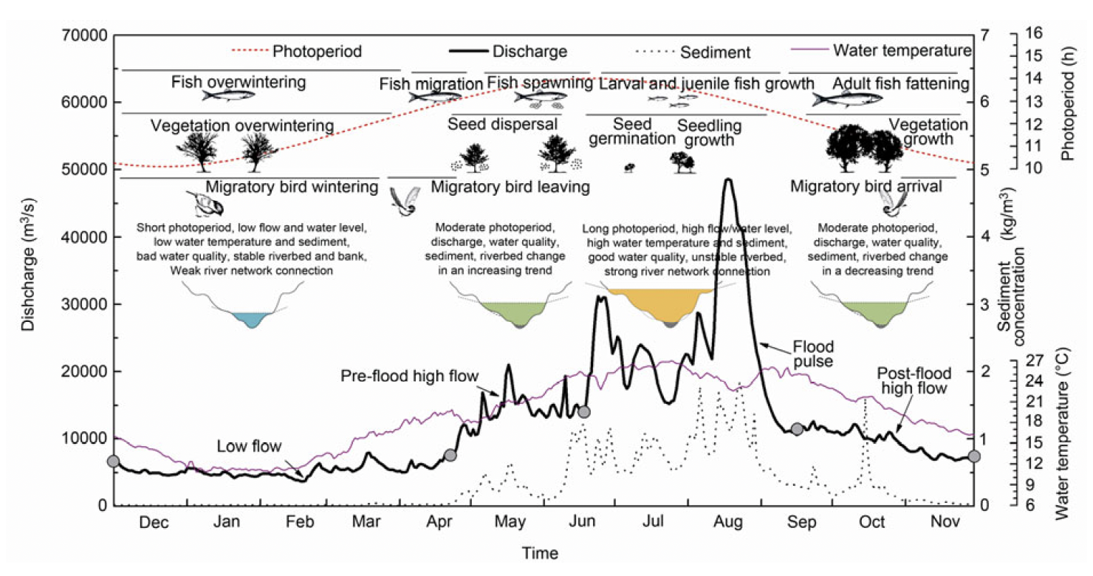
Dammed Rivers as Complex Social–Ecological Systems
Coupling between flow regime and ecological processes in natural rivers
Dams fundamentally reorganize river systems by altering flow, temperature, sediment transport, connectivity, and habitat. These changes propagate through coupled hydrologic, geomorphic, and ecological processes, often producing nonlinear responses, feedbacks, and long-lasting legacy effects.
Working in the Yangtze River downstream of the Three Gorges Dam—one of the world’s largest and most consequential hydropower projects—our research addressed:
How did dam regulation reshaped river ecosystems, from flow and thermal regime to fish diversity?
How can environmental flows and adaptive management restore key ecological processes and functions in regulated rivers?
Notes:
J Wang, Z Dong, W Liao, C Li, S Feng, Q Peng, H Luo. Science China Technological Sciences. 2013.
J Wang, C Li, X Duan, D Chen, S Feng, Q Peng, W Liao. Freshwater Biology. 2014.
J Wang, C Li, X Duan, H Luo, S Feng, Q Peng,WLiao. River Research and Applications. 2013

Slide 12
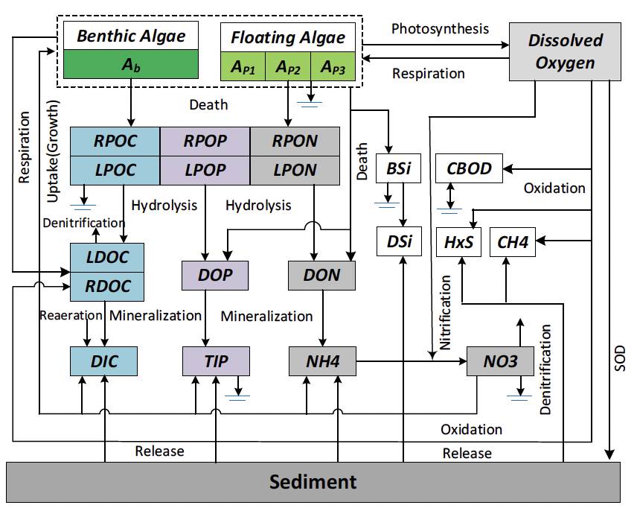
Algae–carbon–nutrient simulation models
Regime Shifts in Eutrophic River Ecosystems
Regime shifts between clear-water and turbid-water states in eutrophic lakes are well studied and are often attributed to species interactions and nutrient loading. In eutrophic rivers, however, the drivers of abrupt shifts in algal communities, dissolved oxygen, and nutrient dynamics remain less clear.
By coupling hydrodynamic models with algae–carbon–nutrient models, we found that:
Flow velocity is a major driver of water-quality regime shifts in river ecosystems.
Along the river–estuary continuum, changes in salinity further reshape algal communities and nutrient cycling.
Algal mortality and community reorganization are often accompanied by declines in dissolved oxygen and concurrent nutrient release.
Notes:
J Wang, F A Bombardelli, X Dong. Water Resources Research. 2021.
J Wang, Z Zhang, B Johnson. Water Research. 2019.
J Wang, Z Zhang. Journal of Environmental Management. 2020.

Slide 13
Publication page
This is the easiest, but I need to update my pdf (what is the title of new submitted articles).
The things I really need to do:
The first page should have an appealing picture.
My ResearchGate Page
Pubulication page should have PDF available.

