Slide 1

Project update: targeted recombination optimization
John Cameron
8/9/2022

Slide 2
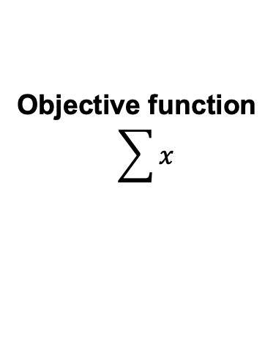
Decision variables
Data: phased marker- effects
S: mate-pair to cross
t: Optimal recombination points/haplotypes
x: Optimal haplotype
i: marker loci
k: individual
j: homolog
Objective function
$$\sum{x}$$

Slide 3

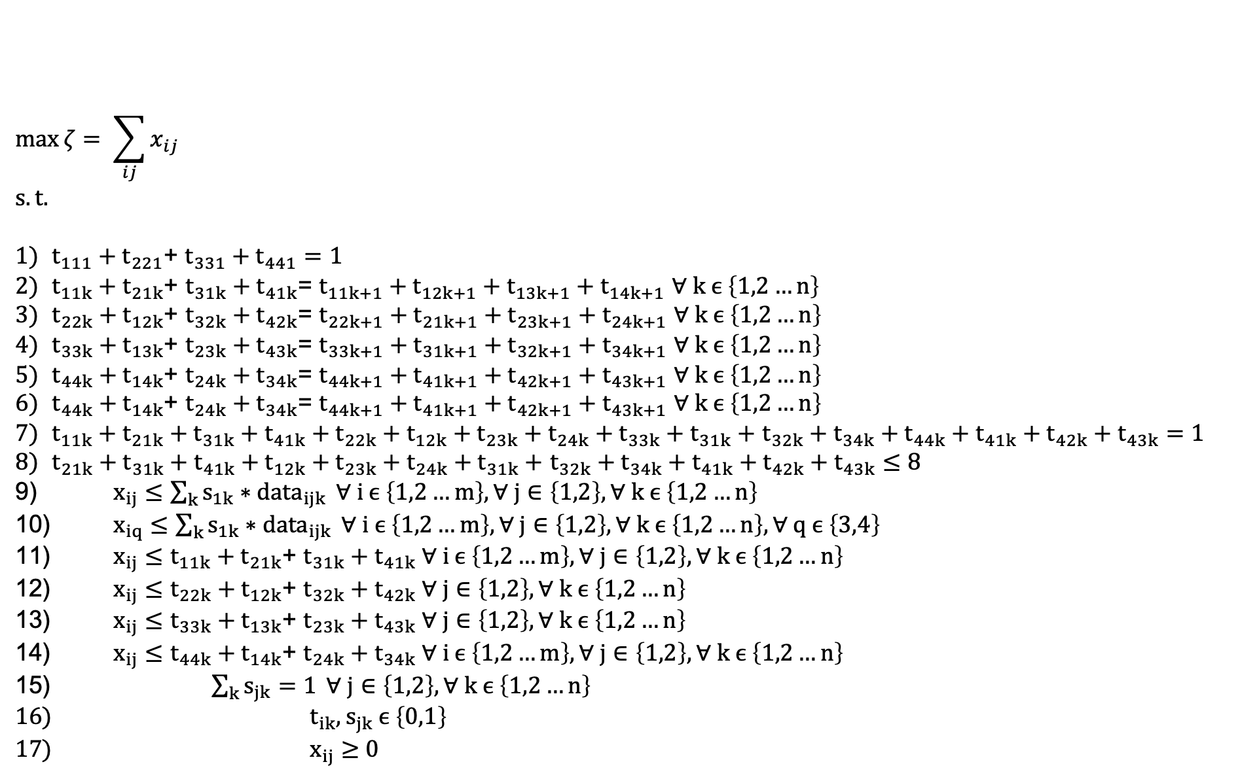
$$\max{ζ= \sum_{ij}{x_{ij}}}$$
$$s.t.$$
$t_{111}+t_{221}$+ $t_{331}+t_{441}=1$
$t_{11k}+t_{21k}$+ $t_{31k}+t_{41k}$= $t_{11k+1}+t_{12k+1}+t_{13k+1}+t_{14k+1}$ $∀ k ϵ \left\{1,2…n\right\}$
$t_{22k}+t_{12k}$+ $t_{32k}+t_{42k}$= $t_{22k+1}+t_{21k+1}+t_{23k+1}+t_{24k+1}$ $∀ k ϵ \left\{1,2…n\right\}$
$t_{33k}+t_{13k}$+ $t_{23k}+t_{43k}$= $t_{33k+1}+t_{31k+1}+t_{32k+1}+t_{34k+1}$ $∀ k ϵ \left\{1,2…n\right\}$
$t_{44k}+t_{14k}$+ $t_{24k}+t_{34k}$= $t_{44k+1}+t_{41k+1}+t_{42k+1}+t_{43k+1}$ $∀ k ϵ \left\{1,2…n\right\}$
$t_{44k}+t_{14k}$+ $t_{24k}+t_{34k}$= $t_{44k+1}+t_{41k+1}+t_{42k+1}+t_{43k+1}$ $∀ k ϵ \left\{1,2…n\right\}$
$t_{11k}+t_{21k}+t_{31k}+t_{41k}+t_{22k}+t_{12k}+t_{23k}+t_{24k}+t_{33k}+t_{31k}+$ $t_{32k}+t_{34k}+t_{44k}+t_{41k}+t_{42k}+t_{43k}=1$
$t_{21k}+t_{31k}+t_{41k}+t_{12k}+t_{23k}+t_{24k}+t_{31k}+$ $t_{32k}+t_{34k}+t_{41k}+t_{42k}+t_{43k}≤8$
$x_{ij}≤\sum_{k}{s_{1k}∗{data}_{ijk}} ∀ i ϵ \left\{1,2…m\right\},∀ j∈\left\{1,2\right\},∀ k ϵ \left\{1,2…n\right\}$
$x_{iq}≤\sum_{k}{s_{1k}∗{data}_{ijk}} ∀ i ϵ \left\{1,2…m\right\},∀ j∈\left\{1,2\right\},∀ k ϵ \left\{1,2…n\right\},∀ q ϵ \left\{3,4\right\}$
$x_{ij}≤t_{11k}+t_{21k}\text{+} t_{31k}+t_{41k} ∀ i ϵ \left\{1,2…m\right\},∀ j∈\left\{1,2\right\},∀ k ϵ \left\{1,2…n\right\}$
$x_{ij}≤t_{22k}+t_{12k}\text{+} t_{32k}+t_{42k} ∀ j∈\left\{1,2\right\},∀ k ϵ \left\{1,2…n\right\}$
$x_{ij}≤t_{33k}+t_{13k}\text{+} t_{23k}+t_{43k} ∀ j∈\left\{1,2\right\},∀ k ϵ \left\{1,2…n\right\}$
$x_{ij}≤t_{44k}+t_{14k}\text{+} t_{24k}+t_{34k} ∀ i ϵ \left\{1,2…m\right\},∀ j∈\left\{1,2\right\},∀ k ϵ \left\{1,2…n\right\}$
$\sum_{k}{s_{jk}=1} ∀ j∈\left\{1,2\right\},∀ k ϵ \left\{1,2…n\right\}$
$t_{ik},s_{jk} ϵ \left\{0,1\right\}$
$x_{ij}$ $≥$ 0

Slide 4
Testing
Use Bayer training sets to determine
Optimal mate pairs and recombination points
The increase in genetic gain relative to ‘conventional’ GS
Can we solve deterministically, or do we need to use heuristic solver
Other Questions
Can we feasibly build desirable haplotype using PCV selection faster than pyramiding approach?
Can we pick a set of mates and recombination points that maximize genetic gain and genetic variance (response surface building)?
Can we look at selection optimal gametes in both heterotic groups to maximize complementarity of desirable alleles at each locus

Slide 5
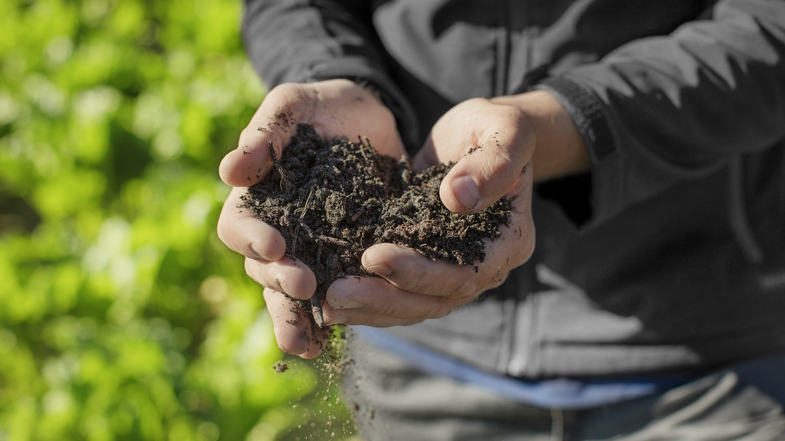
Advancing
life

