Slide 1
NBN Web Services Workshop
Jon Cooper
Chris Johnson

Slide 2
Contents
Rapid ‘what is a soap web service?’
NBN Web Services documentation
Today’s tools:
SOAPUI – for creating requests
WAMP – for running our php pages
soapUI and basic php grid map + exercises
Data access model and registration keys + exercise
Easy Maps + exercises

Slide 3
Contents contd...
Video clip: Java and proxy objects
Exercise: species list web service
Exercise: taxonomy search web service

Slide 4
What is a web service?
Client
getSharePrice(company=Acme)
Web service
£1.23
A method that is callable remotely across a network
Defines an interface for communication
Eg mandatory arguments
Communication is independent of technology
Eg .NET client and Java web service
Does not provide a GUI
Client provides GUI – eg web page

Slide 5
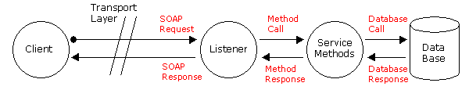
What is a SOAP web service?
Messaging protocol that uses xml
Request-response dialog usually via HTTP
Web Service Definition Language (WSDL) file
Clients – eg today’s php examples
XML messages over internet
NBN web services

Slide 6
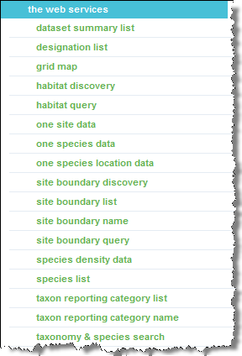
Documentation
www.nbn.org.uk > Guidebooks > Web services guide

Slide 7
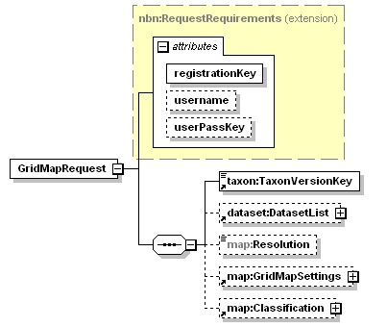
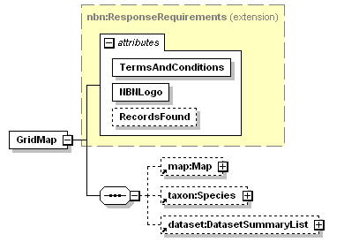
Documentation
www.nbn.org.uk > Guidebooks > Web services guide
Request
Response

Slide 8
Today’s tools
soapUI
www.soapui.org
For consuming web services
Writing and testing requests
EasyPHP
www.easyphp.org
Windows Apache MySql Php server
For running our php examples
Notepad++
XML Notepad

Slide 9
First practical session
Exercise 1: using soapUI
Consume NBN WSDL and list all web services
Write a working Grid Map request
Get request ready for pasting to php
Exercise 2: basic php grid map
Build working grid map
Step through skeleton page adding content
Show compliance with NBN terms and conditions

Slide 10
Overview of data access model
A guide to the NBN data access model is here: http://www.nbn.org.uk/Guidebooks/Gateway-users/Data-Access-Controls/NBN-Gateway-Access-Controls.aspx
Access is controlled per dataset by an administrator
Access is given to users, groups of users and the public
Almost all datasets have a public level of access
You can apply for better access to datasets
Two important controls for web services:
Records in map images
Records in data

Slide 11
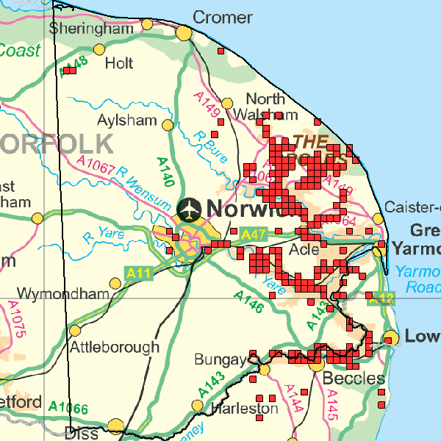
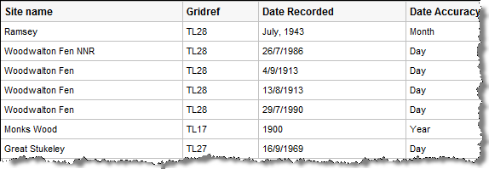
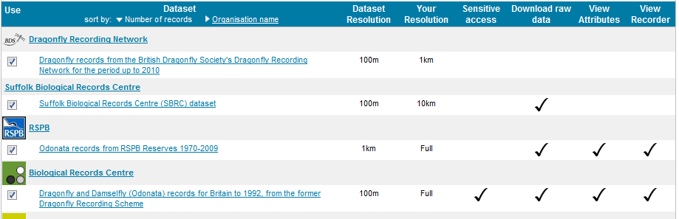
Records in maps and raw data
Squares on maps
Record data

Slide 12
Web service registration keys
Registration keys are explained fully here: http://www.nbn.org.uk/Guidebooks/Web-services-documentation/Resources/registration.aspx
Register your client to obtain a registration key
Three types of key:
Public access: access to publicly available data
Fixed user access: one specific account’s access
Variable user access: allows credentials to be passed
Include key in your request
Eg as seen in exercise 2: <map:GridMapRequest registrationKey="a85d4c129728e58...

Slide 13
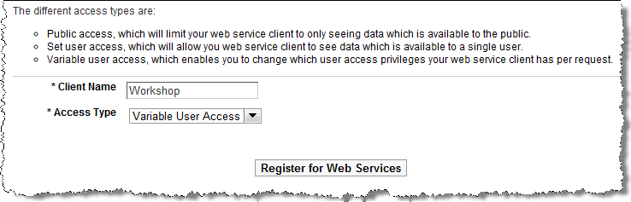
Steps to get a registration key
Log onto http://data.nbn.org.uk
Go to My Account
Select Web Services > Apply for Access
Provide a client name, choose a key type and submit
Accept Ts & Cs and you will be e-mailed your key

Slide 14
Second practical session
Exercise 3: Using a Variable User Access key

Slide 15
Easy Maps
Developed by Biological Records Centre
Full documentation at http://www.brc.ac.uk/schemes/NBNWidget/Easy_Maps_v6.pdf
A ‘wrapper’ around the Grid Map web service
Simplifies using the Grid Map web service
Applies Terms and Conditions out-of-the-box
Allows styling and customisation
Let’s use it – Exercise 4

Slide 16
Video: consuming web services in Java
WSDL consumed to create client proxy classes
Proxy classes hide client-web service communication
Proxy are classes very intuitive to use
.NET provides similar technology
Focuses on SummaryDatasetList
http://www.youtube.com/watch?v=6DKW27gFDWM
(local flash)

Slide 17
Species List web service
A list of species
http://www.nbn.org.uk/Guidebooks/Web-services-documentation/the-web-services/Species-List/request.aspx
Can be filtered by:
Site boundary or geographical area
Designation (eg BAP)
Date
Datasets
Species keys (aka Taxon Version Keys)
Species group key (aka Taxon Reporting Category key)
Try Exercise 5 – which creates a species list for a dataset

Slide 18
Taxonomy web service
Taxonomic search service
http://www.nbn.org.uk/Guidebooks/Web-services-documentation/the-web-services/taxonomy---species-search/introduction.aspx
Allows searching by:
Scientific name
Common name
Taxon Version Key
Can include a designation filter (eg BAP)
Returns with a list of species items
Exercise 6 illustrates a simple example

Slide 19
Help
Use the forum: http://forums.nbn.org.uk/viewforum.php?id=15
Try the help desk: support@nbn.org.uk (watch out for typo on attendees version!)

