Slide 1
NBN Web Services Workshop
Jon Cooper

Slide 2
Contents
What is a web service?
Easy Maps + exercise
Basic grid map + exercises
Data access model and registration keys + exercise
The range of NBN web services
Site report exercise
Video clip: Java and proxy objects
Using NBN maps (WMS) in GIS systems + exercise
Extra exercises if time permits

Slide 3
What is a web service?
Client
getSharePrice(company=Acme)
Web service
£1.23
A service that is called across a network
Defines an interface for communication
Eg What to call + arguments
Communication is independent of technology
Eg .NET client and Java web service
Does not provide a Graphical User Interface (GUI)
Client provides GUI – eg web page

Slide 4
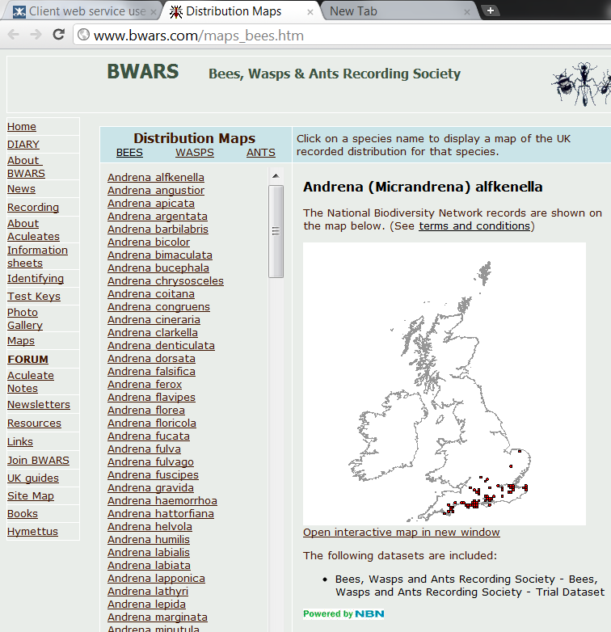
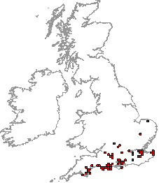
Example of NBN web service being used
BWARS
web server
ww.bwars.com/maps_bees.htm
Whole web page request
Just the map bit
NBN
web service

Slide 5
Easy Maps
Simplifies using the Grid Map web service
Developed by Biological Records Centre
Full documentation at http://www.brc.ac.uk/schemes/NBNWidget/Easy_Maps_v6.pdf
A ‘wrapper’ around the Grid Map web service
Applies Terms and Conditions out-of-the-box
Allows styling and customisation

Slide 6
How Easy Maps works
BWARS
web server
ww.bwars.com/maps_bees.htm
iFrame
ww.bwars.com/maps_bees.htm
Everything but the map
Easy Maps
web server
NBN
web service

Slide 7
First practical session
Exercise 1: Using Easy Maps
Create a basic distribution map
Customise map – colours, background, region, etc

Slide 8
Using NBN web services directly
Easy Maps is a client between the web page and Grid Map web service
Easy Maps
NBN web service
All other NBN web services do not have such a client
We’ll now look web pages that access web services directly
Direct access
NBN web service
First some background...

Slide 9
Most NBN web services use SOAP
Messaging protocol that uses xml
Request-response dialog usually via HTTP
Web Service Definition Language (WSDL) file
Clients – eg today’s php exercises
XML messages over internet
NBN web services
Listening for
SOAP requests
+ WSDL file

Slide 10
Second practical session
Exercise 2: Build a Grid Map request
Use WSDL in soapUI to view all NBN web services
Create working Grid Map request
Edit request ready for exercise 3
Exercise 3: Grid map in php
Fire up php environment
Add Grid Map request to php web page
View in browser

Slide 11
Nusoap – a php SOAP library
All your php exercises have this line:
require_once('..\lib\nusoap.php');
This is a reference to a free SOAP library from:
http://sourceforge.net/projects/nusoap
It allows php to easily communicate with SOAP web services

Slide 12
Overview of data access model
A guide to the NBN data access model is here: http://www.nbn.org.uk/Guidebooks/Gateway-users/Data-Access-Controls/NBN-Gateway-Access-Controls.aspx
Access is controlled per dataset by an administrator
Access is given to users, groups of users and the public
Almost all datasets have a public level of access
You can apply for better access to datasets
Two important controls for web services:
Records in map images
Records in data

Slide 13
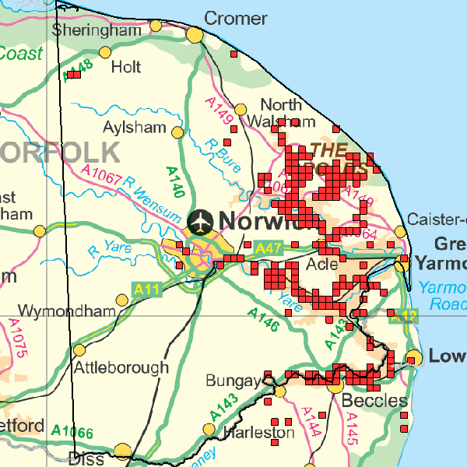
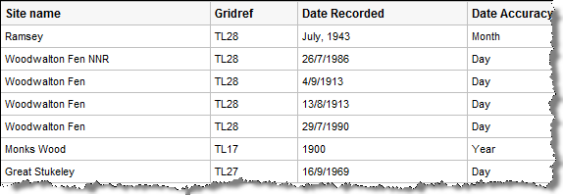
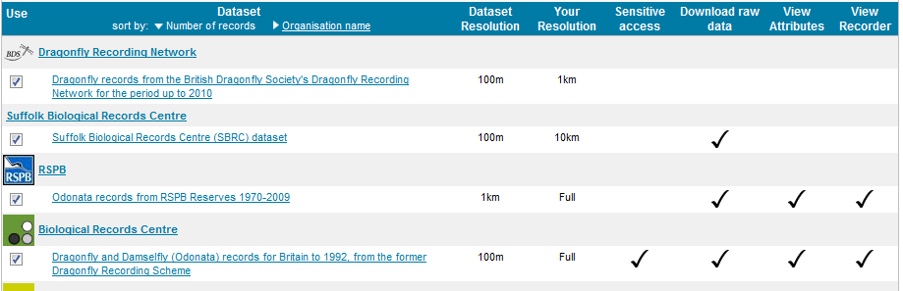
Records in maps and raw data
Squares on maps
Record data

Slide 14
Web service registration keys
Registration keys are explained fully here: http://data.nbn.org.uk/Documentation/Web_Services > Registration
Register your client to obtain a registration key
Three types of key:
Public access: access to publicly available data
Fixed user access: one specific account’s access
Variable user access: allows credentials to be passed
Include key in your request
Eg as seen in exercise 4: <map:GridMapRequest registrationKey="a85d4c129728e58...

Slide 15
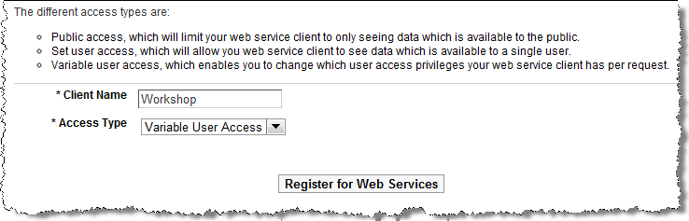
Steps to get a registration key
Log onto http://data.nbn.org.uk
Go to My Account
Select Web Services > Apply for Access
Provide a client name, choose a key type and submit
Accept Ts & Cs and you will be e-mailed your key

Slide 16
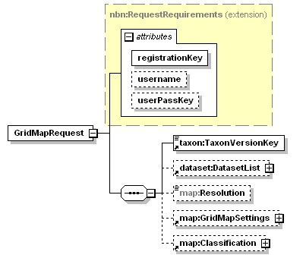
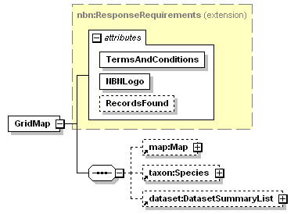
Documentation illustrating credentials
http://data.nbn.org.uk/Documentation/Web_Services
Request
Response

Slide 17
Third practical session
Exercise 4: Using a Variable User Access key

Slide 18
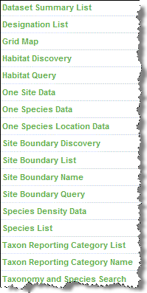
The range of NBN web services
http://data.nbn.org.uk/Documentation/Web_Services

Slide 19
Main web services
Web service name | Data that is returned | Filters allowed in request (see table below)
Taxon reporting category list | List of taxon groups (eg bird, flowering plant) | A,B,C,D
Species list | List of species | A,B,C,D,E,F
Species density data | Counts grouped by grid square | A,B,C,D,E,F
One site data | All observation records for a single location | A,B,C,D,E,F
 | Filter name | Restricts data to
A | GeographicalFilter | A grid square, administrative boundary or user defined polygon (mandatory for One site data service)
B | DateRange | A specific date range
C | DatasetList | One or more specific datasets
D | Designation | A single designation (eg BAP 2007)
E | TaxonReportingCategoryKey | A single taxon group (eg bird)
F | TaxonVersionKeys | One or more specific taxa (eg Otter)

Slide 20
Single species web services
Web service name | Data that is returned | Filters allowed in request (see table below)
One species data | All observation records for a single species | A,B,C
One species location data | Unique locations where the species is found | A,B,C
Grid map | Single species distribution map with dataset list | A,B,C
 | Filter name | Restricts data to
A | TaxonVersionKey | A specific taxon (eg Otter) - mandatory
B | DateRange (or Classification) | A specific date range
C | DatasetList | One or more specific datasets

Slide 21
Support web services
Helper services for building lists, finding keys and converting keys to names
Web service name | Data that is returned
Dataset summary list | List of datasets and their descriptions
Designation list | List of designations and their descriptions
Site boundary discovery | List of site layers on the NBN Gateway (eg SSSI, SAC)
Site boundary list | List of sites for a single site layer
Site boundary query | List of sites that intersect your polygon or grid square
Site boundary name | Name of a site for it key
Taxon reporting category name | Name of a taxon category from its key
Taxonomy and species search | List of species that match a search term or key

Slide 22
Fourth practical session
Exercise 5: Interactive site selection and species lists
Get example running
Illustrates multiple web services working together
Edit example for different list of sites

Slide 23
Video: consuming web services in Java
Use WSDL to create client proxy classes
Proxy classes hide client-web service communication
Proxy are classes very intuitive to use
.NET provides similar technology
Focuses on SummaryDatasetList
http://www.youtube.com/watch?v=6DKW27gFDWM
(local flash or try vlc)

Slide 24
GIS and NBN WMS
GIS systems work with geographic data
Most GIS systems can use WMSs
WMS = Web Map Service
Georeferenced map image
Served over the internet
Standard protocol

Slide 25
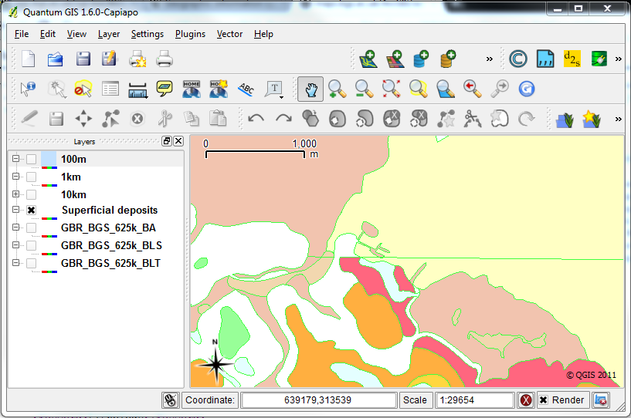
Example: geology WMS in Q-GIS

Slide 26
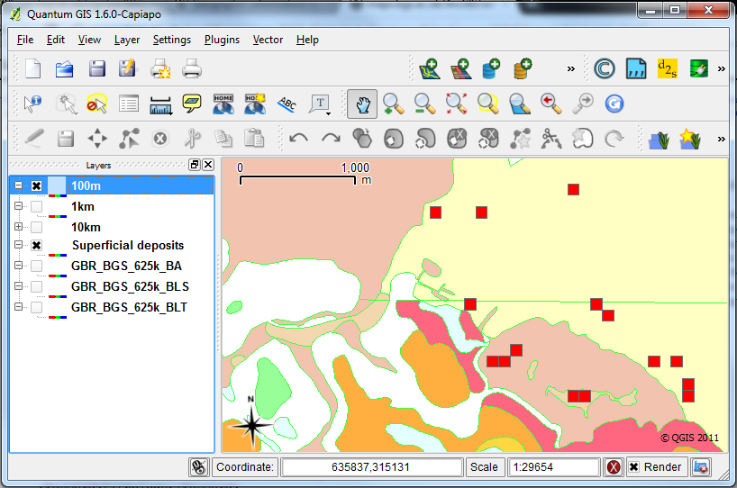
Example: NBN WMS added

Slide 27
NBN WMS
Full documentation:
http://data.nbn.org.uk/Documentation/Web_Services > Web Map Services
GIS system requires this url:
http://gis.nbn.org.uk/arcgis/rest/services/grids/<SERVICETYPE>/<REQUIREDNBNKEY>/WMSServer?
Type of map | <SERVICETYPE> | <REQUIREDNBNKEY>
Single species records | SingleSpeciesMap | Taxon key (eg NBNSYS0000005629)
Species density for a single dataset | DatasetSpeciesDensityMap | Dataset key (eg GA000858)
Species density for a designation | DesignationSpeciesDensityMap | Designation code (eg ECCITES-A)

Slide 28
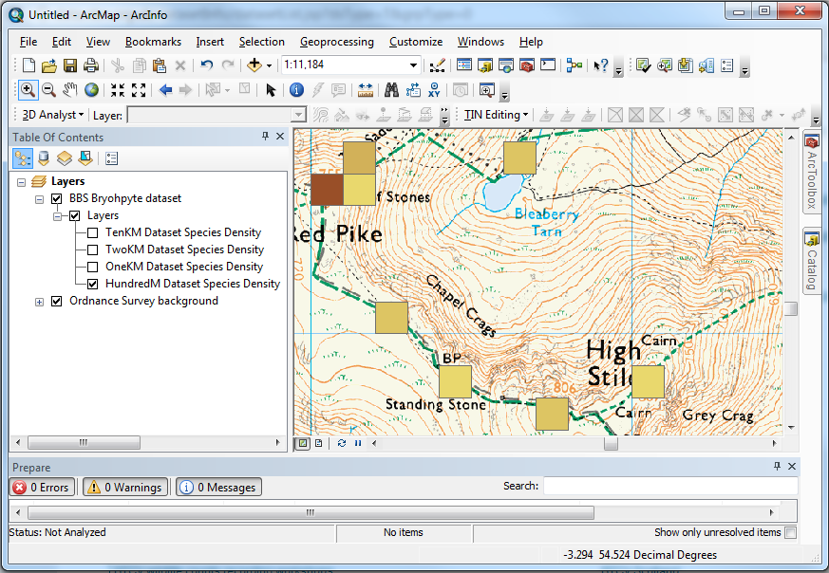
Example: Species density in bryophyte dataset

Slide 29
Fifth practical session
Exercise 6: Use NBN WMS in a GIS system
Add geology WMS as background
Add NBN WMS species WMS
Explore data – panning, zooming, etc

Slide 30
Help
Use the documentation:
http://data.nbn.org.uk/Documentation/Web_Services
Use the forum:
http://forums.nbn.org.uk/viewforum.php?id=15
Use the help desk: support@nbn.org.uk

Slide 31
Extra time: Species List web service
A list of species
http://data.nbn.org.uk/Documentation/Web_Services > Species List
Can be filtered by:
Site boundary or geographical area
Designation (eg BAP)
Date
Datasets
Species keys (aka Taxon Version Keys)
Species group key (aka Taxon Reporting Category key)
Try Exercise 7 – which creates a species list for a dataset

Slide 32
Extra time: Taxonomy web service
Taxonomic search service
http://data.nbn.org.uk/Documentation/Web_Services > Taxonomy and Species Search
Allows searching by:
Scientific name
Common name
Taxon Version Key
Can include a designation filter (eg BAP)
Returns with a list of species items
Exercise 8 illustrates a simple example

