Slide 1
GraphDraw Project Presentation

Slide 2
Demo

Slide 3
The code is split into 3 packages:
graph.drawing.RTProject
  classes that are specific to this project
helper
  classes that support other calculations
phases
  layout phase classes

Slide 4
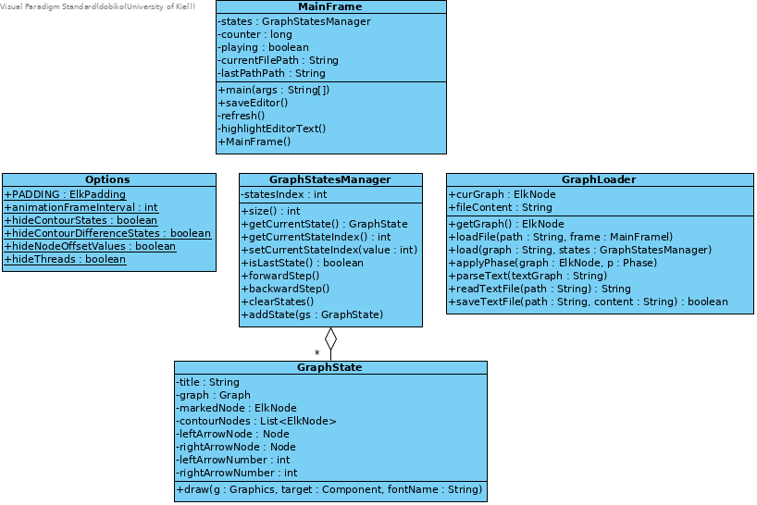
RTProject Package

Slide 5
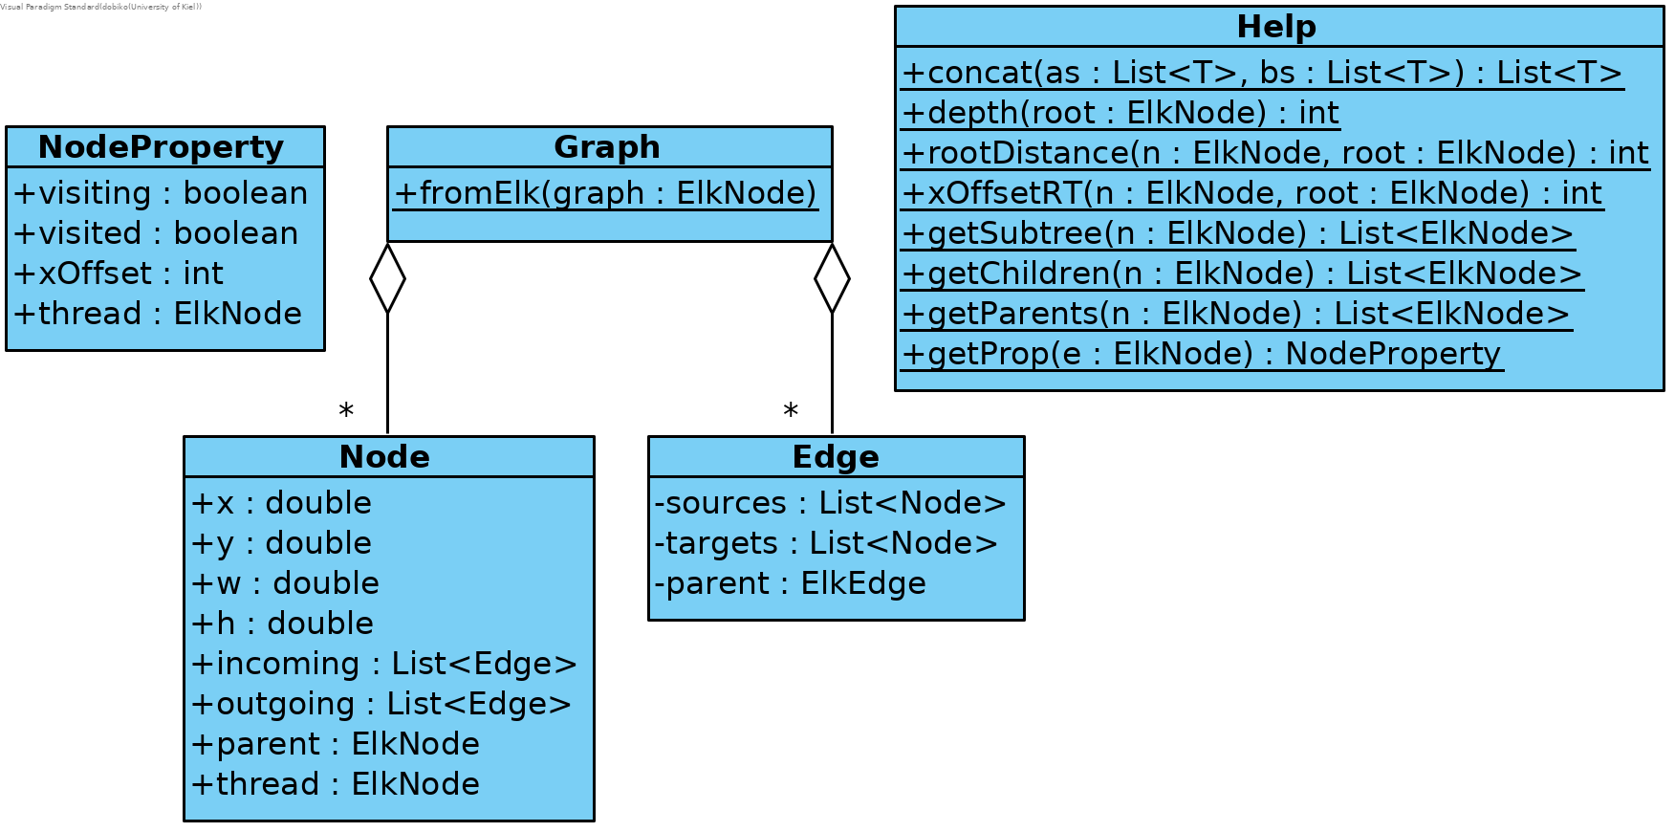
helper Package

Slide 6
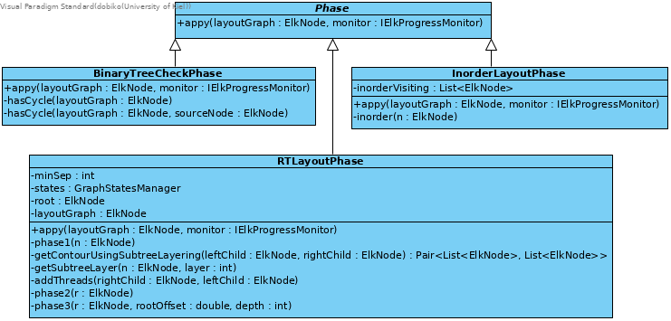
phases Package

Slide 7
Fragen

