Slide 2
LDA Metrics

Slide 3
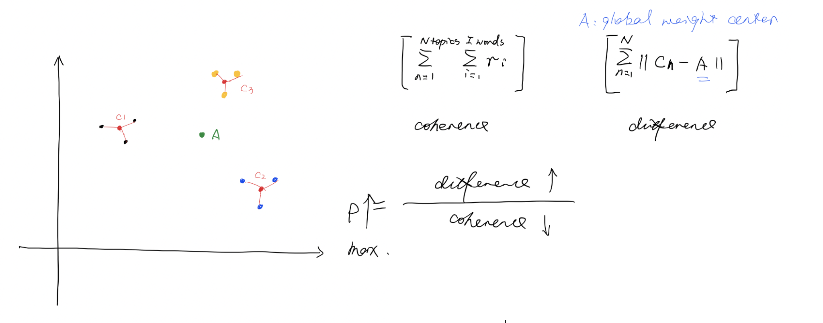
Semantic Distance
Word2Vector 2013
GloVe 2014: global vectors for word representations GloVe + our data
ElMo 2018, BERT 2019 differences? Why choose GloVe?
https://nlp.stanford.edu/projects/glove/
https://keras.io/examples/nlp/pretrained_word_embeddings/
https://colab.research.google.com/drive/1pPBSsHNUFxH1GFLOo-QwvM0Uv_g33Maj?usp=sharing
https://www.analyticsvidhya.com/blog/2019/03/learn-to-use-elmo-to-extract-features-from-text/

Slide 4
Baseline:
Hyperband + glove (no local fine tuning / fine tuning)
Random search + glove (no local fine tuning / fine tuning)
Random search
Hyperband w/ data as resources
Random search + glove
Glove fine tuning
Metric calculation

Slide 5
Coherence based measure
Commonly: take the average of all the coherence for every topic, and select the number of topics that result in the max average coherence
What we can optimize:
It’s possible that average has extreme values (very bad topics which we should avoid)
This does not consider the mutual/overlap information between topics (e.g., every topic has the same or similar top words, but every topic still have high coherence)
As a result, we can try to maximize the formula below:
avg coherence + \alpha * min coherence - \beta * max(coherence of pairs between topics)
coherence of pairs between topics: we aggregate the top words between two topics, if these two topics have large mutual information, then it is expected to have a high coherence and result in larger punishments.
\Alpha and \beta are two coefficients that can be set to decide the degree of punishments.

Slide 6
LDA METRICS

Slide 7
Increase Score

Slide 8
Decrease Score
Abnormal words
Relation between topics

Slide 9
Capturing model semantics

Slide 10
Topics interpretability

Slide 11
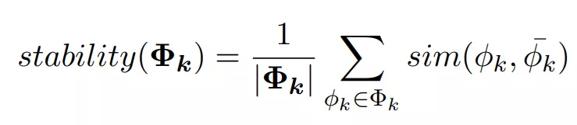
稳定度
计算其所有 Gibbs Sampler 提取出的词分布的平均值与各个 Gibbs Sampler 提取的词分布的相似度 (原论文 [4] 中使用了 cosine similarity, Euclidean distance, KL-divergence 以及 Jaccard similarity 来计算这个相似度)，取和后就得到了这个主题的主题稳定度。

Slide 12

离散度
转向了文档这一层次，从这些 Gibbs Sampler 的结果中，我们还可以得到他们的标准方差（standard deviation）。但是标准方差太过敏感，于是为了能够获得一个更稳定的结果，我们还可以用平均值除以偏差，以得到变异系数（coefficient of variance，cv）。
D 表示第 D 篇文章，k 则表示主题 k。

Slide 13
基于语言的内部特性进行判断
主题连贯性（Topic Coherence）就利用 PMI（Pairwise Pointwise Mutual Information）对主题词间的连贯性进行计算

Slide 14
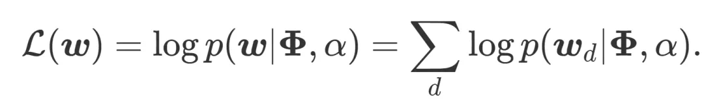
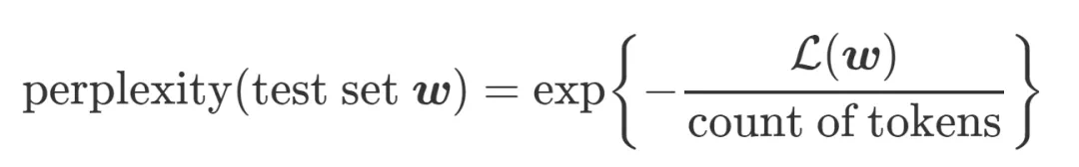
混淆度 (perplexity)
Wallach09a （http://dirichlet.net/pdf/wallach09evaluation.pdf）中提出了一些对 likelihood 进行估计的方法，感兴趣的可以自己看一下，因为其效果并不很好

Slide 15
主题连贯性（Coherence）
如果这些词是相互支撑的，那么这组词就是连贯的。换句话说，如果把好多个主题的词放在一起，用完美的聚类器做聚类，那么同一个主题的词应该在同一个类别中。
Newman et al. (2010) 提出使用 PMI 计算主题连贯性后，Mimno et al. (2011) 基于主题连贯性的理念，又使用了一种基于条件概率的方式对连贯性进行计算，Musat et al. (2011) 也在同年提出利用 WordNet 的层级概念来获取主题间的联系；然后，Aletras and Stevenson (2013a) 也提出了一种基于分布相似度的方法来求连贯性

Slide 16
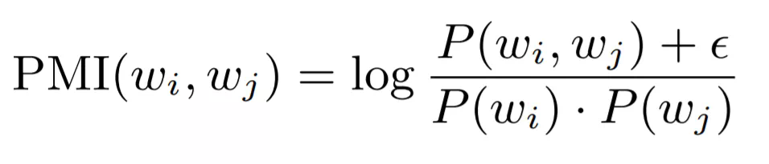
PMI (frequent itemset?)

Slide 17
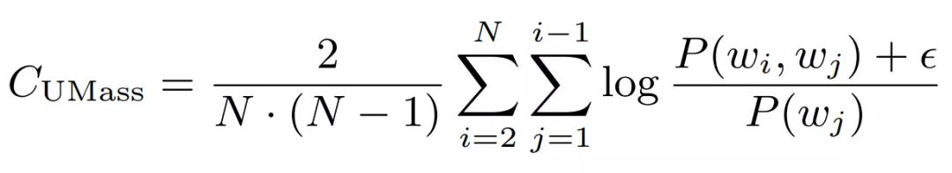
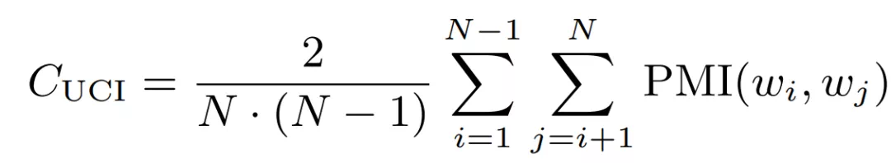
基于滑动窗口，对给定主题词中的所有单词对（one-set 分割）的点态互信息 (point twise mutual information, PMI) 进行计算

Slide 18
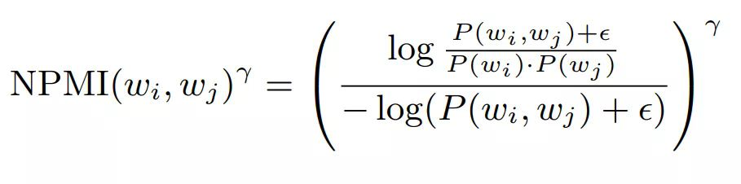

Slide 19
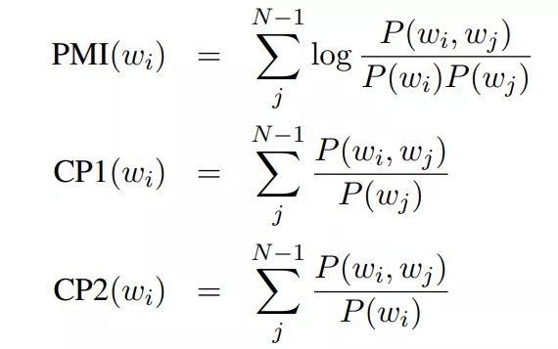
人工 -间接方法
然后将这些特征进行合并，利用 Ranking SVM Regression 来找到异常词， outlier detection

Slide 20
