Slide 1
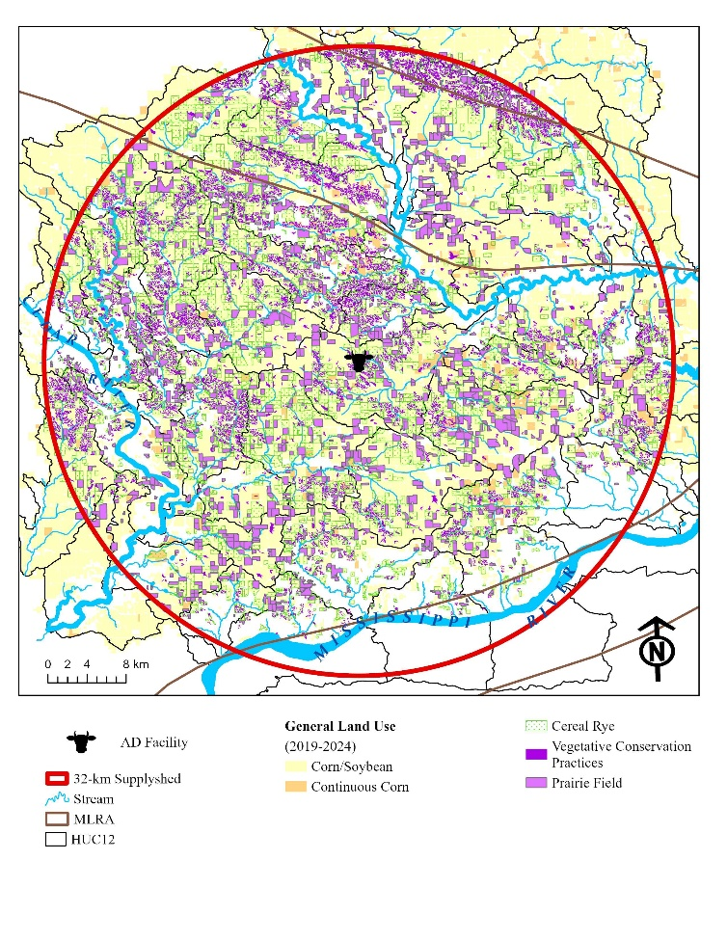
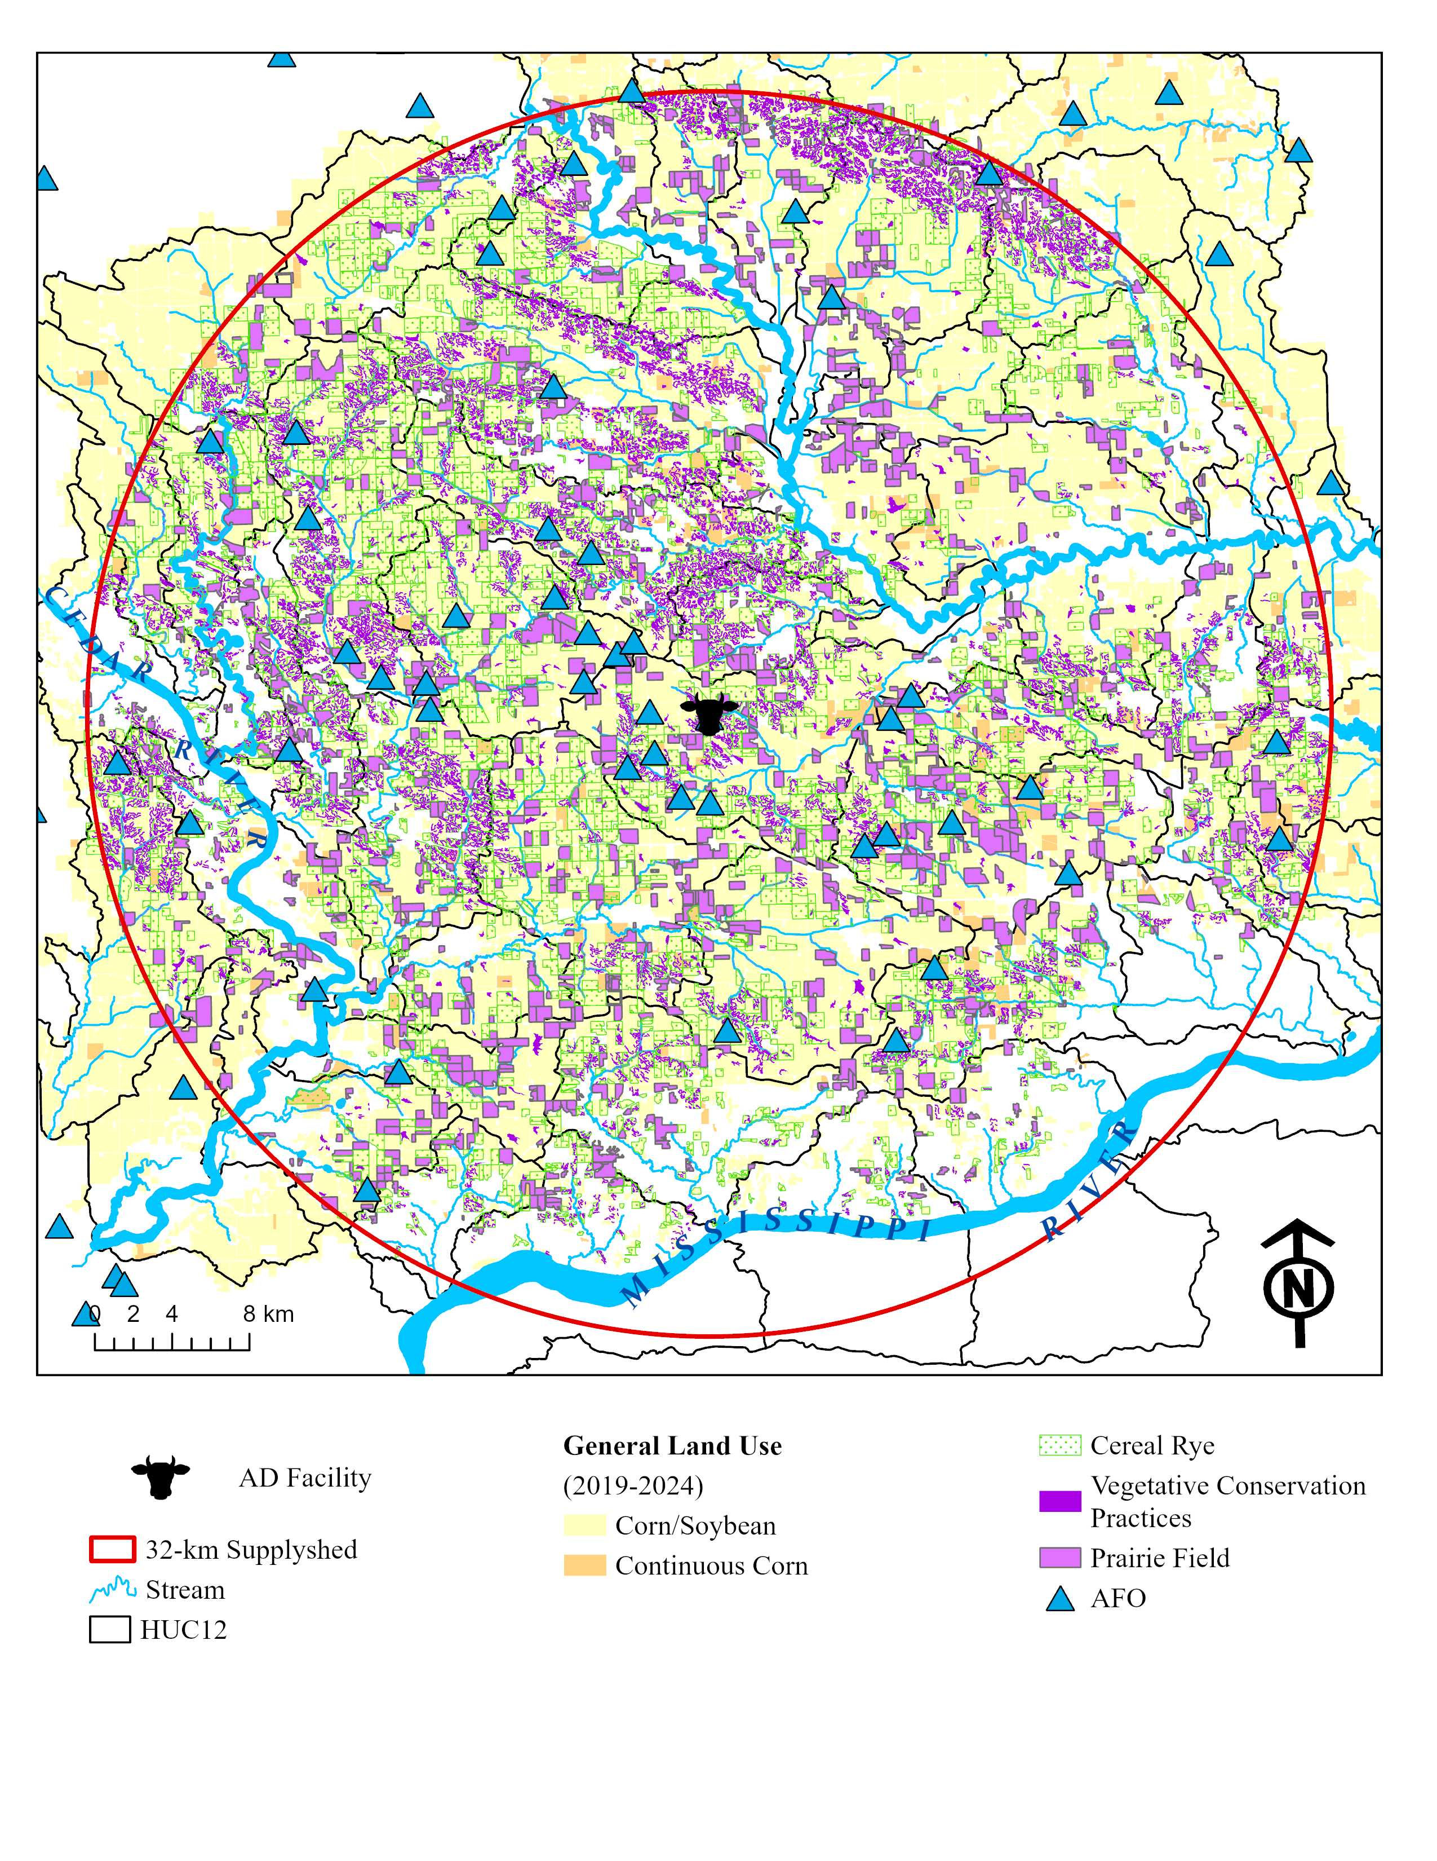
Implications for systematic conservation and bioeconomic planning
32-km supplyshed: 313,962 ha (73% cropland)
Public and private planning goals: 72,656 ha cereal rye + 42,891 ha of prairie
AD facility biomass goal: 809 ha cereal rye yr⁻¹ + 809 ha prairie yr⁻¹
Opportunities for AD technology expansion in region. 91 Animal Feedlot Operations (AFOs) with minimum manure production (EPA 2025).
Diversify farmer income portfolio (AD payments, environmental markets, and conservation payments)
Ecosystem Service | Unit | Iowa Nutrient Reduction Strategy + Iowa Wildlife Action Plan Outcomes
 |  | Rye | NRW | Sat Buff | Perennial
NO₃ | Load Red. (Mg) | 614 | 774 | 61 | 1,254
 | TCE ($ kg⁻¹) | $ 51.79 | $ 31.20 | $ 7.65 | $ 21.78
Sediment | Load Red. (Mg) | 140,278 | 84,126 | 50,273 | 126,903
 | TCE ($ kg⁻¹) | $ 0.37 | $ 0.40 | $ 5.25 | $0.44
CO₂ | Load Red. (Mg) | 54,196 | 3,661 | 1,436 | 81,869
 | TCE ($ kg⁻¹) | $ 0.58 | $ 6.23 | $ 2.33 | $ 0.68
N₂O | Load Red. (Mg) | 8,468 | 1,046 | 410 | 23,391
 | TCE ($ kg⁻¹ CO_{2 eq}) | $3.74 | $ 21.81 | $ 8.14 | $ 0.89
Biomass | Yield (Mg) | 276,565 | 11,456 | 9,331 | 256,160
 | TCE ($ MMBtu⁻¹) | $ 9.59 | $ 155.02 | $ 27.89 | $ 10.01
Wildlife | Core Patch (ha)² | - | - | - | 27,153
 | Linear Habitat (ha)³ | - | - | 593 | 6,654
Jessica Stephenson, John Tyndall

Slide 2
Implications for systematic conservation and bioeconomic planning
32-km supplyshed: 313,962 ha (73% cropland)
Public and private planning goals: 72,656 ha cereal rye + 42,891 ha of prairie
AD facility biomass goal: 809 ha cereal rye yr⁻¹ + 809 ha prairie yr⁻¹
Opportunities for AD technology expansion in region. 91 Animal Feedlot Operations (AFOs) with minimum manure production (EPA 2025).
Diversify farmer income portfolio (AD payments, environmental markets, and conservation payments)
Ecosystem Service | Parameter | Iowa Nutrient Reduction Strategy + Iowa Wildlife Action Plan Outcomes
 |  | Rye | NRW | Sat Buff | Perennial
NO₃ | Load Red. | 7% | 9% | 1% | 15%
 | TCE ($ kg⁻¹) | $ 51.79 | $ 31.20 | $ 7.65 | $ 21.78
Sediment | Load Red. | 21% | 13% | 8% | 19%
 | TCE ($ kg⁻¹) | $ 0.37 | $ 0.40 | $ 5.25 | $0.44
CO₂ | Load Red. (Mg) | 54,196 | 3,661 | 1,436 | 81,869
 | TCE ($ kg⁻¹ CO_{2 eq}) | $ 0.58 | $ 6.23 | $ 2.33 | $ 0.68
N₂O | Load Red. (Mg) | 8,468 | 1,046 | 410 | 23,391
 | TCE ($ kg⁻¹ CO_{2 eq}) | $3.74 | $ 21.81 | $ 8.14 | $ 0.89
Biomass | Yield (Mg) | 276,565 | 11,456 | 9,331 | 256,160
 | TCE ($ MMBtu⁻¹) | $ 9.59 | $ 155.02 | $ 27.89 | $ 10.01
Wildlife | Core Patch (ha)² | - | - | - | 27,153
 | Linear Habitat (ha)³ | - | - | 593 | 6,654
Jessica Stephenson, John Tyndall

