Slide 1
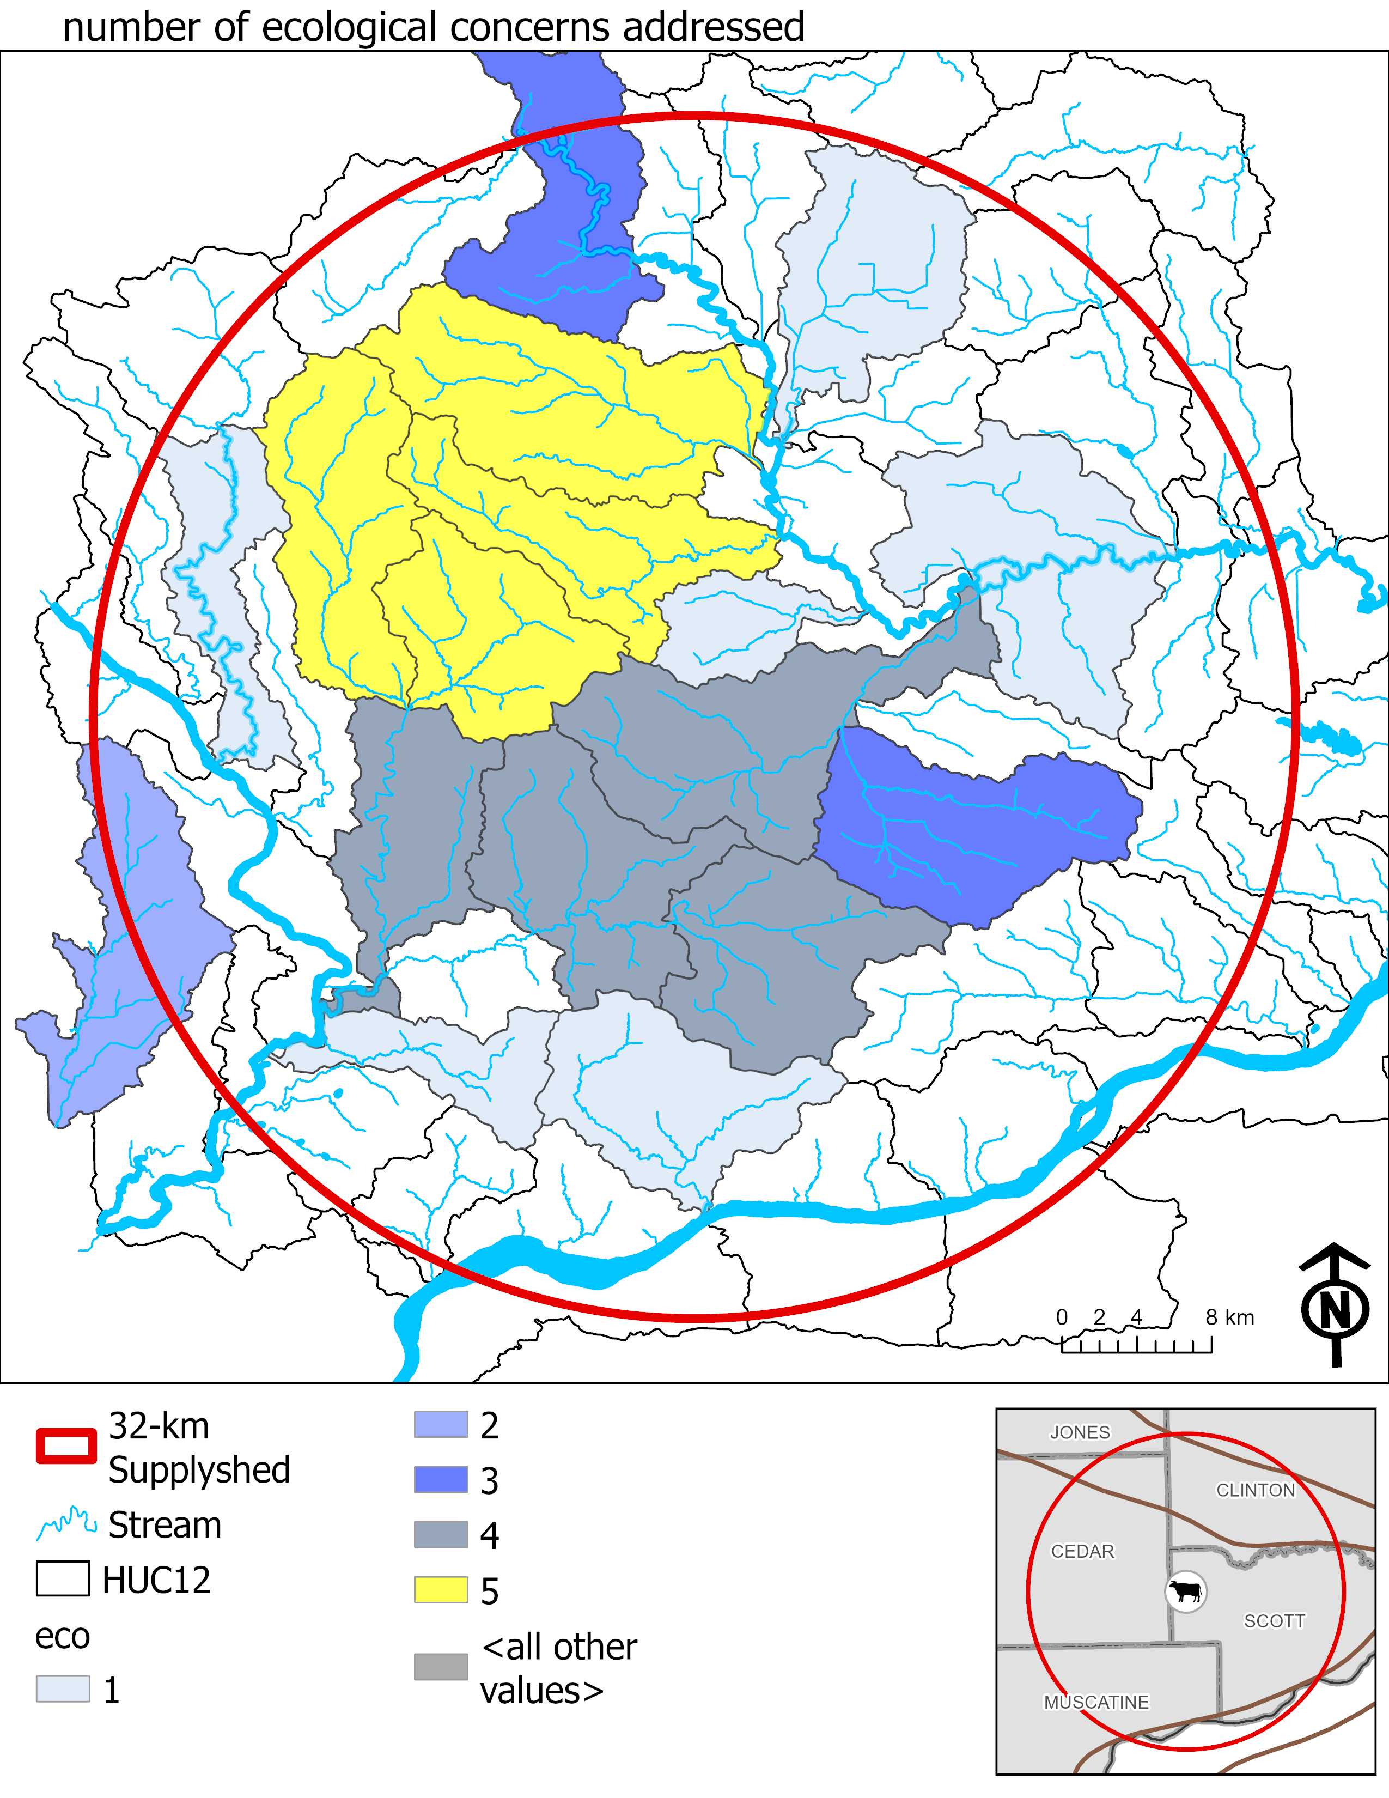
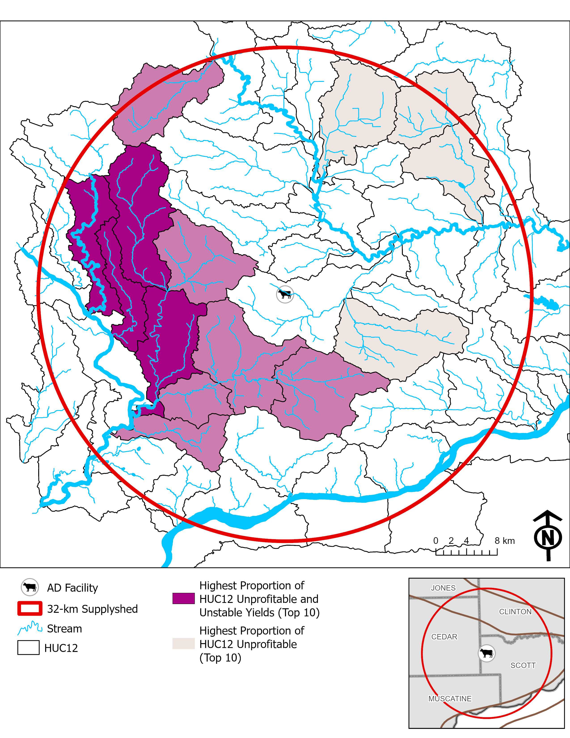

Slide 2
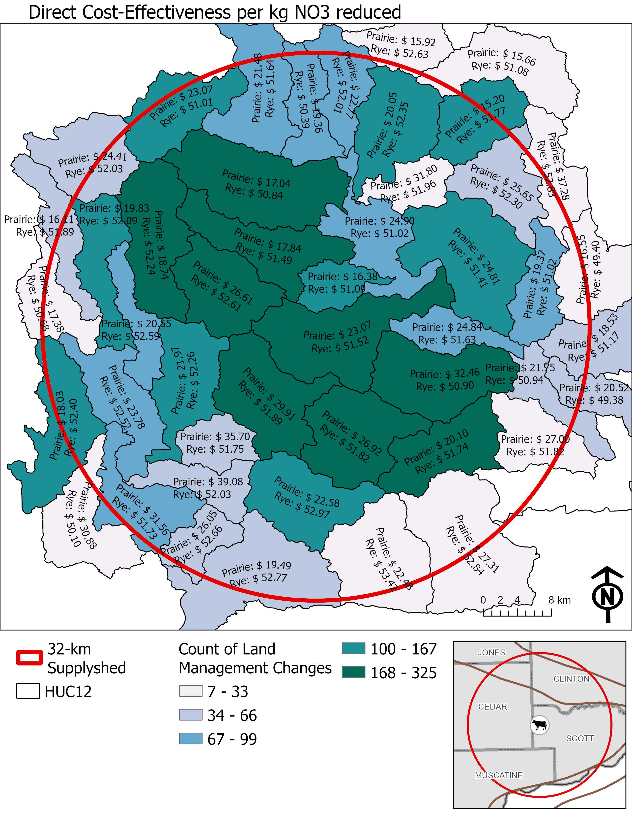
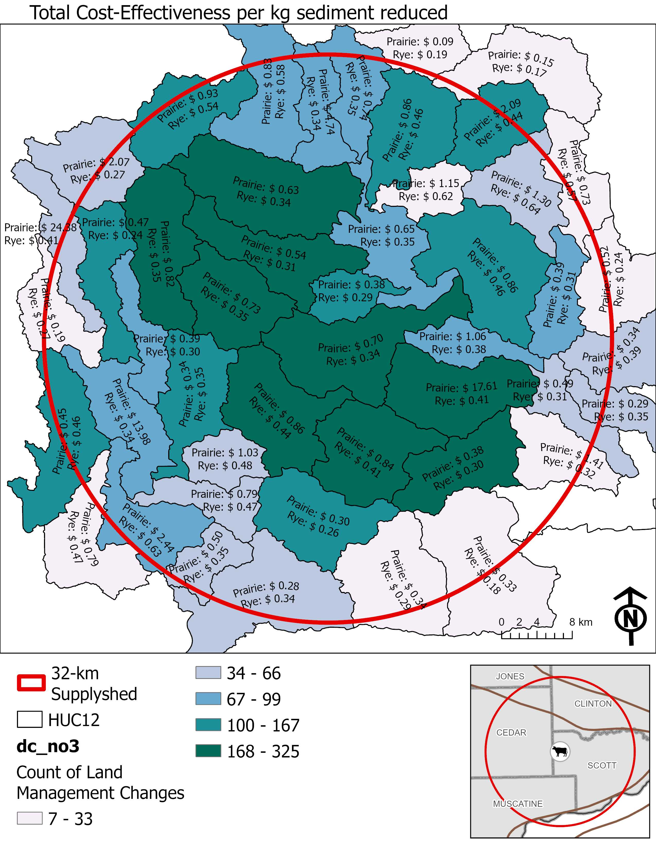
Total

Slide 4
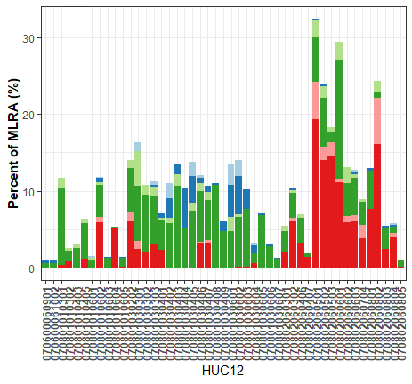
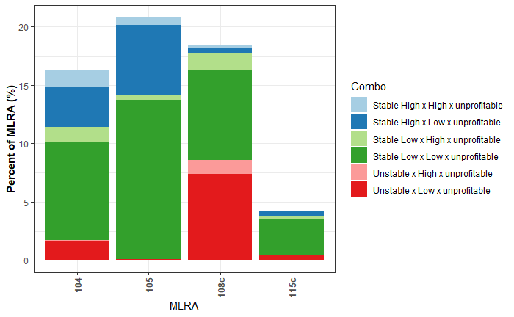
HUC12 intersecting Supplyshed (%)

Slide 5
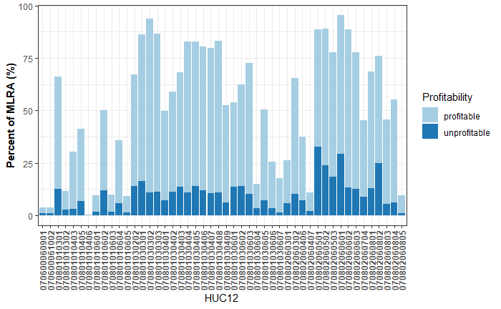
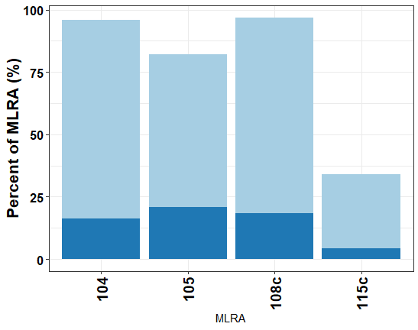
HUC12 intersecting Supplyshed (%)

Slide 6
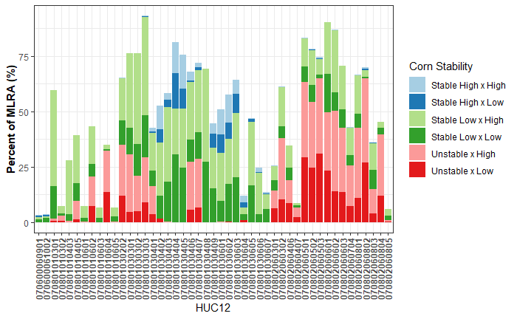
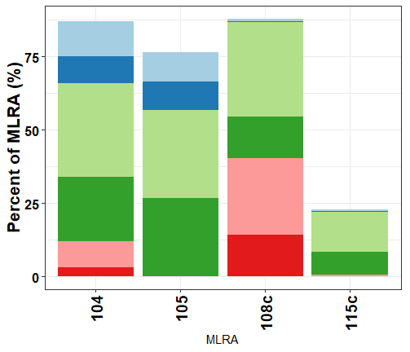
HUC12 intersecting Supplyshed (%)

Slide 7
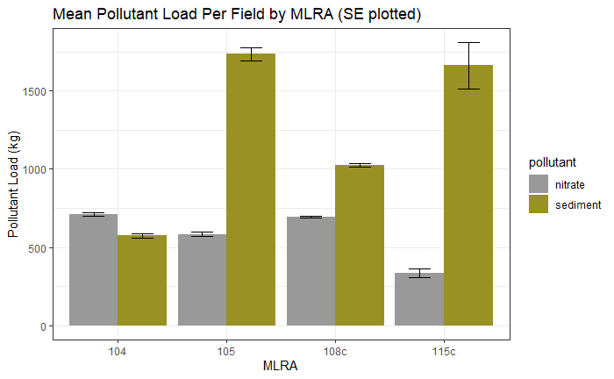
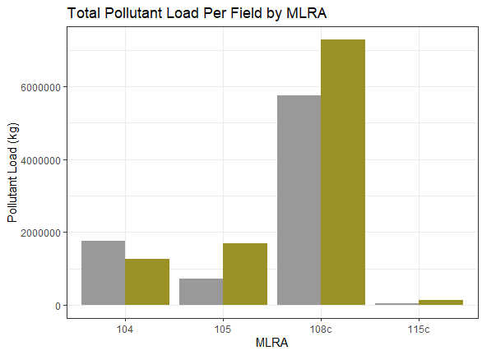

Slide 8
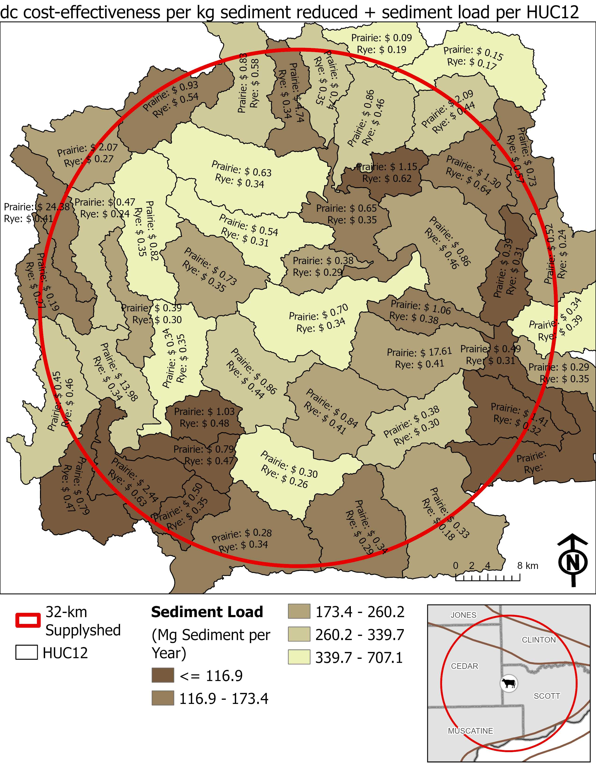
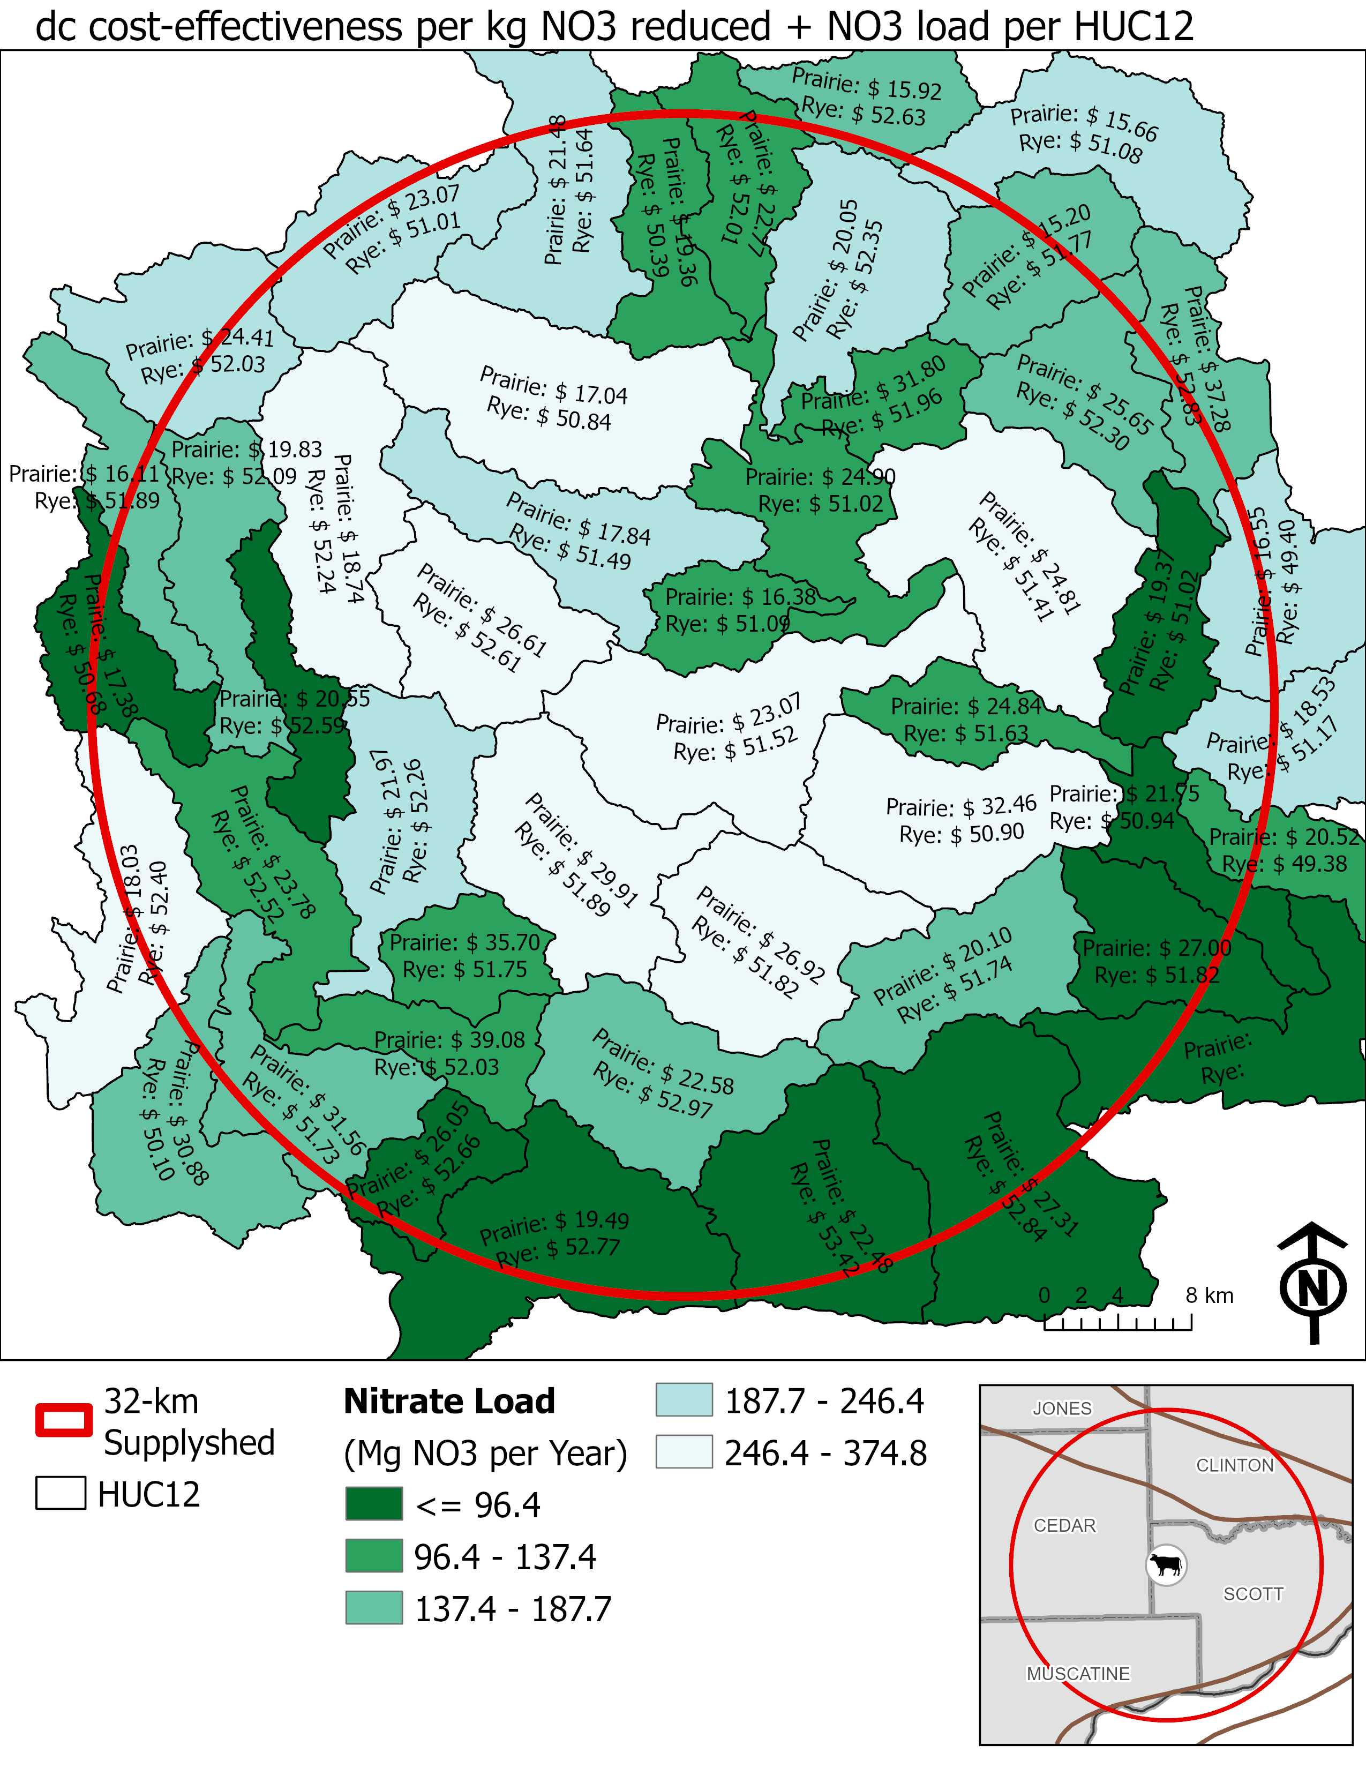

Slide 9

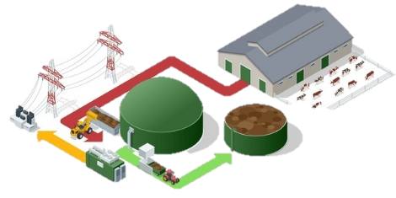


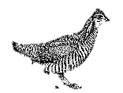

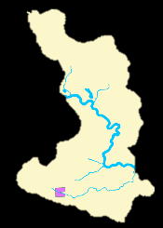
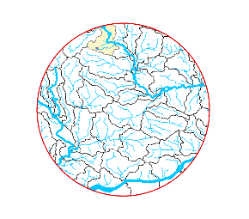

ACPF
INPUT
HUC 12 Boundary
Field boundary
Soils
Land Use
DEM
OUTPUT
SVI
Stream network
Terrain attributes (FDR, FAC, hDEM)
Saturated buffer
Prairie Strips
NRW
Drainage Table
OFE
INPUT
[ACPF dataset]
DEP/WEPP
OUTPUT
Sediment loss raster
Soil loss by-field
FiNRT
GeoProfit
INPUT
[ACPF dataset]
[OFE dataset]
MRTN fertilizer rate calculations
Practice costs
Land rent costs (Ag DecisionMaker)
NO₃ reduction fraction (INRS)
Sediment reduction fraction (MOSM)
GHG reduction rate (COMET)
Soil leaching values by MLRA
Biomass yields
Energy potential
OUTPUT
N fertilizer rates per field
NO₃ load
Outcome by practice an field:
NO₃ load reduction
CO₂ and N₂O reduction
Biomass yield
Energy yield potential
Costs by practice:
Direct cost
Opportunity cost
Total cost
Cost-effectiveness
INPUT
[ACPF dataset]
NASS county yields
Corn price
Soybean price
Land rent Costs
OUTPUT
Field profitability
Yield stability
Local Resource Plan Analysis
Public: INRS, IWAP, ICACC
Private: Energy production (AD technology)
N₂O
CO₂
Aggregate modeling outcomes to public and private planning scales.
Field
HUC12
Supplyshed
MLRA

