Slide 1
Election Sentiment and Topic Model Analysis
James Nelson
MSDS696 Data Science Practicum II
Professor Busch
Regis University

Slide 2
Project Overview
Issue: Political polarization and how bad is it?.
The state of the nation is facing political polarization like never before and there are so many factors as to why mainly attributed to big tech algorithms according to the netflix documentary “The Social Dilema.” The main question though is how bad is it?
The plan: mine, clean/process, explore, and model tweet data for a sentiment analysis and topic model.
Stream real-time tweets from twitter and store into MongoDB.
Clean/process the tweets before normalizing it for the sentiment analysis
Run the data through the gensim/mallet library in python for topic modeling.
The expected result:
The sentiment analysis and topic modeling will give enough insight into knowing if the nation is politically polarized or not

Slide 3
Tweet Streaming/Cleansing
I streamed real-time tweets the morning, afternoon, evening and station closing for mountain and pacific times on day one with different tracking filters “Election,” “Biden,” and “Trump.”
Then I continued streaming for the morning, afternoon, and the evening for the next two days until the election results announcement.
Overall I collected 360,000 tweets
I normalized the tweets by removing the newline characters, removed the accented characters, lemmatized/stemmed the text, removed special characters, removed extra whitespace, removed stopwords, lower cased the text and then tokenized the text.

Slide 4


Feature Engineering
Vectorization
I vectorized the text after cleaning it with TFIDF vectorization (Term Frequency - Inverse Document Frequency)
TFIDF is a feature extraction method used to build a feature matrix (vectorization) for later use for more in depth analytical tools like clustering, the sentiment analysis, and topic modeling.
The equation for TF is
“Where f wD denoted frequency for word w in document D, which becomes the term frequency (tf ),” (Dipanjan Sarkar, 2019)
The equation for IDF is
“Where idf (w, D) represents the idf for the term/word w in document D, N represents the total number of documents in our corpus, and df (t) represents the number of documents in which the term w is present,” (Dipanjan Sarkar, 2019)
Leaving the final computation tfidf = tf * idf to give a calculated weight for the terms of each document being processed through the tfidf vectorization function

Slide 5
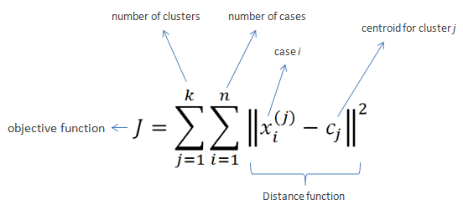
Exploring the Data with K-Means Clustering
To explore the data,I chose to use k-means clustering to keep it the exploration simple and navigate my curiosity.
K-Means Clustering
Clustering is an unsupervised form of machine learning where there is not any categorical data for the raw data to be associated with. The way K-Means works is by placing centroids randomly on in a dimension where the data points of the data will be measured by case based on its distance for similarity. The algorithm iterates over and over trying to move these centroids around the k clusters chosen to place themselves in the center, and when that happens the algorithm stops (Anas Al-Masri, 2019).
Since I don’t want to overkill the clustering I just went with 2 clusters for the exploration. In addition to clustering I extracted the features that were used for each of the clusters. (Next Page)
(“K-Means,” 2020)

Slide 6
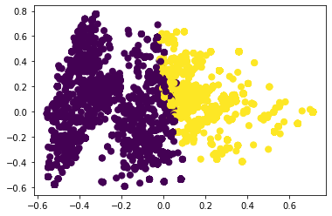
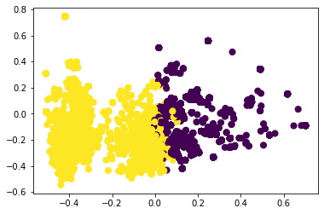


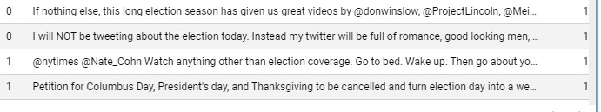

Exploring the Data with K-Means Clustering
election_am_clustered.xlsx dataset
election_aft_2d_clustered.xlsx dataset

Slide 7
Sentiment Analysis Intro
Sentiment Analysis Introduction
A sentiment analysis is a tool of textual analytics to gain insight from the sentiment of a user’s text. It is considered the more popular tool of natural language processing/text analytics (Dipanjan Sarkar, 2019) probably since it is easy after normalizing the text.
With everything out there that is from a comment, email, tweet, post, review, etc. there is a certain level of value behind someone’s point of view and this is where a sentiment analysis comes into play. How the text of a document is scored is based off the polarity score reflecting the words in the text.
The Sentiment Analysis Utilized
AFINN and VADER lexicons, both are pre curated with lexically scored terms providing an unsupervised sentiment analysis.
I will use AFINN to compare with VADER, but VADER will be the focus of the sentiment analysis

Slide 8
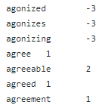
AFINN Sentiment Analysis
About AFINN
“The AFINN lexicon is perhaps one of the simplest and most popular lexicons and can be used extensively for sentiment analysis. Developed and curated by Finn Årup Nielsen,” (Dipanjan Sarkar, 2019). As of now AFINN-en-165.txt is the most recent/update of Finn’s lexicon which has over 3,300 words attached with polarity scores to each of them.
What is being scored
For the AFINN sentiment I chose to add the neutral threshold for the predicted sentiment. If the threshold of the predicted sentiment is equal to zero then the predicted sentiment is neutral, but if it is anything greater than zero it is positive.
(fnielsen, 2019)

Slide 9
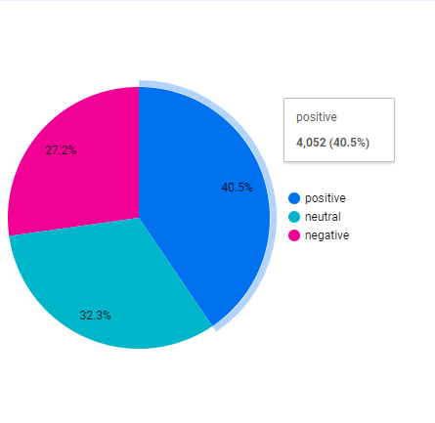

AFINN example
election_pollclose_mtn_afinn.xlsx dataset
10,000 total tweets were scored based off the extracted features in the feature matrix.
4,052 tweets were scored positive.
It is one thing to note though these sentiment analysis aren’t contextual and therefore won’t account for sarcasm or humor

Slide 10

Vader Sentiment Analysis
The VADER lexicon which stands for Valence Aware Dictionary and sEntiment Reasoner which was developed by C.J. Hutto (Dipanjan Sarkar, 2019) is the one I will be basing most of my analysis off because it has 7520 lexical terms for sentiment polarity scoring.
(I will be showing off Vader with topic modeling to stay within the time limit)
(cjhutto, 2020)

Slide 11
Topic Modeling with Gensim and Mallet
Topic modeling is basically what the title says which is modeling topics found in the corpus of documents. Topic modeling uses mathematics and statistics to snag multiple topics and themes from the text (Dipanjan Sarkar, 2019). I chose to use topic modeling in conjunction with a sentiment analysis to paint a better picture of the overall opinion and feelings of those tweeting during these times of streaming the tweets into the database. Using the sentiment and looking at every tweet individually would take forever and that is why using a topic model will help articulate the same thing but on a broader scale.
How a Topic Model is made is through feature extraction again but in a different way. The model needs ngrams for a bigram model, and ngrams are phrases that are extracted from the text that carry from term to term. (for example) Take the sentence “The cow jumps over the moon”. If N = 2 (known as bigrams) then the phrased terms will look like this:
the cow
cow jumps
jumps over
over the
the moon (Kavita Ganesan, 2018)
Once the bag of words model is established (a collection of extracted features/bigrams) the topic modeling can commence.

Slide 12
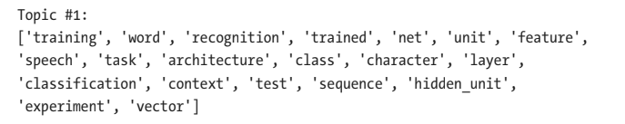
Preferences for the Topic Model
Since these tweets are going to be very diverse, the function I made to get a coherence score on how many topics should be used will be pretty high (20-25 topics).
So I kept it relatively small with only 6 topics. I know this may be a difficult to portray all the possible topics, but the performance of my local pc would take days to run the model for all them.
(Dipanjan Sarkar, 2019/2019)

Slide 13
Viewing the Analysis
Day One
Day Two
Day Three
Results
Overall

Slide 14
Conclusion
Analysis Conclusion
There isn’t enough data or enough time for the short amount of research this project needed to conclusively measure how politically polarized the nation really is.
The topics are so diverse and the sentiments are extremely symmetrical that I don’t want to justify the issue without further research.
Moving Forward
If this research project was to continue, I suggest the following actions take place for the next step
Increase research project duration
Establish an appropriate timeline for the data science lifecycle
Broaden the data population
Not everyone uses Twitter
Use a mailing questionnaire with multiple choice and open-ended questions
Use more textual analytical tools alongside the sentiment analysis and topic modeling
text similarity, semantic analysis, text summarization, and text classification are all great analytical tools of natural language processing within text analytics.

Slide 15
Conclusion (cont’d)
The outcome of such a research project will only point towards the possible issues that everyone faces when it comes to political visibility and big tech company algorithms. The enlightenment of such an issue could pave the way into the future of how laws are made to ensure that big tech companies and their algorithms cannot condition everyone into opposite silos of each other based on political belief. Although everyone is entitled to their own opinion and free thought it is important that everyone is exposed to an opposing belief so democracy can still thrive.

Slide 16
References
Anas Al-Masri. (2019, May 14). How Does k-Means Clustering in Machine Learning Work? Retrieved December 1, 2020, from Medium website: https://towardsdatascience.com/how-does-k-means-clustering-in-machine-learning-work-fdaaaf5acfa0
cjhutto. (2020, May 22). cjhutto/vaderSentiment. Retrieved December 9, 2020, from GitHub website: https://github.com/cjhutto/vaderSentiment/blob/master/vaderSentiment/vader_lexicon.txt
Dipanjan Sarkar. (2019). Text analytics with Python : a practitioner’s guide to natural language processing. New York: Apress Springer Naure. (Original work published 2019)
fnielsen. (2019a, January 8). fnielsen/afinn. Retrieved December 9, 2020, from GitHub website: https://github.com/fnielsen/afinn
fnielsen. (2019b, January 8). fnielsen/afinn. Retrieved December 9, 2020, from GitHub website: https://github.com/fnielsen/afinn
Kavita Ganesan. (2018, November 2). What are N-Grams? | Kavita Ganesan, Ph.D. Retrieved December 7, 2020, from Kavita Ganesan, Ph.D website: https://kavita-ganesan.com/what-are-n-grams/#.X85r8NhKiUk
K-Means. (2020). Retrieved December 9, 2020, from Saedsayad.com website: https://www.saedsayad.com/clustering_kmeans.htm

