Slide 1
The zip file should contain an MXD named ‘Cart_Test_SDA.mxd’.
This ArcMap document already has the toolbox and map layers needed to do testing.

Slide 2
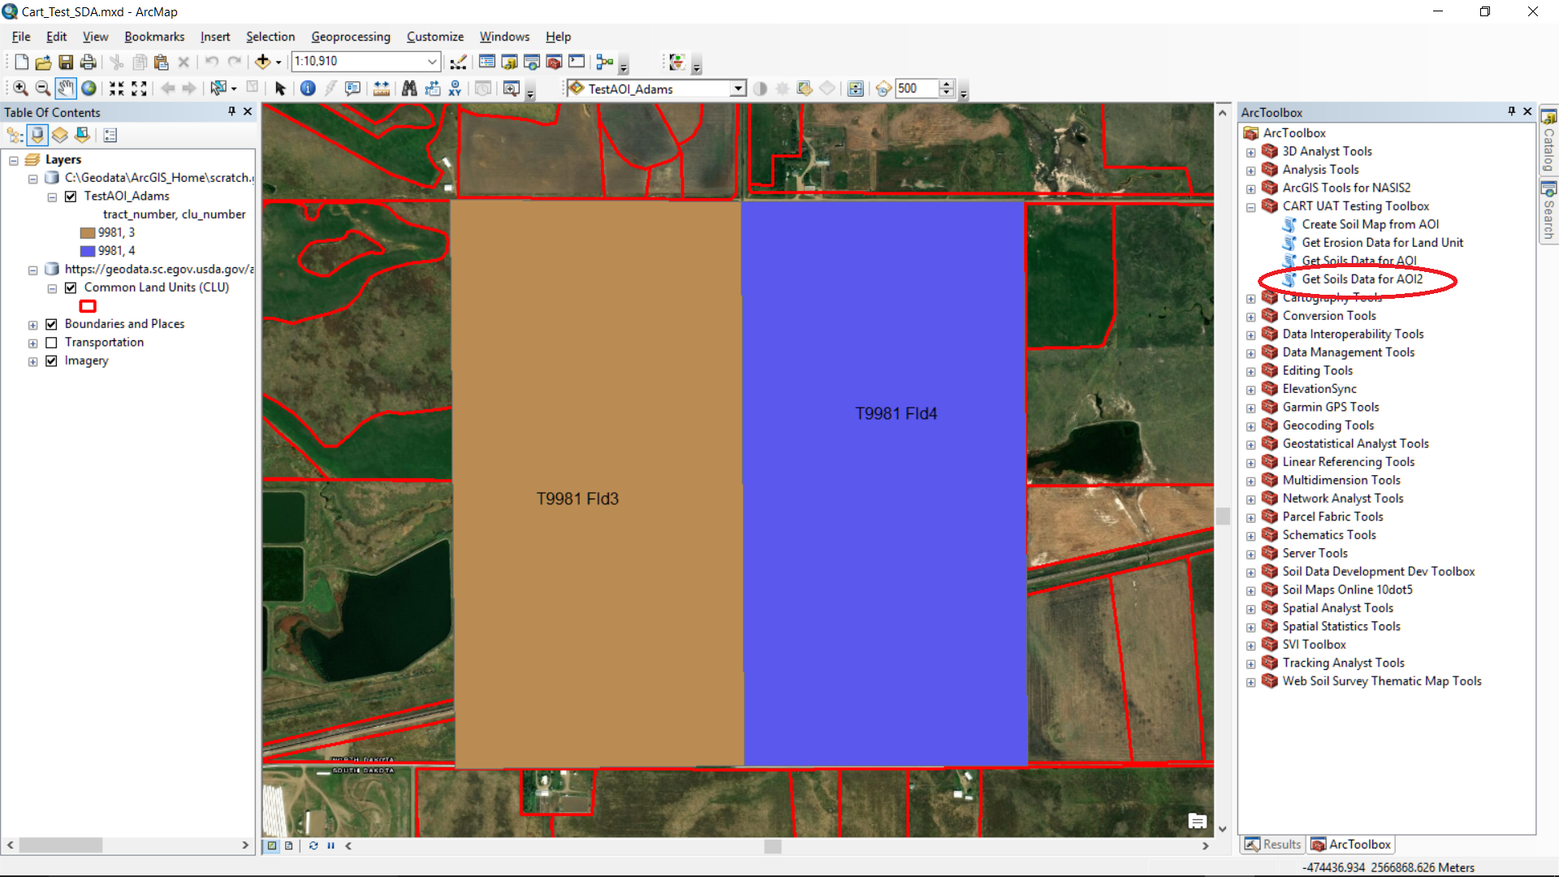
To run the ‘Get Soils Data for AOI2’ tool, first turn off either the ‘Common Land Units or TestAOI_Adams layers and then select one or more landunit polygons in the remaining layer.

Slide 3
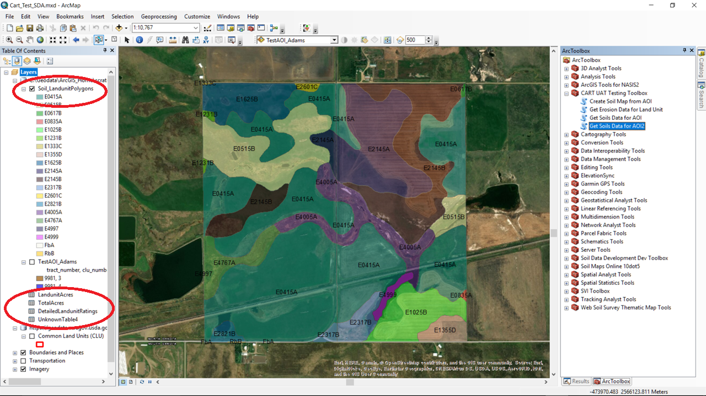
Tool outputs

