Slide 1
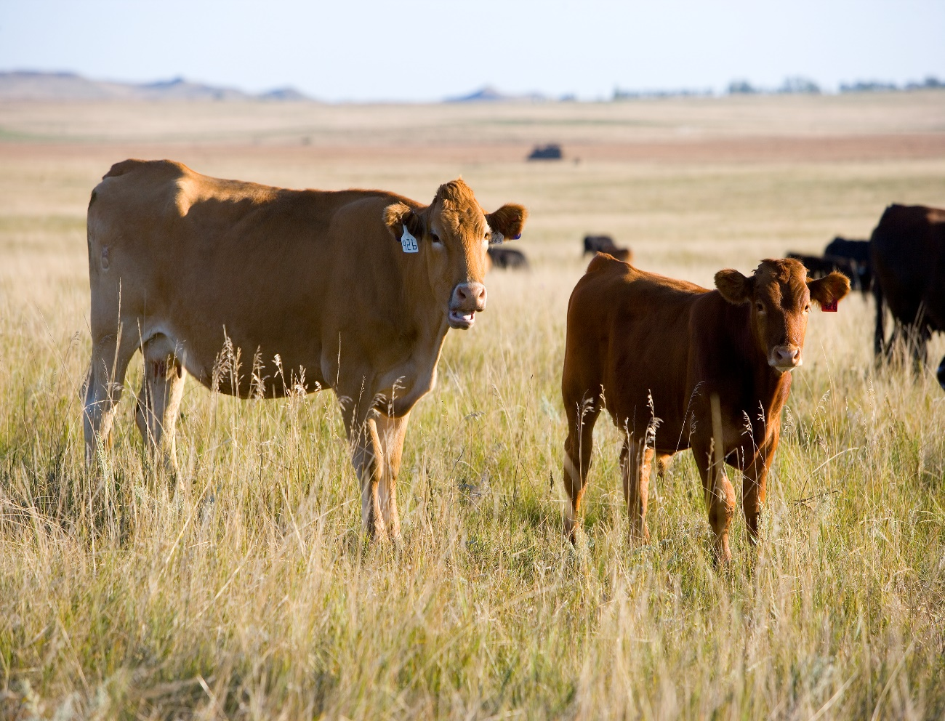
SSURGO-Query Tool (SSURGO-QT) developed for CEAP-Grazing Lands
Notes:
Hi all. Thank you for being a part of this beta-test for the SSURGO-Query Tool, developed by the CEAP-Grazing Lands component in partnership with the Soil & Plant Sciences Division and Stone Environmental as the private contractor.
I’m Lori Metz, the CEAP-GL Component Leader. I’ll begin with some housekeeping items, and then introduce our two presenters. This meeting will be recorded, and I’ll provide a link of the recording to all registered reviewers after this rollout meeting.
We have asked each of you to review this web application, particularly for its ability to provide quick geospatial results of user-selected soil physical, chemical and positional characteristics. We feel that the soil properties identified here are the main ones that drive plant community development. The tool should aid in creating or refining ecological site concepts or in the selection of soils for modeling effects of conservation practices. It’s also a very useful tool for conservationists, ranchers, agronomists, and other users, to help identify soil characteristics across their areas of interest.
For housekeeping items, please hold all comments/questions until the end, at which time I’ll moderate verbal question/answers. Please do not enter comments in the Chat box, rather use the “Raise Hand” function in Zoom, and I’ll call on people in an orderly fashion.
Also, as you conduct your review, please refer to the User Guide provided within the application portal, under the Info icon on the right side of the top banner. Note that Appendix 3 in the User Guide gives you the link to the Reviewer Questionnaire, which is the final act we ask you to perform in relation to this internal review. The User Guide also provides extensive documentation of the SSURGO data fields from which we extracted values to build the tool, and a guide to the MLRAs with the most data records that may result in slow map-loading performance, just so you are aware.
Our partnership with Stone Environmental fulfilled a vision many conservationists have had for over a decade: To create a soil characteristic selection tool that is map-based, combining soil features that are most influential in driving plant community assemblages. Without the help from the following NRCS folks, the application would not have been possible: Jason Nemecek, who wrote the SQL to extract data from Soil Data Access for this tool; Carrie-Ann Houdeshell, who worked closely with me and the rest of the development team to keep us honest with respect to soil properties and characterization; Rachel Meade, the Colorado NRCS State Range Con, and; Steve Barker, retired Arizona NRCS SRC and State Range Con – both of whom, like me, have extensive experience in developing ecological site descriptions and working on soil surveys. Together, this team conceptualized and created the SSURGO-Query Tool web application, then reached out to Stone Environmental to build it. Warren Rich serves as the Project Director at Stone Environmental, and Alan Hammersmith is the senior GIS web applications developer on the project.
I’ll provide some initial context for the SSURGO-QT, and then turn it over to Warren and Alan, who will walk us through the online web application where you will be conducting your review. At the end, we’ll open the floor to verbal questions which I’ll moderate. Please use the “Raise Hand” function in Zoom during the Q&A.

Slide 2
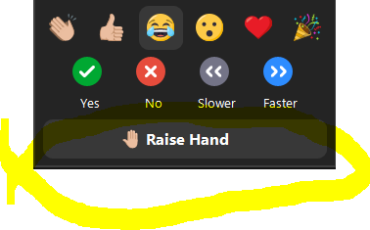
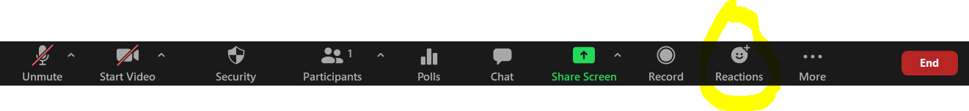
SSURGO-Query Tool (SSURGO-QT) developed for CEAP-Grazing Lands
Notes:
Hi all. Thank you for being a part of this beta-test for the SSURGO-Query Tool, developed by the CEAP-Grazing Lands component in partnership with the Soil & Plant Sciences Division and Stone Environmental as the private contractor.
I’m Lori Metz, the CEAP-GL Component Leader. I’ll begin with some housekeeping items, and then introduce our two presenters. This meeting will be recorded, and I’ll provide a link of the recording to all registered reviewers after this rollout meeting.
We have asked each of you to review this web application, particularly for its ability to provide quick geospatial results of user-selected soil physical, chemical and positional characteristics. We feel that the soil properties identified here are the main ones that drive plant community development. The tool should aid in creating or refining ecological site concepts or in the selection of soils for modeling effects of conservation practices. It’s also a very useful tool for conservationists, ranchers, agronomists, and other users, to help identify soil characteristics across their areas of interest.
For housekeeping items, please hold all comments/questions until the end, at which time I’ll moderate verbal question/answers. Please do not enter comments in the Chat box, rather use the “Raise Hand” function in Zoom, and I’ll call on people in an orderly fashion.
Also, as you conduct your review, please refer to the User Guide provided within the application portal, under the Info icon on the right side of the top banner. Note that Appendix 3 in the User Guide gives you the link to the Reviewer Questionnaire, which is the final act we ask you to perform in relation to this internal review. The User Guide also provides extensive documentation of the SSURGO data fields from which we extracted values to build the tool, and a guide to the MLRAs with the most data records that may result in slow map-loading performance, just so you are aware.
Our partnership with Stone Environmental fulfilled a vision many conservationists have had for over a decade: To create a soil characteristic selection tool that is map-based, combining soil features that are most influential in driving plant community assemblages. Without the help from the following NRCS folks, the application would not have been possible: Jason Nemecek, who wrote the SQL to extract data from Soil Data Access for this tool; Carrie-Ann Houdeshell, who worked closely with me and the rest of the development team to keep us honest with respect to soil properties and characterization; Rachel Meade, the Colorado NRCS State Range Con, and; Steve Barker, retired Arizona NRCS SRC and State Range Con – both of whom, like me, have extensive experience in developing ecological site descriptions and working on soil surveys. Together, this team conceptualized and created the SSURGO-Query Tool web application, then reached out to Stone Environmental to build it. Warren Rich serves as the Project Director at Stone Environmental, and Alan Hammersmith is the senior GIS web applications developer on the project.
I’ll provide some initial context for the SSURGO-QT, and then turn it over to Warren and Alan, who will walk us through the online web application where you will be conducting your review. At the end, we’ll open the floor to verbal questions which I’ll moderate. Please use the “Raise Hand” function in Zoom during the Q&A.

Slide 3
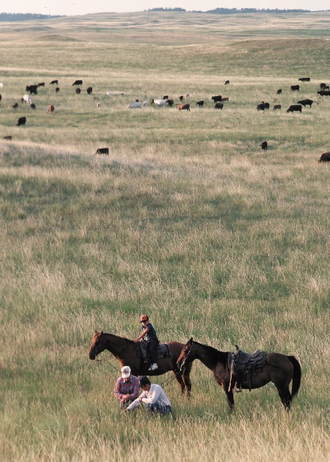
Introduction and Purpose
Soil physical, chemical and positional characteristics coalesce to create unique plant assemblages across the land.
Created to aid users of soils information to develop ecological site concepts, or just do spatial queries for specific soil characteristics for conservation planning.
Uses data extractions via SQL directly within Soil Data Access (Jason Nemecek created the SQL). Links the tabular data from Soil Data Access with the correct gSSURGO spatial data to create an attributed map.
SSURGO-QT can be used by soil scientists, conservation planners, ecological site specialists, landowners, etc to aid in conservation planning.
Your expert review is needed!
Notes:
So we’re all aware that various soil physical, chemical and positional characteristics coalesce to create variable expressions of vegetation across the landscape. But before now, there was never a map interface that allowed a user to select different soil characteristics to see where they occur, and if patterns emerge that help us interpret soil data more efficiently and effectively.
We created SSURGO-QT to provide a spatial display of soil characteristics that ultimately translate into “soil performance data” (what is a given soil capable of producing?), and into potential soil interpretations (what should it be used for? What shouldn’t it be used for?). This information is extremely useful in the conservation planning process and development of tools such as ecological site descriptions that help support conservation planning.
We use the most recent data from Soil Data Access, linking that tabular data with the correct vintage of gSSURGO spatial data, to create an interactive map of soil attributes. The data behind SSURGO-QT will be updated annually after each SSURGO and gSSURGO refresh. Both the spatial and tabular data selected by the user in the app can be downloaded for use on their local computer.
SSURGO-QT was envisioned for use by soil scientists, conservation planners, landowners, ecological site specialists and others, predominantly to aid in conservation planning.

Slide 4
Roles of SSURGO-QT in NRCS Activities
Conservation Planning:
Enhance local knowledge of soils and potential conservation practice needs or effects by providing a quick spatial query tool for user-selected soil data.
Adds efficiency to the planning process by highlighting portions of the farm or ranch where potential soil-related concerns may exist.
Allows for rapid spatial, landscape-scale interpretation for those not familiar with each soil map unit or component.
Potential screening or analysis tool to help with resource assessments at multiple scales.
Notes:
There are several niches that SSURGO-QT can fill related to NRCS activities.
The first is in the Conservation Planning process.
The app can enhance local knowledge of soils and potential conservation practice needs or effects by providing a quick spatial query tool for user-selected soil data.
It increases efficiencies in the planning process, allows for rapid landscape- and field-scale interpretation for people not familiar with each soil map unit or component., and is a potential screening or analysis tool for multi-scalar resource assessments.

Slide 5
Roles of SSURGO-QT in NRCS Activities
Conservation Effects Modeling:
Group landscapes based on soil characteristics to determine model scenarios and extent of modeled effects.
Ecological Site/Soil Concepts:
Effectively build ecological site concepts based on soil criteria, then overlay vegetation data to build State-and-Transition Models within the ecological site descriptions.
Map occurrences of the same or similar ecological sites once correlated to soil map unit components.
Notes:
It can also play a role in base data and modeling scenarios for the determination of conservation practice effects.
And it can be effectively used to build ecological site concepts based on soil criteria, which are then combined with vegetation data to build state-and-transition models within ESDs. Once correlated to soil components, it provides a map of those ecological sites by map unit component.

Slide 6
Role of SSURGO-QT in Soil Data Updates
A new CEAP-Grazing Lands literature review database is under development.
The literature database will provide research data on many values such as crop or forage yields, forest stand data, developing soil use interpretations, etc, that could be used to update existing soil data.
Notes:
With the current work we are also doing on a literature review database, there will be an opportunity to couple research values with soil performance data values. Updating existing soil performance data, such as crop or forage yields, forest stand data, and developing a suite of soil use-interpretations could be enhanced with the interaction of SSURGO-QT and research data.

Slide 7
Let’s Explore the SSURGO-QT web app
Warren Rich and Alan Hammersmith, of Stone Environmental, will now give us a tour of SSURGO-QT.
All data contained in the tool is directly derived from Soil Data Access.
Verbal Q&A will follow. Distribution of the SSURGO-QT link will be provided to everyone who registered via the Google Form as a Reviewer.
Conduct your review through March 11.
Please complete the Reviewer Questionnaire!
Notes:
But for right now, let’s dive into the SSURGO-Query Tool!

Slide 8
SSURGO-Query Tool (SSURGO-QT) developed for CEAP-Grazing Lands
Thank you!
Notes:
Thank you

