Slide 1


DSP Hub FY21 Strategic/Tactical Plan -DRAFT Briefing for: Luis Tupas, Deputy Chief SSRA; David Lindbo, Director SPSD; Dave Hoover, NSSC Director and Olympia Train Business Owner Provided by: Michael Robotham, National Soil Scientist December 1, 2020
Special thanks to Laura Morton (FPAC-BC), Skye Wills (SPSD) and Jason Nemecek (SPSD)
December 2020

Slide 2
What is the DSP Hub?
DSP Hub Strategic/Tactical Plan
Component of the Core Nat Res Info Systems Value Stream of the Business Capabilities Roadmap
Original description: Provide Ability to Store Soil Health and Land Management Data (Dynamic Soil Property and Land Management Database)
Complimentary to and integrated with other value stream overall requirements (aka Epics)
Limited funding for initial design has been authorized
Propose to expand from database to broader data hub

Slide 3
CR-LMOD
Management System
Resource Concerns-conservation Planning
DSP Data Hub
Context
Project information
Condition
Treatment
Site_obs link to mgmt.
Aggregation Rules
Pedotransfer fxns
Interpretations
Soil Health Field Metrics
Soil Health Demo Trial
CIG
NASIS - point
Project
Site
DSP PLOT ID
Site Observation
Pedon
DSP Pedon ID
Location
Horizon & Layer
DSP Layer ID
MGMT Info
Veg
Soil Health Economic Case Studies
Soil Survey Data
EDIT
Ecological Site info
Soil Health
Commercial labs
Program
Project
org
SOILS DATA/INFORMATION
NASIS – Aggregated
SSURGO
Detailed Management info
LIMS (KSSL)
Site Info (location)
Pedon info
Horizon & Layer
Lab properties
Water and Climate
SCAN
PRISM
Other data source
Outcomes
Statistical analysis
functions
production
Economics
Source data for models and tools
Lab Data Mart (NCSS Charz)
LIMS Data
Cooperator data (universities)
Science of Soil Health
PLFA
Summary tables
User Interface
Step 9 activities
Edge-of-Field

Slide 4
DSP Hub Goal Statement
DSP Hub Strategic/Tactical Plan
The DSP Hub will provide an authoritative source for data and interpretations on soil properties that change rapidly due to land uses and conservation management (aka DSPs).
The DSP Hub will deliver three main products:
Authoritative dynamic soil properties data
Custom interpretations curated and approved for specific uses
Official “outcomes” data related to dynamic soil properties

Slide 5
DSP Hub Objectives
DSP Hub Strategic/Tactical Plan
Align to USDA enterprise data governance
Provide a business tool to support data stewardship and science-based analyses
Ensure dynamic soil property data is complied, curated and distributed according to clearly defined standards
Ensure interpretations and other data-based products (e.g. outcome assessments) are science-based and authoritative
Engage customers and stakeholders as both providers and consumers of data and information

Slide 6
DSP Related Database Development – FY21
NASIS Modernization
Data Model Changes
DSP Data Hub
CIG
OFSHDT
DSP tables, fields and choices – store data collected by SPSD
Input Data, fetch data, link soil and conservation databases
Program, practice, and grant management info. SHDB template data (Soil tests, Economics etc.)
Future:
Research data
Custom Products
Interpretations
Reports
Soil Survey Products
Future:
Manipulate and analyze data
Report outcomes
Export for agency models and tools (especially soc)
CIG websites
Awardees and Progress reported
Results for SHDB reported

Slide 7
Dynamic Soil Properties (DSP) Hub Goal Statement
The DSP Hub will provide an authoritative source for data and interpretations on soil properties that change rapidly (geologically-speaking) due to land uses and conservation management.
Objective
Align to USDA enterprise data governance
Strategy
Include data stewardship and authoritative data concept (single source of truth)
Objective
Ensure dynamic soil property data and interpretations are science-based and authoritative
Objective
Provide a business tool to support the science-based processes and data stewardship
Strategy
Prioritize the use of authoritative data sets for DSP Hub processes
Objective
Engage DSP Hub customers and stakeholders
Strategy
Identify customers, service providers, and stakeholders
Strategy
Develop the DSP Hub technology
Strategy
Provide a scientific framework and decision-making process that supports and enforces the DSP Hub business process.
Tactic
Develop policies for data stewardship and authoritative methods
Strategy
Adopt advisory structure for DSP Hub (proposed DSPAC)
Tactic
Adopt a data quality rating framework to evaluate existing data products
Tactic
Document data processing and approval process for data products
Tactic
Identify scopes, roles, and areas of expertise needed.
Tactic
Link, use, and develop authoritative data
Tactic
Provide raw data repository for priority initiatives (#1 = Soil Health)
Tactic
Prioritize initial customers and stakeholders for the MVP
Action Steps
Draft policy structure based on DSP Hub Strategic and Tactical Plan
Action Steps
Develop data standards for use by other teams (e.g. Soil Health)
Action Steps
Draft zRoles framework to support DSP Hub business process
Action Steps
Propose candidates and draft policy for discussions with Deputy Chief
Action Steps
Evaluate data assets: SHDB, PEDON, and COMET reference data
Action Steps
Work with TSPi contractors on Minimally-Viable Product initial design
Action Steps
Focus initial design on SHAPE interpretation and carbon outcomes
DSP Hub Strategic/Tactical Plan

Slide 8
DSP Hub Minimally-Viable Product Plan
DSP Hub Strategic/Tactical Plan
Evaluate narrow set of data assets: SHDB, PEDON, and COMET reference data
Focus initial design on SHAPE (formerly SMAF) interpretation and carbon outcomes
Draft data standards for use by other teams (e.g. Soil Health)
Draft zRoles framework to support DSP Hub business process

Slide 9
Agile Approach
Fine-tune business and IT processes and standards for scaling up
Soil Carbon outcomes
Soil Health SHAPE Interp
Early FY21 – initial PIs
Formally launch DSPAC by FY22
Later FY21 – learn from MVP, draft process to scale up

Slide 10
Support from FBC on “data planning”
Data Planning High-level – for MVP
Identify different customers data needs from enterprise view
Determine analytics needs (quality, methods) from statute and customers
Evaluate assets and gaps in data collection and reporting
Develop recommendations for meeting needs for analytics for program
Develop a data management and operational plan
Data collected for “corporate” like marketing, profitability, risk/recalls, etc
Using Agile with incremental steps, we are here

Slide 11
DSP Hub – Advisory Committee – Why?
DSP Hub Strategic/Tactical Plan
Multiple types of DSP data are being and will be collected in the future by agency staff, partners, and the public
Multiple internal and external stakeholders are interested in using the data
Standards will be needed
Minimum data requirements including metadata
Data “tiers” to document and recognize different intensities of data collection and management
Data collection and analysis methods
Privacy and confidentiality concerns
Other issues

Slide 12
DSP Hub – Advisory Committee – How?
DSP Hub Strategic/Tactical Plan
Draft policy proposal (completed)
Obtain guidance from Deputy Chief on scope, roles, and areas of expertise needed
Develop position expectations and subcommittees needed for near-term projects
Begin invitations for membership

Slide 13
Next Steps
DSP Hub Strategic/Tactical Plan
Continue development of initial design (MVP)
Continue to collaboratively explore integration with other value stream components
NASIS modernization
Soil Interpretations Generator
Others
Charter and convene a DSP Hub Advisory Committee to advise future development
Obtain continued funding to pay for it ☺

Slide 14

Questions and
Discussion
USDA is an equal opportunity provider, employer, and lender

Slide 15
CR-LMOD
Management System
Resource Concerns-conservation Planning
DSP Data Hub
Context
Project information
Condition
Treatment
Site_obs link to mgmt.
Aggregation Rules
Pedotransfer fxns
Interpretations
Soil Health Field Metrics
Soil Health Demo Trial
CIG
NASIS - point
Project
Site
DSP PLOT ID
Site Observation
Pedon
DSP Pedon ID
Location
Horizon & Layer
DSP Layer ID
MGMT Info
Veg
Soil Health Economic Case Studies
Soil Survey Data
EDIT
Ecological Site info
Soil Health
Commercial labs
Program
Project
org
SOILS DATA/INFORMATION
NASIS – Aggregated
SSURGO
Detailed Management info
LIMS (KSSL)
Site Info (location)
Pedon info
Horizon & Layer
Lab properties
Water and Climate
SCAN
PRISM
Other data source
Outcomes
Statistical analysis
functions
production
Economics
Source data for models and tools
Lab Data Mart (NCSS Charz)
LIMS Data
Cooperator data (universities)
Science of Soil Health
PLFA
Summary tables
User Interface
Step 9 activities
Edge-of-Field

Slide 16
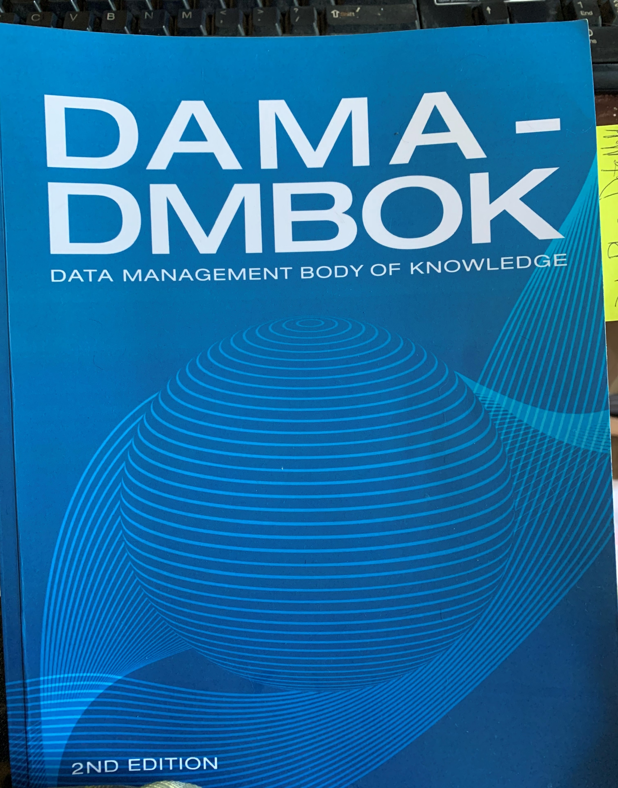
Standards for Solid foundation
Step 1 – Define Purpose/Use of Data
Step 2 – Analysis of Current State and Options
Step 3
Data Collection
Step 4
User Access
Step 5
Maintain
Step 6
Evaluate/Improve
Step 7
Archive
Data Management and Maturity (DAMA) Data Management Body of Knowledge (DMBOK)
Data Planning
Life-Cycle
Based on DAMA and OMB Circular A-16, align to CDO Data Strategy

