Slide 1
DSP related database development – FY21
NASIS Modernization
Data Model Changes
DSP Data Hub
CIG
OFSHDT
DSP tables, fields and choices – store data collected by SPSD
Input Data, fetch data, link soil and conservation databases
Program, practice, and grant management info. SHDB template data (Soil tests, Economics etc.)
Future:
Research data
Custom Products
Interpretations
Reports
Soil Survey Products
Future:
Manipulate and analyze data
Report outcomes
Export for agency models and tools (especially soc)
CIG websites
Awardees and Progress reported
Results for SHDB reported

Slide 2
Soil Survey Data
CR-LMOD
Management System
Resource Concerns-conservation Planning
DSP Data Hub
Context
Aggregation Rules
Project information
Condition
Treatment
Site_obs link to mgmt.
Pedotransfer fxn
Soil Health Field Metrics
Soil Health Demo Trial
CIG
NASIS - point
Project
Site
DSP PLOT ID
Site Observation
Pedon
DSP Pedon ID
Location
Horizon & Layer
DSP Layer ID
MGMT Info
Veg
Soil Health Economic Case Studies
EDIT
Ecological Site info
Soil Health
Commercial labs
Program
Project
org
Detailed Management info
Soil Survey
Information
Water and climate
NASIS – Aggregated
SSURGO
LIMS (KSSL)
Site Info (location)
Pedon info
Horizon & Layer
Lab properties
Outcomes
Statistical analysis
functions
production
Economics
Source data for models and tools
Lab Data Mart (NCSS Charz)
LIMS Data
Cooperator data (universities)
Science of Soil Health
PLFA
Summary tables
User Interface
Step 9 evaluation

Slide 3
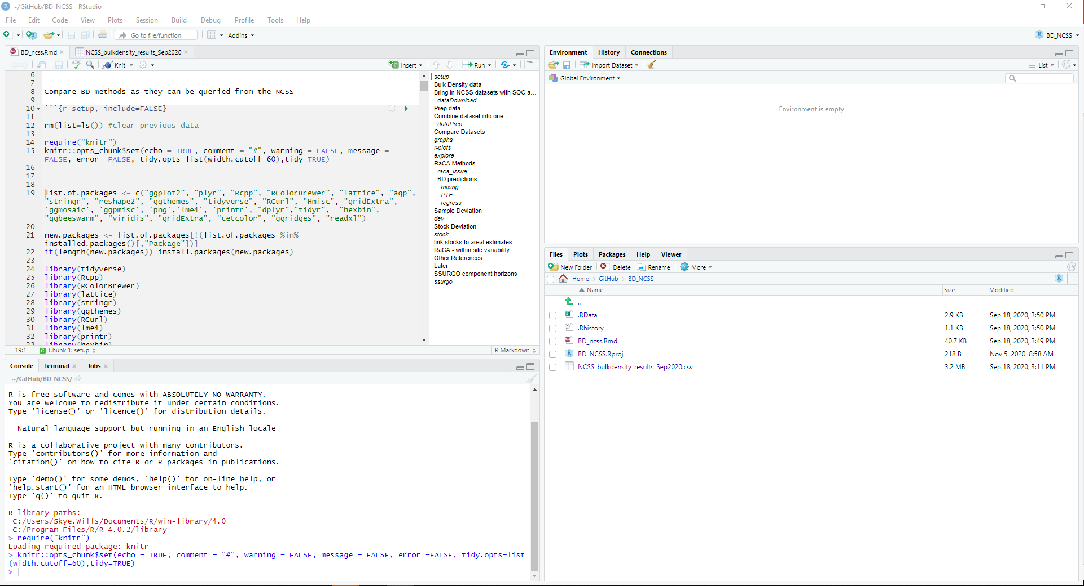
UI – DSP Hub (modeled on R studio)
Dataset 1
Dataset 2
Context Data - Maps
Context Data - tables
Primary DATA:
Input , fetch, stream
Metadata
Fields
Definitions
Authorities etc.
Context DATA:
Metadata
Fields
Definitions
Authorities etc.
Spreadsheet view
Maps
Context DATA:
Metadata
Fields
Definitions
Authorities etc.
Spreadsheet view
Maps
Info/metadata view
Data/Spreadsheet view
Analysis ‘Ruleset’ 1
Analysis Ruleset script
Manipulation (inference engine):
Filter, query, aggregate
use both primary and context data
Have both a gui and scripting option
Allow saving and loading of authorized rules and schemes
Outputs:
Tabular
Graphical
Spatial
Push to reports
Push to models
Ruleset 1 GUI
Ruleset 1 Script
Output 1
Output 2

