Slide 1
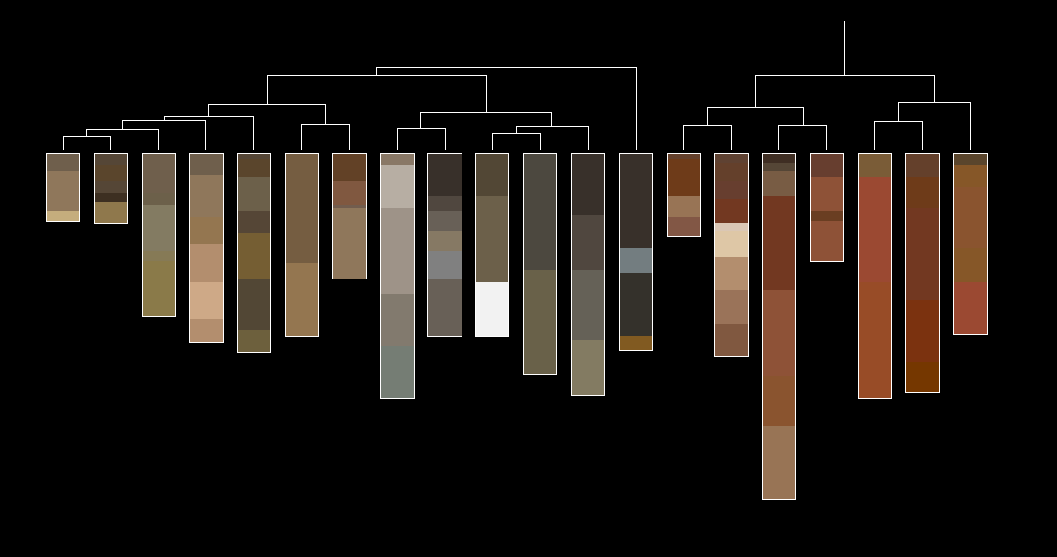
NCSS Soil Characterization Data Update SDA web-service / New Snapshots
Jason Nemecek, Adolfo Diaz, Henry Ferguson, Dylan Beaudette July 2020
Notes:
https://nasis.sc.egov.usda.gov/NasisReportsWebSite/limsreport.aspx?report_name=SDA-KSSL
http://ncss-tech.github.io/AQP/soilDB/SDA-tutorial.html
http://ncss-tech.github.io/AQP/soilDB/SDA-tutorial-2.html
file:///E:/working_copies/ncss-tech.github.io/AQP/soilDB/KSSL-demo.html
https://github.com/brownag/sANDREWbox/blob/master/KSSLExtended/fetchKSSL_xrd-cole_demo.R

Slide 2
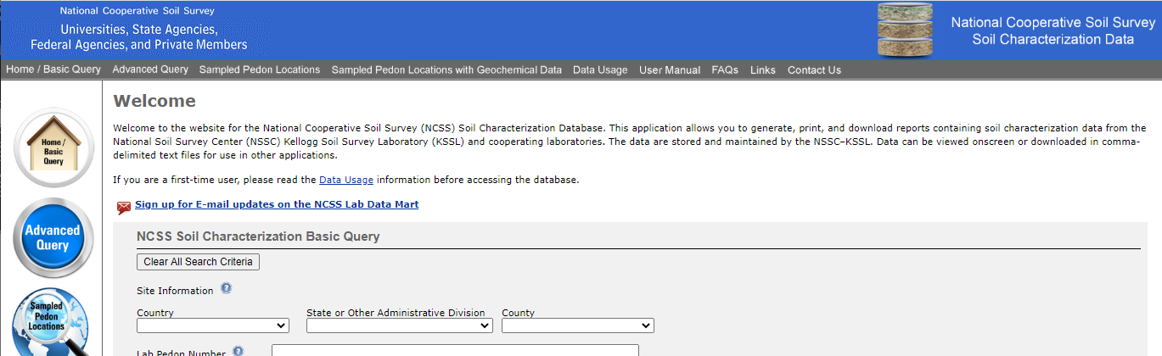
Acknowledgments
Skye Wills, Cathy Seybold, Henry Ferguson / Rick Nesser
Jason Nemecek / Adolfo Diaz
USDA-NRCS staff who have collected these data
Kellogg Soil Survey Laboratory (KSSL) Staff
100+ years of soil survey efforts
Previous NCSS Lab Data Interfaces / Products
custom text reports from LIMS
annual MS Access snapshot (c/o Rick Nesser and Henry Ferguson)
NCSS Lab tables in NASIS
SoilWeb KSSL web-service via fetchKSSL() in R
Lab Data Mart (https://ncsslabdatamart.sc.egov.usda.gov)

Slide 3
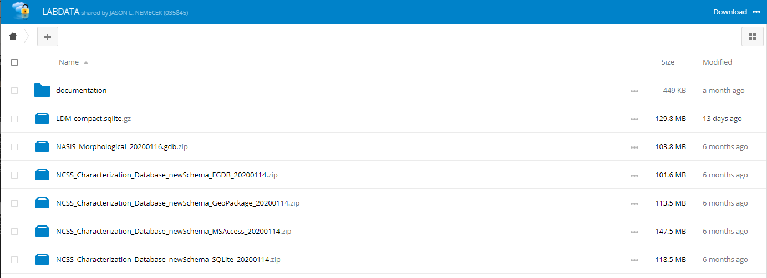
New KSSL Snapshots
semi-automated refresh: expect at least monthly updates
SQLite: compact, efficient, open source libraries
ESRI File Geodatabase: use directly in ArcGIS / ArcPro
MS Access (until 32bit drivers stop working)
new table structure
morphologic data from NASIS
https://new.cloudvault.usda.gov/index.php/s/eSoPYbWDBQNX2HP

Slide 4
Soil Data Access (SDA)
SQL-based interface to SSURGO, STATSGO, and now KSSL data
REST/POST requests → JSON returned
high-performance access to tabular / spatial data
spatial data returned via WKT encapsulated in JSON
use favorite environment: R, python, JS, etc.
100k record limit / 32Mb JSON limit → not replacement for local copy
Year | Web Soil Survey sessions | Soil Data Access requests
2015 | 1,724,855 | 1,795,930
2016 | 2,930,866 | 8,627,342
2017 | 2,478,939 | 24,502,272
2018 | 2,440,116 | 28,525,832
2019 | 2,487,664 | 122,737,185
Total | 12,062,440 | 186,188,561
https://sdmdataaccess.nrcs.usda.gov http://ncss-tech.github.io/AQP/soilDB/SDA-tutorial.html

Slide 5
Soil Data Access (SDA)
SELECT
-- mu data
mu.mukey,
-- component data
co.cokey AS id, comppct_r, compkind, compname,
-- horizon data
hzname, hzdept_r, hzdepb_r,
sandtotal_r AS sand, silttotal_r AS silt, claytotal_r AS clay,
ph1to1h2o_r AS phh2o, cec7_r AS cec
-- table selection
FROM mapunit AS mu
-- join conditions
INNER JOIN component AS co ON mu.mukey = co.mukey
INNER JOIN chorizon as ch ON co.cokey = ch.cokey
-- component filtering
WHERE majcompflag = 'Yes'
AND mu.mukey IN
-- spatial query
(
SELECT *
FROM
-- WGS84 coordinate pair (longitude, latitude)
SDA_Get_Mukey_from_intersection_with_WktWgs84('point(%s %s)')
)
ORDER BY comppct_r DESC, hzdept_r ASC ;
Notes:
get morphology + physical / chemical properties for components at WGS84 coordinates

Slide 6
KSSL Data via SDA
same table structure / linkages as snapshots
simple connection to SSURGO / STATSGO via SQL JOINs
100k record limit / 32Mb JSON limit → not replacement for local copy
simplified table structure: suites of related data
value + method code for each soil layer sampled / characterized
linkages to NASIS pedon records (soil morphology)
¦--physical
¦ ¦--particle_size_method
¦ ¦ °--methods
¦ ¦ ¦--PSDA, Moist, Pipet
¦ ¦ ¦--PSDA, Routine, Pipet
¦ ¦ ¦--PSDA, no pretreatment, Pipet
¦ ¦ ¦--PSDA, centrifuge
¦ ¦ ¦--PSDA, Hydrometer, sand fractions wet sieved
¦ ¦ °--PSDA, coulter counter
https://sdmdataaccess.nrcs.usda.gov

Slide 7
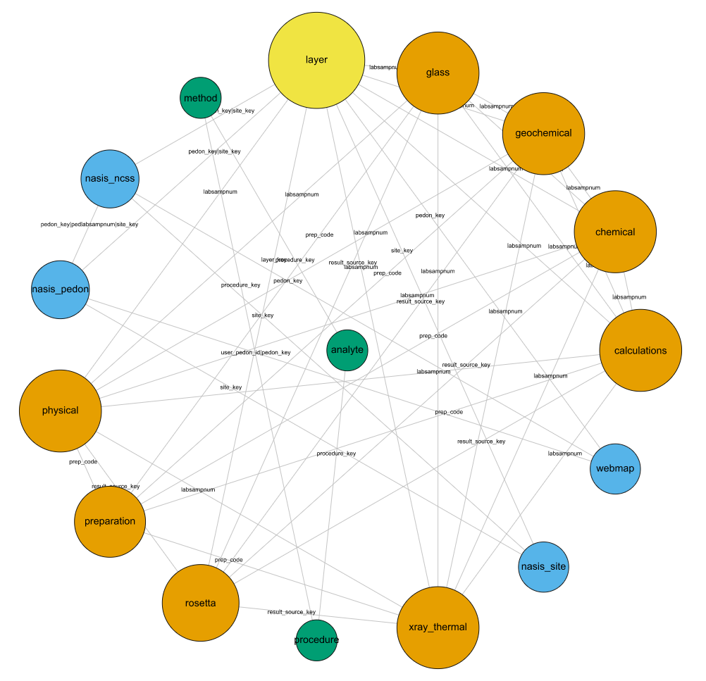
This isn't documentation...

Slide 8
Thank You
The new snapshots / SDA are a work in progress
Proper documentation + worked examples soon
We appreciate feedback
Contact Jason, Adolfo, or Dylan for details
USDA is an equal opportunity employer, provider and lender

