Slide 1

Project 2
By
Jacob Nesteruck,Ray Jaconski, Raymond Fillingame
Keyon Hawkins, Martin Salinas

Slide 2
Task
Generate a randomized dataset based on the given E-Commerce data structure
Analise a large dataset of 10-15 thousand records using an E-Commerce data structure.

Slide 3






Tech Stack
Python 3.10
Microsoft Visual Studio Code 1.70
Spark/PySpark 3.3
Microsoft Excel, Excel Online
Tableau Public 2022.2
Github

Slide 4
Github Repository
https://github.com/jnesteruck/rev-proj2

Slide 5
What is the top selling category of items? Per country?

Slide 6
Sales By Category

Slide 7
Sales By Category By Country

Slide 9
Best Selling Categories By Country
Clothes – Iran
Furniture – France, Ireland, United States
School Items – Australia, Brazil, China, India, Ukraine
Technology – Germany, Great Britain, Japan, Korea, Mexico, Russia

Slide 10
How does the popularity of products change throughout the year? Per country?

Slide 11
Popularity By Quarter

Slide 14
Popularity By Month

Slide 17
Across the board, all products become far more popular towards the end of the year, regardless of category, price, or item. Once the new year arrives, this popularity plummets.
This coincides with the Holiday season, in which many people across many cultures shop more often than usual.
Most products experience a summer bump as well, though not as large as the fall/winter bump.
There is a minor spring bump for some products, though this is inconsistent within different product categories. For instance, this is fairly noticeable with school supplies and furniture, but almost non-existent with technology and clothing.

Slide 18
Popularity over Time in Select Countries

Slide 19
Which locations see the highest traffic of sales?

Slide 20
Top 5 Countries by Sales Traffic
Country | Total Sales | Percentage | Population
India | 4243 | 6.90% | 1.38 billion
Ireland | 4228 | 6.88% | 5 million
Great Britain | 4222 | 6.87% | 67.2 million
Korea | 4213 | 6.85% | 51.8 million
United States | 4192 | 6.82% | 329.5 million

Slide 21
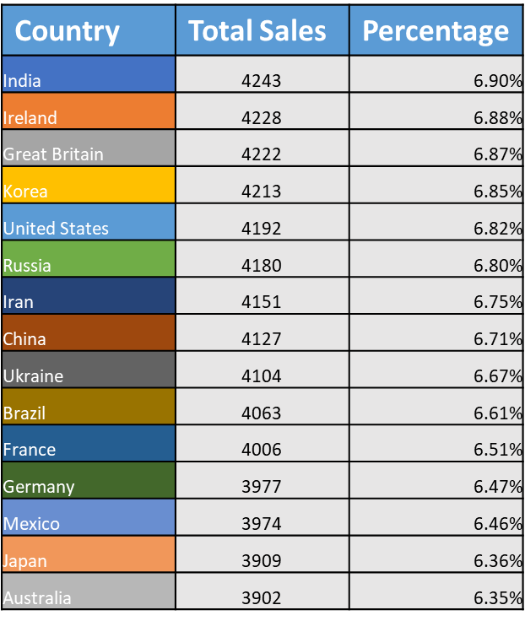
Total Sales Traffic by Country

Slide 23
16 out of the top 20 cities in terms of sales traffic are located in Korea, despite Korea only having the 4th most sales traffic of any country.
India, despite having the most sales traffic of any country, has no cities in the top 20
Ireland had the 2nd most sales of any country in the world, right below India, despite only having about 5 million residents compared to India’s 1.38 billion

Slide 24
What times have the highest traffic of sales? Per country?

Slide 25
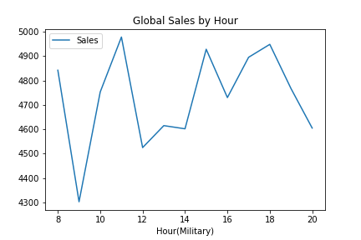
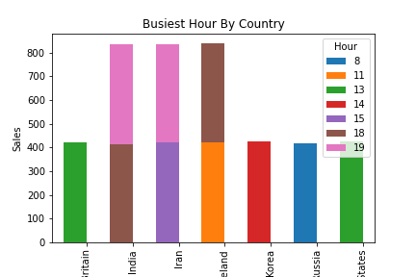
Sales By Hour

Slide 26
Overall Trends
Technology produces by far the most revenue, regardless of metric.
Sales traffic did not necessarily correlate with population, with some highly populated areas seeing less traffic while some less populated regions ranked highly in terms of sales traffic.
There was very little notable difference in trends between products. Everything saw the same trends throughout the year, with massive peaks in December.

