Slide 1

Project 2
By
Jacob Nesteruck, ,Ray Jaconski, Raymond Fillingame
Keyon Hawkins, Martin Salinas

Slide 2
Task
Generate a randomized dataset based on the given E-Commerce data structure
Analise a large dataset of 10-15 thousand records using an E-Commerce data structure.

Slide 3






Tech Stack
Python 3.10
Microsoft Visual Studio Code 1.70
Spark/PySpark 3.3
Microsoft Excel, Excel Online
Tableau Public 2022.2
Github

Slide 4
Github Repository
https://github.com/jnesteruck/rev-proj2

Slide 5
What is the top selling category of items? Per country?

Slide 6
Sales By Category

Slide 7
Sales By Category By Country

Slide 8
Category Sales By Country

Slide 9
Best Selling Categories By Country
Clothes – Iran
Furniture – France, Ireland, United States
School Items – Australia, Brazil, China, India, Ukraine
Technology – Germany, Great Britain, Japan, Korea, Mexico, Russia

Slide 10
How does the popularity of products change throughout the year? Per country?

Slide 11
Popularity By Quarter

Slide 14
Popularity By Month

Slide 18
Locations that see the highest traffic of sales.
Country | Total Sales | Percentage
India | 4243 | 6.90%
Ireland | 4228 | 6.88%
Great Britain | 4222 | 6.87%
Korea | 4213 | 6.85%
United States | 4192 | 6.82%

Slide 19
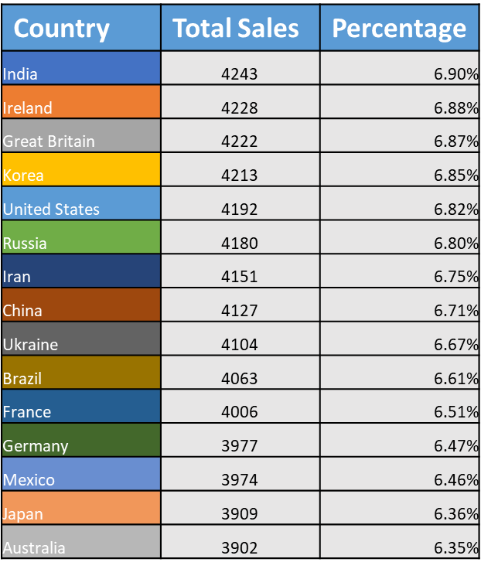
Total sales by country

Slide 20
What times have the highest traffic of sales? Per country?

