Slide 1
What is DePIN?
Decentralized Physical Infrastructure Networks
Definition: DePIN refers to decentralized networks that provide physical infrastructure services—such as storage, compute, wireless, and energy—powered by user-owned hardware and coordinated via blockchain technology.
Community-Driven: Unlike traditional infrastructure, DePINs are operated by a distributed network of contributors who are incentivized to maintain and expand services.
Key Technologies: Blockchain enables trustless coordination, micropayments, and verifiable contribution proofs, making large-scale decentralized infrastructure viable.
Notes:
DePIN, or Decentralized Physical Infrastructure Networks, are a new class of infrastructure models that use blockchain to coordinate distributed physical services like cloud storage, compute, and wireless coverage. Instead of relying on massive centralized data centers or telecom towers, these networks are powered by individuals running nodes or devices from their homes and businesses. Blockchain is key to making this work at scale, enabling fair compensation, contribution verification, and tamper-proof recordkeeping. This approach creates infrastructure that's not only distributed and resilient, but also owned and operated by its users.

Slide 2
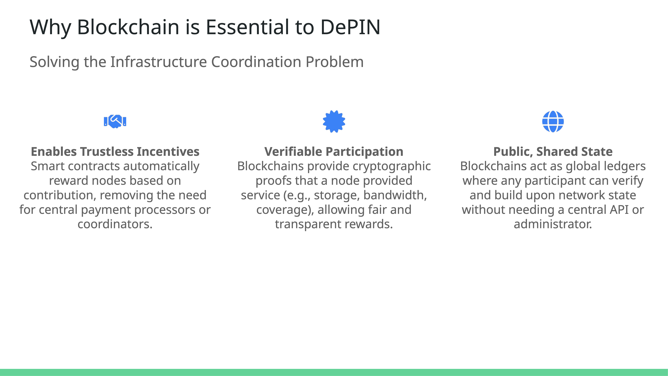



Why Blockchain is Essential to DePIN
Solving the Infrastructure Coordination Problem
Enables Trustless Incentives Smart contracts automatically reward nodes based on contribution, removing the need for central payment processors or coordinators.
Verifiable Participation Blockchains provide cryptographic proofs that a node provided service (e.g., storage, bandwidth, coverage), allowing fair and transparent rewards.
Public, Shared State Blockchains act as global ledgers where any participant can verify and build upon network state without needing a central API or administrator.
Notes:
What really unlocked DePIN as a viable model was the advent of blockchain. Before blockchain, community-powered networks struggled with core problems: how do you incentivize participation, track contributions, and avoid central control? Blockchain introduced the primitives needed—programmable rewards, cryptographic proofs, and a public, shared state that anyone can interact with. This is why DePIN didn't gain traction in the 2000s or early 2010s, despite the ideas being around. Blockchain is the operating system that made large-scale decentralized infrastructure possible.

Slide 3



DePIN vs. Centralized Infrastructure
Understanding the Architectural Shift
Architectural Differences
DePINs utilize distributed networks where participants share resources directly, eliminating central control points.
Performance & Scalability
Decentralized models can enhance resilience and reduce bottlenecks, though they may face challenges in achieving the performance levels of optimized centralized systems.
Incentive Structures
Participants are rewarded with tokens for contributing resources, fostering a collaborative ecosystem.
Notes:
Transitioning from traditional centralized infrastructures to DePINs marks a significant shift in how we manage and distribute resources. In centralized systems, control rests with a single entity, creating potential bottlenecks and single points of failure. DePINs, however, operate on distributed networks, where each participant contributes and shares resources, enhancing resilience. While this model offers improved fault tolerance, matching the performance and scalability of established centralized systems remains a challenge. To encourage participation, DePINs employ token-based incentives, rewarding individuals for their contributions and fostering a vibrant, collaborative community.

Slide 4
Benefits of DePIN
Why Decentralized Infrastructure Matters
Cost Efficiency
By leveraging shared resources, operational costs can be significantly reduced.
Resilience and Performance
Decentralized networks offer enhanced fault tolerance and can adapt to failures without disrupting services.
Democratization of Infrastructure
Empowers individuals and communities to participate in and benefit from infrastructure services.
Notes:
Embracing DePINs brings a multitude of advantages. Firstly, cost efficiency: by pooling resources from numerous contributors, operational expenses are minimized, making services more affordable. Secondly, resilience is inherently enhanced in a decentralized setup; the network can gracefully handle individual node failures without compromising overall functionality. Lastly, DePINs democratize infrastructure, shifting power from centralized entities to a diverse community of participants, ensuring more equitable access and opportunities.

Slide 5
Key DePIN Use Cases & Examples
Storage and Compute Networks
Storj: Decentralized cloud storage providing secure, private, and cost-effective solutions by distributing data across a global network of nodes.
Akash Network: A decentralized marketplace for cloud computing resources, enabling developers to deploy applications at significantly lower costs compared to traditional cloud providers.
iExec: Offers decentralized cloud computing by providing on-demand access to computing resources, with a focus on data privacy and security.
Filecoin: A decentralized storage network designed to store humanity's most important information, incentivizing participants to provide storage space.
Sia: Utilizes blockchain technology to create a decentralized storage marketplace, offering affordable and secure cloud storage solutions.
Notes:
Let's explore some of the leading DePIN projects revolutionizing storage and compute infrastructures. Storj provides a decentralized cloud storage solution that ensures security and privacy by distributing encrypted data fragments across a global network of nodes. It's an attractive alternative to traditional providers due to its cost-effectiveness and resilience.
Next, we have the Akash Network, a decentralized marketplace for cloud computing resources. By tapping into underutilized resources, Akash significantly reduces deployment costs for developers, making cloud computing more accessible.
iExec focuses on providing decentralized cloud computing with a strong emphasis on data privacy and security. It enables developers to access computing resources on demand while maintaining control over sensitive data, a crucial factor for many industries.

Slide 6
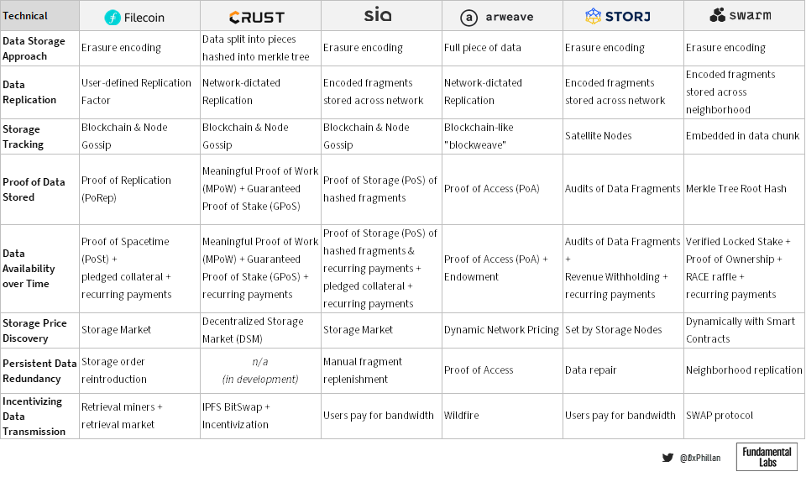

Slide 7
Networking and Bandwidth Sharing
DePIN Use Cases & Examples
Helium Network: A decentralized wireless network enabling devices to connect wirelessly to the internet through community-operated Hotspots, reducing reliance on centralized telecoms.
Theta Network: A decentralized video delivery network that uses blockchain technology to incentivize users for sharing bandwidth and computing resources for video streaming.
Myst Network: Provides decentralized VPN services, allowing users to share bandwidth securely while protecting privacy and enabling censorship-resistant internet access.
NYC Mesh: A community-owned mesh network aiming to provide affordable, high-speed internet access across New York City by connecting users through a decentralized infrastructure.
Althea: A decentralized internet service provider that allows communities to build and maintain their own internet infrastructure, promoting affordable and reliable connectivity.
Notes:
Now let's explore networking and bandwidth sharing DePIN projects. Helium Network provides decentralized wireless coverage through community-operated Hotspots, cutting costs and expanding connectivity. Theta Network revolutionizes video streaming by decentralizing video delivery, rewarding users for sharing resources. Myst Network ensures secure, censorship-resistant internet access through decentralized VPN services. NYC Mesh builds a community-owned network offering affordable high-speed internet access. Althea allows communities to construct and operate their own decentralized internet infrastructure, fostering accessibility and independence.

Slide 8
Rendering and Media Distribution
DePIN Use Cases & Examples
Render Network: Provides decentralized GPU rendering solutions, allowing artists and developers to access powerful rendering capabilities at a fraction of traditional costs.
Gala Games/Music: Decentralizes gaming and music ecosystems by enabling users to own, share, and monetize digital assets while reducing reliance on centralized platforms.
Livepeer: A decentralized video streaming network built on the Ethereum blockchain, offering scalable and cost-effective broadcasting solutions.
Audius: A decentralized music streaming protocol that enables artists to share their music directly with fans, ensuring fair compensation and ownership rights.
Theta Network: Beyond networking, Theta supports decentralized media distribution, enabling high-quality video streaming with reduced costs and latency.
Notes:
Finally, let's explore DePIN applications in rendering and media distribution. Render Network decentralizes GPU rendering processes, providing affordable access to rendering power for creators. Gala Games and Music empower creators and players by decentralizing gaming and music ecosystems, enabling ownership and monetization of digital assets. Livepeer decentralizes video streaming, reducing broadcasting costs and enhancing scalability. Audius allows artists to share music directly with fans, ensuring fair compensation and control. Theta Network supports decentralized media distribution, improving video streaming efficiency while lowering costs.

Slide 9
Wearable Health Technologies
DePIN Use Cases & Examples
CUDIS: An AI-powered smart ring that tracks health metrics like heart rate and sleep quality, storing data securely on the Solana blockchain, allowing users to monetize anonymized data for research purposes.
Circular: Smart ring focused on enhancing sleep, energy, and activity tracking, offering personalized health recommendations for better well-being.
Brilliant: Smart glasses integrating AR and AI for immersive experiences and real-time data overlays, enhancing daily interactions and productivity.
Echoes: Location-based app combining classical music and technology to create immersive auditory experiences tied to urban exploration.
World ID: Decentralized digital identity system storing biometric data on decentralized networks, ensuring secure identity verification and data privacy.
Notes:
Wearable health technologies are evolving within the DePIN ecosystem, offering users control and ownership over their health data. CUDIS leads this space with its AI-powered smart ring, tracking vital health metrics while allowing secure, monetized data sharing. Circular focuses on holistic health tracking, providing actionable recommendations for better well-being. Brilliant merges AR and AI in smart glasses, enhancing daily productivity and immersive experiences. Echoes creates location-based auditory journeys, enriching urban exploration through classical music. Meanwhile, World ID ensures privacy through a decentralized digital identity system, giving users secure control over their biometric data. These innovations highlight how DePIN reshapes wearable tech, putting user empowerment at the core.

Slide 10
Energy Ecosystem Innovations
DePIN Use Cases in EV & Energy Networks
PowerPod: A decentralized EV charging network allowing private charger owners to share their stations, powered by blockchain for secure transactions and incentivized participation.
InductEV: Wireless charging technology enabling EVs to power up while driving through embedded roadway charging plates, reducing downtime and enhancing efficiency.
ItsElectric: Curbside EV chargers operating independently of the traditional power grid, providing accessible urban charging options with financial incentives for property owners.
Wagners CFT: Integrates EV charging stations into existing street infrastructure like lighting poles, expanding charging networks without additional street clutter.
St. Helena EV Initiative: A remote island initiative focusing on sustainable energy by installing EV chargers and boosting renewable energy production to reduce fossil fuel reliance.
Notes:
The energy ecosystem is rapidly evolving, with DePIN projects revolutionizing electric vehicle (EV) charging and sustainable energy distribution. PowerPod leads with its community-driven EV charging network, allowing private charger owners to share infrastructure securely through blockchain technology. InductEV introduces wireless charging solutions, enabling EVs to power up while driving, minimizing downtime. ItsElectric offers urban residents curbside chargers independent of the traditional power grid, providing accessible solutions with financial incentives for property owners. Wagners CFT focuses on integrating EV charging into existing street infrastructure, like lighting poles, efficiently expanding networks. On a broader scale, the St. Helena EV Initiative demonstrates how remote communities can transition to sustainable energy, adopting zero-emission transportation and reducing fossil fuel reliance. Together, these projects highlight the transformative potential of decentralized energy ecosystems.

Slide 11



Compute and Networking Services
DePIN Use Cases & Examples
Golem
A decentralized marketplace for computing power, allowing users to rent out their idle CPU/GPU resources to others for tasks like rendering and scientific calculations.
Nodle
A decentralized IoT network that leverages smartphones as nodes to collect and transmit data from IoT devices, providing connectivity solutions without relying on traditional infrastructure.
Dimo
A decentralized platform enabling users to own and monetize their vehicle data, fostering an ecosystem where developers can build applications utilizing this data for improved transportation solutions.
Notes:
The DePIN ecosystem is expanding with innovative projects that redefine compute and networking services. Golem offers a decentralized marketplace where users can monetize their unused computing resources, facilitating tasks such as 3D rendering and complex computations. Nodle transforms smartphones into nodes within a decentralized IoT network, enabling efficient data collection from IoT devices without the need for conventional infrastructure. Dimo empowers vehicle owners by allowing them to control and monetize their vehicle data, creating opportunities for developers to craft applications that enhance transportation experiences.

Slide 12



Decentralized Mapping and Connectivity
DePIN Use Cases & Examples
Wifi Map
A community-driven platform offering a comprehensive map of Wi-Fi hotspots worldwide, enabling users to find and share internet access points, thus promoting global connectivity.
NATIX
A decentralized mapping network that utilizes data from cameras and sensors to create real-time maps, supporting applications like autonomous driving and smart city development.
Silencio
A project focused on creating noise pollution maps by crowdsourcing data from users' devices, aiming to enhance urban living conditions through informed planning and noise management.
Notes:
Decentralization is revolutionizing mapping and connectivity through projects like Wifi Map, which leverages community contributions to build a global directory of Wi-Fi hotspots, enhancing internet accessibility. NATIX employs decentralized data collection from various sensors to generate dynamic, real-time maps, essential for the advancement of autonomous vehicles and smart city infrastructures. Silencio addresses urban noise pollution by crowdsourcing acoustic data to develop detailed noise maps, providing valuable insights for urban planners and residents seeking quieter environments.

Slide 13
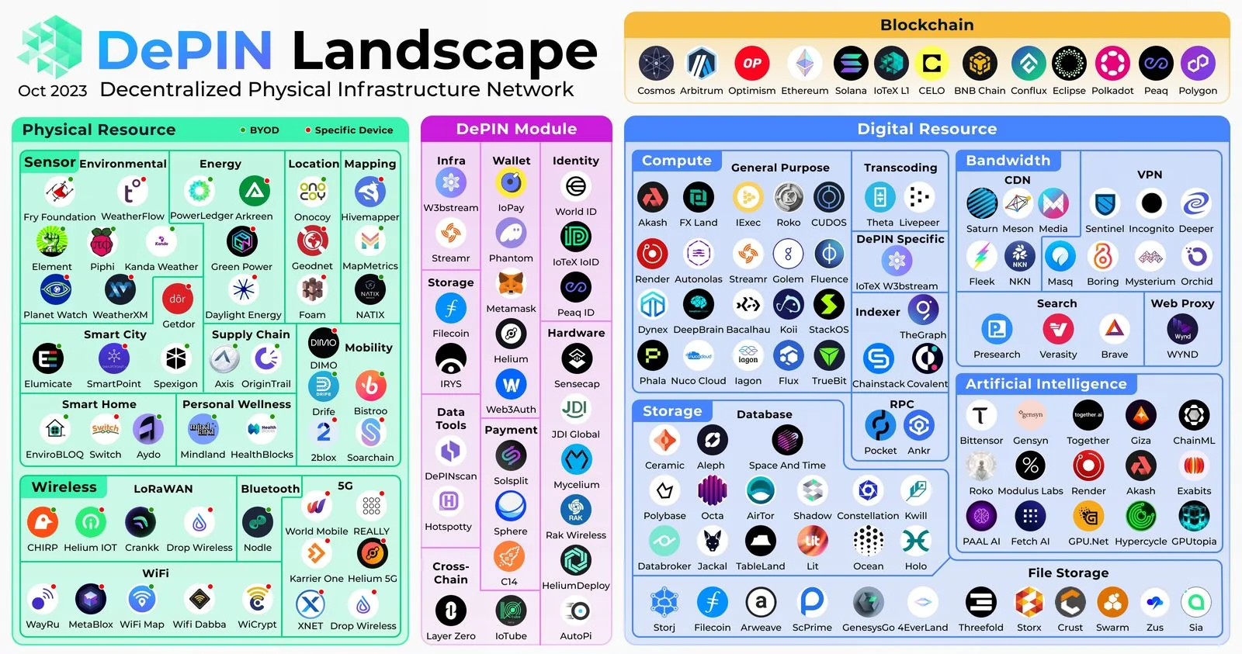
Notes:
Decentralization is revolutionizing mapping and connectivity through projects like Wifi Map, which leverages community contributions to build a global directory of Wi-Fi hotspots, enhancing internet accessibility. NATIX employs decentralized data collection from various sensors to generate dynamic, real-time maps, essential for the advancement of autonomous vehicles and smart city infrastructures. Silencio addresses urban noise pollution by crowdsourcing acoustic data to develop detailed noise maps, providing valuable insights for urban planners and residents seeking quieter environments.

Slide 14
Scalability and Performance Challenges
Balancing Decentralization with Efficiency
Transaction Throughput: Decentralized networks often face limitations in processing a high volume of transactions swiftly, leading to potential congestion and increased latency.
Data Processing Requirements: Growing DePIN networks require real-time data processing capabilities that may surpass current blockchain infrastructure limits, risking bottlenecks.
Resource Management: Ensuring consistent performance across a distributed network of nodes with varying capacity demands advanced resource management strategies.
Storj vs. AWS S3 Performance: Storj shows potential for scalability and cost savings compared to AWS S3 but may exhibit variable performance based on use cases and network conditions.
Notes:
Scalability and performance represent critical challenges in DePIN networks. While decentralization offers unparalleled resilience and cost benefits, sustaining performance comparable to centralized systems remains complex. Decentralized systems can face throughput limitations, particularly as transaction volumes increase, leading to network congestion. Additionally, real-time data processing requirements escalate as networks grow, testing the capabilities of existing infrastructures.
Resource management adds another layer of complexity; with nodes varying in capacity and reliability, sophisticated management strategies become essential. A case in point is Storj, a decentralized storage solution that competes with AWS S3. Storj can offer up to 90% lower costs by leveraging global node networks. However, some users report inconsistent download speeds compared to AWS S3, highlighting performance variability based on network conditions.
Balancing decentralization with high performance requires innovation through advanced consensus mechanisms, optimized data routing, and dynamic resource management strategies. DePIN's future scalability hinges on addressing these factors to unlock its full potential.

Slide 15
Regulatory and Legal Landscape
Compliance Challenges in Decentralized Networks
Jurisdictional Complexities: DePIN networks operate globally, leading to regulatory conflicts across jurisdictions with varying compliance standards.
Data Privacy Regulations: Adherence to data privacy laws like GDPR and CCPA is challenging due to decentralized data storage and processing.
Tokenomics and Securities Laws: Regulatory ambiguity exists regarding whether DePIN network tokens qualify as securities, impacting project sustainability.
Intellectual Property Protection: Decentralized networks face difficulties in enforcing intellectual property rights, particularly for open-source projects.
Notes:
Navigating the regulatory and legal landscape poses significant challenges for DePIN networks. Operating across multiple jurisdictions introduces complexities, as compliance requirements differ globally. This fragmentation can slow down adoption and development as projects attempt to meet diverse legal standards.
Data privacy regulations like GDPR in Europe and CCPA in California further complicate compliance. Decentralized networks, by nature, store and process data across global nodes, making it difficult to ensure adherence to localized data privacy mandates. Tokenomics also remains a gray area, as the classification of network tokens under securities laws can affect funding and operational strategies.
Moreover, protecting intellectual property rights is challenging within decentralized systems, especially for open-source projects. The lack of central authority complicates enforcement, potentially stifling innovation. Addressing these regulatory challenges requires global cooperation, adaptive legal frameworks, and technological innovations that align with compliance standards while maintaining decentralization's core benefits.

Slide 16




Interoperability Challenges
Bridging DePIN and Traditional Systems
Protocol Compatibility
Integrating DePIN networks with traditional systems requires overcoming protocol disparities that impede seamless communication.
Data Standardization
Lack of standardized data formats across decentralized and centralized platforms complicates data exchange and processing.
Cross-Chain Interoperability
DePIN projects built on different blockchains face challenges in interacting with one another, limiting network effects.
Legacy System Integration
Ensuring DePIN compatibility with existing enterprise infrastructure demands customized solutions and advanced APIs.
Notes:
Interoperability remains a significant hurdle for DePIN networks aiming to integrate seamlessly with traditional systems. One of the primary challenges is protocol compatibility; DePIN networks and legacy systems often operate on different communication protocols, hindering seamless integration. Data standardization poses another obstacle, as varying data formats between decentralized and centralized platforms complicate efficient data exchange.
Cross-chain interoperability further limits DePIN potential. Projects developed on different blockchain networks may struggle to interact, reducing network effects and slowing ecosystem growth. Lastly, integrating with legacy enterprise systems requires tailored solutions and robust APIs, making interoperability efforts resource-intensive.
Addressing these challenges involves adopting universal standards, developing cross-chain bridges, and creating adaptable middleware solutions. Overcoming interoperability issues is crucial for unlocking DePIN's full potential and ensuring broad enterprise adoption.

Slide 17



Conclusion & Personal Demo Introduction
DePIN in Action: Exploring Real-World Applications
Recap of DePIN Potential
DePIN networks demonstrate transformative potential across storage, compute, networking, media, health, energy, and mobility, offering decentralized alternatives to traditional infrastructure.
Personal DePIN Journey
Showcase of personal nodes and devices: Storj, iExec, Gala, Akash nodes, Cudis smart ring, Helium modem, and Starpower devices, highlighting hands-on involvement in DePIN ecosystems.
Interactive Demonstration
Live exploration of node performance, data transactions, and device interactions, illustrating practical benefits, challenges, and real-time insights into decentralized infrastructures.
Notes:
As we conclude, let's revisit the transformative potential of Decentralized Physical Infrastructure Networks. From decentralized storage solutions like Storj and compute marketplaces like Akash to networking projects such as Helium and energy innovations like PowerPod, DePIN is reshaping how we think about infrastructure. This shift brings resilience, cost efficiency, and user empowerment, challenging traditional centralized models.
Now, I'll walk you through my personal DePIN journey. I'll showcase how I've been running Storj, iExec, Gala, and Akash nodes, sharing insights into performance metrics, resource utilization, and network contributions. We'll also explore hands-on devices like the Cudis smart ring for health tracking, Helium modem for decentralized wireless coverage, and Starpower devices for energy ecosystems.
Finally, we'll dive into an interactive demonstration, analyzing live node operations, data transaction flows, and device integrations. This session aims to provide practical perspectives on how DePIN infrastructures operate in real time, along with key takeaways on scalability, performance, and participation in decentralized ecosystems.

Slide 18

Storj – Decentralized Storage Deep Dive
Architecture, Performance, and Legal Considerations
How Storj Works
Files are split into 80 encrypted segments using erasure coding, distributed across independent nodes globally. No single node stores a complete file, enhancing security and redundancy.
Performance at the Edge
Decentralized architecture places data closer to users. Parallel downloads from multiple nodes reduce latency, outperforming centralized storage in edge use cases.
Legal Considerations
Node operators host encrypted fragments. Since no complete file resides on a single node and content is unreadable, legal risks are minimized, though oversight challenges persist.
Notes:
Storj operates by fragmenting data into 80 encrypted segments via erasure coding, distributing them across a global network of nodes. This ensures redundancy and security—if some nodes go offline, files can still be reconstructed from available pieces. The decentralized model also brings data closer to end-users, reducing latency by enabling parallel downloads from multiple nodes, making it ideal for edge applications.
From a legal standpoint, Storj protects node operators through encryption and fragmentation. Since no node holds a complete, readable file, operators have minimal liability concerning stored content. However, this same encryption limits the ability to detect illicit material. Storj balances performance, cost-efficiency, and privacy, offering an attractive alternative for workloads prioritizing distributed access and resilience.
For engineers familiar with centralized systems, think of Storj as a CDN-meets-object-storage solution, but decentralized, with S3 compatibility for easy integration.

Slide 19

CUDIS – Health Data Ownership Deep Dive
Blockchain Security, Data Privacy, and NFT-Based Marketplace
Blockchain Security Model: CUDIS encrypts health data client-side before storing metadata on Solana’s blockchain and files on IPFS. The blockchain acts as an immutable audit trail, ensuring tamper-proof records.
Data Privacy and Control: Users retain private keys for data access. Without keys, data remains encrypted, ensuring unauthorized parties cannot access personal health information.
NFT-Based Data Marketplace: Health data is minted as NFTs. Selling the NFT transfers full ownership to buyers, granting them permanent access. Smart contracts may include royalties for future resales.
Comparisons to Oura Ring: Unlike Oura, CUDIS prioritizes user data monetization and decentralized storage. Oura’s data resides on centralized servers with no monetization options for users.
Notes:
CUDIS revolutionizes health data management by minting user data as NFTs. This NFT-based model means that when users choose to sell their health data, ownership is permanently transferred to the buyer—granting them full, unrestricted access. This ensures clear ownership rights, eliminating ambiguity for researchers or healthcare providers. Importantly, smart contracts can introduce royalty mechanisms, meaning that if the NFT is resold in the future, the original data owner can receive a percentage of the sale. However, unless such mechanisms are in place, data access cannot be revoked once sold. This consent-driven, blockchain-secured approach contrasts with centralized wearables like Oura, where users lack monetization opportunities and data control. By blending data privacy, user empowerment, and blockchain transparency, CUDIS offers a transformative shift in how health data is owned and monetized.

Slide 20

Akash Network – Decentralized Cloud Deep Dive
Architecture, Performance, and Security Considerations
Decentralized Cloud Architecture
Akash operates a decentralized marketplace where users can lease underutilized compute resources. Leveraging Kubernetes for deployment, it enables dynamic scaling and high availability.
Cost and Performance Advantages
Akash offers up to 90% lower costs compared to AWS and Google Cloud. The pay-as-you-go model ensures efficient resource utilization without vendor lock-in.
Security and Data Sovereignty
By decentralizing compute resources, Akash reduces risks associated with centralized data centers, enhancing resilience and ensuring data sovereignty for users.
Interoperability and Flexibility
Supports containerized applications via Docker and Kubernetes, providing developers with seamless multi-cloud deployment options.
Notes:
Akash Network transforms cloud computing by decentralizing access to compute resources. Its architecture allows anyone to lease underutilized hardware, significantly reducing cloud costs while enhancing scalability and performance. The network supports Kubernetes and Docker, ensuring developers can deploy containerized applications seamlessly across multiple providers without vendor lock-in. Security is strengthened by decentralizing resources, minimizing single points of failure and promoting data sovereignty. For engineers used to centralized cloud platforms, Akash offers familiar orchestration tools with the added benefits of decentralized infrastructure—reducing costs and enhancing resilience without compromising performance.

Slide 21
Helium Network – Decentralized Wireless Infrastructure
IoT Connectivity, Incentives, and Network Architecture
Decentralized IoT Architecture: Helium uses community-operated Hotspots to create a decentralized wireless network, providing long-range connectivity for IoT devices at a fraction of traditional telecom costs.
Proof-of-Coverage Consensus: Helium's unique consensus mechanism verifies Hotspot locations and network coverage, rewarding users with HNT tokens for contributing to network growth and reliability.
Scalability and Cost Advantages: By decentralizing wireless infrastructure, Helium reduces deployment costs and enables rapid global expansion without the overhead of traditional telecom infrastructure.
5G and LoRaWAN Integration: Supports both LoRaWAN for IoT and 5G networks, allowing users to deploy small cells that enhance mobile coverage while earning rewards.
Notes:
Helium Network revolutionizes wireless infrastructure by leveraging a decentralized model where community-operated Hotspots provide long-range connectivity for IoT devices. This approach dramatically lowers costs compared to traditional telecom solutions and enables rapid global network expansion. Helium employs a Proof-of-Coverage consensus mechanism that verifies the presence and quality of Hotspots, rewarding users with HNT tokens for maintaining network integrity. The network's flexibility is further enhanced by supporting LoRaWAN for IoT applications and 5G small cells for broader mobile coverage. For engineers accustomed to centralized telecom infrastructure, Helium demonstrates how decentralized networks can achieve scalable, cost-effective wireless connectivity, empowering individuals to participate in building global infrastructure while earning incentives.

Slide 22



Helium Mobile – Decentralized Cellular Network Deep Dive
Hybrid Coverage, Hotspot Connectivity, and Technical Insights
Hybrid Coverage Model
Helium Mobile operates as an MVNO on T-Mobile’s network, offering nationwide cellular coverage. Hotspots supplement coverage by providing localized connectivity in areas with limited traditional infrastructure.
Hotspot Connectivity
Helium Mobile Hotspots use a host's Wi-Fi or Ethernet for backhaul, broadcasting LoRaWAN or 5G signals. Subscriber devices automatically offload to hotspots when in range, optimizing network efficiency.
Dynamic Network Switching
Subscribers’ devices switch seamlessly between T-Mobile’s network and Helium Hotspots based on signal strength and availability, ensuring uninterrupted calls, texts, and data sessions.
Coverage and Scalability
Helium's decentralized approach allows rapid network expansion without costly infrastructure investments. However, mobile coverage quality depends on hotspot density and distribution, with urban areas seeing faster adoption.
Notes:
Helium Mobile represents a groundbreaking shift in cellular network design by merging traditional carrier infrastructure with decentralized, community-driven coverage. As an MVNO on T-Mobile's network, Helium Mobile ensures nationwide coverage comparable to traditional providers. The innovative aspect lies in its user-operated hotspots, which supplement coverage by broadcasting LoRaWAN or 5G signals using the host’s internet connection for backhaul. Subscriber devices are equipped to automatically switch between T-Mobile’s network and nearby Helium Hotspots based on availability and signal quality, maintaining seamless connectivity for calls, texts, and data usage.
This dynamic network-switching capability optimizes data routing, reduces congestion on traditional networks, and lowers operational costs. The decentralized deployment model allows rapid scalability, particularly in urban areas where hotspot adoption is higher. However, comprehensive coverage still depends on hotspot density, which is developing as adoption grows. For engineers familiar with centralized telecom infrastructure, Helium Mobile demonstrates how decentralized networks can offer scalable, resilient mobile coverage while empowering users to participate in and benefit from the network's expansion.

