Slide 1
Modelling UK electricity regional costs for commercial buildings
SEF Journal Club
Presenter: Luke Bennett
07/05/2026

Slide 2
The big picture.

Slide 3
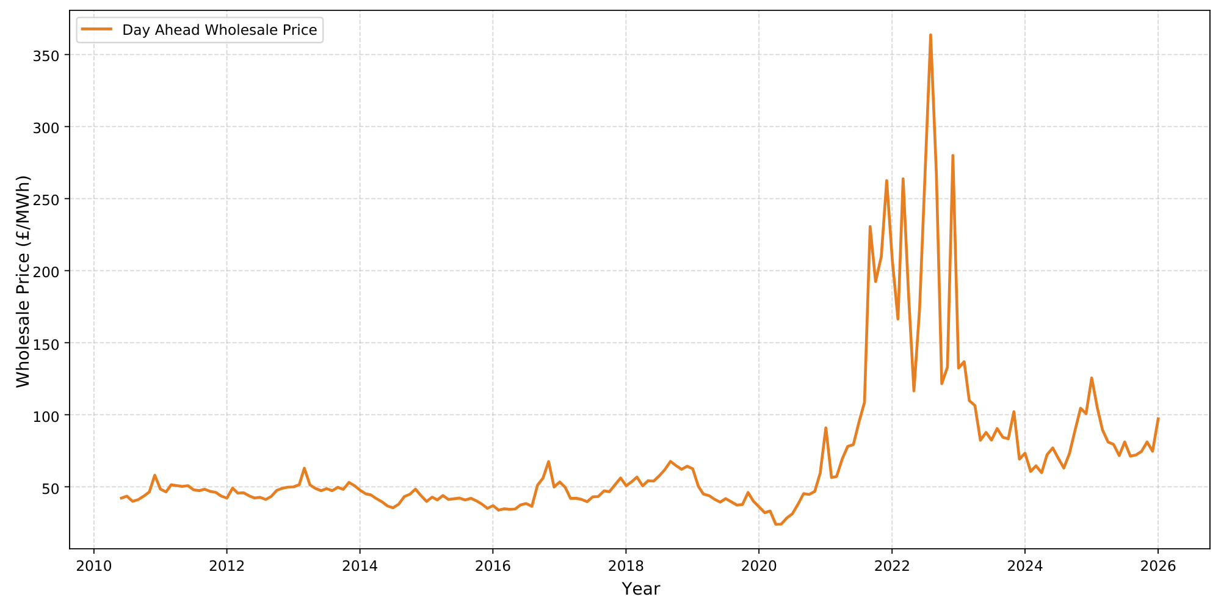

Slide 4
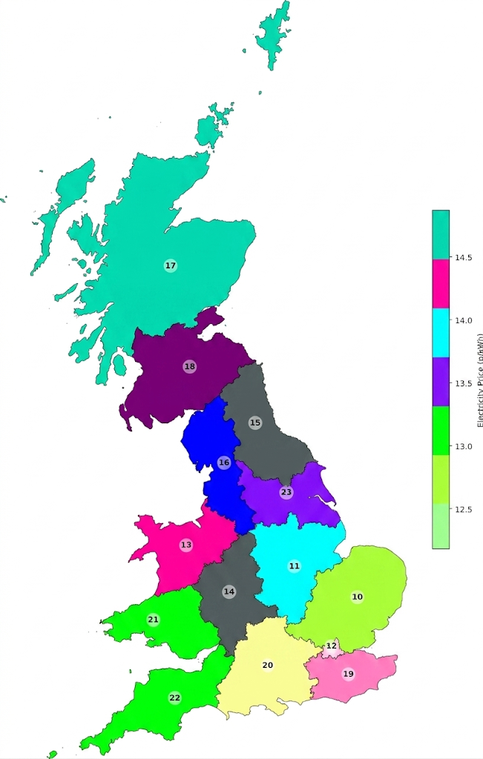

super technical and accurate map

Slide 5
Electricity Price (p/kWh) by DNO Region

Slide 7
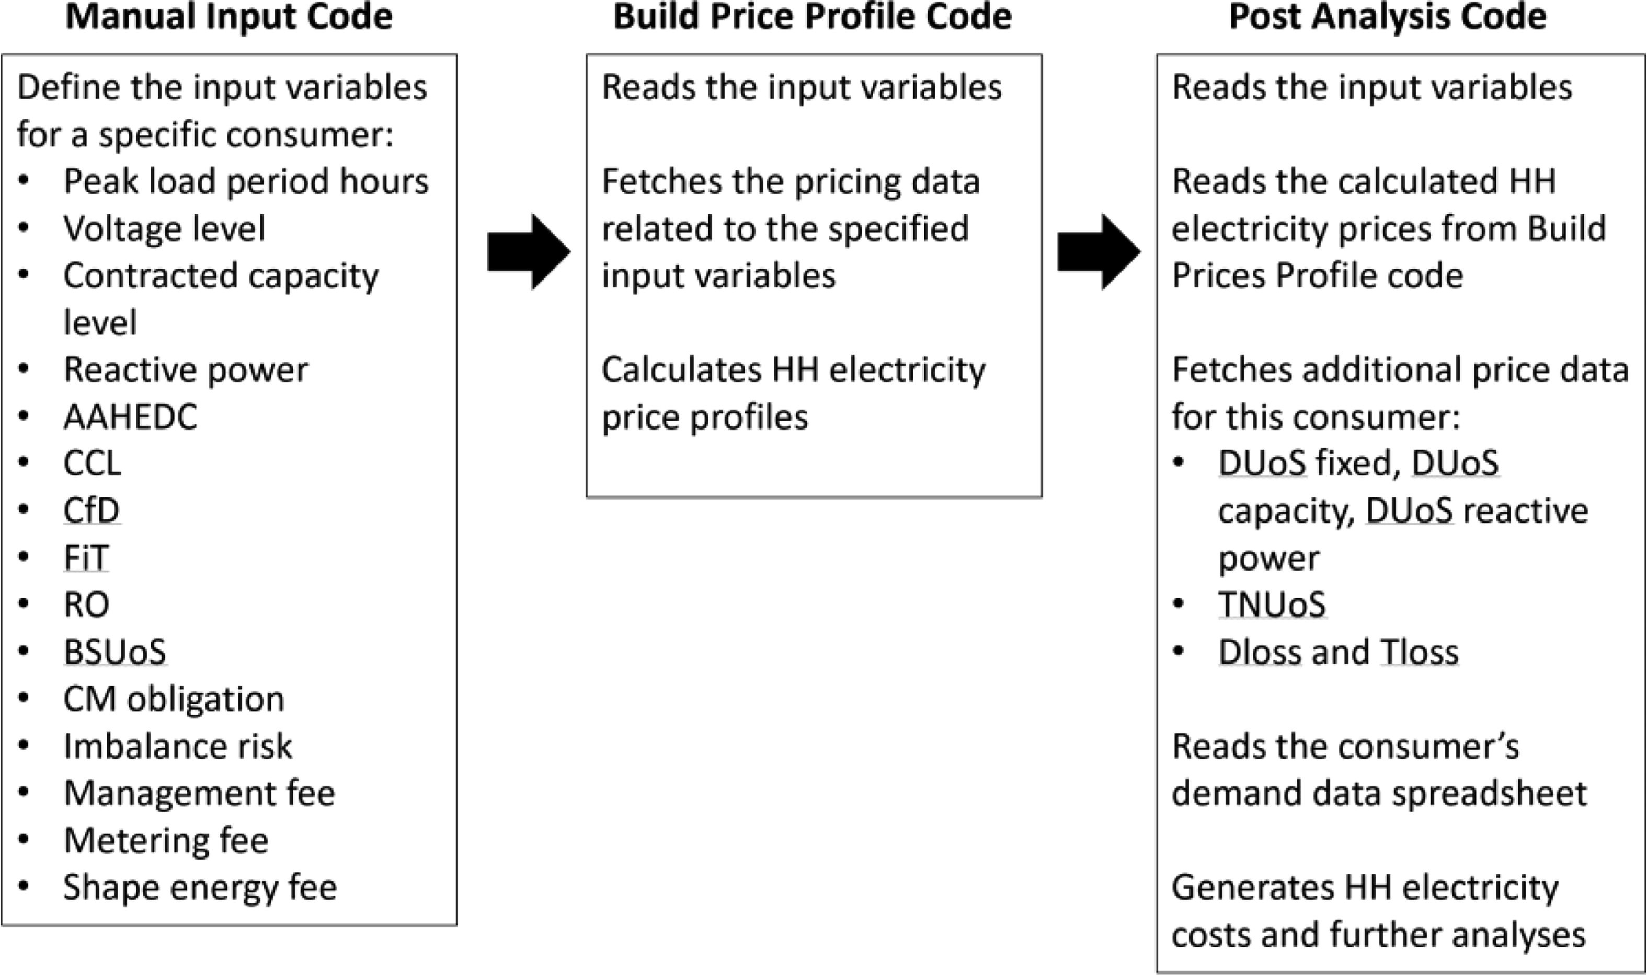
Methodology
asd

Slide 8
Methodology

Slide 9
Methodology

Slide 10
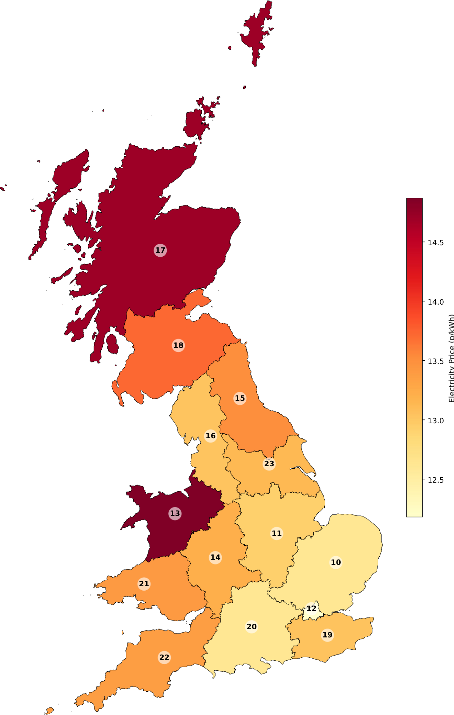
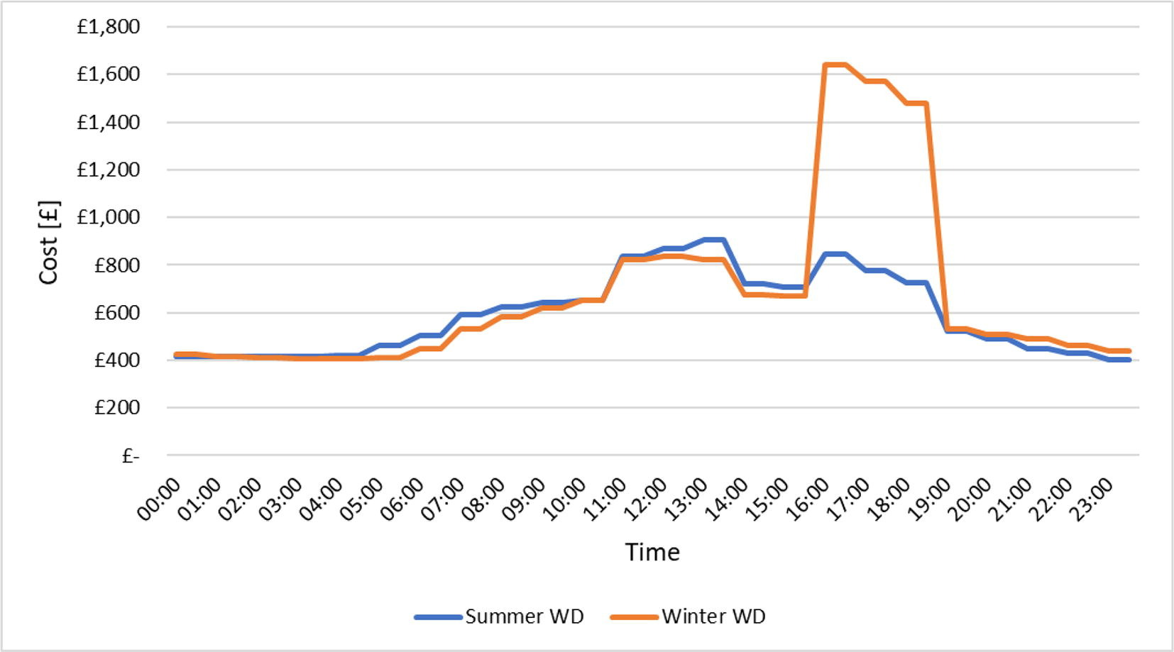
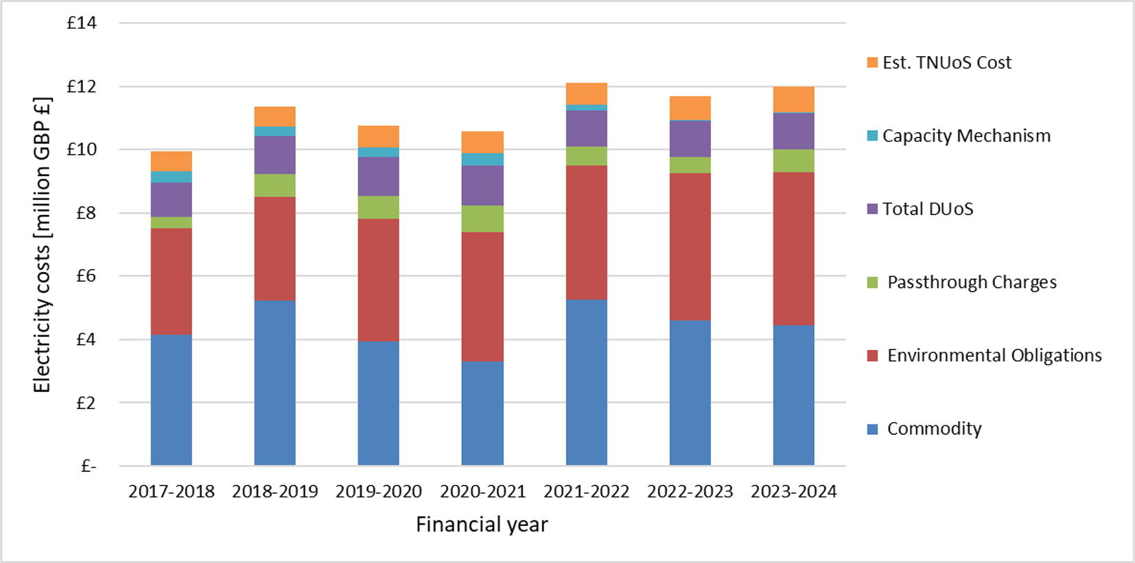
Key findings
Daily electricity cost (university case study)
Annual electricity cost (university case study)

Slide 11
Key findings
Electricity Cost (p/kWh) by DNO Region
Daily electricity cost (university case study)
Annual electricity cost (university case study)

Slide 12
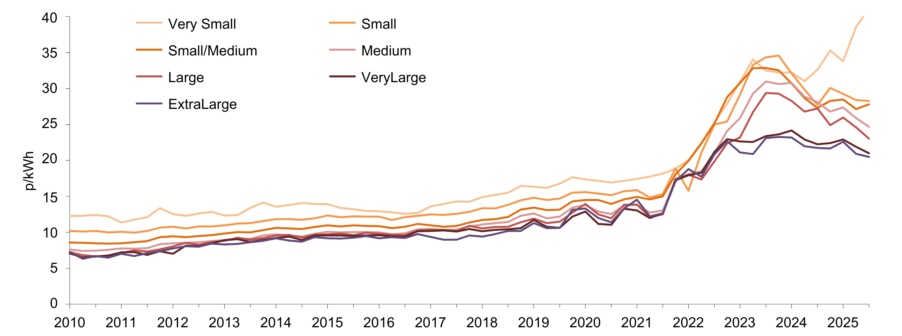
My take
Electricity prices for non-domestic consumer classes

Slide 13
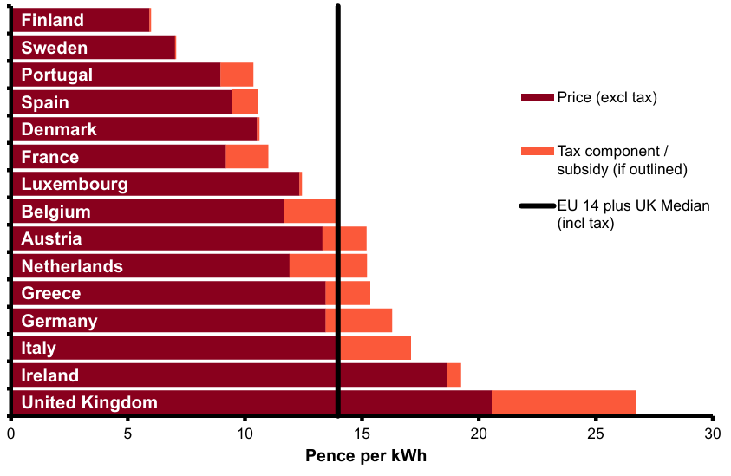
My take
UK non-domestic electricity against EU peers

Slide 14
Discussion time
SEF Journal Club

