Slide 1
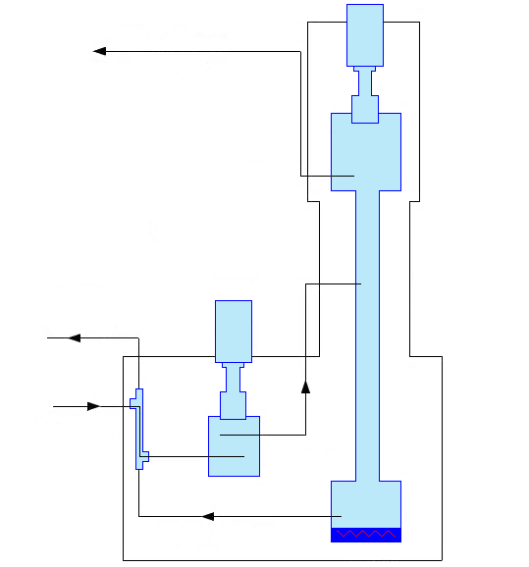
PTR
offgas Xe
(high Kr)
condenser
PTR
purified Xe
(low Kr)
Xe input
reboiler
cooler
purified Xe
heater

