Slide 1
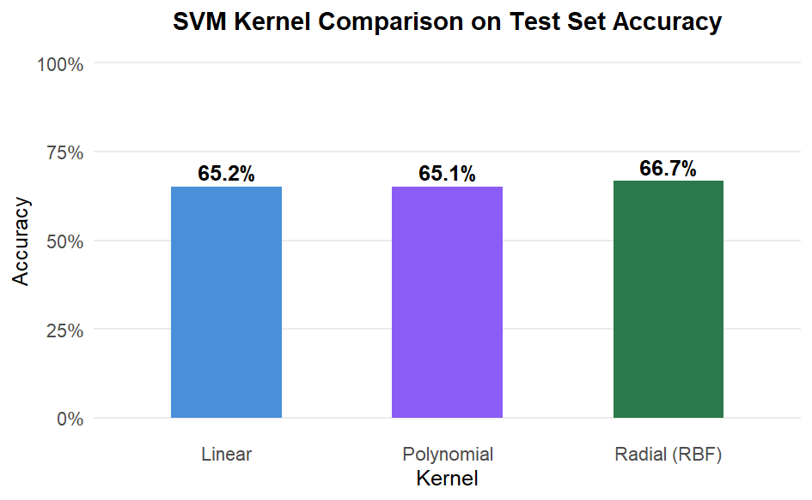
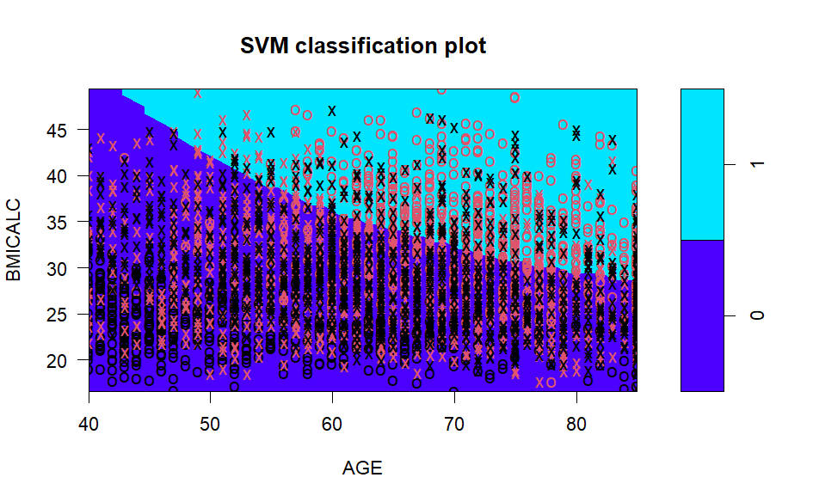
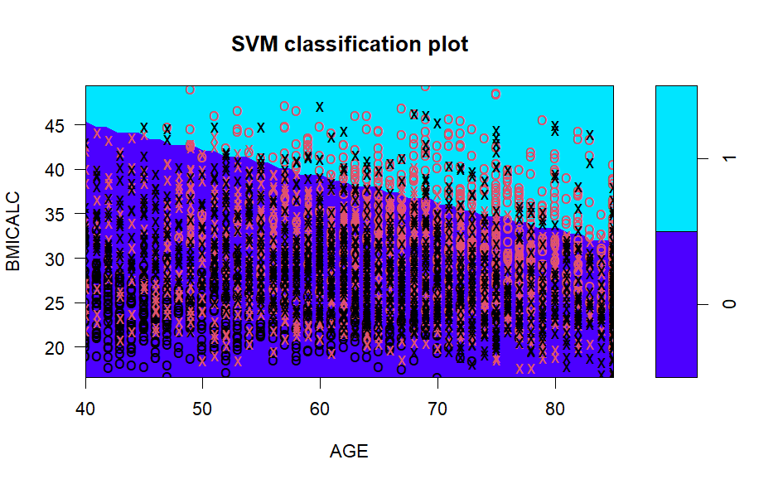
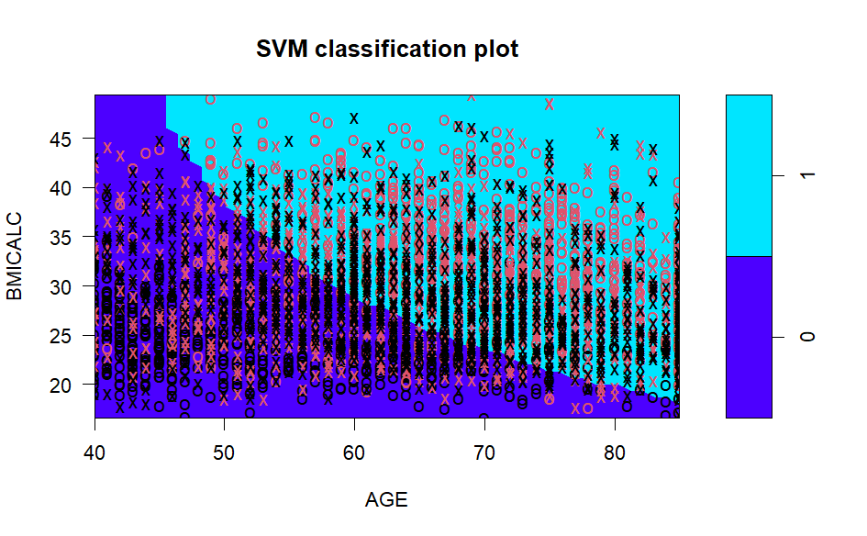
Predicting Diabetes from Health Behaviors and Demographics Using Support Vector Machines
Njenga Gakwa • DATA 5322 Statistical Machine Learning II • 2026
Introduction
Results
Kernel Train Error Test Error Accuracy Sensitivity
Diabetes affects millions of adults and is closely tied to lifestyle behaviors and demographic factors.
Using data from the 2022 National Health Interview Survey (NHIS) via IPUMS Health Survey, this study investigates which habits and demographics predict diabetes diagnosis.
The dataset includes demographic variables such as age and BMI, alongside behavioral measures including physical activity, sleep, alcohol use, and smoking status.
Adults 40+ were the focus: diabetes risk increases substantially with age.
Three SVM models (linear, polynomial, radial kernels) were trained to classify ever-diagnosed diabetes.
Research Question: Can demographic and behavioral survey data predict diabetes in adults 40+?
Linear 32.8% 34.8% 65.2% 61.2%
Polynomial 31.7% 34.9% 65.1% 60.7%
Radial ★ 31.5% 33.3% 66.7% 66.8%
Discussion
All three kernels achieved approximately 65–67% accuracy. On a balanced dataset, a naive model only reaches ~50%, so these results represent genuine predictive power.
The radial kernel performed best, suggesting the Age and BMI vs diabetes relationship is non-linear.
This is also supported by the sensitivity test where the radial kernel achieved the highest sensitivity, correctly identifying 66.8% of diabetic cases compared to 61.2% for linear and 60.7% for polynomial.
The small difference between the kernels (only about 1.5%) suggests that switching to a more complex SVM doesn’t really help. The limitation is in the predictors themselves, not the model.
The decision boundary plots also make the story clearer: the separating line tilts in a way that shows younger adults with higher BMI are more likely to have diabetes, while older adults with lower BMI tend not to. That pattern actually lines up with what we know clinically, in younger populations, Type 2 diabetes often shows up in individuals with higher body weight, whereas older adults without obesity are less likely to have it.
Physical activity (continuous minutes) contributed meaningful signal, more than binary flags would have. Dose matters.
Limitations: Downsampling discards a large portion of the majority-class data, which reduce model stability. The ~33% test error also suggests these 7 behavioral/demographic variables alone are insufficient to separate the classes. Age and BMI are the strongest individual predictors, supported by the diagonal decision boundary in the Age × BMI plots above, consistent with established risk factors (ADA, Diabetes Care, 2023). Physical activity and cardiovascular history contribute additional information
Theoretical Background
Figure 1. Test set accuracy by kernel after hyperparameter tuning
A Support Vector Machine is a supervised classification method that finds the optimal decision boundary, called a hyperplane, that separates two classes with the maximum possible margin. The margin is the width of the region bounded by two parallel hyperplanes equidistant from the decision boundary. In the soft-margin SVM, points may fall inside or on the wrong side of the margin controlled by cost C. The training points closest to the decision boundary and any margin violators are called support vectors. Maximizing this margin minimizes generalization error.
For non-linearly separable data, SVMs use a kernel function to implicitly map data into higher-dimensional space where a linear boundary can be found.
Optimization Problem (Soft-Margin SVM):
Minimize: ½‖w‖² + C Σξᵢ
Subject to: yᵢ(wᵀxᵢ + b) ≥ 1 − ξᵢ, ξᵢ ≥ 0
Kernels Used:
Linear: K(xi, xj) = xiᵀxj best for linearly separable data
Polynomial: K(xi,xj) = (γ xiᵀxj + r)ᵈ interaction effects; tuned via degree d, cost C
Radial (RBF): K(xi,xj) = exp(−γ‖xi−xj‖²) complex boundaries; tuned via γ, cost C
Cost C controls bias-variance tradeoff: small C = wider margin, large C = tighter training fit. Optimized via tune.svm() cross-validation.
Decision Boundary Plots for Age vs BMI
Figure 2. Radial Kernel: Age vs BMI. 0 for non-diabetic, 1 for diabetic.
Methodology
Data & Predictors
NHIS 2022 filtered to adults 40+ (higher-risk group)
7 predictors: Age, BMI, Smoking, Vigorous activity (min/day), Moderate activity (min/day), Heart disease history, Stroke history
Activity kept as continuous minutes to preserves dose-response signal for the SVM kernel
Class Imbalance Fix
Raw data ~75% non-diabetic; naive models predicted no diabetes cases at all
Majority class downsampled to match minority, yielding a balanced 50/50 dataset
Tuning (3-fold CV, 80/20 split)
Linear: cost ∈ {0.001, 0.01, 0.1, 1, 10}
Radial: γ ∈ {0.0001–0.1} × cost ∈ {1–1000}
Polynomial: degree ∈ {2,3,4} × cost ∈ {0.1–100}
Figure 3. Linear Kernel: Age vs BMI. 0 for non-diabetic, 1 for diabetic.
Conclusions
Demographic and behavioral survey data carry meaningful predictive signal for diabetes, even without clinical measurements.
Age and BMI are the strongest individual predictors, but physical activity and cardiovascular history contribute additional information.
Policy: Prevention programs targeting adults 40+ should prioritize weight management and sustained physical activity, especially for individuals already showing elevated BMI.
Future Work: Add dietary variables from NHIS; apply cost-sensitive learning instead of downsampling; include clinical biomarkers if available.
Figure 4. Polynomial Kernel: Age vs BMI. 0 for non-diabetic, 1 for diabetic.
Reference:
Blewett LA, Rivera Drew JA, King ML, Williams KCW. IPUMS Health Surveys: National Health Interview Survey, Version 7.3. Minneapolis, MN: IPUMS, 2023. https://doi.org/10.18128/D070.V7.3
American Diabetes Association. (2023). Standards of Medical Care in Diabetes-2023. *Diabetes Care*, 46(Supplement 1). https://doi.org/10.2337/dc23-S001
How to read: Colored regions show where the model predicts each class across Age × BMI space. 0 = predicted non-diabetic; 1 = predicted diabetic. X markers are support vectors, the training points nearest the boundary that define it. The boundary shifts diagonally: higher BMI combined with older age tends to predict diabetes, consistent with known clinical risk factors (ADA, Diabetes Care, 2023).

