Slide 1

Trot
John Nganga

Slide 2
Motion
iLQR
Explicit DDP
Trot with vx = 0.5

Slide 3
Motion
ExtMod DDP
Tensor DDP

Slide 4
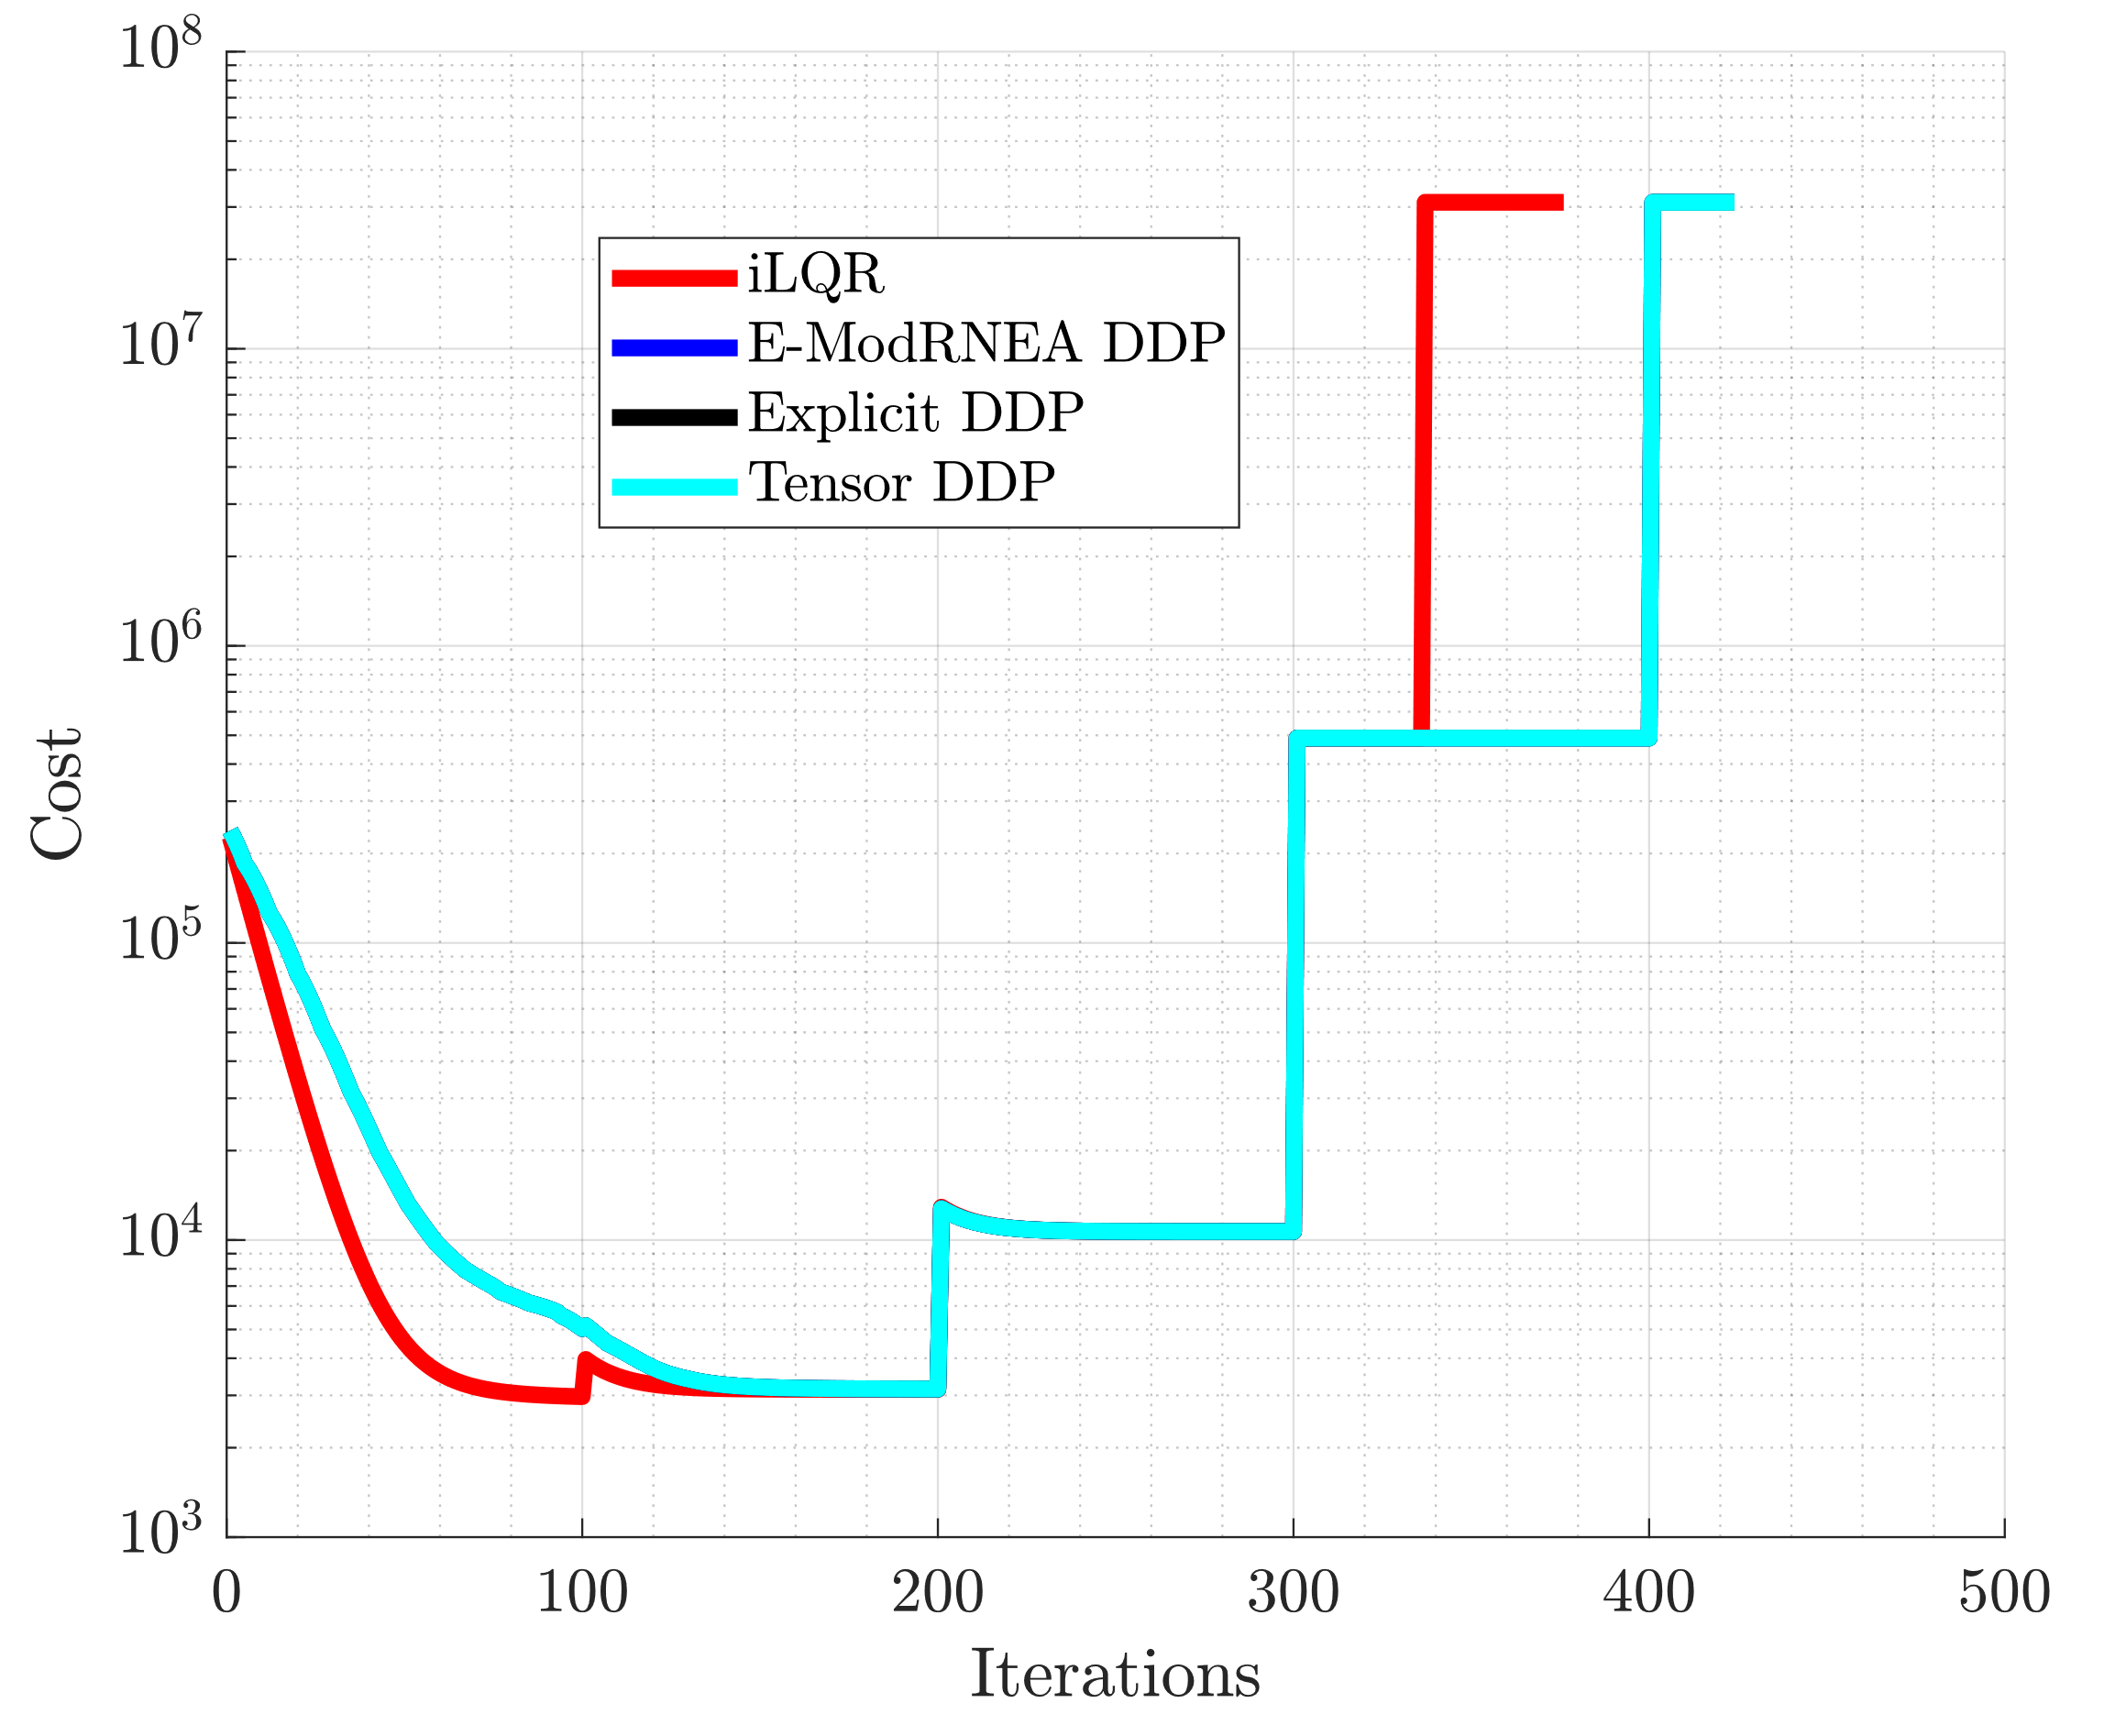
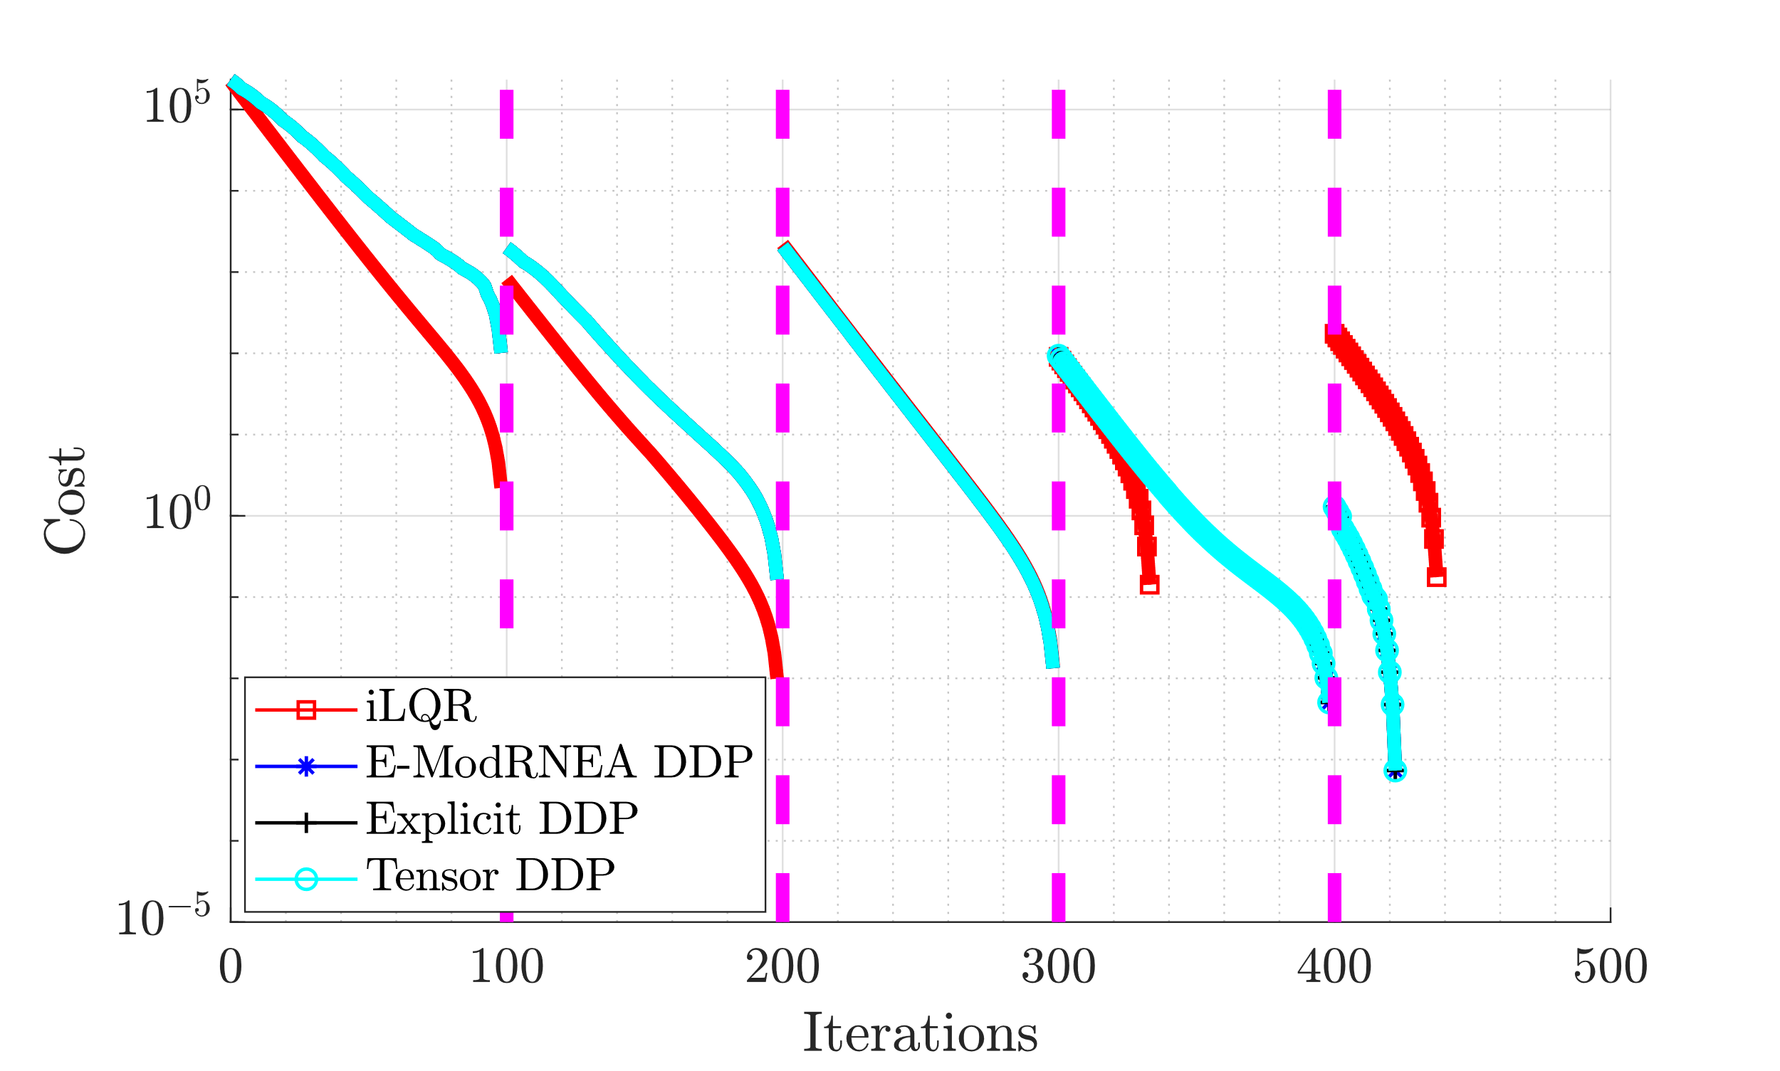
Cost

Slide 5
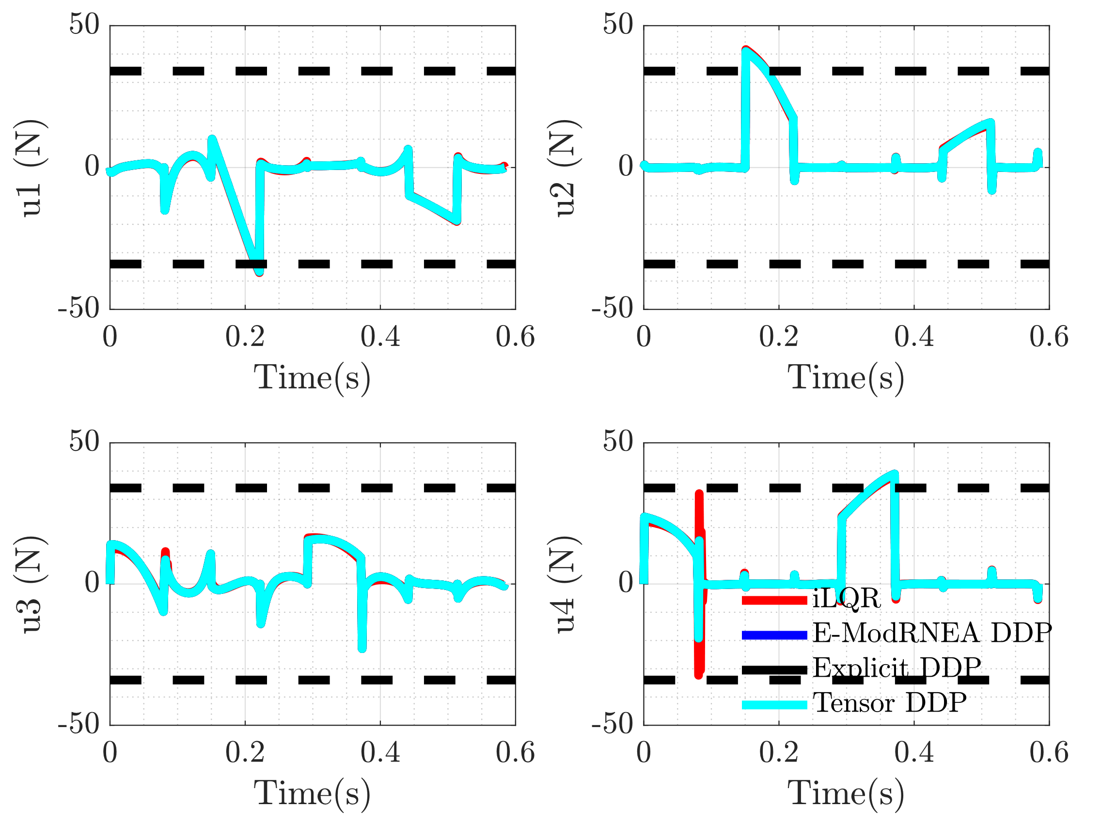
Control

Slide 6
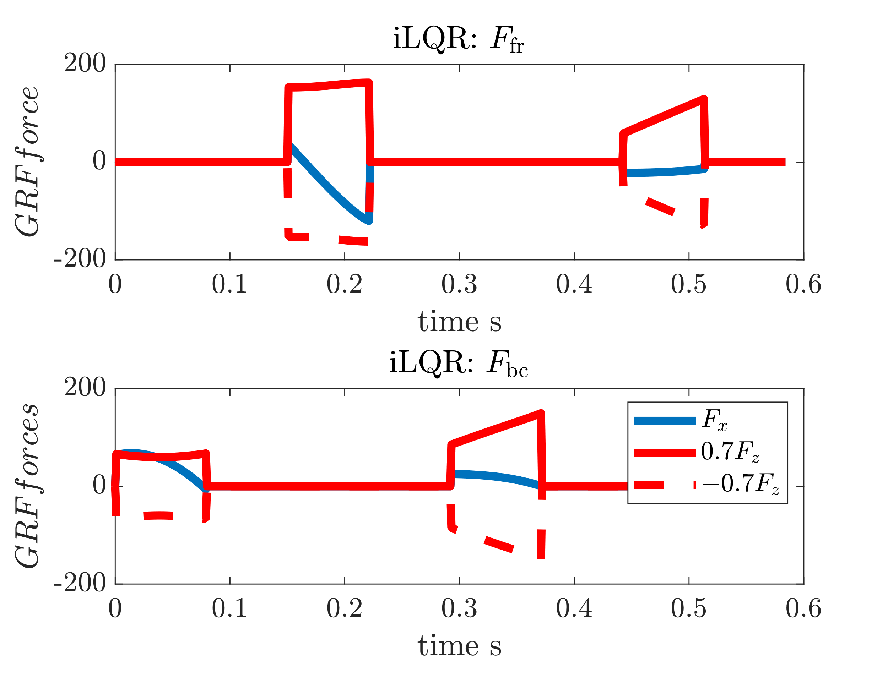

GRFs

Slide 7
Add noise to control
Use optimized trajectory and control as initial guess
Add weiner noise to controller
Run either iLQR/DDP for 20 iterations
Noise scaling
scaler = linspace(-2,2,15);
N = 585; dt = 1e-3;
dW = sqrt(dt)*randn(4,N); %weiner noise
W = cumsum(dW) * scaler(i);

Slide 8
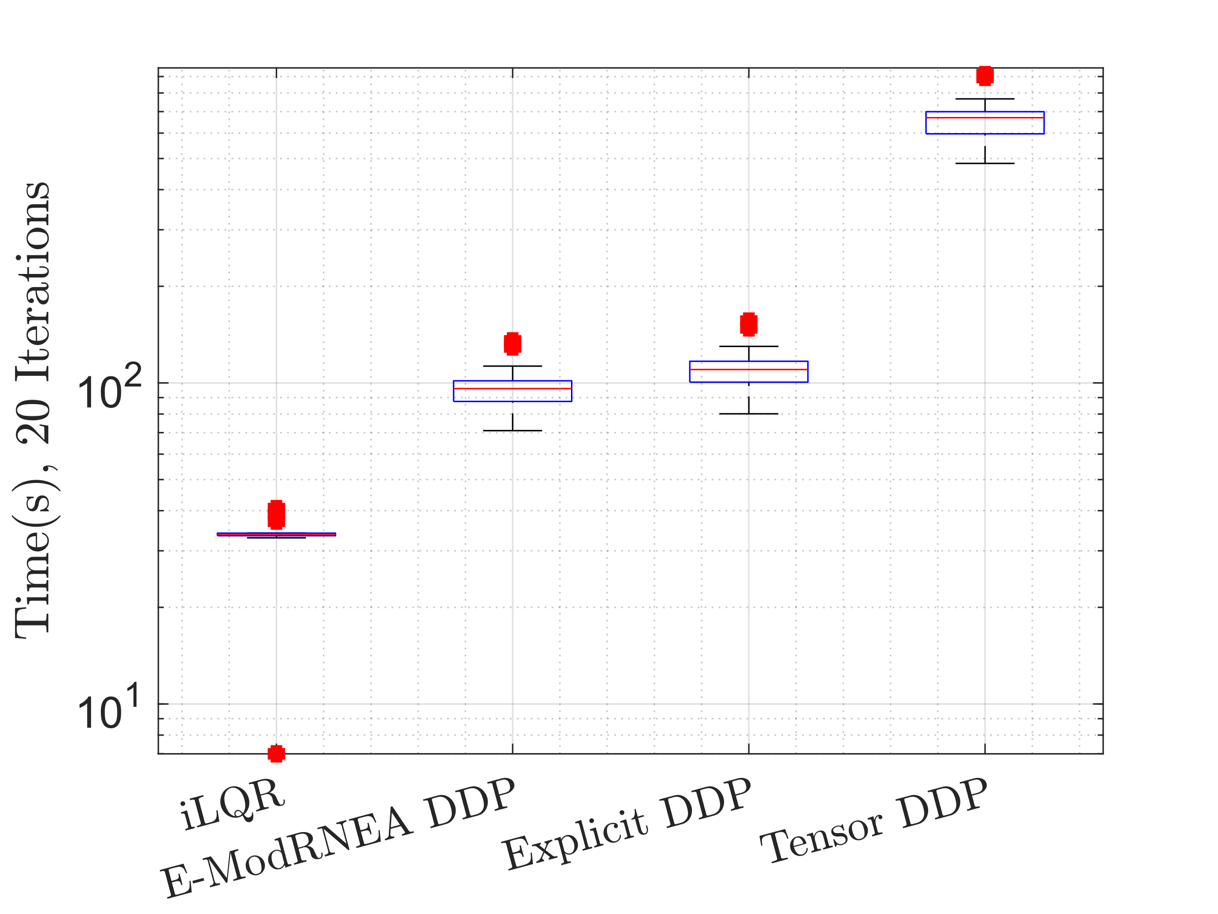
Time

Slide 9
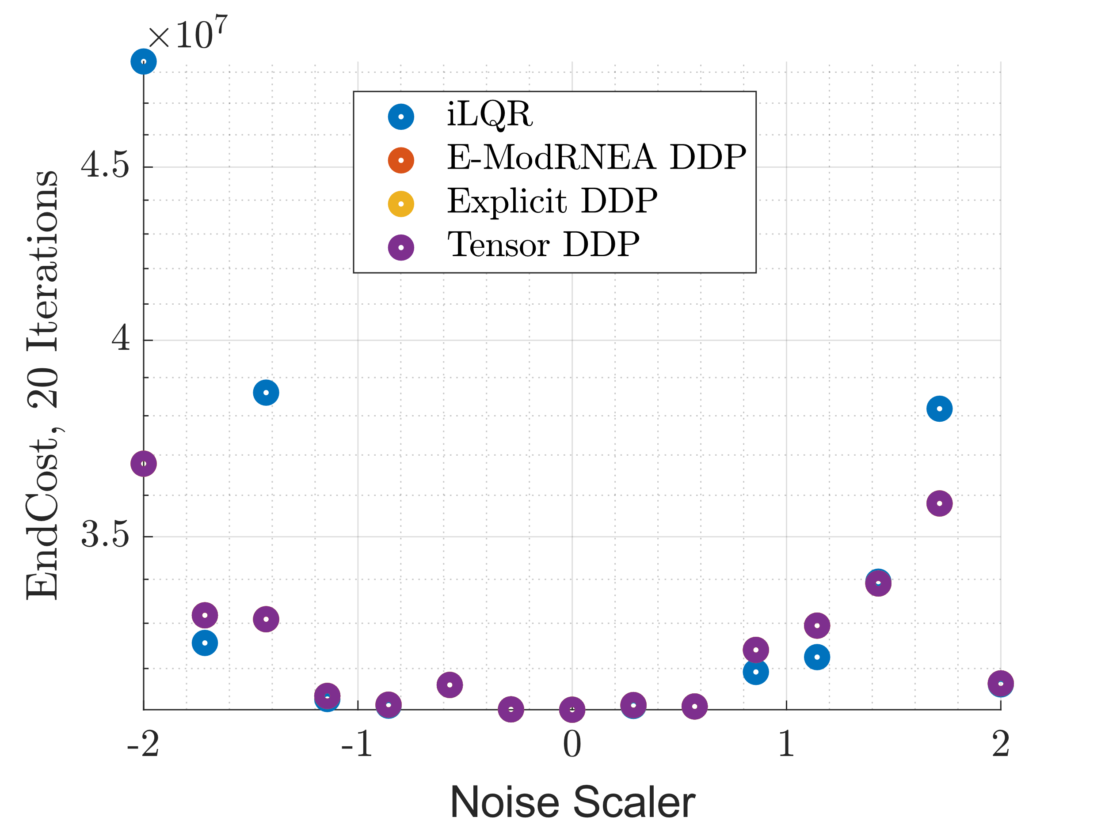
End Cost

Slide 10
Add noise to control
Use optimized trajectory and control as initial guess
Add weiner noise to controller
Run either iLQR/DDP for 150 iterations
Noise
N = 585; dt = 1e-3;
dW = sqrt(dt)*randn(4,N); %weiner noise
W = cumsum(dW);

Slide 11
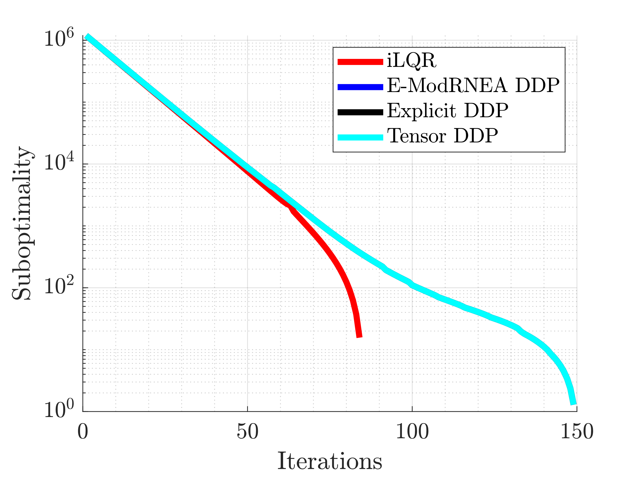
Suboptimality
Suboptimality = semiology(Vbar – Vbar (end))

Slide 12
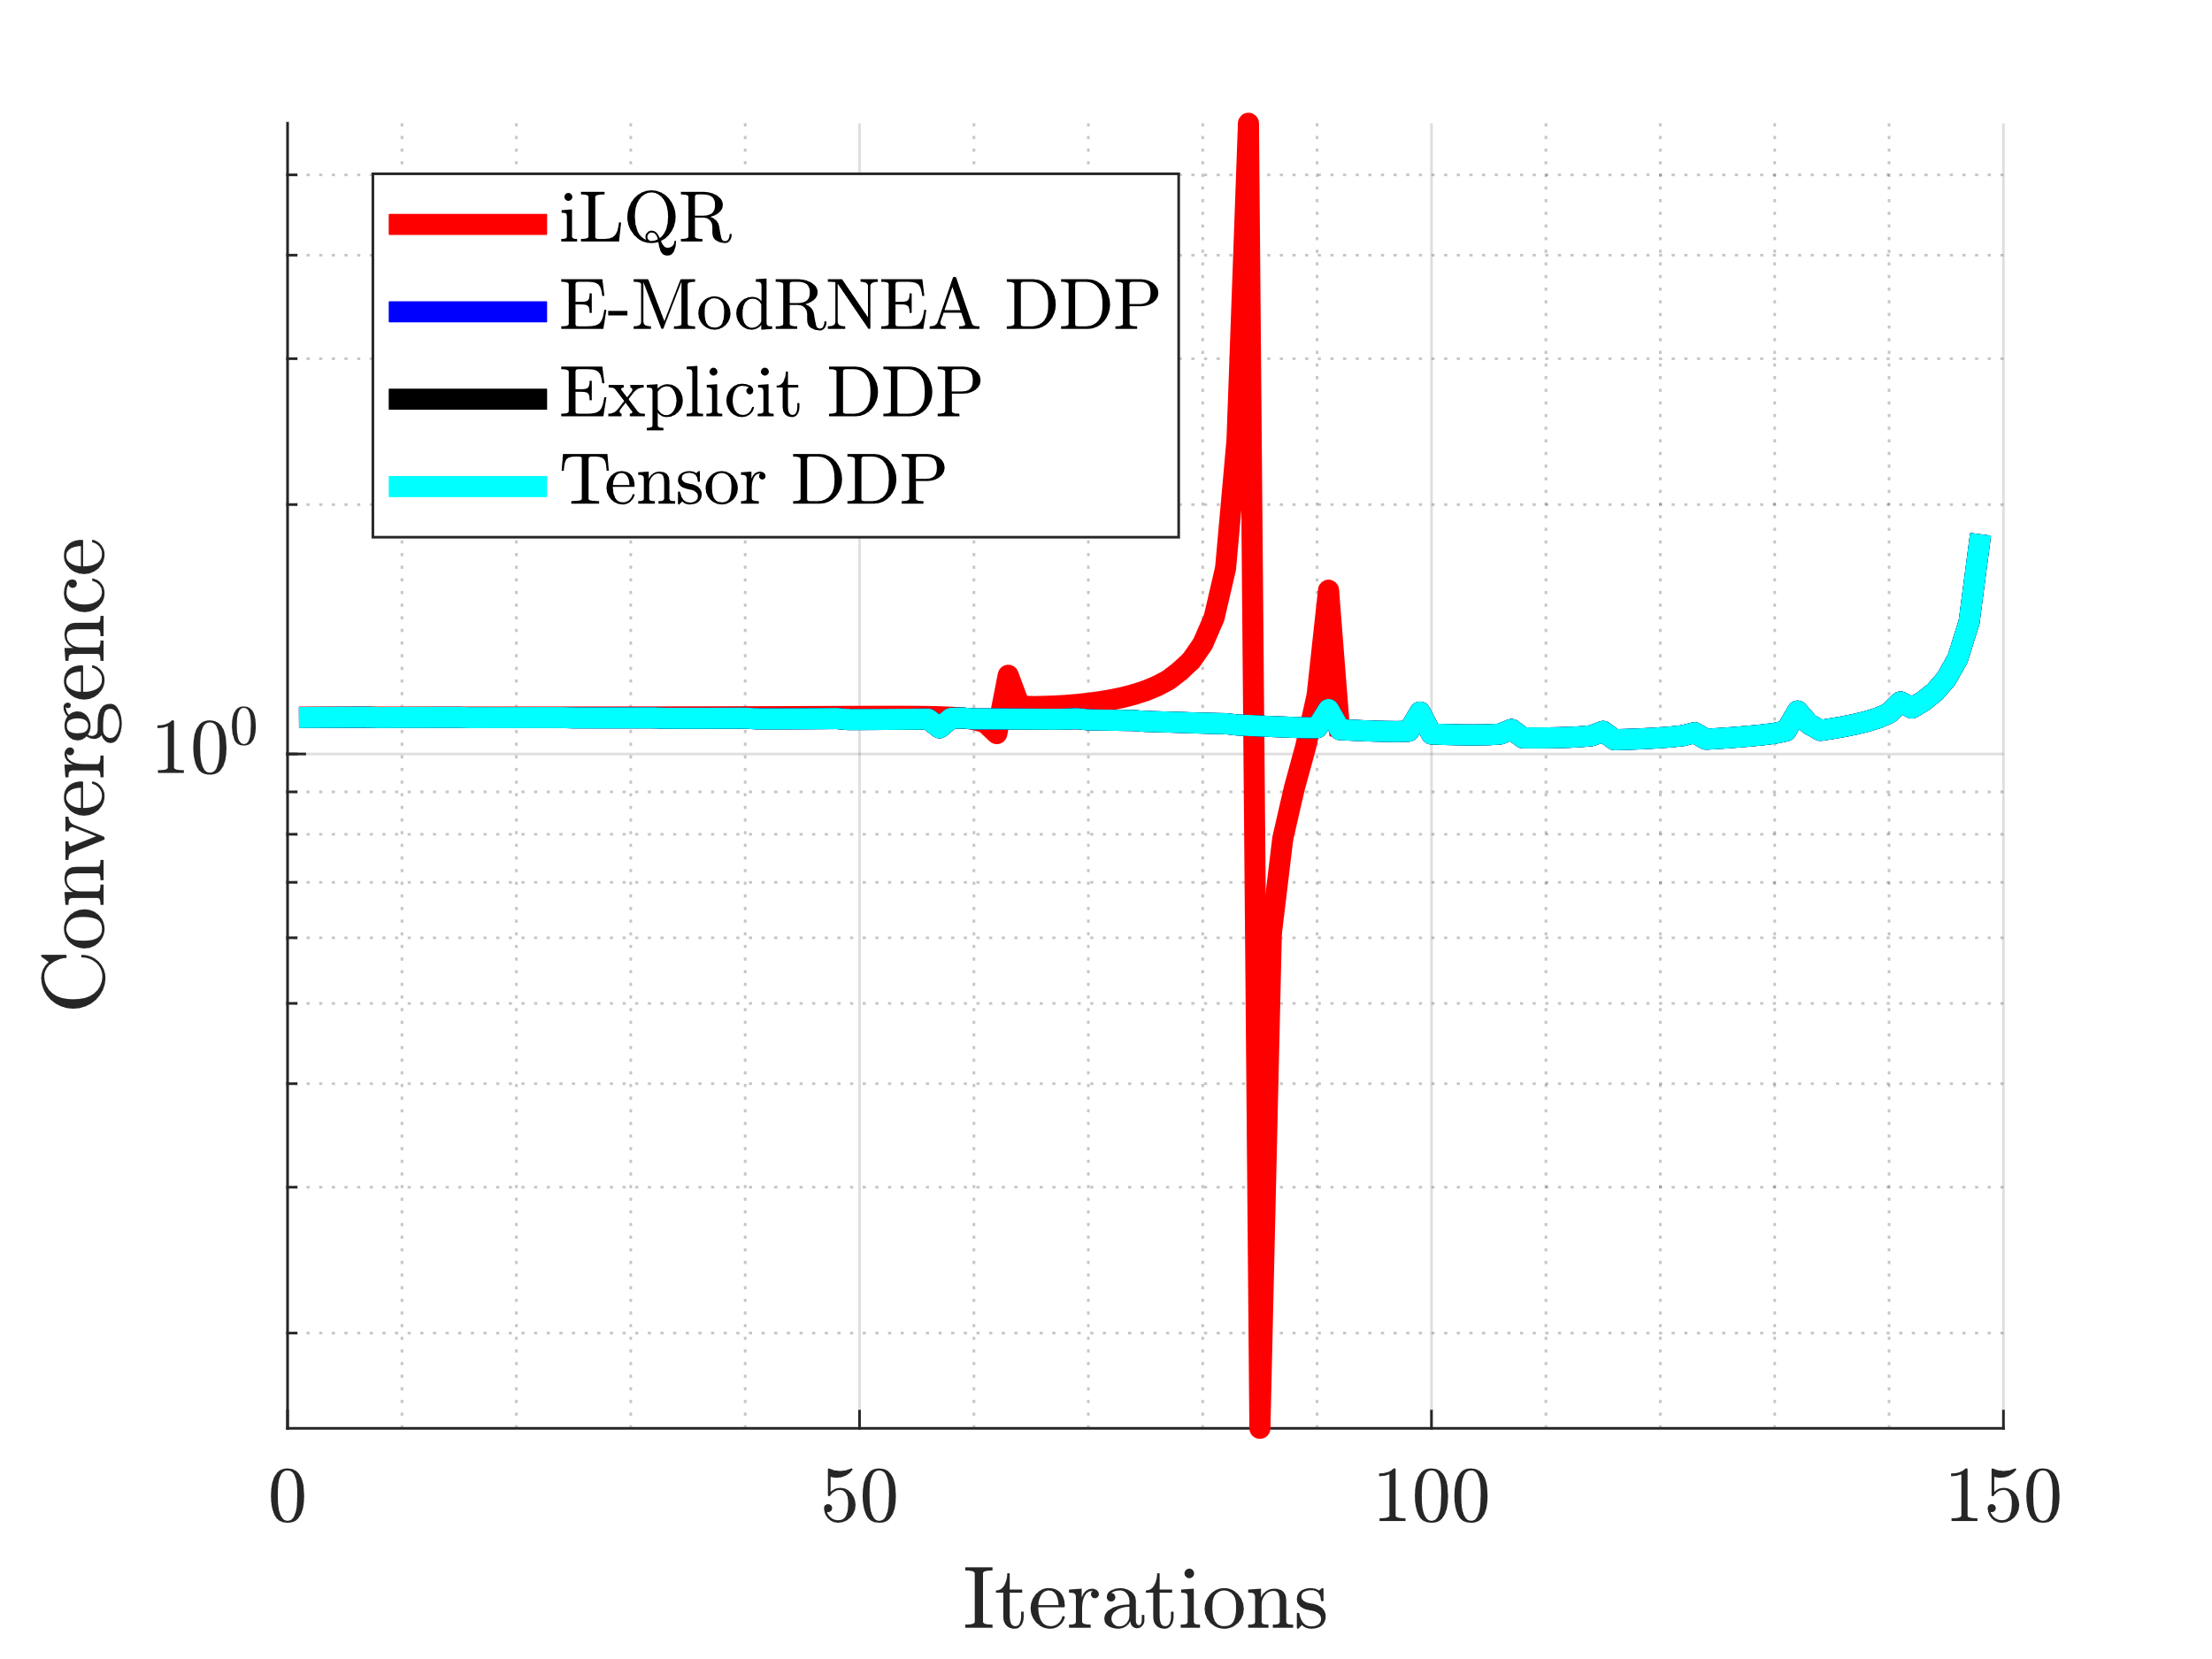
Convergence Rate
H = semiology(Vbar – Vbar (end))
Convergence = abs(H(2:end) ./ H(1:end-1));

