Slide 1
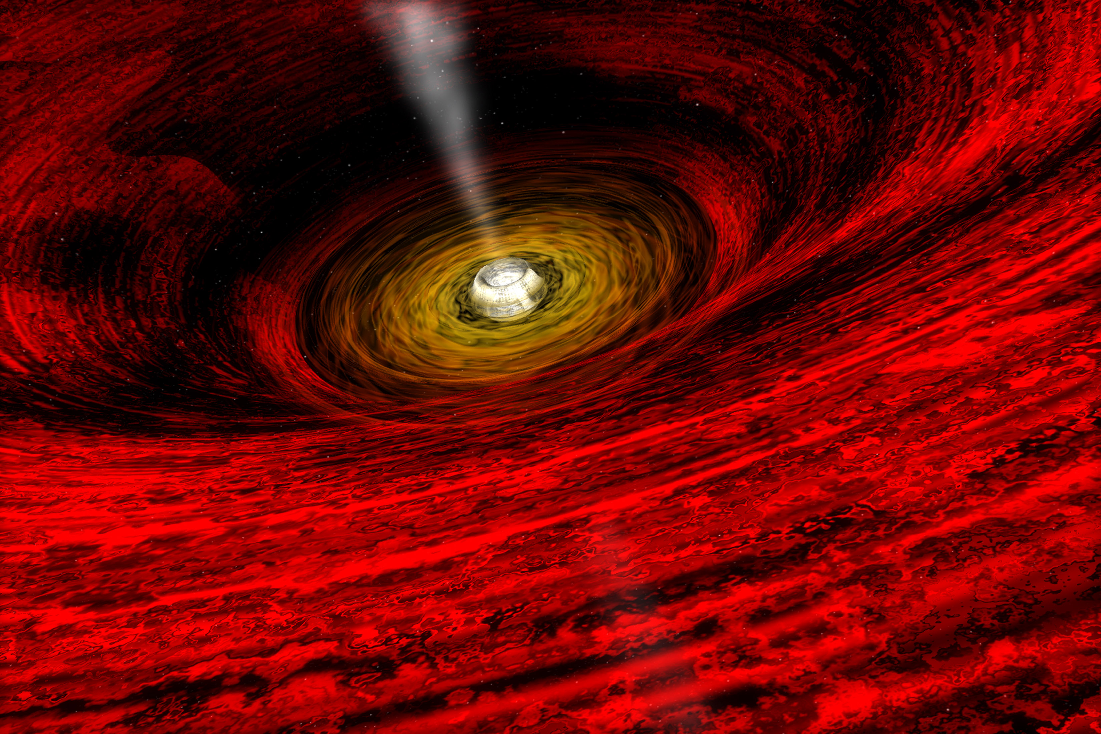
Thin Disk Oscillations
Nicolas Garavito
Astr 545: Final project
Image credit: NASA

Slide 2
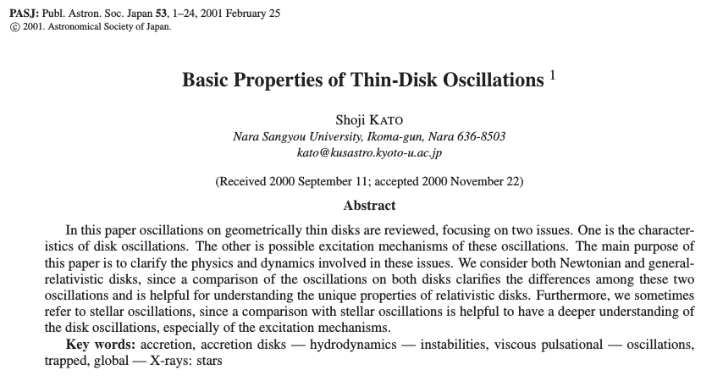

Slide 3
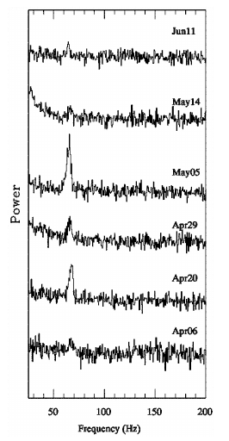
Why it is important to study disk oscillations?
Strong chaotic time variations in X-rays observations of BH and AGNs.
Quasi Periodic Oscillations (QPO).
Power
Frequency (Hz)
Morgan e.a. 97

Slide 4
1. Characteristics of thin disk oscillations.
2. Excitation mechanisms of the oscillations.
Notes:
Testing the notes

Slide 5
Characteristics of accretion disks:
Non-self gravitating
Collisional
Potential of central object axisymmetric
Compressible fluids & viscosity
Magnetic fields

Slide 6
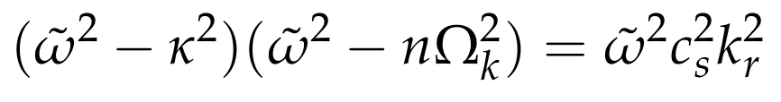

Keplerian Disks, dispersion relation:
κ : epicyclic frequency
n: Number of nodes in the vertical direction of the disk.
n=1 (corrugation)
m: number of arms of the perturbations in the azimuthal direction.

Slide 7

Inertial – acoustic oscillations
If n=0:
Inertial waves: due to the rotational restoring force with frequency κ(r)
Acoustic waves: Additional pressure restoring force due to compressible fluids.

Slide 8
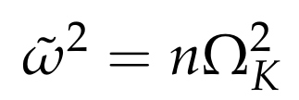
Vertical oscillations
If k_{r} = 0
This represents vertical oscillations in the disk due to the restoring force (gravity) with frequency ΩK
Inertial +acoustic + vertical oscillations give rise to:

Slide 9
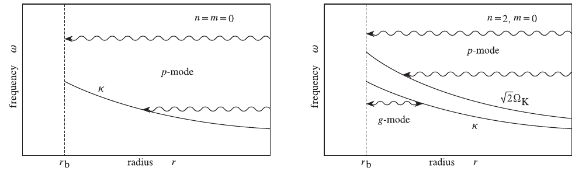
p-mode: max(w**2) g-mode: min(w**2)
n = m = 0
n = 2, m = 0
Frequency
radius
radius
Kato, PASJ, 01

Slide 10
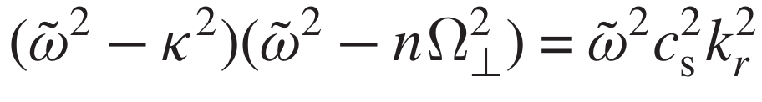
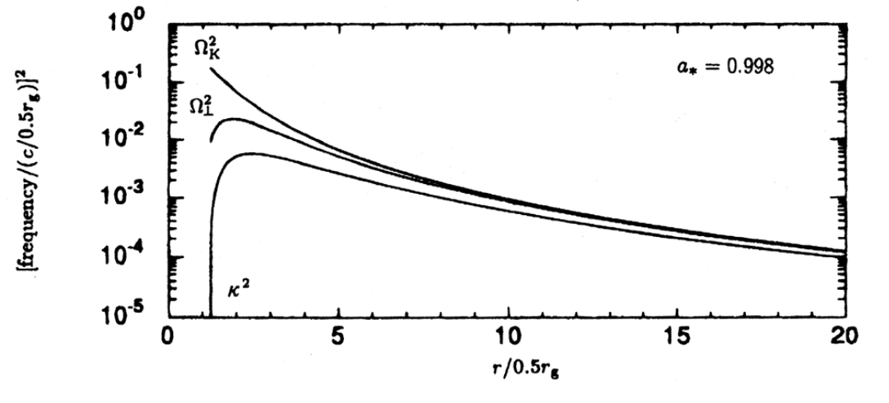
General Relativity dispersion relation
Kato, PASJ, 01

Slide 11
There are 2 types of oscillations of interest (can be observed!)
1. Low Frequency Global Oscillations
1.1. Eccentric deformation of disks
1.2 Tidally deformed disks
2. Trapped Oscillations (Relativistic effects)

Slide 12
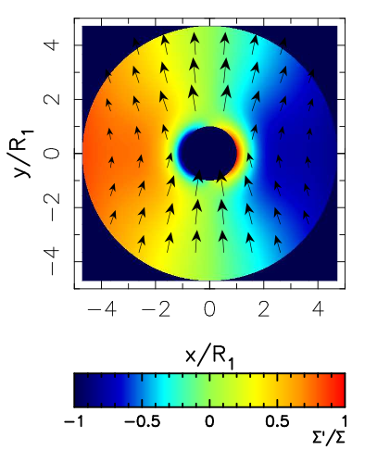
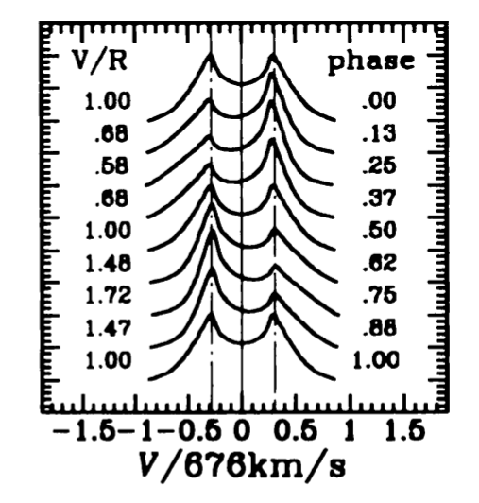
Eccentric deformation of disks are low frequency oscillations. (m=1,n=0)
Pressure changes the Keplerian rotation and make oscillations at different radius coherent. w<< Ωk.
Oktariani et al., PASJ, 08
Okazaki, PASJ, 96

Slide 13
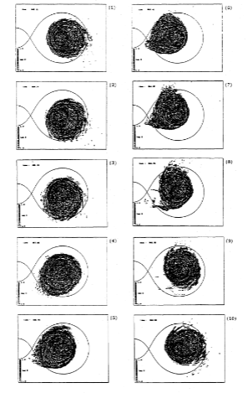
Tidally deformed disks as an explanation of “superhump” phenomena in dwarf novae
Kato, PASJ, 01

Slide 14
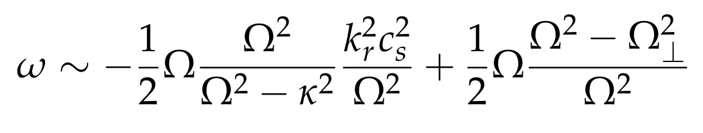
Relativistic corrugation waves with m=1 are low frequency oscillations
This is only valid for a<<1
Ω
Warps in AGNs and in X-ray binaries

Slide 15

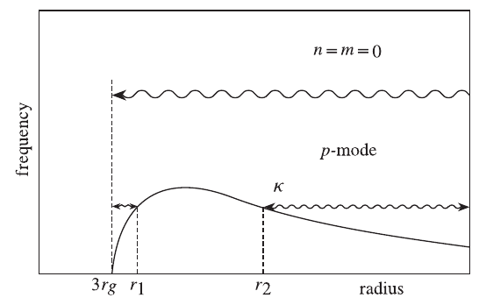
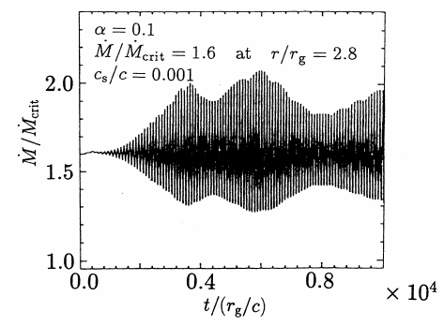
Trapped Waves, Fundamental node.
1
3
2
Matsumoto e.a. 98

Slide 16
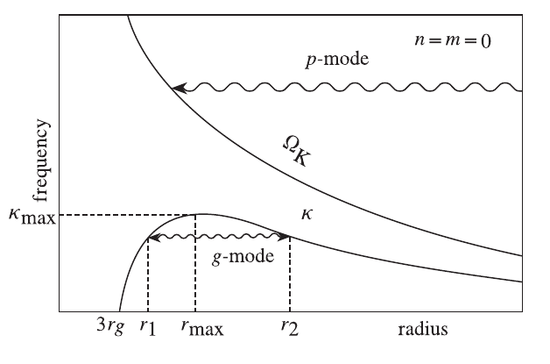
First overtone oscillations n=1
Kato, PASJ, 01
Morgan e.a. 97

Slide 17
Excitation of disk oscillations

Slide 18
Excitation processes in disks (Viscosity)
1. Thermal process of viscosity.
Thermal energy is transformed to kinetic energy due to viscosity.
2.Turbulent process of viscosity (η-mechanism).
Angular momentum energy can be transform into kinetic energy due to viscosity.

Slide 19
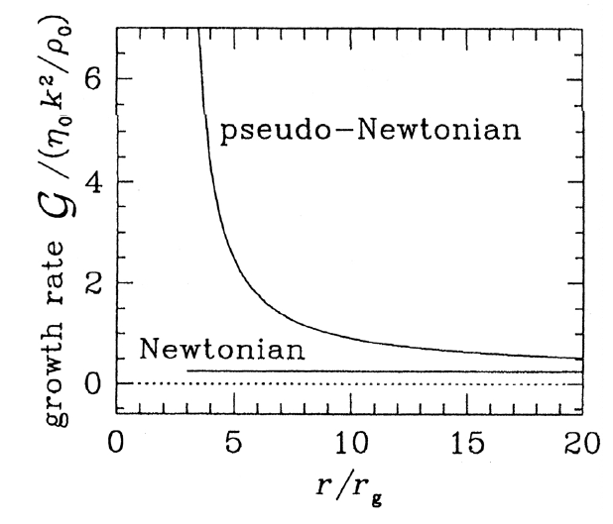
Growth rate for isothermal oscillations for n=m=0.
Kato, e.a. 98

Slide 20
Conclusions
V/R variations | Eccentric deformation of disks | Turbulence viscosity
'Super humps' | Tidally deformed disks | Turbulence viscosity
QPO | Trapped Oscillations n=0 | Turbulence viscosity
QPO | Trapped Oscillations n=1 | Dynamical action of turbulence?

