Slide 1

Github basics
Ekta Patel
&
Nicolas Garavito-Camargo
Code Coffee
27/09/17

Slide 2
Version control: software that do management of changes to documents
Git
Mercurial
SVN
CVS
Github
GitLab
Bitbucket
Source Forge
Web-based hosting service for source code.

Slide 3
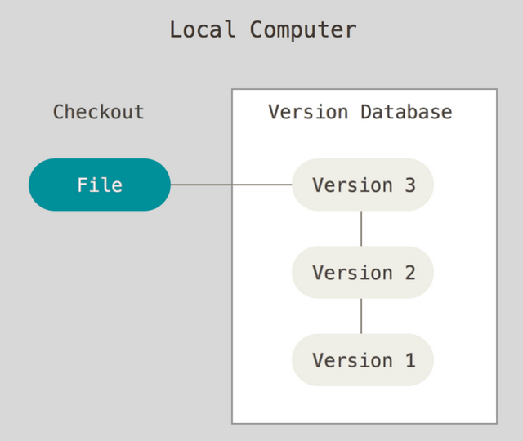
Local version
control
Credit: https://git-scm.com/book/en/v2/Getting-Started-About-Version-Control

Slide 4
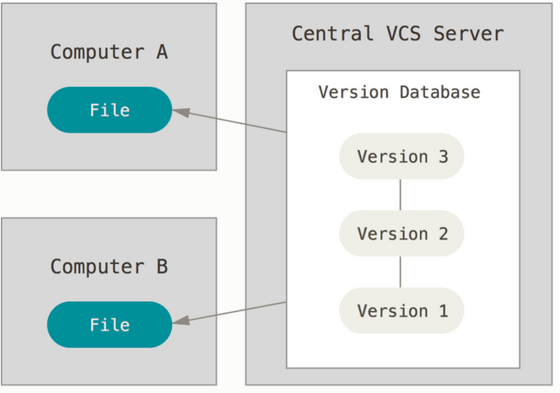
Centralized version control
Local version
control
Credit: https://git-scm.com/book/en/v2/Getting-Started-About-Version-Control

Slide 5
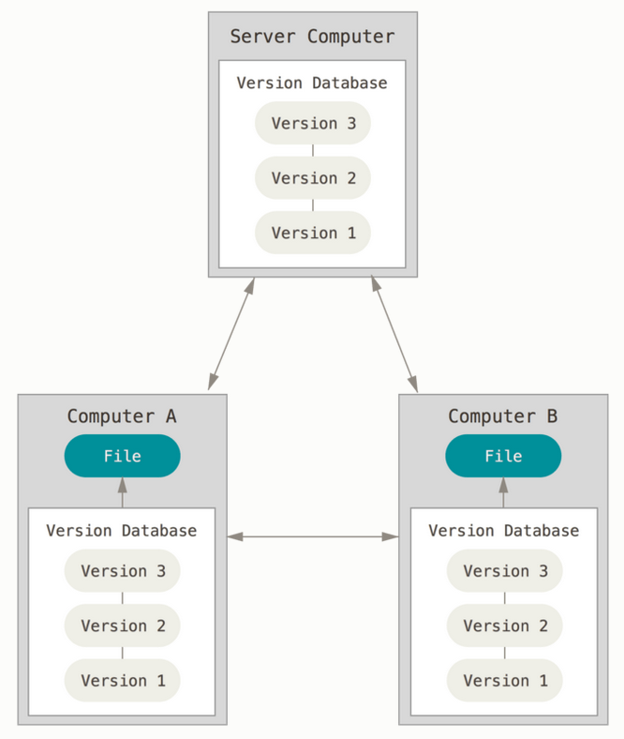
Distributed version control
Centralized version control
Local version
control
Git, Mercurial, SVN, etc..
Credit: https://git-scm.com/book/en/v2/Getting-Started-About-Version-Control

Slide 6
Github features
Unlimited Public repositories, limited Private repositories.
Documentation of software: Doc, Readme
Issues: Report bugs or other issues with a given code.
Email notifications.
Github host web pages: https://pages.github.com/
Student package: https://education.github.com/pack

Slide 7
Github in astronomy:
NASA, LSST, DESI etc ..
Astropy: https://github.com/astropy/astropy
Matplolib, scikits-learn, emcee, and many many more.
Help science to be reproducible.

Slide 8
Hands-on

Slide 9
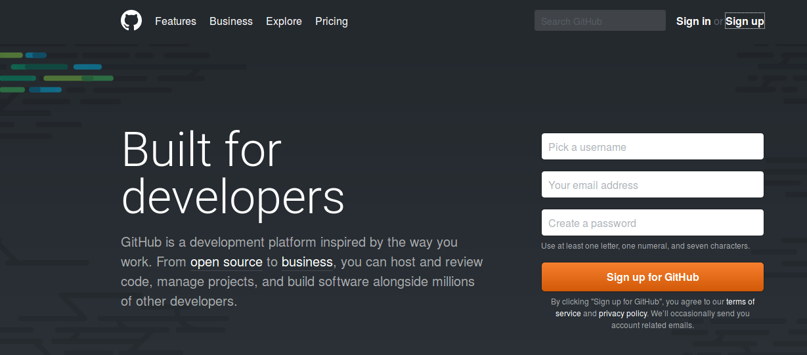
1. Create a github account: go to github.com
Github tour

Slide 10
2. Installing git
(see the docs)
For mac: Type git and follow instructions.
For Linux:
$ sudo yum install git-all
$ sudo apt-get install git-all
For Windows:
http://git-scm.com/download/win

Slide 11
3. Set up git:
(https://help.github.com/articles/set-up-git/)
Set a Git user name
$ git config --global user.name "Mona Lisa"
Setting your email address for every repository on your computer
$ git config --global user.email "email@example.com"

Slide 12
Optional: Caching your GitHub password in Git
go here

Slide 13
4. Create a repository.
From github:
https://help.github.com/articles/create-a-repo/
From a terminal:
Adding an existing project to github

Slide 14
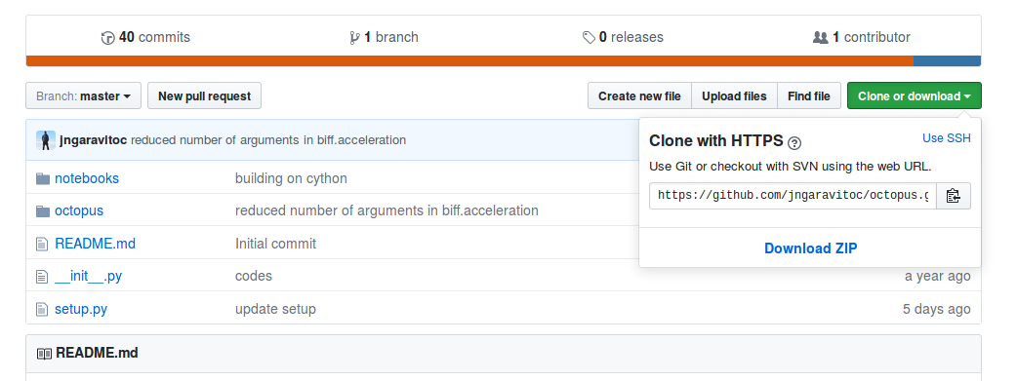
5. Clone your repository to your computer and see its status.
$ cd github_repos
$ git clone https://github.com/….
$ cd your_repo_name
$ git status

Slide 15
6. Add a file, commit and push your file
Create a document
$ echo ‘hello git’ > git_doc.txt
See your repository status
$ git status
Add your file → start tracking your file (staging area)
$ git add first_doc.txt
$ git status
Commit your file → Store your file
$ git commit -m ‘descriptive comment’
$ git log
$ git push

Slide 16
7. Editing, moving and removing files.
Move a file:
$ git mv file_from file_to
Remove a file:
$rm file
$ git rm file
Remove file from github but not from your pc.
$git rm --cached file

Slide 17
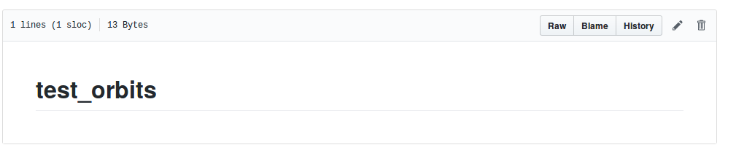
Do a commit through your repository web page.
Pull your web page commits to your laptop.
On your repository type:
$ git pull

Slide 18
Definitions:
Branch: Temporary version of your code in which you can do tests of a new feature.
Fork / Pull request: Your own copy of a repository, that you can edit and merge changes back (with permission), and you can receive changes from the master repository.
(stackoverflow)
Clone: Local copy of a repository you can’t merge back (unless you own the repository) but you can receive changes from the master repository.

Slide 19
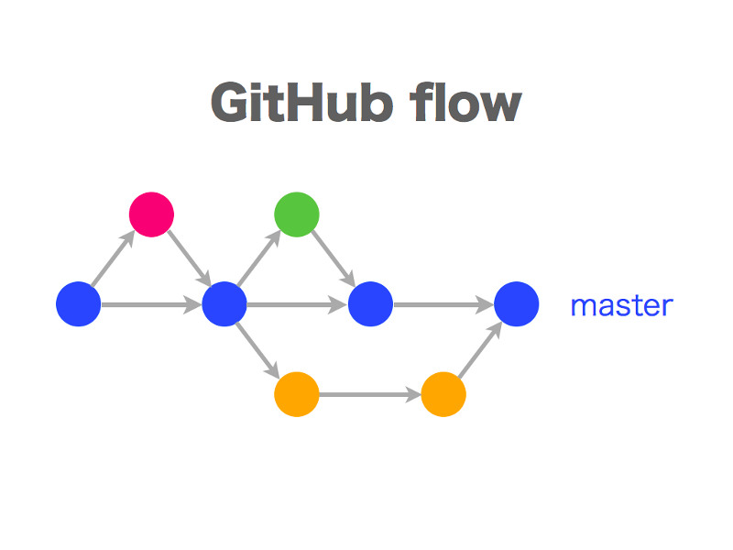
8. Branches

Slide 20
Creating a branch:
$ git branch branch-name #Create new branch
$ git checkout branch-name #Move to new branch
$ git branch # Tells you which branch
Do some changes in the editing branch and commit those changes:
$ git add debugged_code.py
$ git commit -m ‘fixed bug in ... ’
$ git push origin branch-name
Merging the editing branch with the master branch:
$ git checkout master #Move to master branch
$ git merge branch-name # Merge branches
$ git push
$ git branch -d branch-name #Delete branch-name
$ git push origin --delete branch-name

Slide 21
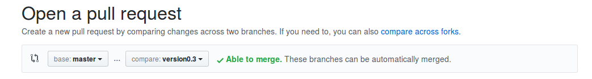
9. Pull requests:
1. Create a branch.
2. Do some edits to the branch.
3. Go to your repository on github.
4. Click on New Pull Request

Slide 22
10. Collaborating
a) You are part of the team.
- Add a colleague to your repository.
- Clone the repository.
- Do your edits.
- Commit your edits / pull requests.
b) You are not part of the team.
- Fork or clone the repository.
- Do your edits.
- Commit your edits and make a pull request.

Slide 23
Good practices:
1. Document your repository.
2. Before working always: $git pull
3. Use descriptive comments in your commits, avoid ‘update’
4. Cite and acknowledge others code in your code and repository.
5. Add a License to your repository.

Slide 24
Useful links
Github help web page is very complete:
https://help.github.com/
Git documents are very complete and easy to read:
https://git-scm.com/doc
A 15 min interactive tutorial:https://try.github.io/levels/1/challenges/1
Merging issues:
used git mergetool: https://www.git-scm.com/docs/git-mergetool

