Slide 1
AUTOSAR (AUTomotive Open System ARchitecture)
khang.nguyen@banvien.com
https://www.renesas.com/en-in/solutions/automotive/technology/autosar/autosar-layerdarch.html

Slide 2
Concept and goals
AUTOSAR provides a set of specifications that describes basic software modules, defines application interfaces and builds a common development methodology based on standardized exchange format. Basic software modules made available by the AUTOSAR layered software architecture can be used in vehicles of different manufacturers and electronic components of different suppliers, thereby reducing expenditures for research and development and mastering the growing complexity of automotive electronic and software architectures

Slide 3
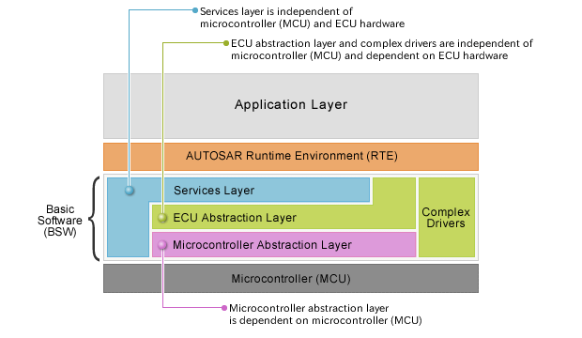
Software architecture
AUTOSAR uses a three-layered architecture:
Basic Software
Runtime environment
Application Layer

Slide 4
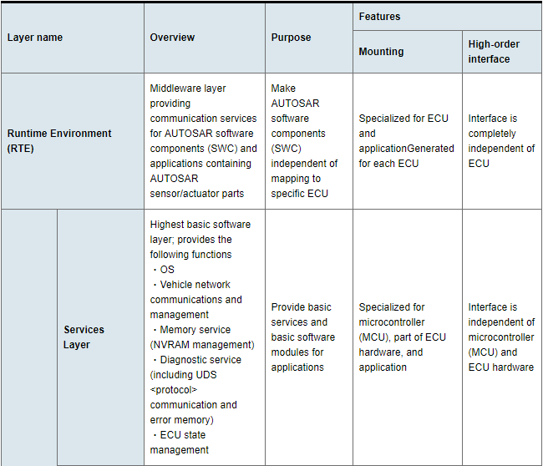

Slide 5
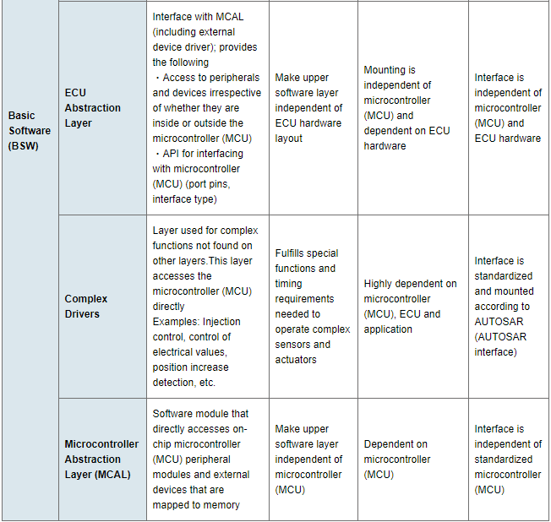

Slide 6
Three Key AUTOSAR Features
- AUTOSAR is a development process that increases automotive software reusability, enables stable quality and reliability, and reins in software-related costs. AUTOSAR has three key features.
Layered Architecture
AUTOSAR Methodology
Application Interface

Slide 7
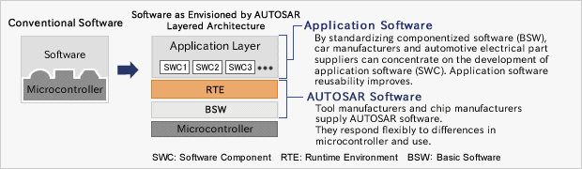
AUTOSAR Methodology
In AUTOSAR, software is componentized and application software reusability is improved.

Slide 8
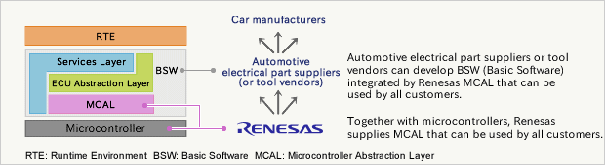
MCAL

