Slide 1
RV850
Real-Time Operating System
User’s Manual: Functionality
Khang.nguyen@banvien.com

Slide 2
Overview
The RV850 is real time multitasking OS developed with the aim of providing an efficient real-time process and multitasking environment, and for enlarging the arena of embedded control application running on the target devices.

Slide 3
Task State
RUNNING State
WAITING State
SUSPENDED State
READY State
SUSPENDED state: In this state, the task is under the management of the RV850, but it is not subject to scheduling.
READY state: In this state, the task is subject to RV850 scheduling, but it is waiting for allocation of the processor, because another task's process is currently running.
RUNNING state: State in which the processor have been allocated to the task, and is currently being processed. Only one task can be in the running state at one time in the whole system.
WAITING state: Tasks transition to this state when the conditions required to continue processing as a task are not met.

Slide 4
Tasks
Tasks are processing routines that are not executed unless the state is manipulated using a system service, or if conditions defined in a CF file are met.
The basic form for coding a task in the C language is shown below.
TASK ( OsTask ) {
..................
..................
}

Slide 5
Interrupt Service Routines
#pragma ghs interrupt
ISR ( OsIsr ) {
..................
..................
return;
}

Slide 6
RESOURCE MANAGEMENT
- The RV850 provides resource management facilities as a mechanism for achieving mutual exclusion. Resources are exclusively controlled using "priority ceiling protocols", and racing over resources by tasks or interrupt service routines (category 2) that use the limited number of shared resources (data, peripheral devices, common functions, etc.) or deadlocks can be prevented
- The RV850 supports three types of resource:
Normal resources: These resources can be acquired and released dynamically by issuing GetResource and ReleaseResource
Internal resources: These resources are allocated automatically by the RV850 when the task state changes from READY to RUNNING.
Linked resources: These resources inherit properties (ceiling values and OS-Application identifiers) from another resource.

Slide 7
Ceiling Values
A ceiling value is a priority assigned to the interval between the acquisition and release of a resource by a processing program (task or interrupt service routine).
Priorities range: 0 – 29, INTPRI0 - INTPRI5

Slide 8
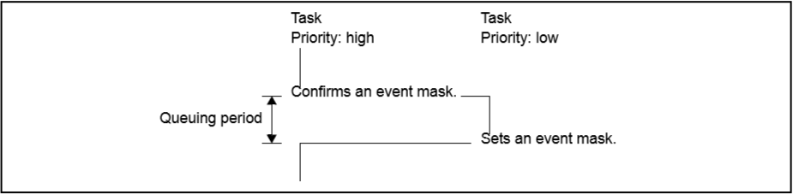
EVENT MANAGEMENT
The RV850 provides event management functions as a mechanism for queuing tasks that are waiting to execute a process until another task outputs the results of its processing
- In the RV850, the distinction between a basic task and an extended task is based on whether an event has been assigned (whether Event identifier "OsTaskEventRef" has been defined).
- In the RV850, the maximum number of events that can be assigned to an extended task is 32.

Slide 9
COUNTER MANAGEMENT
The RV850 provides counter management functions as a mechanism to perform processing in accordance with the number of times an application specific trigger has occurred, and supports two types of counter.
Software counters: The count value is updated when the system service "IncrementCounter" is called from a processing program.
Hardware counters: The count value is updated when an interrupt occurs corresponding to the Exception code "OsCounterExceptionCode" defined in the Counter information.

Slide 10
ALARM MANAGEMENT
The RV850 provides alarm management functions as a mechanism to perform processing in synchronization with the change of counter values
Alarm Callback
ALARMCALLBACK ( OsAlarmCallbackName ) {
..................
..................
return;
}

Slide 11
SCHEDULE TABLE MANAGEMENT
The RV850 provides schedule table management functions as a mechanism to perform processing in synchronization with the change of counter values
RUNNING State
STOPPED State
NEXT State

Slide 12
Schedule table states
STOPPED state In this state, the schedule table is under the management of the RV850, but it is not subject to schedule counting.
NEXT state In this state, the schedule table specified in parameter ScheduleTableID_To is to be shifted from STOPPED state due to issuance of NextScheduleTable. A schedule table is shifted from NEXT state to RUNNING state at the timing of when the schedule table (schedule table specified in parameter ScheduleTableID_From) currently in RUNNING state has completed schedule counting.
RUNNING state In this state, the schedule count is running.

Slide 13
OS-APPLICATION MANAGEMENT
The RV850 provides OS-Application management functions as a mechanism to group objects (e.g. tasks and counters) used on the system and provide access protection (disables or enables manipulation of objects when system services are issued).
Note that objects are grouped in individual OS-Applications. Access protection is implemented by allowing unconditional access to objects belonging to the same OS-Application and granting individual access to objects belonging to other OSApplications using OS-Application identifier "OsTaskAccessingApplication", OS-Application identifier "OsCounterAccessingApplication", etc.

Slide 14
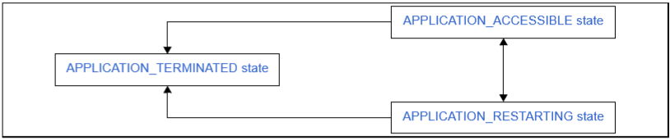
OS-APPLICATION MANAGEMENT
Reliability: In the RV850, OS-Applications are divided into the following two types.
Trusted OS-Applications
Non-Trusted OS-Applications
States

Slide 15
OS EXECUTION MANAGEMENT
In the RV850, six types of hook routines with different usages are supported as common hook routines.
StartupHook: This is a dedicated hook routine for initialization processing that is called when StartOS is issued from a processing program. The basic form for coding StartupHook in the C language is shown below
void StartupHook ( void ) {
..................
..................
}
ShutdownHook This is a dedicated hook routine for shutdown processing that is called when ShutdownOS is issued. The basic form for coding ShutdownHook in the C language is shown below.

Slide 16
OS EXECUTION MANAGEMENT
The RV850 provides OS execution management functions as a mechanism to perform processing when the RV850 starts up and shuts down

Slide 17



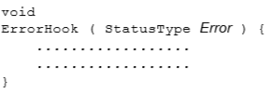

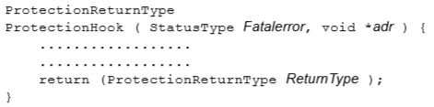
Common Hook Routines
StartupHook This is a dedicated hook routine for initialization processing that is called when StartOS is issued from a processing program.
ShutdownHook This is a dedicated hook routine for shutdown processing that is called when ShutdownOS is issued.
PostTaskHook
PreTaskHook
ErrorHook
ProtectionHook

Slide 18

Idle Handler
This is a routine dedicated to idle processing that is extracted for effectively using the low-power support function provided in target devices. It is called from the Scheduler when there are no tasks (READY state or RUNNING state tasks) targeted for RV850 scheduling.

Slide 19
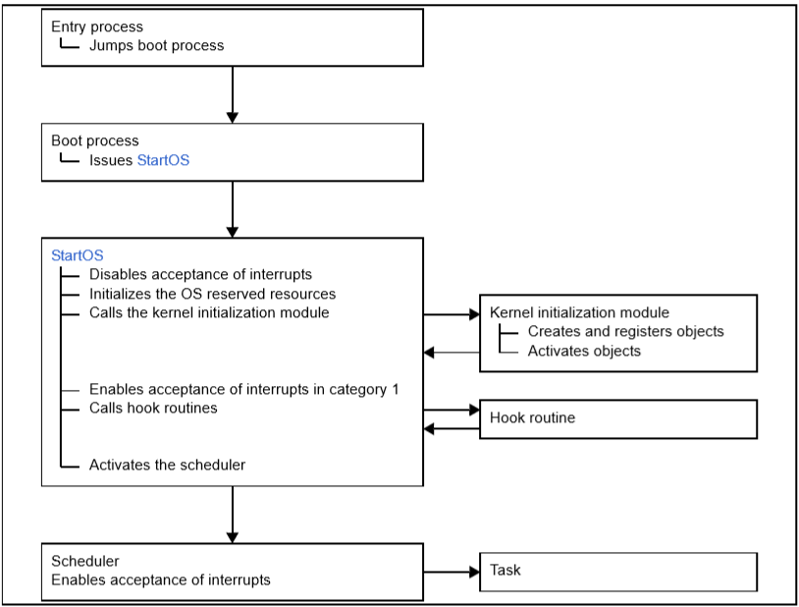
SYSTEM INITIALIZATION

Slide 20
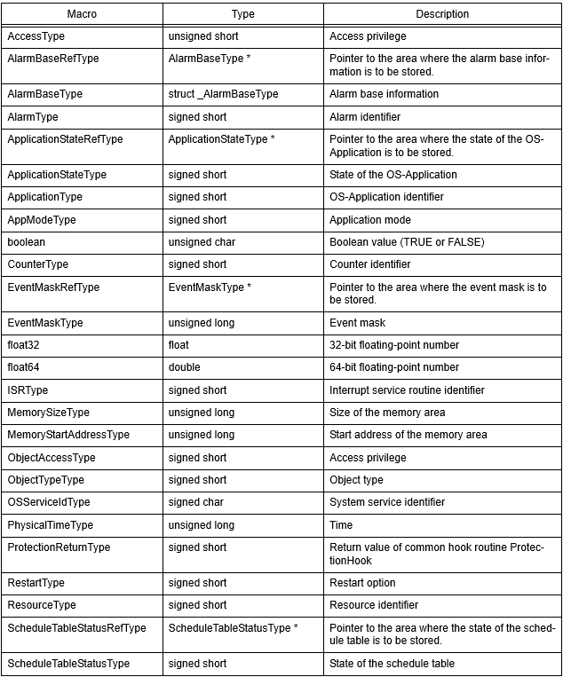
Data types The data types are defined in the header file "Os_types.h" that is called from standard header file "Os.h".

Slide 21
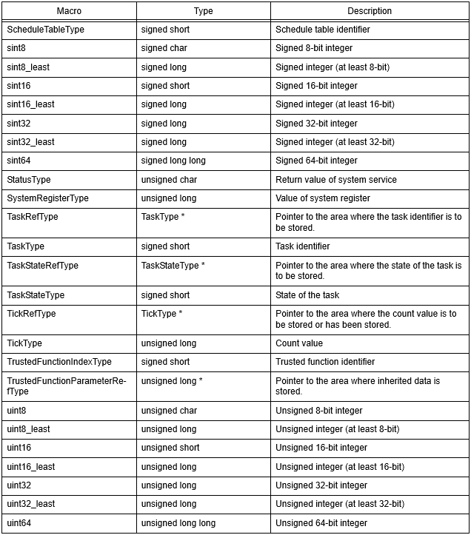
Data types(Cont.)

Slide 22
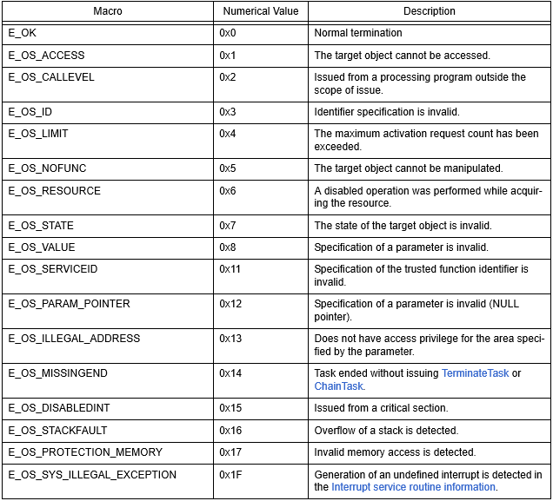
Error status Below are the macros corresponding to the return values (error status) from system services. The error status is defined in the header file "Os_error.h" that is called from standard header file "Os.h".

Slide 23
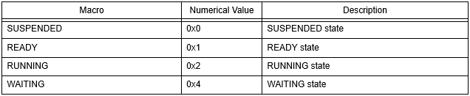
Invalid task identifier
Task States

Slide 24


Schedule table states
Exit with error

Slide 25
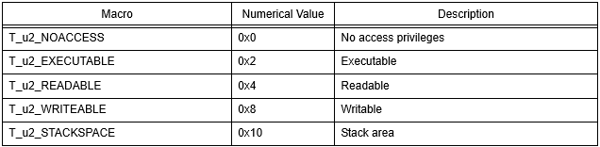
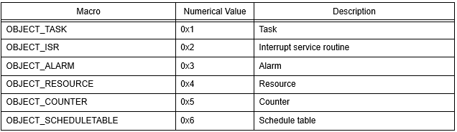
Access privilege types
Object types

Slide 26

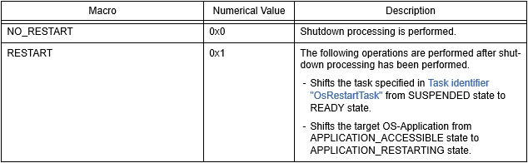
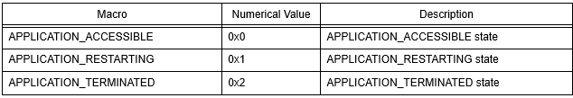
Checking for access privileges
Restart options
State of OS-Application

Slide 27
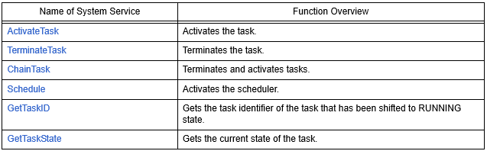
Task management The following shows the system services for task management provided by the RV850

Slide 28
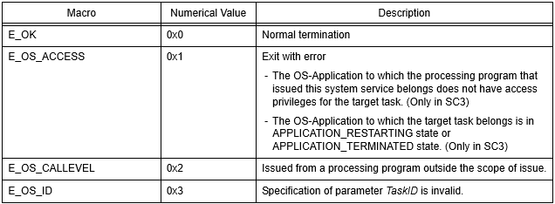
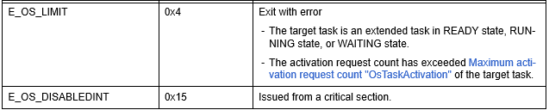
ActivateTask Activates the task.
[Syntax] StatusType ActivateTask ( TaskType TaskID );
[Function]: Shifts the target task (the task specified in parameter TaskID) from SUSPENDED state to READY state
[Return values]

Slide 29
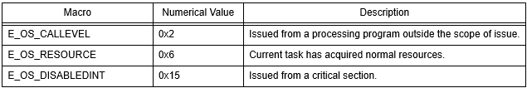
TerminateTask Terminates the task.
[Syntax] StatusType TerminateTask ( void );
[Function] Shifts the current task (the task that issued this system service) from RUNNING state to SUSPENDED state
[Return values]

Slide 30
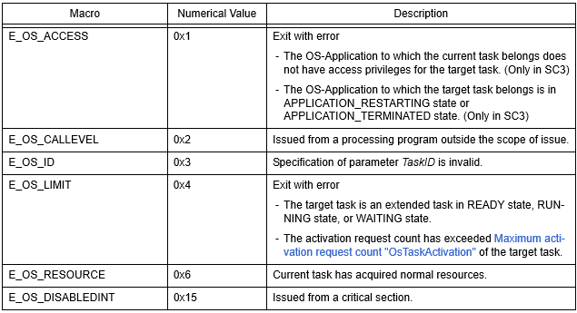
ChainTask Terminates and activates tasks.
[Syntax] StatusType ChainTask ( TaskType TaskID )
[Function] Shifts the current task (the task that issued this system service) from RUNNING state to SUSPENDED state and shifts the target task (the task specified in parameter TaskID) from SUSPENDED state to READY state.
[Return values]

Slide 31
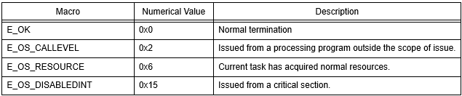
Schedule Activates the scheduler.
[Syntax] StatusType Schedule ( void );
[Function] Activates the scheduler
[Return values]

Slide 32
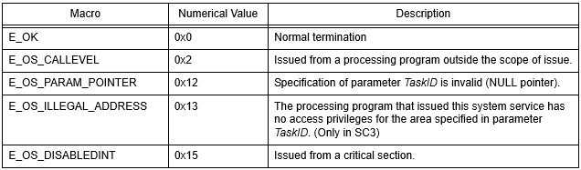
GetTaskID Gets the task identifier of the task that has been shifted to RUNNING state.
[Syntax] StatusType GetTaskID ( TaskRefType TaskID )
[Function] Gets the task identifier of the target task (the task that changes to RUNNING state when this system service is issued) and stores it in the area specified in parameter TaskID
[Return values]

Slide 33
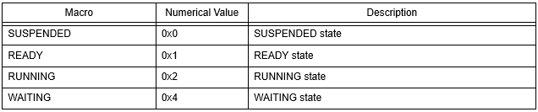
GetTaskState Gets the current state of the task.
[Syntax] StatusType GetTaskState ( TaskType TaskID, TaskStateRefType State );
[Function] Gets the current state of the target task (the task specified in parameter TaskID) and stores it in the area specified in parameter State.
The value stored in parameter State depends on the type of the current state, as shown below

Slide 34
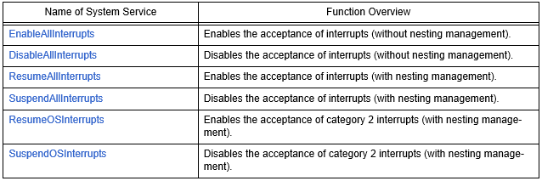
Interrupt handling

Slide 35

Resource management
GetResource: Acquires the target resource (the resource specified in parameter ResID). In this system service, a resource is acquired (the target resource is occupied between issuance of this system service and issuance of ReleaseResource) and the current priority is changed.
StatusType GetResource ( ResourceType ResID );
ReleaseResource: Releases the target resource (the resource specified in parameter ResID). In this system service, a resource is released (the occupied target resource is released between issuance of GetResource and issuance of this system service) and the current priority is changed.
StatusType ReleaseResource ( ResourceType ResID );

Slide 36
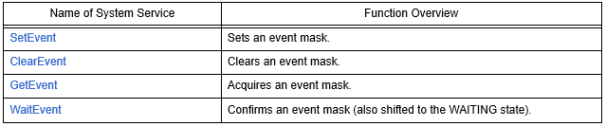
Event management
SetEvent: Sets the event mask specified in parameter Mask to the event (32-bit width) assigned to the target task (the extended task specified in parameter TaskID).
StatusType SetEvent ( TaskType TaskID, EventMaskType Mask );
ClearEvent: Clears the current pattern of the event (32-bit width) assigned to the current task (the extended task that issued this system service), using the event mask specified in parameter Mask.
StatusType ClearEvent ( EventMaskType Mask );
GetEvent: Gets the current pattern of the event assigned to the target task (the task specified in parameter TaskID), and stores it in the area specified in parameter Event.
StatusType GetEvent ( TaskType TaskID, EventMaskRefType Event );
WaitEvent: Checks whether the current pattern of the event assigned to the current task (the task that issued this system service) meets the conditions of the request pattern specified in parameter Mask.
StatusType WaitEvent ( EventMaskType Mask );

Slide 37
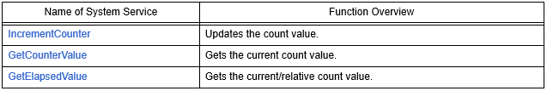
Counter management
IncrementCounter: Increments the target counter (software counter specified by parameter CounterID, unit: tick) by 0x1.
StatusType IncrementCounter ( CounterType CounterID );
GetCounterValue: Gets the current count value (unit: tick) of the target counter (counter specified by parameter CounterID), and stores it in the area specified by parameter Value.
StatusType GetCounterValue ( CounterType CounterID, TickRefType Value );
GetElapsedValue: Gets the current count value (unit: tick) of the target counter (counter specified by parameter CounterID), and stores that current count value in the area specified by parameter Value. Also, the difference between the starting count value (unit: tick) specified in parameter Value and the current count value (relative count value, unit: tick) is stored in the area specified by parameter ElapsedValue.
StatusType GetElapsedValue ( CounterType CounterID, TickRefType Value, TickRefType ElapsedValue );

Slide 38
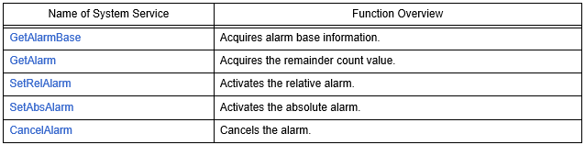
Alarm management
GetAlarmBase: Gets the alarm base information (Maximum count value "OsCounterMaxAllowedValue", Minimum cycle value "OsCounterMinCycle", and Basic count value "OsCounterTicksPerBase" of the counter associated with the target alarm) for the target alarm (alarm specified in parameter AlarmID), and stores it in the area specified by parameter Info.
StatusType GetAlarmBase ( AlarmType AlarmID, AlarmBaseRefType Info );
GetAlarm: Gets the remainder count value (unit: tick) until expiry conditions of the target alarm (alarm specified in parameter AlarmID) are met, and stores it in the area specified by parameter Tick
StatusType GetAlarm ( AlarmType AlarmID, TickRefType Tick );
SetRelAlarm: Sets the expiry conditions specified by parameters increment and cycle in the target alarm (alarm specified in parameter AlarmID) and switches the target alarm from the inactive state to the active state.
StatusType SetRelAlarm ( AlarmType AlarmID, TickType increment, TickType cycle );
SetAbsAlarm: Sets the expiry conditions specified by parameters start and cycle in the target alarm (alarm specified in parameter AlarmID) and switches the target alarm from the inactive state to the active state
StatusType SetAbsAlarm ( AlarmType AlarmID, TickType start, TickType cycle );
CancelAlarm: Shifts the target alarm (alarm specified in parameter AlarmID) from the active state to the inactive state.
StatusType CancelAlarm ( AlarmType AlarmID );

Slide 39
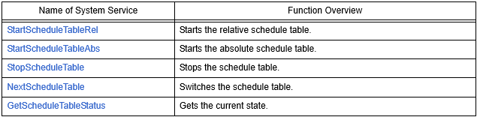
Schedule table management
StartScheduleTableRel: Shifts the target schedule table (the relative schedule table specified in parameter ScheduleTableID) from STOPPED state to RUNNING state.
StatusType StartScheduleTableRel ( ScheduleTableType ScheduleTableID, TickType Offset );
StartScheduleTableAbs: Shifts the target schedule table (the absolute schedule table specified in parameter ScheduleTableID) from STOPPED state to RUNNING state
StatusType StartScheduleTableAbs ( ScheduleTableType ScheduleTableID, TickType Start );
StopScheduleTable: Shifts the target schedule table (the schedule table specified in parameter ScheduleTableID) from RUNNING state or NEXT state to STOPPED state.
StatusType StopScheduleTable ( ScheduleTableType ScheduleTableID );
NextScheduleTable: Switches from the schedule table specified by parameter ScheduleTableID_From to the schedule table specified by parameter ScheduleTableID_To.
StatusType NextScheduleTable ( ScheduleTableType ScheduleTableID_From, ScheduleTableType ScheduleTableID_To );
GetScheduleTableStatus: Gets the current state of the target schedule table (the schedule table specified in parameter ScheduleTableID), and stores it in the area specified in parameter ScheduleStatus.
StatusType GetScheduleTableStatus ( ScheduleTableType ScheduleTableID, ScheduleTableStatusRefType ScheduleStatus );

Slide 40
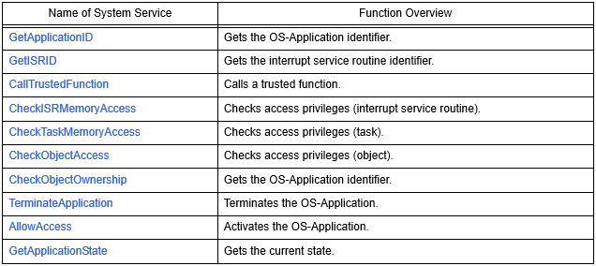
OS-Application management
GetApplicationID: Gets the identifier of the target OS-Application (the OS-Application to which the processing program that issued this system service belongs), and returns the OS-Application identifier
ApplicationType GetApplicationID ( void );
GetISRID: Gets the identifier of the target interrupt service routine (the interrupt service routine that issued this system service, or the interrupt service routine that called the hook routine that issued this system service), and returns the interrupt service routine identifier.
ISRType GetISRID ( void );

Slide 41
OS-Application management(Cont.)
CallTrustedFunction: Calls the target trusted function (the trusted function specified in parameter FunctionIndex). When a trusted function is called from processing of this system service, the value specified in parameter FunctionIndex is passed as the first argument to the trusted function and the value (pointer) specified in parameter FunctionParams is passed as the second argument to the trusted function
StatusType CallTrustedFunction ( TrustedFunctionIndexType FunctionIndex, TrustedFunctionParameterRefType FunctionParams );
CheckISRMemoryAccess: Checks whether the target interrupt service routine (the interrupt service routine specified in parameter ISRID) has access privileges for the target memory area (the memory area specified by parameters Address and Size) and whether the target memory area is a stack area, and returns a value indicating the results.
AccessType CheckISRMemoryAccess ( ISRType ISRID, MemoryStartAddressType Address, MemorySizeType Size );
CheckTaskMemoryAccess: Checks whether the target task (the task specified in parameter TaskID) has access privileges for the target memory area (the memory area specified by parameters Address and Size) and whether the target memory area is a stack area, and returns a value indicating the results.
AccessType CheckTaskMemoryAccess ( TaskType TaskID, MemoryStartAddressType Address, MemorySizeType Size );
CheckObjectAccess: Checks whether objects (tasks, interrupt service routines, alarms, etc.) belonging to the target OS-Application (the OSApplication specified in parameter ApplID) have access privileges for the object specified by parameters ObjectType and ObjectID, and returns a value indicating the result
ObjectAccessType CheckObjectAccess ( ApplicationType ApplID, ObjectTypeType ObjectType, <Object>Type ObjectID );

Slide 42
OS-Application management(Cont.)
CheckObjectOwnership: Gets the identifier of the OS-Application to which the target object (the object specified by parameters ObjectType and ObjectID) belongs, and returns a value indicating the result.
ApplicationType CheckObjectOwnership ( ObjectTypeType ObjectType, <Object>Type ObjectID );
TerminateApplication: Executes the operation specified in parameter RestartOption for the target OS-Application (the OS-Application specified in parameter Application).
StatusType TerminateApplication ( ApplicationType Application, RestartType RestartOption );
AllowAccess: Shifts the target OS-Application (the OS-Application to which the processing program that issued this system service belongs) from APPLICATION_RESTARTING state to APPLICATION_ACCESSIBLE state.
StatusType AllowAccess ( void );
GetApplicationState: Gets the current state of the target OS-Application (the OS-Application specified in parameter Application) and stores it in the area specified in parameter Value
StatusType GetApplicationState ( ApplicationType Application, ApplicationStateRefType Value );

Slide 43
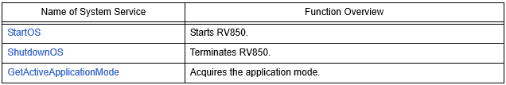
OS execution management
StartOS: Executes the startup processing for the RV850
void StartOS ( AppModeType Mode );
ShutdownOS: Executes the termination processing for the RV850
void ShutdownOS ( StatusType Error );
GetActiveApplicationMode: Gets the application mode that was specified in parameter OsAppMode in StartOS, and returns the application mode
AppModeType GetActiveApplicationMode ( void );

Slide 44
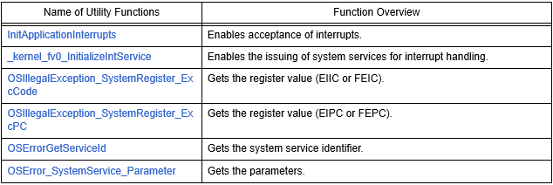
Utility functions

Slide 45
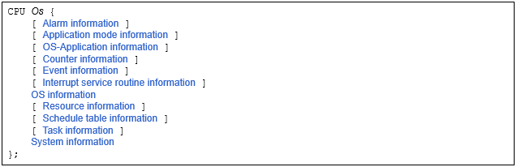
Configuration Information(CI)
CPU

Slide 46
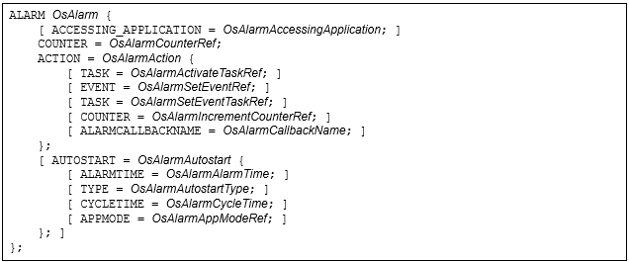
Configuration Information(CI)(Cont.)
Alarm
Application mode information

Slide 47
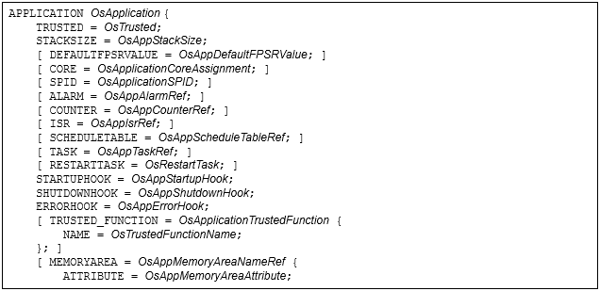
Configuration Information(CI)(Cont.)
OS-Application information

Slide 48
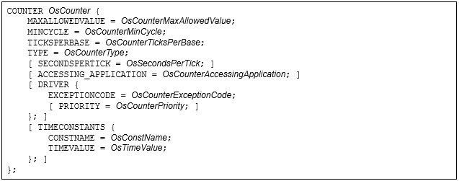
Configuration Information(CI)(Cont.)
Counter information
Event information

Slide 49
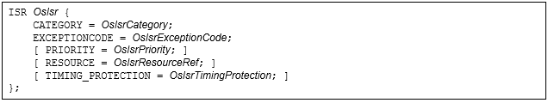
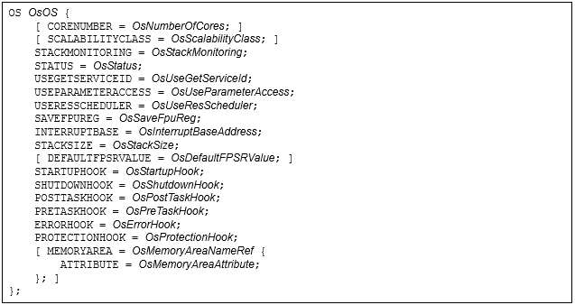
Configuration Information(CI)(Cont.)
Interrupt service routine information
OS information

Slide 50
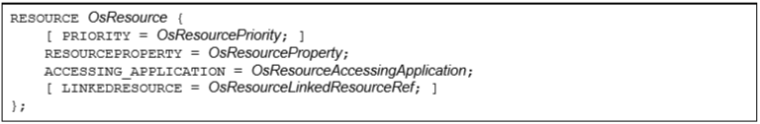
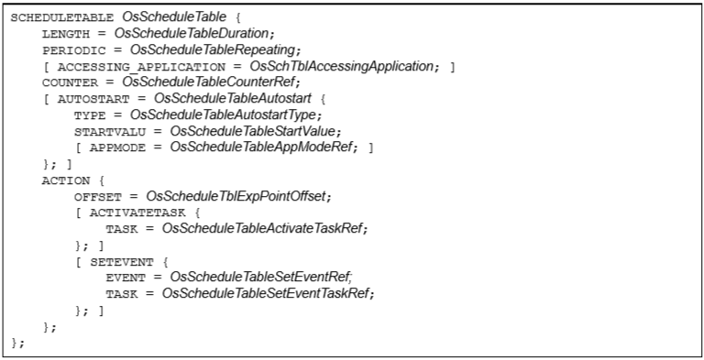
Configuration Information(CI)(Cont.)
Resource information
Schedule table information

Slide 51
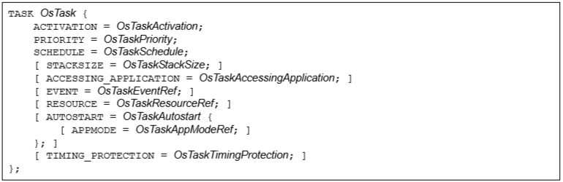
Configuration Information(CI)(Cont.)
Task information

Slide 52
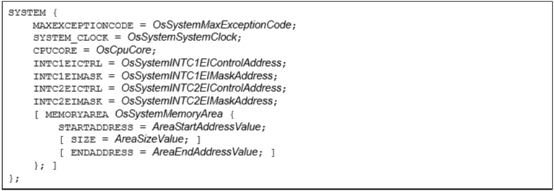
Configuration Information(CI)(Cont.)
System information

Slide 53
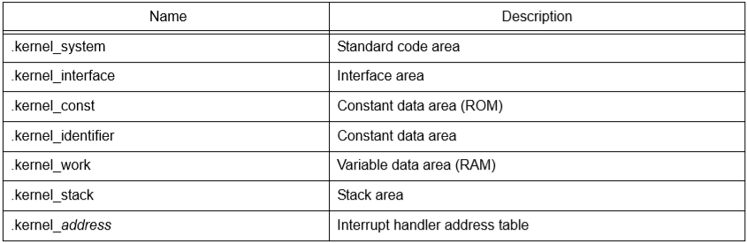
MEMORY FOOTPRINT

