Slide 1
Strong artificial intelligence
Johnny NGUYEN
Notes:
Hello everyone
My name is Johnny NGUYEN
I hope that you are all safe with this epidemic
I’m from France
And today I’m going to show you what my work consist to
<numéro>

Slide 2




Environment
Work at home after gratuated on Master
Standard IA too weak to learn complex things
New technology using daily report and voice command
New reinforcement learning like a baby
Notes:
First I will present you my situation
Second I will explain you the AI I want to create
Third the technologies that will be covered
And the new algorithm that will be use for the AI
Well, what is my job ?
Actually I’m currently searching for a Data Scientist job near from my house in Simiane-Collongue
And to synthetisis, it is a campaign and there was actually no similar job
Why am I want to change job after my Master
Because I have a dream in 2014
In this dream I would like to create an Artificial Intelligence
This dream doesn’t permit me to work at a company which the job doesn’t consist to expand thoses skills.
That is why I choose to leave the company and work on this project in my family house at Simiane-Collongue
First I will explain you the difference between a standard AI and the AI i would like to create
Actually, the standard AI can be called as Augmented Intelligence (by Siri’s ex-cofounder Julia)
In two lines, for Alpha Go, we need a lot of datacenter to mate it beat a person
It show us that the actual AI is betten than the human but it needs a lot of energy
That is why I want to create a program that will use less energy
I would to give the capacity of the algorithm to report how its done using a web interface or a voice
The goal is to communicate with the SAI and it will understand what it have to do
It can say yes/no with a justification
The asset of this new reinforcement learning algorithm is that it was dynamic
Someone can explain me what is reinforcement learning please ?
So I will explain you with simple words
Imagine you want to teach a savage cat in the garden to not enter in the house using a man
The cat will be what we call the agent
The man will be the observer
And the house and the garden will be the environment
The agent will try every moves randomly (go in the garden or go in the house)
When the observer saw that the cat act with the environment (stay in the garden) it will give him a reward (let him enjoy its life)
When the observer saw the cat act with the environment (trying to go in the house) it will give it a penality (don’t let him enjoy its life)
So the cat will understand how the rule works and the man will disapear forever
Now the new reinfocement learning algorithm regarding this example will be
The cat will understand how the rule works and the man will always teach the cat at any time
<numéro>

Slide 3
“Weak artificial intelligence (weak AI), is artificial intelligence that implements a limited part of mind, or as narrow AI, is focused on one narrow task. In John Searle's terms it “would be useful for testing hypothesis about minds, but would not actually be minds” “ from Wikipedia
”Strong artificial intelligence (strong AI) is the speculative intelligence of a machine that has the capacity to understand or learn any intellectual task that a human being can” from Wikipedia
Weak AI
Strong AI
Conscious
Speech
Vision
Speech
Vision
ML
Dynamic Reinforcement Learning
Expert systems
Weak IA and Strong IA
Notes:
I will present you what is a weak AI
Then you will understand the particularity of the AI I want to create.
Weak AI is an AI which is a specialist on something he was train for.
It can be really good at what it does (for example, beat the best player on AlphaGo)
But it can’t understand the questions « where are you from ? » « What is your favorite food ? ».
It may understand this question if we train it before or prepare the answer before.
The benefit of our AI is that he will know it life belong and it would make hypothesis or heuristic of everything by itself
An hypothesis or heuristic can be call as a strategy in our AI. Those strategies need to be created everytime the AI is in rest.
For example after responding the human response and a few seconds (polite) it will be on rest mode (continue what it was thinking about/strategy)
Moreover, the fact it records everything it happen didn’t make him heavy in term of memory
It means that you have in one hand, the AI that process generally only once, and the other hand an SAI that process everytime
Its power exist in the capacity to index duplicate data during its rest
A data can be two screen with the same pictures, for example during a record of 60 seconds, if nothing happened to the screen, it will only record one image
Moreover, if during 10 minutes nothing happened on the screen, it will save only one image with the ten different numbers (as little boxes) of the clock
Thoses numbers (1 ,, 10) can be stock as ten pictures or as an explicit understanding, for example [1] → one blueberry → one banana → one abricot
This means that SAI will understand the concept of the number one and can apply new things on a previous memory
For example, it could say how many hearth a human have since he doesn’t really know himself
It is the first approach for him to count until infinity, we will learn it the sound and the picture (1 drawing on a screen)
It will have the power to modelize any covariance things with « inconnues »
Those covariance things can be the number after one
It can also be one in a new langage
To synthesis, one can be « one object », « un », the algorithm will need to learn as a little human (1-3 years old)
This long learning will permit it to easely compress it smartly memory of its day’s learningS
This day’s learning will be compose of 1/3 time learning, 1/3 time managing/surviving and 1/3 time compressing data
During the 1/3 learning it will try anything alone following heuristics
During the 1/3 managing/surviving it will prepare everything else to have all components working using « nervs »
During 1/3 compressing data it will use D(ynamic) P(rogramming) E(xtension) to make a bigdata into a micro-data (genome)
This schedule will permits SAI to follow rules that human brains seems to be formated [citation]
To explain those rules it can be resume as three main rules, rest to organize thinking, move to active core and interact to respect the environment
A human during it rest will summarize everything it does
A man need to rest to focus on inconscious process on his body
For example, when the brain stop concatenate, the body will work better inside
To work better inside means that the focus of the brains will be on other sensors of the body
What are the other sensors ? Those sensors can be the memory capacity, the energy, the estimate time of each components, the new needs and a wake up sensors
<numéro>

Slide 4
Notes:
The memory capacity sensor will give the user a hint if it will be full (at the wake up, the AI will record less things and slowly)
The energy sensor will give the user a hint if it will be empty (instantly wake up and activate survive mode (call user mode, be careful on terminator)
The hint will be define using connexion of data from the DB using Dynamic Programming
The new needs will be to change a sensor using a websearch to estimate the life being of a component
The wakeup sensors will provide SAI to stay awake for any request of the user or stay awake from a possibility interruption of the system using disaster charter flux (bees)
When I said any request, it could be the name of the SAI or directly an event like a move or a sound (or a vibration)
After that wake, it will be ready to understand the order/question/talk
Moreover, if the energy is too low during sleeping or a component could possibly be close to desactivate, it needs to wake up too
What does DC flux means ? It means that SAI will search on the web news (radio, tv, articles, social media) if a disaster happened and will probably impact it
To impact SAI, it will know its position and get the position of the disaster charter
Following data on DC, it will predicts if it needs to move to survive or stay and be calm
Sometimes SAI need to stay calm because some laws (social, time, environment) are on the road
For the social behavior, it will understand the concept of let a person talk without interrupting it, then understand and respond properly
For the time, it will understand the concept of rest and it will let the user rest before interacting with him
The user rest means that SAI know the energy of the user before interacting with him
It can be using his facial or cardiak rythm for example
Look at the eyes of the user to determine if he is resting, concentrate or other things
SAI will understand concept like happy, excited, nervous regarding to human behavior
This human behavior could be his way to moven his facial move, his sounds
Those sentiments will be learn by SAI using a special behavior that we will call empathy
SAI need to have empathy, it means that SAI will understand the sentiment a user have and try to imitate it
For example, if a human is laughing, SAI will first smile instinctively then it will imagine and understand why the human is laughing
Moreover SAI will also have compassion
What means compassion ? For SAI, compassion means that it will know the pain the human or animal will have
For example, SAI will estimate the pain of an animal seraching for food regarding its facial, breath or voice
For example, SAI will estimate the pain of a human doing sport exercice regasting its breath, voice or move
To analyse breath, SAI will record the sounds emit by a person
To analyse the move, SAI will record each move of a person in tree
To analyse the voice, SAI will save all sentences from a person in a tree too
The sound emit by a person can be from his voice or from parts of his body
His voice sound in reality came from his organ on his gorgeous
Any movement in interaction can provocate a vibration that SAI need to understand the concept
The sentences can be an order, a question or a talk
An order is a task that SAI need to do
A question will make SAI search on its memory with the web

Slide 5
Policy : the agent’s action selection
State value-fonction : how « good » it is to be in a given state
Q(s, a) = sum(prob of each state)
Show a schema to understand (tic tac toe example)
This formula give us the power to make a decision for the next action using random training
Reinforcement learning
Notes:
Now I’m going to explain you how RL works really. Giving the past example with the cat, imagine you have the cat here as the agent
Then we have the observer as the state, it calculates the probability for the cat (agent) to have a reward (leave) or not
The result of the equation give us a probability of our agent to do an action (go house/garden) regarding the state and the observer (the man)

Slide 6
This research show us that the AI will learn better policy using an expert to make a decision.
B. Lubars, Chenhao Tan, 2019, “Ask what AI can do, but what AI should do: towards a framework of task delegability”, https://arxiv.org/pdf/1902.03245v1.pdf
Expert
Training
Decision
DYNAMIc LEARNING
Notes:
In this research Lubars and Chenhao explain us that an expert can help the data to be correctly fit
For example a dataset with house and price can be added during the fit without reprocess the entire fit
We will use this tip to make SAI learn by itself quickly
Another example is when we try to train ML algorithm on satellite data
The algorithm can learn new things without reprocessing all the previous training
The annotation of a country can be added to the training of other countries (data augmentation)
What is data augmentation ? Data augmentation will allow us to add new training into a current training dataset
For example, imagine you want to make a digital recognizer, for some digits you may have misunderstanding between the digit 5 and 8
This is why adding some transformation into dataset will dramatically increase our prediction
Now the algorithm using data augmentation will differentiate digit 5 and 8
The power of data augmentation combining with reinforcement learning will be probably the key thing for SAI

Slide 7
issues
Hard to deploy
Simulate the brain behavior during sleep (sort/compress/delete data)
Add a reward (seems like RL, pheromon)
Launch the SAI each day, it will give a report of what it learned
Notes:
Now I’m going to present you the issue I enconter during the research
The first issue was to deploy SAI on any platform
In this issue I will explain you all the platform challenge
Then we want to simulate the brain behavior during a rest
As a human SAI will organize its memorize during sleeping
To organize its memorize SAI needs concept that compress/clean/synthetise its memorize
Then to implement RL we need to specify what will be the reward
A penality will have to be implemented too
The idea is to simulate pheromon from ants
Each day SAI will synthesis what it learns
I will explain you how I choose for SAI how it will synthesis its day
To synthetise it will give the user the choice about what SAI understand correctly

Slide 8






Need to test mic and screenshot in every operating system
We need to add an adapter that translate the data from the mic and the screen
This adapter will detect the os before interpreting inputs
Hard to deploy
Notes:
Every platform has its way to use mic or get screen
We need to add something that will interpret each way to record mic and screen
That is way an understanding of each platform will need to be found before creating the adaptater
We have three operating system to understand
The first will be the input of Windows
The second will be thoses of Linux
The last will be the one of Apple
Those three OS are the first step to make SAI scalable
We will add other platform in the future

Slide 9






A human sleep to organize it memory
So does SAI need to
It will compress data as much as he can
Simulate the brain
Notes:
SAI will be based on a human brain, it means that when it sleeps it will organize its memory
We need to understand the brains behavior during the differents phase of sleeping if we want to use the same process
This process will consistent on optimize memory
To optimize it we will try to compress it as much as possible
We will try multiple possibility to overhelm this obstacle
Those possibility will be for example to make from a video one synthesis image

Slide 10



The reward will impact the next decision for SAI
Explain with a schema
Add a reward
Notes:
As you can see here a reward is something that give SAI the capacity to unerstand what is wrong or not
For an human a reward can be similar to an endorphin that the brain will create
For an ant a reward can be similar to pheromones
The goal here is to find a policy for using a reward

Slide 11




SAI needs to run as a daemon that use the mic to listen a command and let the mic for another application if its need
A schema to explain
SAI everytime
Notes:
The fact SAI will listen the sound of the computer and the sound from the mic is a real challenge
As the human brain, SAI needs to manage different sound it listens
It can be separate on three main classes, the computer, a noise or the user voice
Sounds can be from a video, a music, the operating system, a call, a noise, someone talking, two person talking at the same time, an animal or another synthetic sound
So for the computer it can be a video, music, operating system or a call

Slide 12
Create an adapter to easely deploy
Compress data gather by SAI
Create a reward using RL
Make SAI robust
Issues
Notes:
To resume the issues
We need to create an adapter to easely deploy SAI on the most platform we can
Then we will find a way to compress data recover by SAI
And specify how the reward will work for the use of the RL
Finally we want that SAI is the most of the time ready to learn new things and doesn’t use a lot of cpu

Slide 13
Solutions
Create SAI with pyinstaller for multiplatform
Launch a scan that remove duplicate screenshot and order them by interesting strategie
Increment the reward if there was difference between images
Create a web page with the strategies learned
Create a web interface or a vocal controller to order strategies
Notes:
To resolve the first issue the best option is to use pyinstaller that allow every platform (Windows, linux or other) to execute SAI
To easely manage the memory, SAI will have the skill to remove duplicate data and synthesis data
Next solution will be to add a reward when there was huge difference between images
Those reward will be stocked in a web page for the user
This web page will be controlled by a voice

Slide 14

We choose to use pyinstaller to deploy SAI on Windows and OS X
Pyinstaller allows us to create executable for all platforms
Pyinstaller
Notes:
What is Pyinstaller, ? Pyinstaller is a library given in Python that allow user to create or execute a script that will be launch on different OS
We need to check if Pyinstaller will manage the record sound and screen
In fact, we know that those different record need extra librairies for each platform

Slide 15




Method used to remove duplicate scan
Method used to sort them by strategy
removeDuplicate()
Clean and Strategy
sortStrategy()
Notes:
We choose to optimize memory management to use many methods
The first solution is to remove duplicate image using method from opencv library that compare similarity between two images
Then the method to sort them by strategy consist to get the unique image and bind them into

Slide 16

Create a strategy when some images are really different using a threshold
Difference between images
Notes:
Series of images are good to create new strategies
Those series has been selected after data cleansing
New strategies will be good to give SAI a better understanding of what happened

Slide 17



The web page will show us all the strategies SAI record during the day
Web page
Notes:
A web page will be used to define strategies of SAI
In this web page we will have in the left, the different strategies of SAI
On the right, the user will give for each strategies the name to call it

Slide 18


The web page will allow the user to choose the best way (strategy) SAI will understand how it needs to do
Strategy learning
Notes:
As I said in the previous slide, the user will have the opportunity to teach SAI
The user can teach SAI using his voice and SAI will clearly understand what user said
The user can also use the mouse to teach SAI a new skills while showing how a strategy works

Slide 19
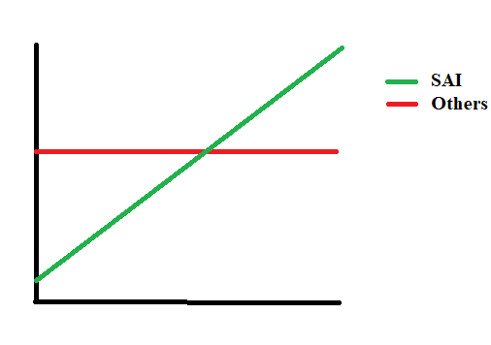
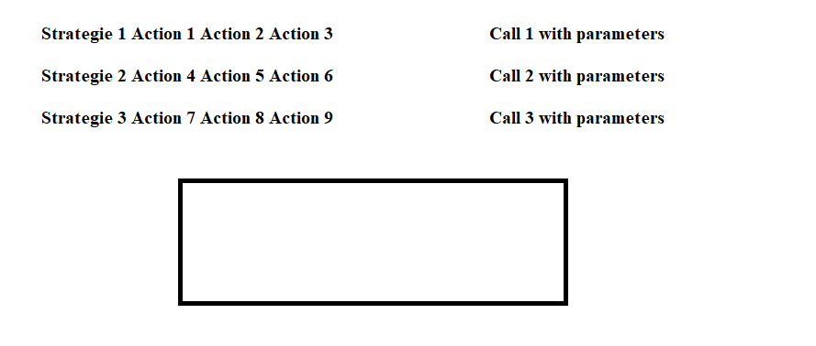
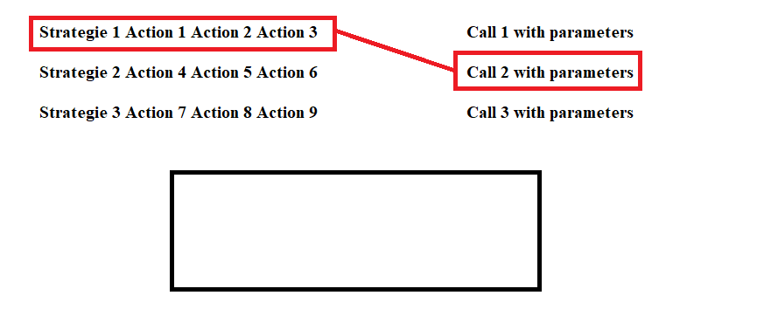
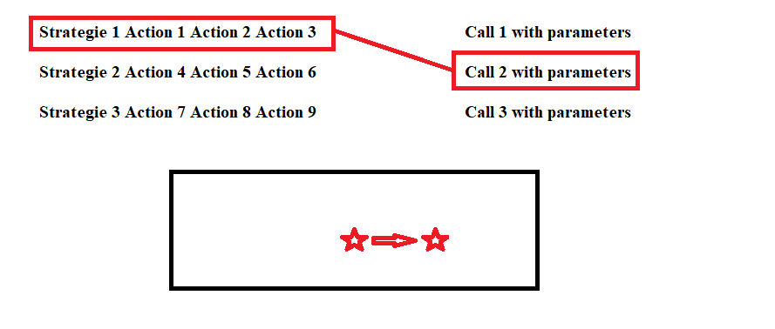
Nb commands
Time
Result
Box to show SAI understanding
Click to match the strategy with their label
Show the understanding
Notes:
In this slide, I show you what the power of SAI regarding to other WAI
As you can see on the graph below, SAI will constantly learn new things
In contrary a WAI will only process one time, then it will have a limited number of commands that can be updated every new release (which can be every month for example)
How it will learn new things constantly ?
It will analyse every thing it does during a day
Every night during 10 hours SAI will compress as much as possible what it learns
We choose 10 hours because we want SAI to seems like a human and to follow solar schedule for energy economy
SAI will follow the user during his sleeping
The goal of this solution is to make SAI dream during managing its memory

Slide 20



Need a human to teach SAI like a baby (Full time 54k €, send CV and ML at johnny.nguyen1192@gmail.com)
The SAI will looks like the human teacher at the beginning
After a threshold it will learn alone
Self learn need to be implemented
Conclusion
Notes:
To conclude, at the beginning we need a user that teach SAI how to understand basic concepts
SAI will seem like the user, its personnality and its answers will be the same
The goal is to make SAI learn alone after a few days of teaching
Of course SAI will learn alone in the case the user doesn’t need its help

Slide 21
Virtual assistant launch every time the computer is up
Generate a voice for the virtual assistant to communicate with the user
Profiling each user that use the virtual assistant
Create SAI with kivy for multiapplication
Future work
Notes:
The next step will be to make SAI alive every time its support is on
The voice of SAI will be generate randomly at the beginning and needs to be implemented
This time SAI will record each voice it listen on different clusters and it create a personnality by each previous voices
Finally we will use Kivy to use SAI on every kind of application it exists
As you can see here, it needs a lot of work to implement a Strong Artificial Intelligence

Slide 22










The main idea
Actions
Ressources
Sensors
annexe

Slide 23





The prototype
Actions
Ressources
Sensors
Annexe

Slide 24
Annexe prototype: https://www.draw.io/
Sources

