Slide 1
Strong artificial intelligence
Johnny NGUYEN

Slide 2
Environment
Work at home after gratuated on Master
Standard IA too weak to learn complex things
New technology using daily report and voice command
New reinforcement learning like a baby

Slide 3
Weak IA and Strong IA
Use definitions
Use schemas

Slide 4
issues
Hard to deploy
Simulate the brain behavior during sleep (sort/compress/delete data)
Add a reward (seems like RL, pheromon)
Launch the SAI each day, it will give a report of what it learned
Sort what SAI learned

Slide 5
Solutions
Create SAI with pyinstaller for multiplatform
Launch a scan that remove duplicate screenshot and order them by interesting strategie
Increment the reward if there was difference between images
Create a web page with the strategies learned
Create a web interface or a vocal controller to order strategies

Slide 6
Result
Show a graph with the strategies learn with a little picture
Show the web interface to choose strategies

Slide 7
Conclusion
Need a human to teach SAI like a baby (Full time 54k €, send CV and ML at johnny.nguyen1192@gmail.com)
The SAI will looks like the human teacher at the beginning
After a threshold it will learn alone
Self learn need to be implemented

Slide 8
Future work
Virtual assistant launch every time the computer is up
Generate a voice for the virtual assistant to communicate with the user
Profiling each user that use the virtual assistant

Slide 9
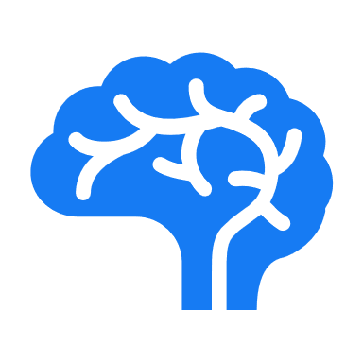









annexe
The main idea
Actions
Ressources
Sensors

Slide 10





Annexe
The prototype
Actions
Ressources
Sensors

Slide 11
Sources
Annexe prototype: https://www.draw.io/

