Slide 1

ATM Usage and Forecasting
Jesse Heaton

Slide 2
The Challenge
Operating a large network of ATMs requires balancing customer demand with operational efficiency. Too many replenishments drive up costs, while too few risk outages and poor customer experience.
Using SQL for data exploration and Python for analysis and visualization, this project focuses on two core questions:
ATM Utilization
Which locations are used most often, and are these placements optimal?
Cash Replenishment
When should ATMs be refilled to avoid running empty while also minimizing costly refills?
The goal is to identify a cost-effective, data-driven strategy for ATM management.

Slide 3
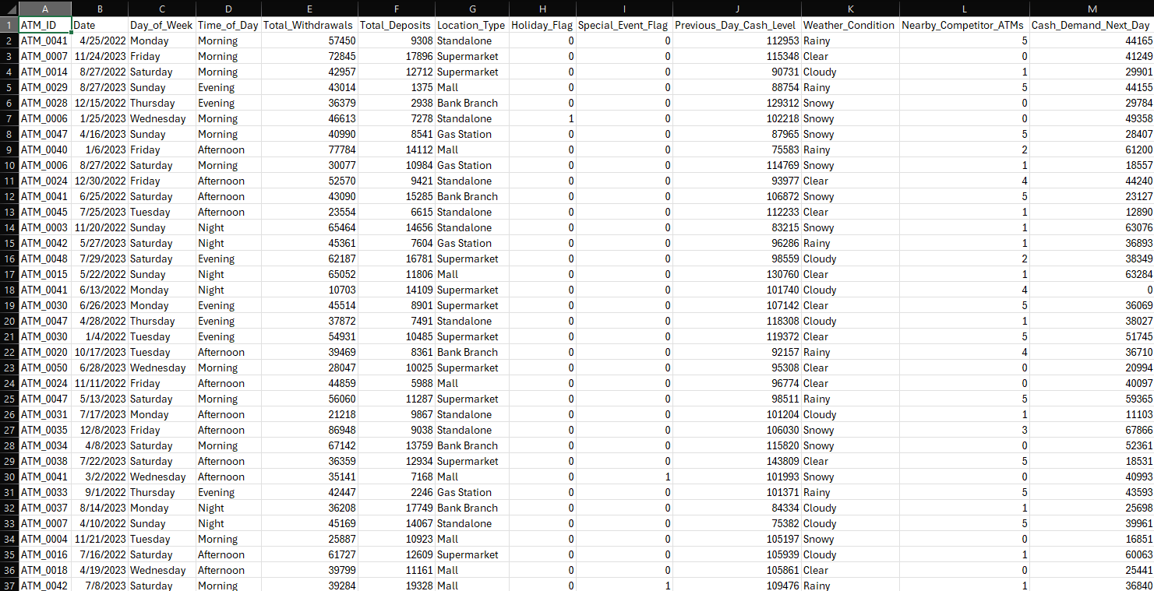
Mock ATM Data Overview
This dataset contains key information about the ATM network, including:
Location type
Daily withdrawals and deposits
Cash demand projections
Special events and holidays
Using SQL, we extract the relevant features needed to drive our analysis and generate actionable insights for ATM placement and cash replenishment.

Slide 4
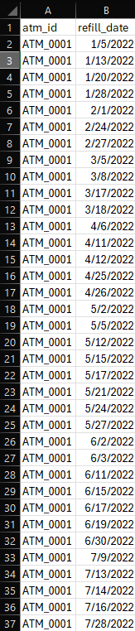
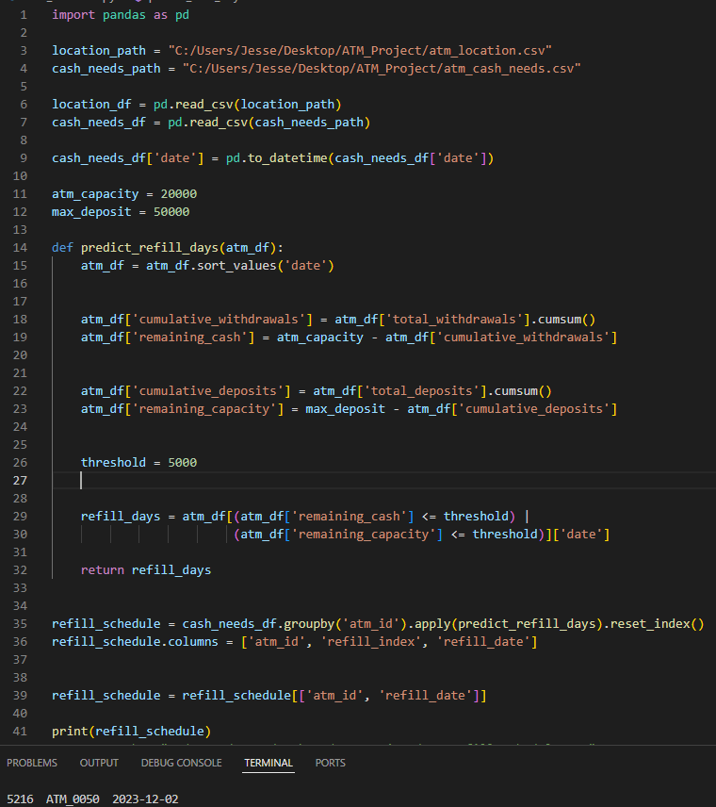
Refill Schedule
Using Python, we analyzed ATM cash flows to identify optimal refill dates.
Refill is triggered when an ATM is running low or approaching full capacity.
This approach reduces unnecessary service visits, lowering operational costs.
Flexible, data-driven scheduling also enhances security compared to fixed weekly refills.

Slide 5
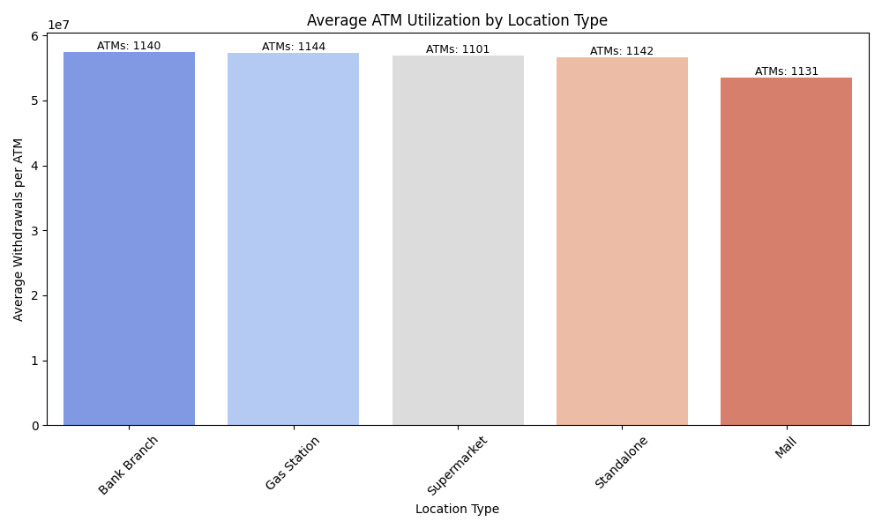
ATM Locations and Placement
Using Python, we analyzed ATM utilization and distribution by location:
Identified how frequently ATMs are used at each site.
Noted lower utilization in mall locations, suggesting potential for relocation or consolidation.
Displayed the number of ATMs per location, providing insight into network density versus demand.

Slide 6
Recommendations
Based on the analysis, we can improve the ATM network in two key ways:
Dynamic Refill Scheduling
Refill ATMs when cash is low or near full capacity.
Reduces unnecessary service visits, lowers costs, and improves security.
Optimize ATM Placement
Malls show lower utilization despite a similar number of ATMs.
Relocating or reducing machines in underused locations can save service hours without affecting overall usage.

Slide 7
Limitations
The analysis is based on a mock dataset, which may not fully reflect real world ATM operations.
Larger datasets with many ATMs may require big data solutions (such as Hadoop or Teradata) to efficiently manage and analyze the data.
Other factors could also influence the results, such as:
Holiday schedules affecting usage/refills
Weather or special events impacting withdrawals and deposits
These variables were not incorporated into the current analysis, so real world implementation may require additional consideration

