Slide 1

Movie Analysis
Joe, Kamryn, and Jacob

Slide 2

Summary
We defined success as profit.
Using things like budget, revenue, profit, and popularity, we determined what a good movie suggestion would be for three budgeting levels of production.

Slide 3
Outline
Business Problem
Data & Methods
Results
Conclusions

Slide 4

Business problem
Microsoft is opening a movie studio
It was our job to analyze our data and create a suggestion for which genre of movie they should make.
We created three budget ranges:
Low (25-75mil)
Medium (75-125mil)
High (125mil+)

Slide 5
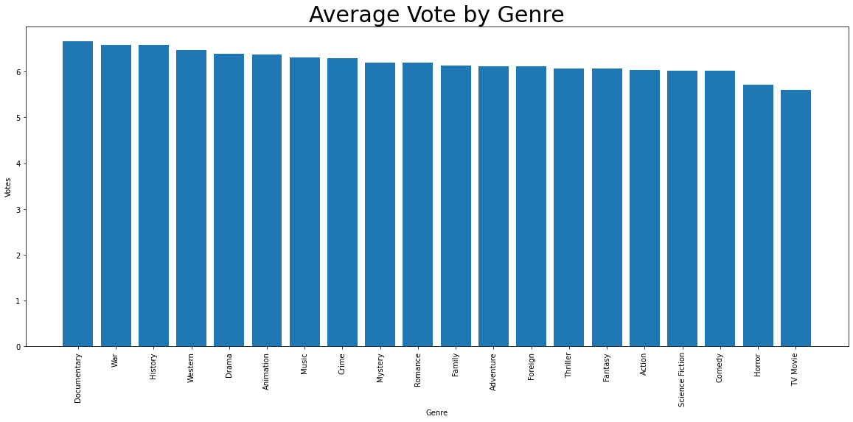
Data & methods

Slide 6
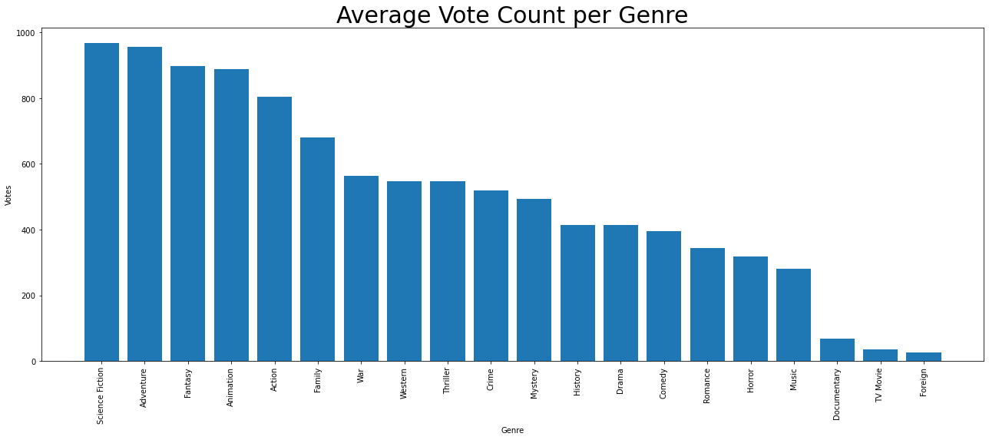
Data & Methods

Slide 7
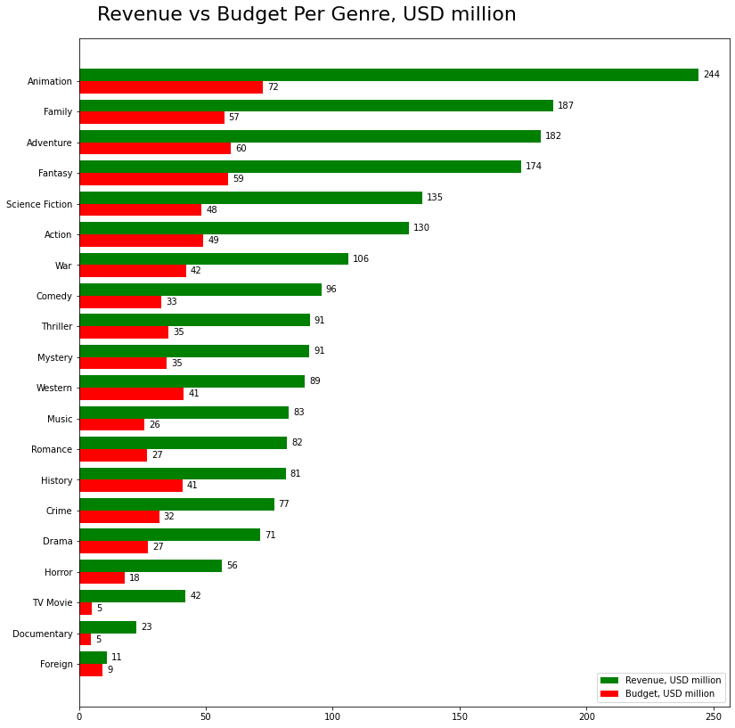
Data & Methods
Average budget and revenue per genre

Slide 8
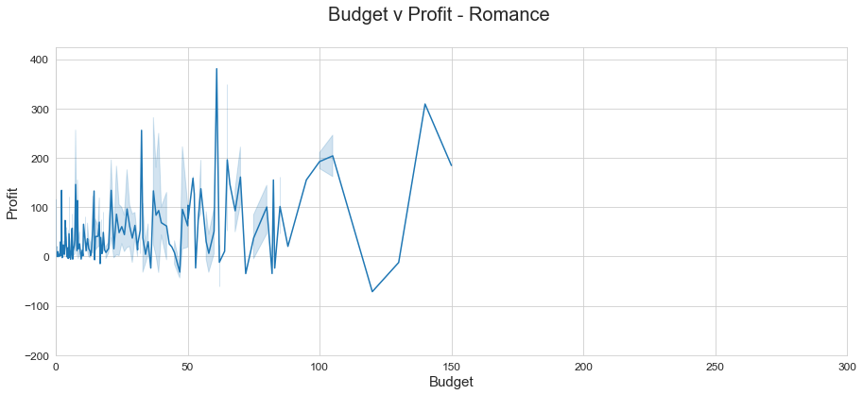
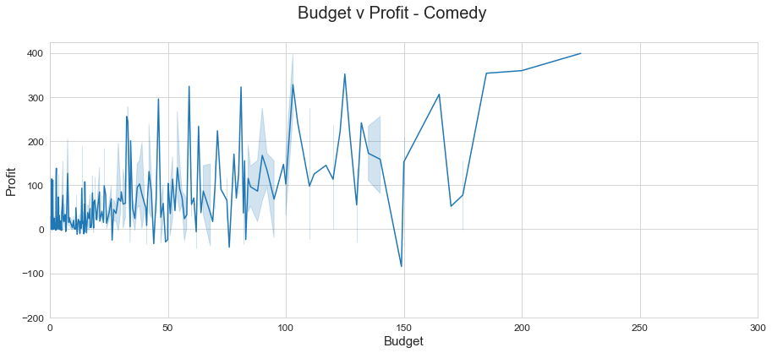
Data & methods
Low budget (25-75 mil)
Budget and Profit values in millions

Slide 9
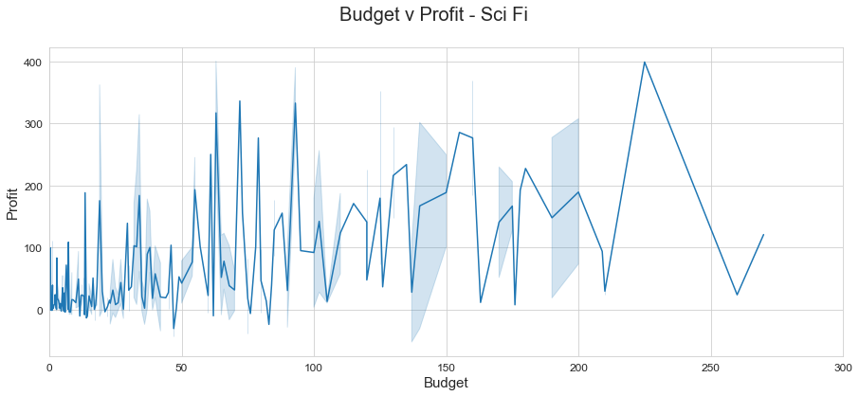
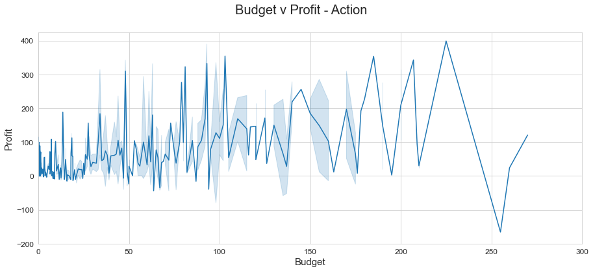
Data & methods
Medium budget (75-125 mil)
Budget and Profit values in millions

Slide 10
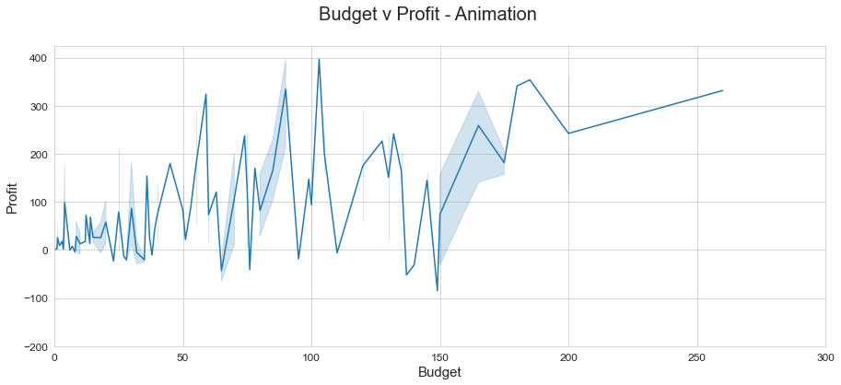
Data & methods
High budget (125+ mil)
Profit and Budget values in millions

Slide 11
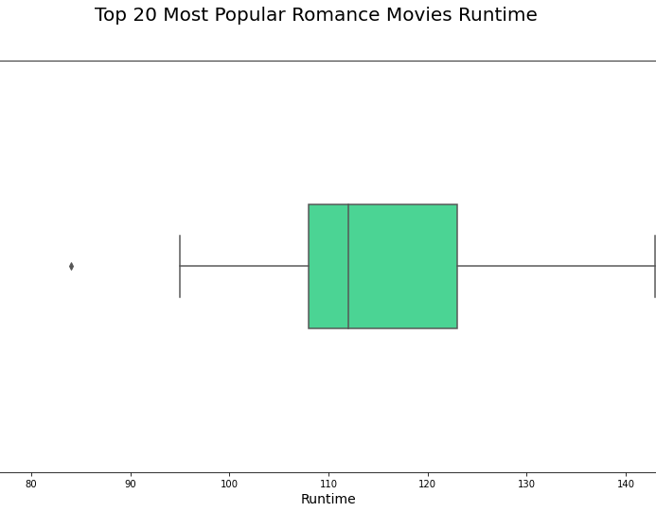
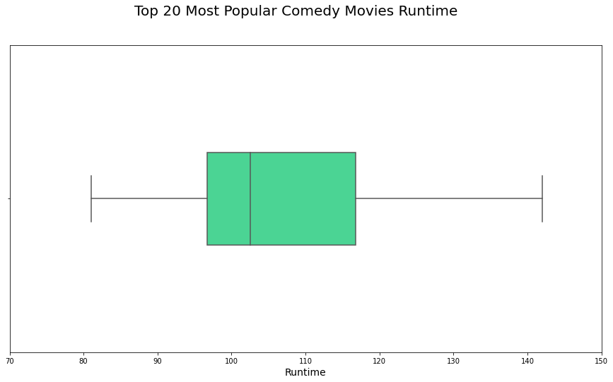
Data & Methods Low Budget (25-75mil)

Slide 12

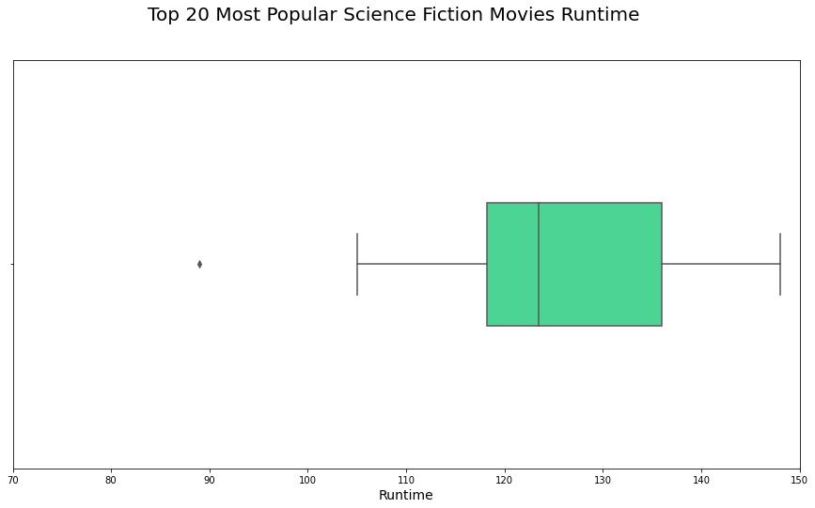
Data & Methods Medium budget (75-125mil)

Slide 13
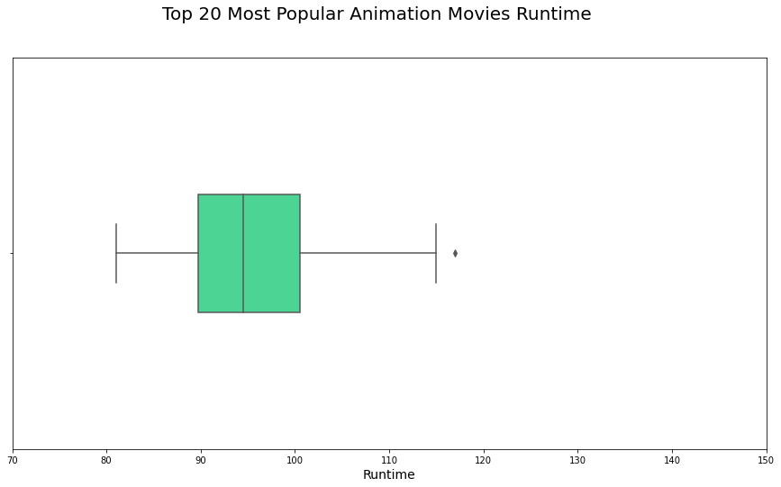
Data & Methods High budget (125mil+)

Slide 14
results
Based on our data, if you want to make a lower budget movie, a romance comedy film is going to be your best bet.
For a more mid-range budget movie, an action-scifi film would be a great option.
Lastly, if you wanted a higher budget movie, animation is the direction you should take.

Slide 15
conclusions
With our suggestions, we are confident you can could produce a profitable and successful movie in your desired budget range.

