Slide 1















$$y_{t}$$
$$c_{t−1}$$
+
+
$$c_{t}$$
Legend:
tanh
$$x_{t}$$
Input
Hidden state
Forget gate
Input gate
Cell state
Output gate
Output
$$h_{t}$$
+
+
$$f_{t}$$
$$f_{t}$$
$$i_{t}$$
$$o_{t}$$
$$i_{t}$$
σ
σ
tanh
σ
$$c_{t}$$
$$o_{t}$$
$$h_{t−1}$$
$$h_{t}$$
$$y_{t}$$
$$x_{t}$$

Slide 2
High-resolution
Low-resolution
Given channel
Predicted channel

Slide 3
Generator 1
Residua´l connections fehlen noch!!!!!!!! + inpiut und output
sEMG 512 x 21
2D Conv
PReLU
2D Conv
Batch norm
PReLU
2D Conv
Batch norm
Elementwise Sum
2D Conv
Batch norm
Elementwise Sum
2D Conv
Pixel Shuffler x2
PReLU
2D Conv
sEMG 512 x 65
k: (9,3)
k: (3,3)
k: (3,3)
k: (3,3)
k: (3,3)
k: (9,3)
n: 64
n: 64
n: 64
n: 64
n: 256
n: 1
s: (4,1)
s: (1,1)
s: (1,1)
s: (1,1)
s: (1,1)
s: (1,1)
p: (4,1)
p: (1,1)
p: (1,1)
p: (1,1)
p: (1,1)
p: (4,1)
16 residual blocks

Slide 4
Discriminator
k: 3
k: 3
k: 3
n: 128
n: 256
n: 512
s: 2
s: 2
s: 2
p: 1
p: 1
p: 1
sEMG
Conv
LReLU (α = 0.2)
Conv
Batch norm
LReLU (α = 0.2)
Conv
Conv
Conv
Conv
Conv
Conv
Dense (1024)
LReLU (α = 0.2)
Dense (1)
Sigmoid
sEMG
real
or
sEMG
synthetic
k: 3
k: 3
k: 3
k: 3
k: 3
n: 64
n: 64
n: 128
n: 256
n: 512
s: 1
s: 2
s: 1
s: 1
s: 1
p: 1
p: 1
p: 1
p: 1
p: 1

Slide 5
Unet
64
128
64
1
1
64
64
7 x 3 x 2048
13 x 5 x 2048
128
256
128
128
128
7 x 3 x 1024
13 x 5 x 1024
256
512
256
Legend:
F
R: rows of channels
C: columns of channels
S: time in samples
F: number of filters
256
256
7 x 3 x 512
R x C x S
13 x 5 x 512
Conv + Batch norm + PReLU
Strided Conv + Batch norm + PReLU
512
512
5x Residual block
Concatenation
7 x 3 x 256
7 x 3 x 256
Transposed Conv + Batch norm + PReLU

Slide 6
Unet - Fourier
1
64
64
128
64
1
13 x 5 x 2048
13 x 5 x 2048
128
128
128
256
128
128
13 x 5 x 1024
13 x 5 x 1024
Legend:
256
256
512
256
F
R: rows of channels
C: columns of channels
S: time in samples
F: number of filters
R x C x S
13 x 5 x 512
13 x 5 x 512
Conv + Batch norm + PReLU
Strided Conv + Batch norm + PReLU
512
512
3x Residual block
Concatenation
Transposed Conv + Batch norm + PReLU
13 x 5 x 256
13 x 5 x 256
FFT
IFFT

Slide 7
Unet - Wavelet
1
64
64
128
64
1
13 x 5 x 2048
13 x 5 x 2048
128
128
256
128
13 x 5 x 1030
13 x 5 x 1030
256
256
512
256
Legend:
F
R: rows of channels
C: columns of channels
S: time in samples
F: number of filters
13 x 5 x 521
13 x 5 x 521
R x C x S
Conv + Batch norm + PReLU
512
512
DWPT
2x Residual block
Concatenation
13 x 5 x 267
13 x 5 x 267
IWPT

Slide 8
LSTM
1
32
64
64
1
64
128
64
128
64
64
64
128
128
128
64
LSTM
LSTM
Hidden size: 1344
7 x 3 x 640
7 x 3 x 1280
7 x 3 x 2560
13 x 5 x 640
7 x 3 x 5120
13 x 5 x 1280
13 x 5 x 2560
7 x 3 x 10240
640 x 2688
640 x 1344
13 x 5 x 5120
13 x 5 x 10240
7 x 3 x 40960
7 x 3 x 20480
13 x 5 x 20480
7 x 3 x 40960
13 x 5 x 40960
13 x 5 x 40960
Legend:
F
R: rows of channels
C: columns of channels
S: time in samples
F: number of filters
Conv + Batch norm + PReLU
Strided Conv + Batch norm + PReLU
Residual block
Flatten/Reshape
R x C x S
Transposed Conv + Batch norm + PReLU

Slide 9
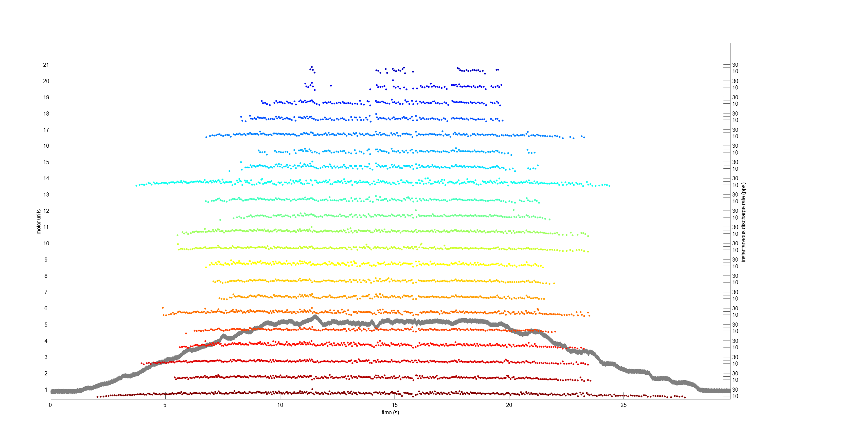
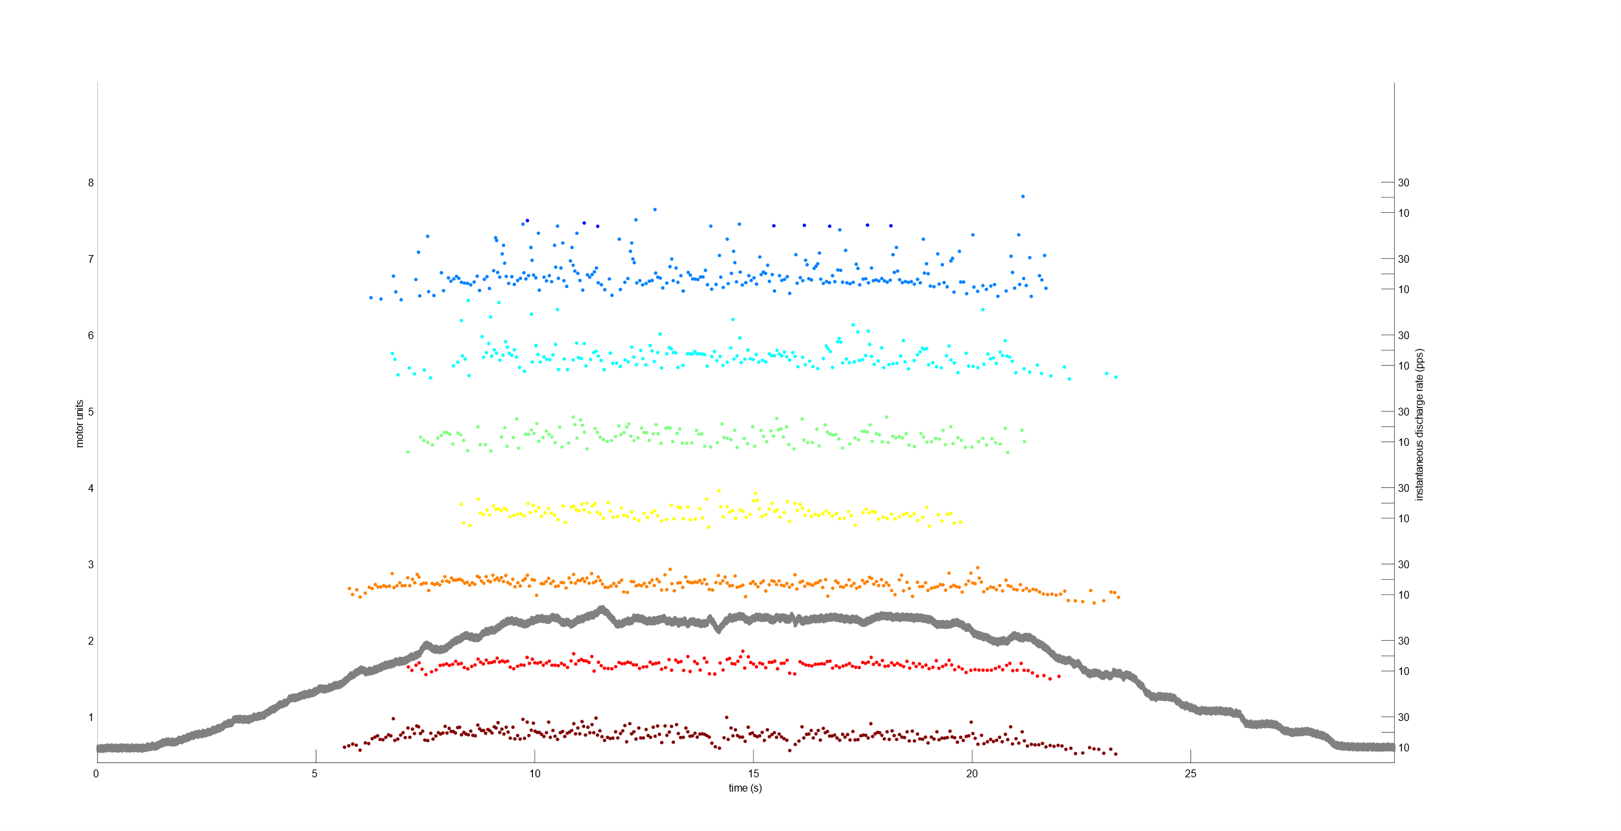
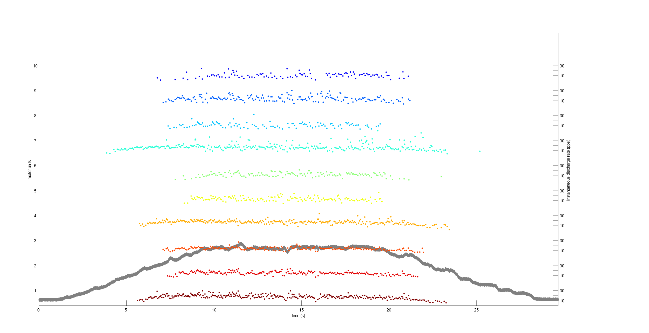
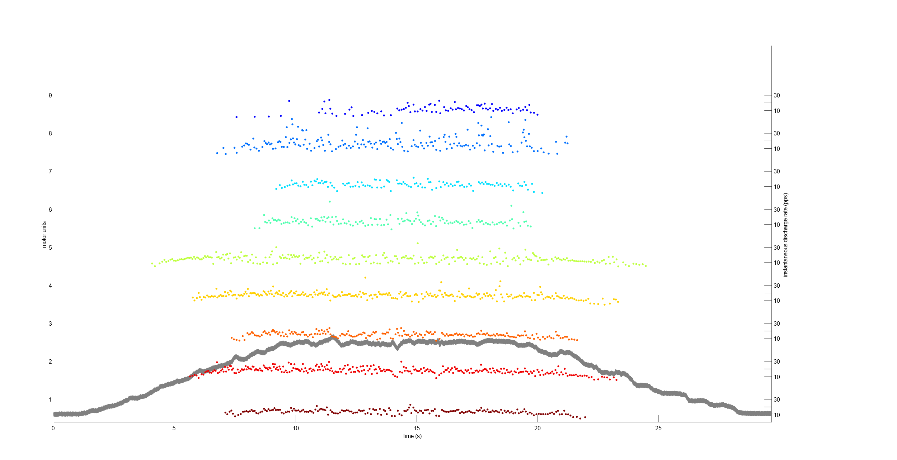
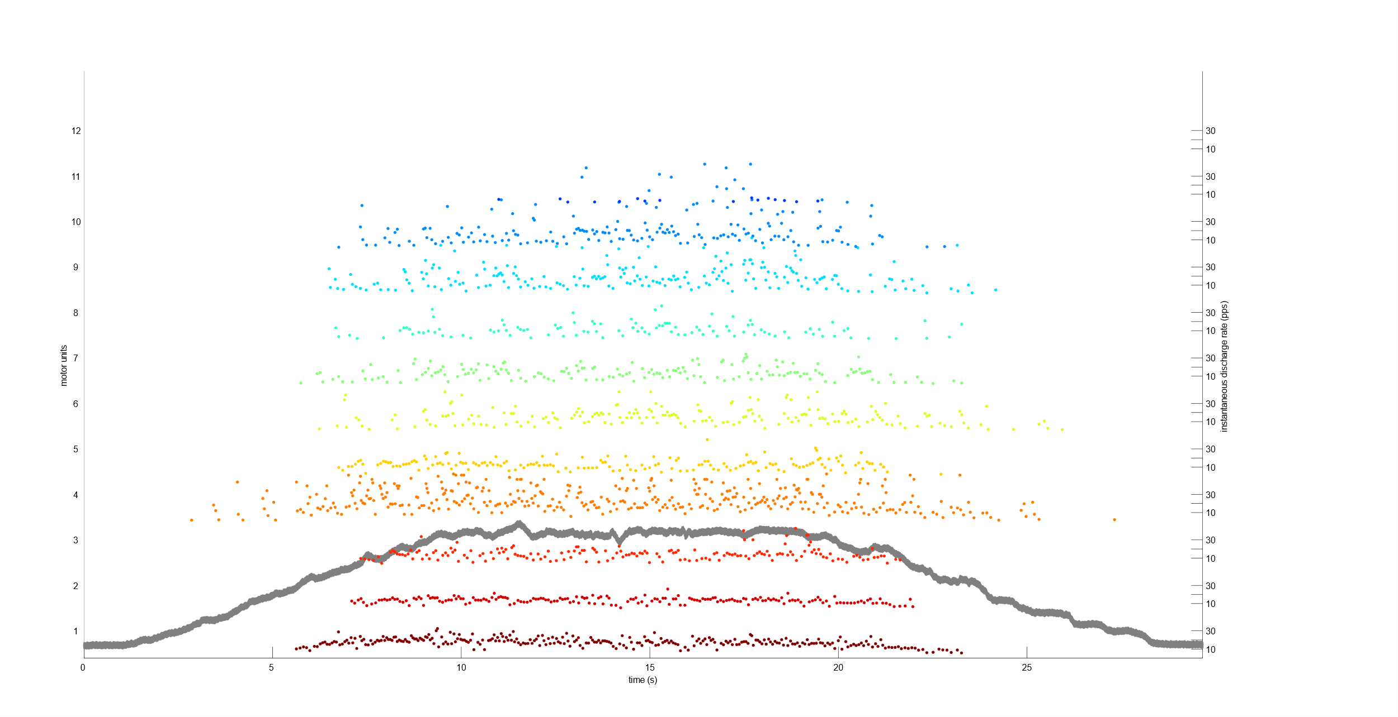
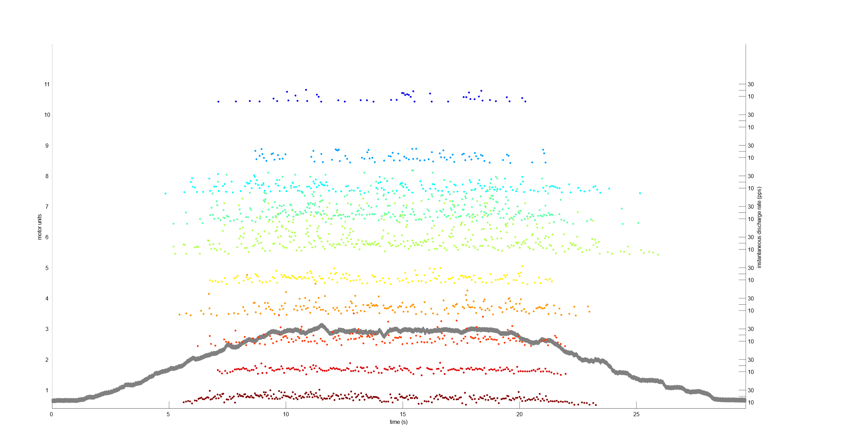
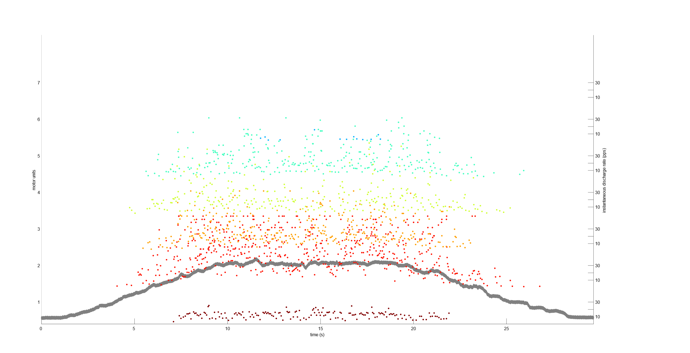
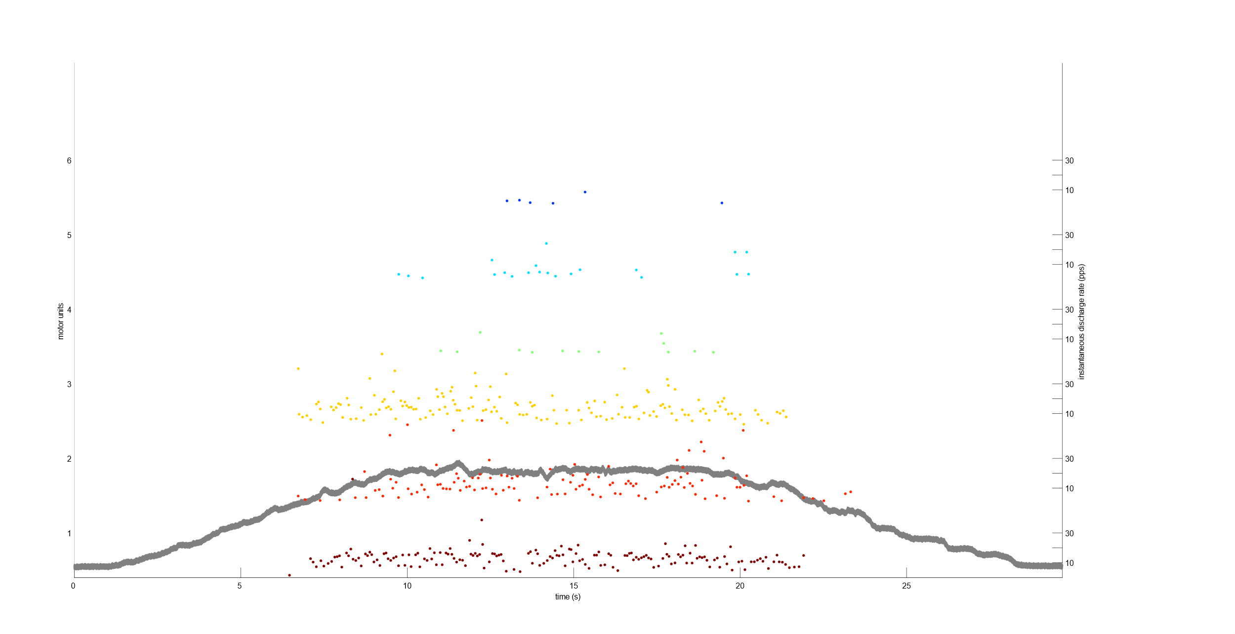
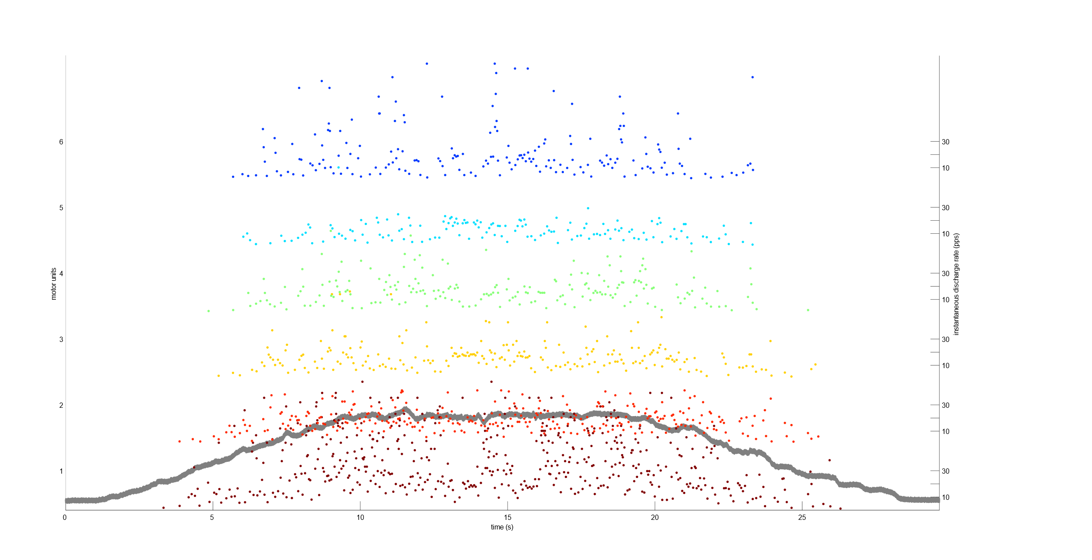
Groundtruth HR
Groundtruth LR
Bilinear
Bicubic spline
SRGAN
UNet
UNet Fourier
UNet Wavelet
CNN-LSTM

