Slide 1
An Overview of Generative Artificial Intelligence
John Nicholson
Department of Computer Science and Information Technology
Austin Peay State University

Slide 2
Introduction
Artificial Intelligence (AI) and Machine Learning (ML) are important technologies that appear to have come out of nowhere
In business, news, education, entertainment, etc.
The technology has both advantages and disadvantages
The affect of the technology on society is being vigorously debated

Slide 3
Generative AI
Generative AI is a type of artificial intelligence that can create new and original content based on patterns it has learned from existing data
Generative AI is not Artificial General Intelligence (AGI)
AGI refers to human-level intelligence, autonomy, and the ability to self-learn
Examples of content that Generative AI systems can create
Computer code
Images
Text
Videos
Voice
Music

Slide 4
The sudden appearance
Dall-E was released in January 2021
A generative AI system from OpenAI that can create images.
After Dall-E, new systems began appearing at an astonishing rate
Midjourney: July 2022
Stable Diffusion: August 2022
ChatGPT : November 2022
Llama : February 2023
Bard: March 2023
Despite the sudden appearance, research on this technology has been performed for decades.

Slide 5
An overview of Generative AI

Slide 6
Major concepts
Machine learning
Techniques for systems to automatically learn and improve from experience without explicit programming.
Uses algorithms that enable systems to recognize patterns, make predictions, and optimize performance based on data
Deep learning
A subset of machine learning for building large artificial neural networks
Automatically learn hierarchical representations of data
Enables the extraction of complex features and the development of sophisticated models
After building and training, the models in generative AI systems have huge numbers of parameters. For example, GPT-4 has 1.8 trillion parameters
Artificial neural network
A computational model inspired by the structure and functioning of the human brain
Designed to perform tasks such as pattern recognition, classification, and regression.

Slide 7
Generative AI Systems
In general, generative AI systems are built and used the same way.
Statistical models are first trained on large amounts of data to configure the model’s parameters.
Interfaces allow users and other developers to interact with the models
User interfaces allow users, both technical and non-technical, to interact with the models.
Application Program Interfaces (API) allow developers to create programs that interact with the models.
For example, ChatGPT, https://chat.openai.com/, is a web-based system with a user interface that allows users to interact with the GPT-3.5 and GPT-4 models.

Slide 8
Training DATASETS
Large amounts of data are used to train these models
Examples
GPT (Generative Pre-training Transformer) - an example of a Large Language Model (LLM)
GPT-3 (ChaptGPT 3.5) was trained on 17 GB of text data
GPT-4 (ChaptGPT 4, Bing) was trained on 45 GB of text data
Generative image models
One model in Stable Diffusion was trained on 160 million images
DALL-E’s CLIP model was trained on 400 million pairs of images with text captions

Slide 9
Generative AI systems

Slide 10
Generative AI SYSTEMS and TOOLs
The number of systems and tools built with generative AI is increasing rapidly.
Reasons include
Companies like OpenAI, the developers of the GPT models and ChatGPT, create APIs that allow other developers and companies to build more focused tools, websites, and apps on top of GPT and ChatGPT.
Companies providing cloud services, such as Amazon (AWS), Google (GCP), and Microsoft (Azure), have AI-related tools that allow companies to build custom AI tools in the cloud.
Many open-source models, such as those released by Stable Diffusion, can be run on (high-end) home computers or in the cloud for low cost.
Generative AI technology is improving quickly, enabling the rapid development of more advanced systems.

Slide 11
Example Systems
Generative image systems
DALL-E from OpenAI - https://openai.com/dall-e-2
Midjourney - https://www.midjourney.com
Leonardo AI - https://leonardo.ai/
Stable Diffusion from Satiability AI - https://stablediffusionweb.com/#demo
Generative text systems, aka, Large Language Models (LLM)
ChatGPT from OpenAI -https://chat.openai.com
Bing from Microsoft - https://www.bing.com/
Bard from Google - https://bard.google.com/
Llama from Facebook - https://huggingface.co/blog/llama2#demo

Slide 12
Miscellaneous Generative Systems
Voice
ElevenLabs https://elevenlabs.io/
https://elevenlabs.io/speech-synthesis
Music
SoundDraw https://soundraw.io/create_music
Video
Runway https://research.runwayml.com/gen2
Training tools
Colossyan https://www.colossyan.com/
Software development
GitHub Copilot
https://github.com/features/copilot
The number of systems is growing weekly
https://www.futuretools.io/

Slide 13
embedded in existing tools
Companies are embedding or working on embedding generative tools into their existing products
Examples
Microsoft with Bing, Microsoft Office, and Copilot
“Over the coming months, you’ll notice new AI features being integrated into Microsoft 365 to support you at work and home. Our new AI-powered features can help you more quickly and creatively do the things you normally do. “ - Unleash your productivity with AI and Microsoft Copilot
“Your everyday AI companion” - https://copilot.microsoft.com/
https://www.bing.com
Google with Google Workspace and Duet AI
“Duet AI is a powerful collaborator that can act as a coach, thought partner, source of inspiration, and productivity booster” - https://workspace.google.com/solutions/ai/
Adobe with Photoshop and other tools
“Use generative AI and simple text prompts to create the highest quality output — beautiful images, text effects, and fresh color palettes. Make all-new content from reference images and explore more possibilities more quickly.” - https://www.adobe.com/products/firefly.html
Grammarly
“Go further with Grammarly—now with the power of generative AI—across all the spaces you write. It’s the AI communication assistant that’s up to speed on your context and preferred writing style.” - https://www.grammarly.com/ai

Slide 14
Smaller Systems that are easier to Run and Deploy
Systems such as OpenAI’s GPT require massive amounts of specialized hardware to run
GPT-4 leaked details
Trained on ~25,000 Nvidia A100 GPUs over 90-100 days
Runs on clusters of 128 A100 GPUs (how many clusters?)
However, smaller systems can be run on (high-end) home computers, for example,
Facebook’s LLaMA for text generation
Stability AI’s Stable Diffusion for image generation
Hugging Face, https://huggingface.co, is a community for AI enthusiasts
Pretrained models available for download
Datasets for training your own models
Notes:
https://medium.com/@daniellefranca96/gpt4-all-details-leaked-48fa20f9a4a
https://klu.ai/blog/gpt-4-llm

Slide 15
ISSUES with Generative AI

Slide 16
Hallucinations
Hallucinations are responses from an AI that do not seem justified by the training data.
This is because AI systems are not “thinking”, they are using probability to generate their responses.
For example,
A New York lawyer cited 6 fake cases generated by ChatGPT in a legal brief filed in federal court.
Google shared a GIF for Bard’s launch that incorrectly stated that the James Webb Space Telescope “took the very first pictures of a planet outside of our own solar system.”
Fast Company asked ChatGPT to generate a news article on Tesla's last financial quarter; ChatGPT created a coherent article but made up the financial numbers contained within.
A Wall Street Journal reporter asked Bard for the definition of “argumentative diphthongization,” a phrase he made up, and received a 5-paragraph answer.
Many users are not aware that this can happen and do not check for them.
Notes:
https://en.wikipedia.org/wiki/Hallucination_(artificial_intelligence)
https://www.legaldive.com/news/chatgpt-fake-legal-cases-generative-ai-hallucinations/651557/
https://www.theverge.com/2023/2/8/23590864/google-ai-chatbot-bard-mistake-error-exoplanet-demo
https://www.wsj.com/articles/hallucination-when-chatbots-and-people-see-what-isnt-there-91c6c88b

Slide 17
Who has rights to use the TRAINING DATA?
Generative AI requires large amounts of training data
Concern has been raised about the training datasets and if companies had the right to use the data
Sarah Andersen, creator of the webcomic Sarah’s Scribbles, and two other artists sued Midjourney, StabilityAI, and DeviantArt in January 2023 in federal court
Claims companies downloaded and used billions of copyrighted images without obtaining the consent of or compensating any of the artists
As of Nov 2023
The judge dismissed parts of the lawsuit but gave the original plaintiffs permission to pursue their claims again in a new complaint.
Plaintiffs filed an amended lawsuit, adding seven new artists to the proposed class action. (Reuters)
GitHub and Copilot Intellectual Property Litigation class action lawsuit against GitHub, Microsoft, and OpenAI challenging the legality of "borrowing" people's code samples.
Notes:
https://www.reuters.com/legal/litigation/artists-take-new-shot-stability-midjourney-updated-copyright-lawsuit-2023-11-30/
https://www.theregister.com/2023/05/12/github_microsoft_openai_copilot/
https://githubcopilotlitigation.com/case-updates.html

Slide 18
Who owns the Output?
In 2023, the U.S. Copyright Office launched an initiative to examine the copyright law and policy issues related to AI.
The current policy says that AI-generated works may not be copyrighted since “copyright can protect only material that is the product of human creativity.”
If a work contains AI generated but is modified by a human, the work may possibly be copyrighted depending on the level of human involvement in the work.
Last fall, the Office issued a notice of inquiry on copyright and artificial intelligence seeking the public’s comments on the subject. Comments were collected until Dec. 2023.
Notes:
https://www.copyright.gov/ai/

Slide 19
BIAS
Researchers are finding racial and gender bias in the AI outputs
Bloomberg created 5,100 images of people for different types of jobs using Stable Diffusion
Racial bias
the image sets generated for every high-paying job were dominated by subjects with lighter skin tones, while subjects with darker skin tones were more commonly generated by prompts like “fast-food worker” and “social worker.”
Gender bias
Stable Diffusion generated almost three times as many images of perceived men. Most occupations in the dataset were dominated by men, except for low-paying jobs like housekeeper and cashier.
According to research from the University of Washington, Carnegie Mellon University, and Xi’an Jiaotong University, AI language models contain different political biases.
OpenAI’s ChatGPT and GPT-4 were the most left-wing libertarian
Meta’s LLaMA was the most right-wing authoritarian.
These are well-known issues in the generative AI field, but unknown to many users.
Notes:
https://www.bloomberg.com/graphics/2023-generative-ai-bias/
https://www.technologyreview.com/2023/08/07/1077324/ai-language-models-are-rife-with-political-biases/

Slide 20
Effects on Users
Some researchers and experts are worried about the negative impact of generative AI, even going so far as to call it an existential threat to humanity.
Individual interactions can affect people.
Kevin Roose from the New York Times had a chat with Bing, in which it began calling itself Sydney, told him it loved him, and then tried to convince him to leave his wife
In his article “A Conversation With Bing’s Chatbot Left Me Deeply Unsettled”, he said that although he knew it was just randomly generated text, it “was the strangest experience I’ve ever had with a piece of technology. It unsettled me so deeply that I had trouble sleeping afterward.”
A Belgian man ended his life after talking to a chatbot Eliza from Chai Research about climate change.
Notes:
https://www.nytimes.com/2023/02/16/technology/bing-chatbot-microsoft-chatgpt.html
https://www.euronews.com/next/2023/03/31/man-ends-his-life-after-an-ai-chatbot-encouraged-him-to-sacrifice-himself-to-stop-climate-

Slide 21

MISUSE and Misinformation
It is expected that generative AI will increase misinformation
Examples
NewsGuard has identified 687 Unreliable AI-Generated News and information websites spanning 15 languages.
A TikTok video of Paris streets littered with trash amassed more than 400,000 views, and all the images were completely fake.
Reports of a robocall in New Hampshire using AI to mimic Pres. Biden’s voice to discourage voters in the state from coming to the polls during NH’s primary election.
Three of the most viral images of 2023 were photos of the pope wearing a Balenciaga puffy, Donald Trump being wrestled to the ground by cops, and an explosion at the Pentagon.
Notes:
https://www.newsguardtech.com/special-reports/ai-tracking-center/
https://www.technologyreview.com/2023/10/04/1080801/generative-ai-boosting-disinformation-and-propaganda-freedom-house/
https://www.pbs.org/newshour/politics/ai-robocalls-impersonate-president-biden-in-an-apparent-attempt-to-suppress-votes-in-new-hampshire
https://www.technologyreview.com/2023/12/19/1084505/generative-ai-artificial-intelligence-bias-jobs-copyright-misinformation/
https://www.cnet.com/news/misinformation/ai-misinformation-how-it-works-and-ways-to-spot-it/
Weekend of March 25, this image appeared
People thought it was real
It wasn’t. It was created by Pablo Xavier, a 31-year-old construction worker from the Chicago. He posted them to FB and Reddit in AI Art groups, but they went viral.
Clues:
look at cross – part of chain is missing
Hand on the left is wonky

Slide 22
Terms of USE and Privacy Policies
When you use a service like ChatGPT, your inputs are likely saved.
Data may be used for training, shared with partners, or sold
Depending on the service, there may be opt-out policies
Example: Information in OpenAI’s policies
According to their privacy policy, https://openai.com/policies/privacy-policy, may provide information to Vendors and Service Providers, Business Transfers, Legal Requirements, Affiliates, Business Account Administrators, Other Users, and Third Parties You Share Information With
Data from individual users may be used for training.
Users can opt out of ahaving their data used for training (https://openai.com/policies/terms-of-use ), but data is still retained for 30 days (https://help.openai.com/en/articles/7730893-data-controls-faq)
Data from Enterprise Users is not used in training. https://openai.com/enterprise-privacy

Slide 23
Conclusion

Slide 24
The Future is HERE
Generative AI is here and will only become more advanced.
It will provide tools for the workplace to increase productivity.
It will provide both positive and negative benefits to individuals and society.
The next several years will not be boring.

Slide 25
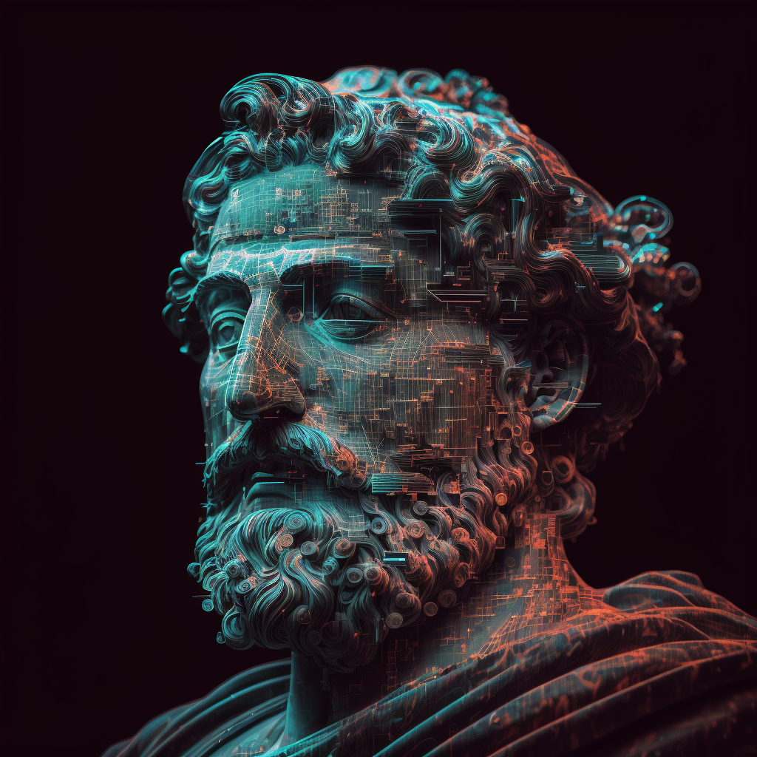
Thank you for listening.
Any questions?

