Slide 1






EBM-KF
Forcings
Plank Feedback
GHGs
Strat. H₂O
Land use Δ
Snow black carbon
Volcanic
Aerosol – Rad
Aerosol – Cloud
Solar insolat.
Contrails
Ozone
Hist*
1850-2022
Transient Clim Resp.
Temp. Anomaly
CO₂ concentration
Ocean heat Δ
MCMC
RMS
FaIR
$$≤0.17°C$$
45 params
1,600,000
224,342
4,356 → 841
GWI

Slide 2
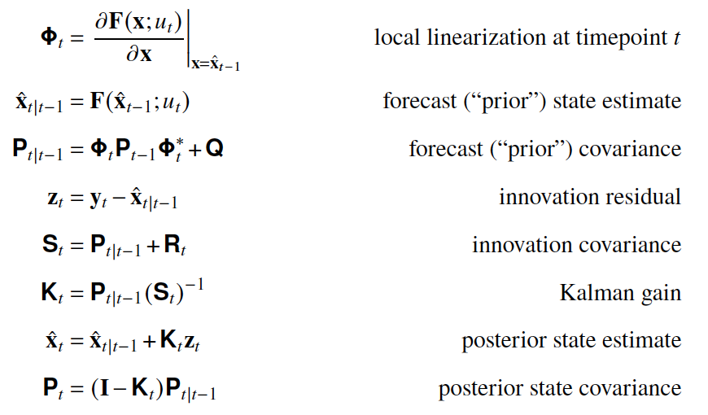
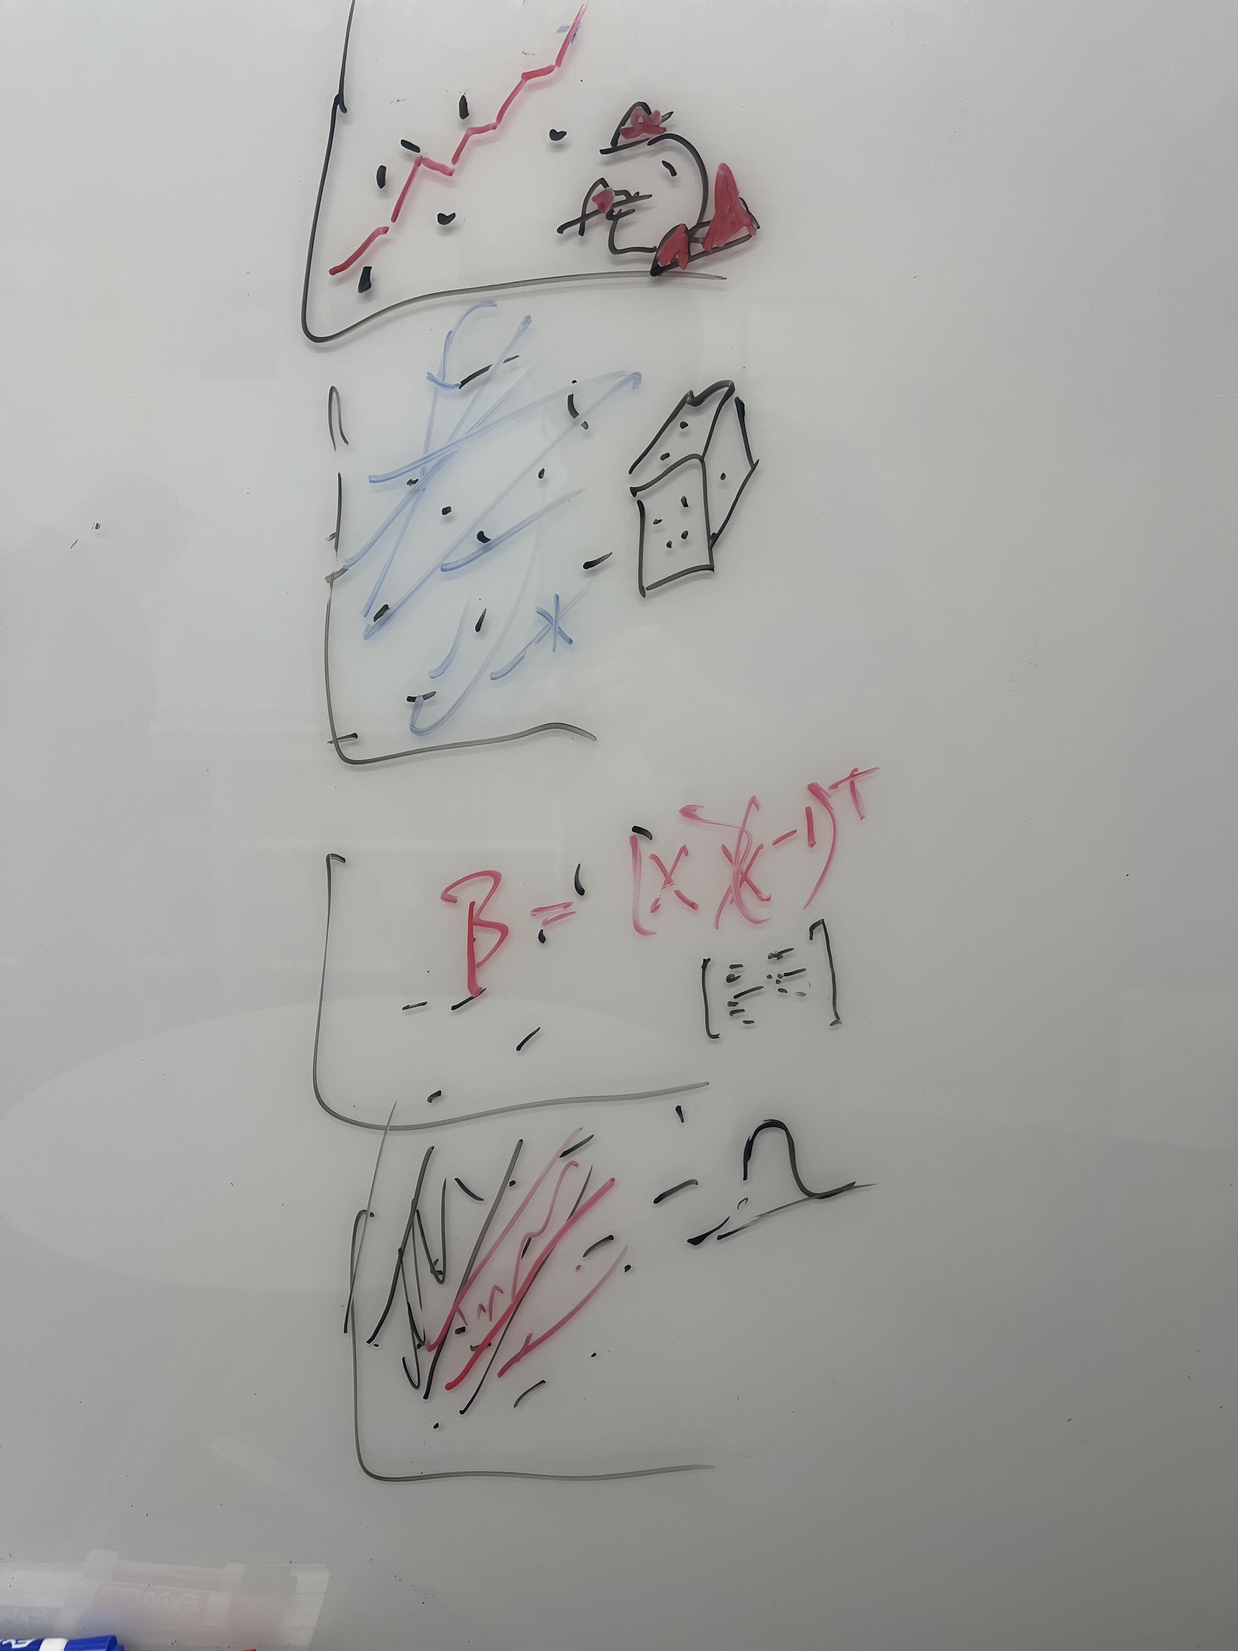


Dynamics
Statistics
linear [CO₂]
Linear
-
Aer
+
H₂O
?
+
+
4
GHG
Land
-
Surface Ocean
EBM-KF
?
Deep Ocean
O₃
Aer
GHG
H₂O
-
+
FaIR
Land
Surface Ocean
Middle Ocean
Deep Ocean
Natural
Anthropogenic
GHG
-
Aer
(FaIR used within this – how??)
GWI
Land
Surface Ocean
-
Deep Ocean
ROF
hist-nat
hist-GHG
hist (or SSP-245)
hist-aer
ROF &
KCC
KCC
GHG
-
Aer

Slide 3
Emissions
Fossil fuel industrial
Agriculture, forestry, other land use
Industrial production
Short lived climate forcers:
Fossil
Industrial
Agricultural
Biomass Burning
Gases
CO₂
CH₄
N₂O
SF₆
NF₃
HFCs
PFCs
Black C
Org. C
SO₂
NO_{x}
NH₃
CO
VOCs
NH₃
(SO₄²⁻)?
CFCs
HCFCs
Halons
Cl- / Br- gas
SO₂F₂
Forcings
Plank Feedback
GHGs
Strat. H₂O
Land use Δ
Snow
Volcanic
Aerosol – Rad
Aerosol – Cloud
Solar insolat.
Contrails
Ozone
all

